Slide 1
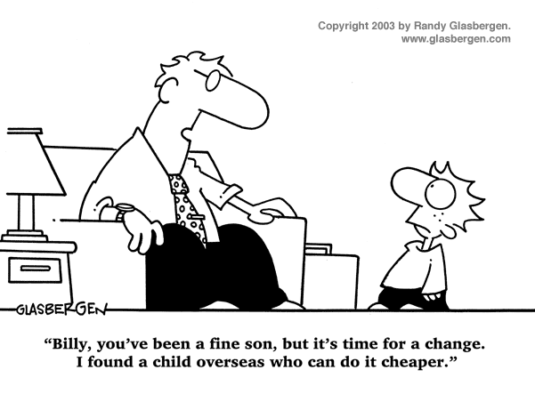
IST346: Debugging and Troubleshooting

Slide 2

Agenda
Discussion
Content
Troubleshooting
Wrap-Up

Slide 3
Discussion Questions
What is the key to solving any problem?
What are the three elements to understanding a problem?
Explain the difference between a quick fix and addressing the root cause of a problem?
When is a quick fix appropriate?
What are two techniques we use to identify the root cause?
Notes:
Give students 1-2 minutes for each question. Its important to provide them with the opportunity to answer the questions based on the reading, labs, and assigned homework.

Slide 4

Lab Debrief
Lab ?

Slide 5
Elements of Understating a Problem
Related systems. Work from outside in.
Mutual understanding of the facts
#1 Assumptions
#2 Scope
#3 Inter-dependencies
Size of the Problem. Work from outside in.

Slide 6
Class Example 1
Problem: This computer will not turn on
What assumptions could I be making?
What is the scope? Broadest scope? Work outside in
What are the Interdependencies: Work outside in
Notes:
Real issue: Power cable was loose on the computer.

Slide 7
Class Example 2
Your roommate says the apartment Wi-Fi is not working.
Assumptions?
Scope?
Inter-dependencies?
Notes:
Using his phone (not a computer)
Power is on
Can connect to the wifi
Can ping the router
Cannot ping google.com internet does not work…
Problem with internet service provider.
Reboot does not fix.

Slide 8
Root Cause Identification
Process of Elimination
Successive Refinement
Eliminate factors until the problem is identified or isolated.
Introduce factors until the problem re-appears.

Slide 9
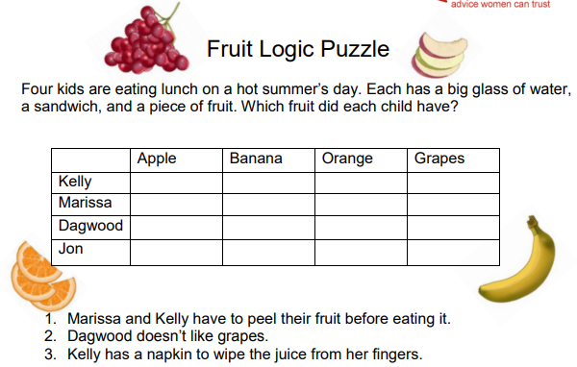
Process of elimination

Slide 10
Class Example 3
My smart phone will not connect to google.com!
Define the problem then use the process of elimination to find the root cause.
Notes:
Google.com is down….

Slide 11
Class example 4
My computer is running slow. When you investigate you see there are 4 programs running: A, B, C and D.
Use successive refinement to identify the problem.
Notes:
When both program A and D are running together, the CPU is at 100%

Slide 12
You can practice this skill!
Lateral thinking puzzles helped me!
http://www.destination-innovation.com/the-top-ten-lateral-thinking-puzzles/
“A man lives on the tenth floor of a building. Every day he takes the elevator to go down to the ground floor to go to work or to go shopping. When he returns he takes the elevator to the seventh floor and walks up the stairs to reach his apartment on the tenth floor. He hates walking so why does he do it?”
Notes:
The man is not tall enough to press a button in the elevator beyond the 7th floor.

Slide 13
Group Activity
Troubleshooting Practice

Slide 14
Details of Group Activity
Divide into pairs. One person plays the role of problem reporter and the other troubleshooter. It can be an IT problem or any problem with a familiar knowledge domain.
Reporter should think of a problem and its root cause, then communicate the problem to the troubleshooter.
Troubleshooter should ask questions until they identify the root cause.
Repeat the exercise with roles reversed.
Plan on discussing it when you are finished.

Slide 15

Your To-Do List
What to work on for next class
Notes:
ALWAYS CONSULT THE SYLLABUS

Slide 16

Exit Ticket
Share one thing you learned today that you didn’t know before class!

Slide 17

Questions?

