Slide 1
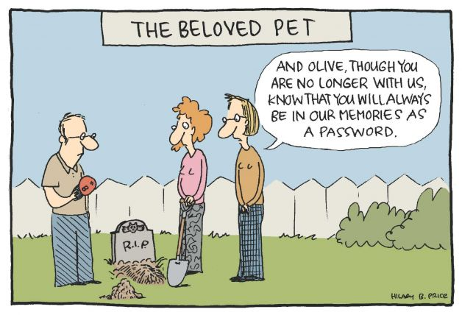
IST346: Information Security & Risk Management

Slide 2

Agenda
Discussion
Content
Information Security
Risk Managment
Wrap-Up

Slide 3
Discussion Questions
Information security is the relationship among which three factors? Give two examples of each!
What are the 4 goals of information security?
How is hashing different from encryption?
What is the difference between disaster recovery and business continuity?
Is being hacked considered a form of disaster for which a company should have a DR/BC plan? Why?
Notes:
Give students 1-2 minutes for each question. Its important to provide them with the opportunity to answer the questions based on the reading, labs, and assigned homework.

Slide 4

Lab Debrief
Lab J

Slide 5
Budgeting for Risk
Risk Budget = Risk Rate * (Estimated cost of disaster – Estimated cost of mitigation)
Single Events
Cost should datacenter be destroyed: $60 million
Risk of Flood one in 1 million
Risk of Earthquake one in 3000
Flood Risk budget = (0.000001)*$60,000,000 = $60
Earthquake Risk budget = (0.000333 )*$60,000,000 = $20,000
So, you should budget and plan for an earthquake but not a flood. Why?

Slide 6
Risk Budgeting
A small on-line retailer cannot make $$$ when their internet connection is down.
It goes down, on average for 2.5 hours each month (every 30 days), in periodic intervals. As per the ISP’s Terms of Service.
The company estimates they lose an average of $15,000 for each hour their connection is down.
What is the Rate of failure for this internet connection?
What is the loss of business each month?
What should the monthly Risk budget be?
Notes:
1. 2.5 hours / 30*24 hours = 0.0035 This is the risk rate each month
2. 2.5 * $15,000 = $37,500 /month
3. 0.0035 * ($37,500 - $0) = $131.50
It makes sense to get a secondary internet connection if you can find one for less than $131.50/month.

Slide 7
Group Activity
Business Continuity Plan

Slide 8
Details of Group Activity
Divide into groups of 3-4
Each team should devise a business continuity plan for the following scenario:
How can your company continue to sell online in the event of an issue with their cloud provider’s data center?
Be sure to think through all the potential ways your service can go off line and factor that into your plan!

Slide 9

Your To-Do List
What to work on for next class
Notes:
ALWAYS CONSULT THE SYLLABUS

Slide 10

Exit Ticket
Share one thing you learned today that you didn’t know before class!

Slide 11

Questions?

