Slide 1
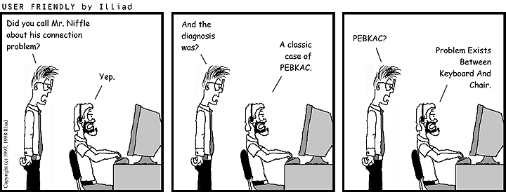

IST346: Troubleshooting Problems

Slide 2
Today’s Agenda
Debugging
Fixing Things Once
Understand the problem you’re trying to fix
Finding the root cause
Debugging tools
Avoid temporary fixes
Fix it once
Fix it right the First time

Slide 3
Debugging Systems and Services

Slide 4
The first step in debugging a problem is to…. ?????

Slide 5
Understand the problem
You need to understand what the customer (or user) who reported the problem was trying to accomplish.
In most cases the customer is expecting a specific result, but is getting an undesirable result.
Oftentimes the data you receive is incomplete.
Examples of “real problems”
I cannot print
The website is down
My computer will not send e-mail.

Slide 6
Elements to Understanding a Problem
Assumptions
Scope
Inter-dependencies
What other systems / services does this problem rely upon?
Your own and the user’s assumptions of how things work.
The size of the problem. Just one person? The entire company?

Slide 7
Understanding Assumptions
Make sure you and your customer are on the “same page” before attempting to debug the problem.
You know what they say about “assume”
Try to gather as much information from the customer as you can so that neither of you are making false assumptions.
E.g. “I cannot print”
Which printer is the customer using? Don’t assume a specific printer, or their default printer.
They might not be able to print by design. I.e. They don’t have permissions to use a specific printer.
Ask the customer for specifics, of course.

Slide 8
Understanding Scope
Just how “big” is the problem?
Work from the “outside in” (widest scope, to narrowest scope)
The scope of the problem will dictate the manner in which you react to it.
E.g. “The Website is down”
Assumption: The user is in their office (not in a starbucks ☺)
Inter-net?
Web-site?
Check User’s Connection
UP
UP
DN
DN
Check ISP
Check Web Svr

Slide 9
Understanding Interdependencies
When you know the scope, next check the interdependences.
What systems and services does that task rely upon?
What systems and services do those rely upon?
E.g. “My computer will not send E-Mail”
Assumption, Scope: Problem is organization-wide
E-Mail depends on SMTP to send mail.
SMTP needs the DNS service to work properly.
Check these “outside in” DNS→ SMTP → E-Mail server

Slide 10
Time to fix the problem
Once you’ve defined the problem, and isolated it, its time to fix it.
Quick fixes:
Restarting services
Rebooting the server dependent on services
Cleaning up disk space
These are quick-fixes and do not address the root cause!!!!

Slide 11
How to find the root cause
Be Systematic
Form a hypothesis or theory
Test and record the results
Make changes as necessary
Use
Process of elimination
Successive refinement
Review
Recent changes made to the system or service in question
Changes risk the opportunity to introduce new problems

Slide 12
Techniques
Process of Elimination
Remove elements of the system until the problem disappears
Isolate and simplify the problem to identify the specific issue.
Successive Refinement
Add components to the system
Each time verify the desired result was achieved

Slide 13
Fixing Things Once!

Slide 14
Fix it once!
Don’t use glue and duct-tape on a problem that requires wood and nails.
When a problem seems trivial we often go for the quick fix: (The three R’s)
Reboot computer
Restart services
Restore from backup
Ben Franklin Said “An ounce of prevention is worth a pound of cure.”
Don’t waste time fixing the same thing again, again, and again.

Slide 15
With Service Outages…
FIRST Fix it quickly!
THEN Fix it permanently
Get your users back up and running, ASAP
That is the top priority first
Do what you can to make sure it stays up until you can….
Spend time after the fire’s out getting to the root cause and then fixing the heart of the problem
That is the next top priority.
Sometimes you need to dedicate a person to fixing the problem.
If you want the problem fixed for good, you need to do both!

Slide 16
Sometimes a fix is out of your control:
Bad hardware
Live with it until you can replace it
Can you move the service elsewhere?
Virtualization helps here
Some vendors write crappy software
Memory leaks mean that systems do not release memory when finished and thus become unstable over time.
Your best bet is to employ “pressure” on the vendor.
Policy issues affect system stability
Examples:
Too many users with “Root” or “Admin access”
Physical access to the data center by too many people
Lobby to have these bad habits changed!

Slide 17
Example…troubleshooting in our Lab
Problem: I cannot map a drive to \\linuxserver\linshare from my Windows 7 computer.
First, is the Linux computer powered on? (duh)
Can you contact the Linux server via other methods (ping, nslookup)?
If not, then is DNS configured properly?
Is the Firewall/SELinux setting turned on?
Is Samba installed?
Are the Samba services started (SMB, NMB)?
DNS Name setup properly in the /etc/hosts and etc/hostname files.
Are the share settings configured correctly (/etc/samba/smb.conf)?
Do you have permissions to this share?
Is the group configured with appropriate permissions?
Is your user a member of this group?
Does the username/password you’re logged into your Win7 computer match the one setup on the CentOS5 server?

Slide 18
Example…troubleshooting in our Lab, pt. 2
Problem: I cannot map a drive to \\win2008\winshare from my Windows 7 computer.
First, is the Windows 2008 server powered on? (duh)
Are you logged into your workstation with the appropriate user in your directory (Active Directory)?
Can you contact the Win2008 server via other methods (ping, nslookup)?
If not, then is the DNS server configured properly on your client?
Is Active Directory/DNS configured on your Win2008 server?
Is the share configured properly?
Is a folder shared with the share name of “Winshare”?
Are the share settings allowing you to see the share (the group)?
Do you have permissions to this share?
Did you create a Domain group to apply these permissions to?
Is the group configured with appropriate permissions?
Is your user a member of this group?

Slide 19
Questions?
“The only problem with troubleshooting is that sometimes trouble shoots back.”

