Slide 1
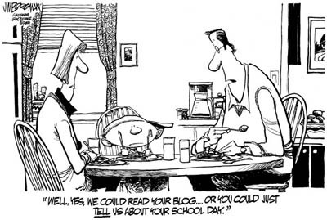
IST346: Web Services and API’s

Slide 2

Agenda
Discussion
Content
Web Services
API’s
Wrap-Up

Slide 3
Discussion Questions
What is a URL? What Type of namespace is it?
What does it mean when we say HTTP is a stateless protocol?
What is an HTTP reverse proxy? Why is it common in cloud environments?
List 3 things required to secure a website?
Why is HTML not a suitable content format for web APIs?
What are two machine-readable content formats for web APIs?
Which HTTP Status code explains the requestor made the error?
Notes:
Give students 1-2 minutes for each question. Its important to provide them with the opportunity to answer the questions based on the reading, labs, and assigned homework.

Slide 4

Lab Debrief
Lab L

Slide 5
Demo: How the web works
Requests and responses
Httpbin.org website – perfect for understanding HTTP
Use Chrome Developer’s tools to see what the browser is doing.

Slide 6
Demo: Reading TLS
Let’s view TLS information in our browser for a website
Chain of trust

Slide 7
Demo: Web API
https://apis.io
https://market.mashape.com/
Try out a few on mashape
Or httpbin.org

Slide 8
Group Activity
Host your own API!

Slide 9
Details of Group Activity
Pair up with a classmate
Search the web for a cloud service you can use to host your own web API
How does it work?
What are the features?
What is the pricing model?

Slide 10

Your To-Do List
What to work on for next class
Notes:
ALWAYS CONSULT THE SYLLABUS

Slide 11

Exit Ticket
Share one thing you learned today that you didn’t know before class!

Slide 12

Questions?

