Slide 1
IST346: Web Services and API’s

Slide 2
Web Services
The most important service in any organization.
Beyond a company’s website, other business processes get “webified”
Webmail
Customer Relationship Portals
E-Commerce
To support these same services outside the browser we “webify” the business logic into an API (Application Program Interface)

Slide 3
But First, The Basics

Slide 4
The World-Wide Web
Information System on the Internet for displaying content resources.
The world wide web is not the Internet; it is part of it!
Built upon open standards
INTERESTING STAT: Half a billion people accessed the internet via their mobile device in 2009!
MORE INTERESTING: 1.2 billion mobile web users in 2011…roughly 17% of the world population! http://mobithinking.com/mobile-marketing-tools/latest-mobile-stats#mobile-internet-access

Slide 5
Web Terminology
URL – Uniform Resource Locator. A global name space which identifies a resource on the web.
HTML – Hypertext Markup Language. A Markup language for rendering web pages.
Web Server – A computer on the web which hosts resources.
Web Browser – A computer on the web which consumes resources
Resource – content at a URL, hosted on a web server and requested by a web browser.

Slide 6

How the web works
Clients make requests to web servers, typically using a browser.
The client provides a request method and a URL
The web server send a response to the client. In the response is the content based on the URL
The client renders (draws) the content in the web browser
Request: GET http://www.syr.edu
Response: Content-Type: HTML

Slide 7



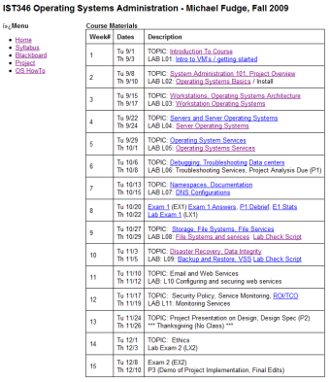

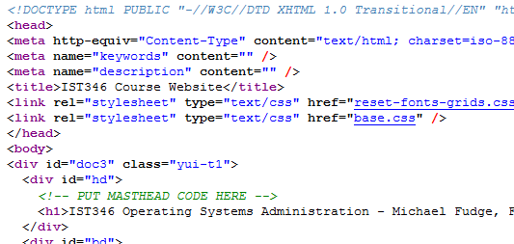
The Web at work: The Details
Your computer IP: 192.168.0.55
Web Server IP: 128.230.182.251
URL
Browser: Connect
Send: HTTP GET /ist346/
Server
Recv: HTTP Response Stream
File containing HTML
Rendered HTML

Slide 8
HTTP
HTTP, or the Hypertext Transport Protocol is the data transfer protocol of the web.
It consists of requests, which contain a verb and URL and a response, which contains a status code and content type.
HTTP is a stateless protocol, which means the current request knows nothing of the previous requests.
The well-known port for HTTP is TCP/80

Slide 9
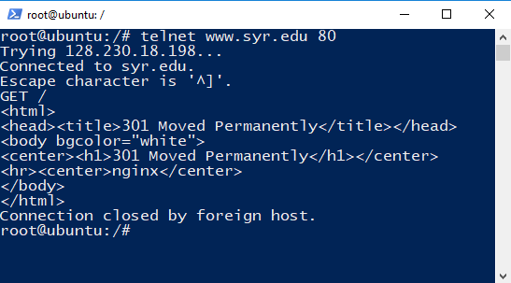
HTTP Protocol in Action
Like SMTP and IMAP, you can use the HTTP protocol directly with telnet:
Host
Port
Request
Response HTML

Slide 10
HTTP Request and Response
HTTP Request
HTTP Response
Verb – Nature of the request
URL – The resource to request
Status Code – What happened?
Content Type – The actual content

Slide 11
HTTP Request Verbs
GET – Request a resource. Most common
POST – Add to a resource. Used when sending data to the website, like submitting a form.
Other Verbs:
PUT – Update a resource
DELETE – Remove a resource
PATCH – Update part of a resource
HEAD – No Response Body
OPTIONS – Reserved.

Slide 12
HTTP Response Status Codes
1xx – Informational
2xx – Success
200 – OK
201 – Created
202 – Accepted
3xx – Redirection
301 – Moved Permanently
304 – Not Modified
307 - Redirect
4xx – Client error
400 – Bad Request
401 – Unauthorized
403 – Forbidden
404 – Not Found
5xx – Server Error
500 – Internal Server Error
501 – Not Implemented
502 – Bad Gateway

Slide 13
HTTP Content Types
These are Media Types. They instruct the client (usually a browser) what to do with the content.
text/plain – plan text
text/html – HTML text
image/gif – gif image format
image/jpeg – jpeg image format
application/json – JSON data format
application/xml – XML data format
application/javascript - JavaScript

Slide 14
Web Servers
Serve up static content over HTTP, or execute code and return a response as content. (This is called CGI – Common Gateway Interface)
Popular Web Servers.
Apache – Open source web server. Most Popular.
IIS – Microsoft’s web server
NGINX – Engine X Open source webserver, commonly used for:
Load balancing
Reverse proxies

Slide 15
HTTP Dependent Services
TCPIP Networking
DNS (internal and root DNS servers) Resolve names like www.google.com to IP addresses

Slide 16
Webmaster vs. Web Administrator
Two major roles in the web
Webmaster (a very outdated term)
Person responsible for content, graphics, usability, etc
What is classically thought of when creating websites / webpages.
Web Administrator
Person responsible for administering webserver (machine or VM), create virtual directories, virtual sites, patching, backups, etc.
Basic skills required in administering any server
Generally the same person for small companies
But NOT the same person for midsized or larger companies.

Slide 17
Web servers
Commonly used examples are LAMP (linux,apache,mysql,php), IIS (internet information server)
Can be architected in different ways:
Single web server, single website
Single web server, multiple websites
Multiple TCP ports (80, 81, 8080, 85, etc..)
Multiple network interfaces/IP addresses
Host header values (multiple IP addresses and DNS records pointing to the same server)
Multiple web servers, single website
Or better known from previous topics as “horizontal scaling”

Slide 18
Web Architectures

Slide 19


3 Types Of Web Service Architectures
Server Interactions
TYPE
Web Server
Static Content
HTTP GET /index.html
Static
HTTP Response Stream
Web Server
CGI / Business Logic
Dynamic CGI / Platform
HTTP GET /index.php
HTTP Response Stream
Web Server
CGI / Business Logic
Data Layer
Dynamic Data /Driven
HTTP GET /index.php
HTTP Response Stream

Slide 20
Web Scalability –Vertical (Scale Up Example)
Web Server and CGI App.
Business Logic Layer
Data Base Service Data Layer
Clients Web Browsers
HTTP Request
DB Calls
HTTP Response
DATA

Slide 21

Web Scalability – Horizontal (Scale Out: Example)
Server 1
Clients Web Browsers
HTTP Request
Load Balancer
Data Replication
HTTP Response
Server 2

Slide 22
Web Scalability –Up and Out (ex)
Web Server 1
Db Server 1
Clients Web Browsers
Web Server 2
HTTP Response
HTTP Request
Data Replication
Web Server 3
Db Server 2
Load-Balancer
Web Server 4

Slide 23
HTTP Reverse Proxy
An HTTP Reverse Proxy is an HTTP server which retrieves resources from one or more servers on behalf of a client.
Used to limit exposure of the web application
Reverse Proxy
Clients Web Browsers
HTTP Request
HTTP Request
Web Site Or Application
HTTP Response
HTTP Response
Internal Network

Slide 24
Reverse Proxies at work
HTTP Server Running A Blog
http://fudge.com/blog
HTTP Server Running The Web Site
http://fudge.com/
HTTP Server Running Web Mail
http://fudge.com/mail
Reverse Proxy Server dispatches requests to the correct server based on configured rules.
Internal Network

Slide 25
Websites and Security

Slide 26
Web Service Security
Since virtually everyone can access your service, security is important.
Rule #1 ALWAYS assume the worst.
There are many layers of security, use them all:
Secure communication with TLS (Transport Layer Security)
Protect the server by service Hardening on the Web server. Only run the services that are required – nothing more.
Protect the web service itself
Secure the application running over the web

Slide 27
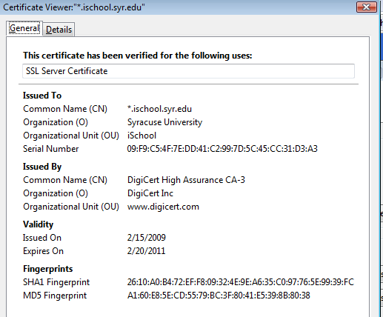
TLS – Transport Layer Security
Encrypts traffic over the wire
Protects against “Man in the Middle” attacks (sniffing data in transmission)
Organizations acquire a certificate from an Authority
Browsers “Trust” the Authority and encrypt the traffic
Clients request https:// instead of http:// to get the TLS encrypted site
Moral: Just because a site uses TLS doesn’t mean its “secure” it only means the traffic between you and the server is encrypted!!!!

Slide 28
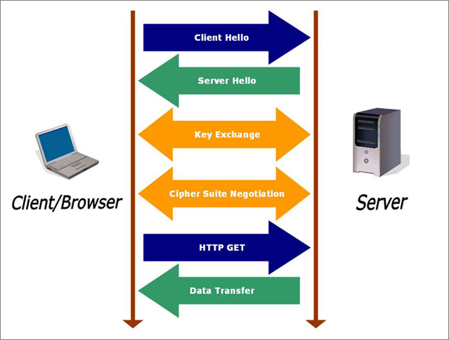
TLS – how it works on the web
Client request
Server response
Key exchange
Cipher negotiate
Client http get
Data transfer

Slide 29
TLS Termination Proxy
We can configure our reverse proxy for TLS but do not require encryption over our internal network.
Reverse Proxy
Clients Web Browsers
HTTPS Request
HTTP Request
Web Site Or Application
HTTPS Response
HTTP Response
Encrypted
Not Encrypted
Internal Network

Slide 30
Protecting content
We must take many steps in protecting website
Common methods of attacks
Directory Traversal: using ../../ to go up or down a directory structure. Can obtain data that is otherwise unavailable
Form field corruption: using a websites forms to enter data or purchase items via hidden data fields. If you know what variables are being used to pass data, you can change the values.
SQL injection: inject SQL statements (select * from lastnames) to add, edit, or delete data in a database or even execute applications on the webserver.

Slide 31
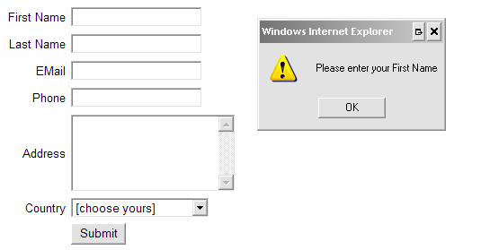
Protecting data
Limited the potential damage.
Connect to databases with read-only permissions if you are not updating or inserting data.
Validate form fields: verify the data the user typed before proceeding
Run web services with only the minimal level of permissions that is needed.
Use logging so if something does happen.
Use change control
ASSUME EVERYONE IS A BAD ACTOR!

Slide 32
Web API’s

Slide 33
What is an API?
API Stands for Application Programming Interface
It is a means to execute code other people wrote in our own programs.
API’s provide abstractions. You don’t have to know how it works only how to use the API.
Think driving a car versus being a mechanic.
Without API’s we would have to write all our code from scratch every time.
Imagine building a house but first you must build your own tools, cut your own wood from trees, make your own nails!

Slide 34
A Web API
A Web API is an API which is executed over the HTTP or HTTPS protocols.
This allows us to leverage services in the cloud into our own programs, such as:
Weather
Text to speech
Video playback
Amazon Alexa is a simple device but seems intelligent because it simply is a voice activated means to execute Web API’s in the Cloud!

Slide 35
Why Web API’s
The Web is transitioning:
From direct user-based consumption of data
To indirect user-based consumption of data through devices and also direct device-to-device consumption.
Examples:
Do you read news in your browser or on your phone?
Do check the weather on weather.com or do you ask Alexa?

Slide 36
RESTful API’s
When a web API embraces the HTTP semantics, it is considered a RESTful API.
REST stands for “Representational State Transfer” and is a design pattern for API’s
REST design uses URL’s and HTTP Verbs to make the intent clear:
Examples:
Current Weather in Syracuse, NY: GET http://fudgeweather.com/weather/Syracuse,NY/current
Add Item to shopping cart: POST http://fudgeazon.com/cart?productid=1043

Slide 37
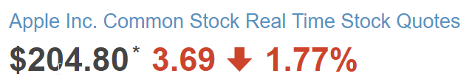
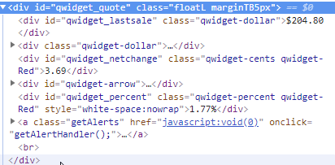
Web API Content formats
HTML is not a desired content format for Web API’s because another computer is the recipient of the output (as opposed to a user).
While HTML **is** machine readable, it mixes data with layout and formatting making it difficult to find the information we wish to extract from the content.
In the example there is HTML layout mixed in with the data, making the extraction of data difficult.

Slide 38
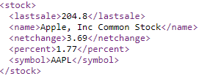
XML Content Format
XML – the Extensible Markup Language is a machine readable content format similar to HTML.
XML allows for the design of schemas so that any data format can be represented. These schemas can then be validated to ensure the content
In the example is trivial for a machine to extract the stock information because the XML only contains data and its structure.

Slide 39
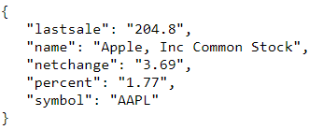
JSON Content Format
JSON – JavaScript Object Notation is a lightweight data interchange format based on how JavaScript data is serialized to text.
The JSON format is more compact than XML and requires little effort for many programming languages to parse (convert from text back into a workable object) easily.
In the example is trivial for a machine to extract the stock information because the JSON only contains data and its structure.

Slide 40
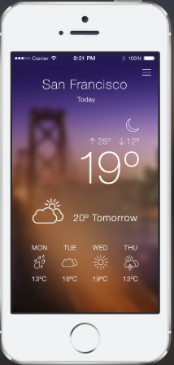
Example: Web API
GET http://fudweather.com/San+Francicso,CA/current
fudweather
Web API
Response: Content-Type: application/json
{
“temperature” : 19,
“conditions” : “partly-cloudy”,
“tomorrow” : 20
}
Weather App On Phone
The Phone App is responsible for calling the API (requesting content) and drawing the API output on the screen

Slide 41




Recall: Micro Services
If you have a Web API, why not use it for any client whether it be Mobile or Web Browser or Anything else that comes along? Future-Proof your infrastructure!
Browser
Presentation
Presentation
CLIENTS
Mobile App
Business Logic
Business Logic
HTTP REST API
Web API
Business Logic Web API
HTTP
Business Logic
Business Logic
Services
…
SERVERS
Data Access
Data Access
ODBC
ODBC
…
Data
Database
Database

