Slide 1
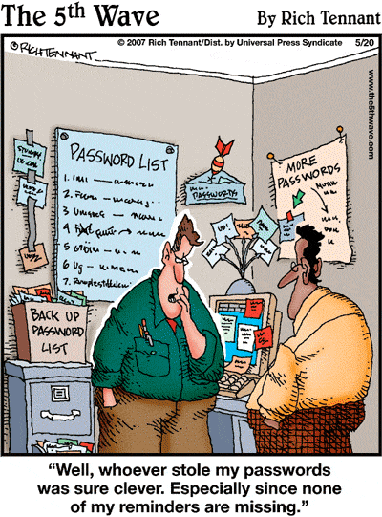
IST346: Namespaces, Identity Management

Slide 2

Agenda
Discussion
Content
Namespaces
Identity Management
Wrap-Up

Slide 3
Discussion Questions
What is a namespace? What are 4 common ways to choosing names? What are the two types of namespaces?
Provide 2 examples of a hierarchical namespace which is global.
What is the name service for computers? For people?
What is AAA? Define each term.
Define self-service. Provide an example of it used on campus.
What is a Distinguished Name, or DN? Is it a global namespace?
Notes:
Give students 1-2 minutes for each question. Its important to provide them with the opportunity to answer the questions based on the reading, labs, and assigned homework.
Thematic, Functional, Descriptive, Formulaic

Slide 4
Namespaces
Types:
Flat
mafudge
Global / Heirarchial
mafudge@gmail.com
mafudge@syr.edu
Conventions:
Formulaic
User001, user001
Thematic
Red, blue, green
Functional
Mail, web, print
Descriptive
Ist-hinds010-pc1

Slide 5

Namespace type and Convention?
What are the namespace type and convention?
An SUID? 101892932
A URL? http://ischool.syr.edu/classes
A Docker image name? Ubuntu Ubuntu:latest
Course numbers? IST346, CAS104
NFL Teams? Dallas Cowboys
A Twitter user name? @mafudge

Slide 6
Identity Management
Too Many
Accounts
Logins
Passwords To Remember
Centralized Authentication
One place to get Authentication, Authorization, and Accounting
Single-Sign On
With Centralized Authentication no need to keep authenticating

Slide 7
Common IM Providers
Central Authentication
LDAP
Active Directory (LDAP, Kerberos)
Federated – multi-institution
Shibboleth
SSO Protocols
OAUTH2, CAS, SAML2

Slide 8
Shibboleth
Blackboard Sign in Example
Blackboard is the service provider. Needs identities and authenticated used.
SU is the identity provider. Provides identities and authenticated users.
SAML2 (Security Assertion Markup Language v2) is the protocol

Slide 9
CAS (Central Authentication Service)
https://syracuseuniversity.qualtrics.com

Slide 10
OAUTH Demos
Sign in g.syr.edu
Setup 2 step verification
Message sent to my phone
Login in to fa.ischool.syr.edu
Login to stack overflow.com or trello.com

Slide 11
Group Activity
Namespacing Exercise

Slide 12
Namespace design
Divide into groups of 3.
You are in charge of your organization’s Identity Management initiative. Design a namespace for managing user accounts and devices on the network. Justify your namespace plan for:
Users
Devices (printers, computers, etc)
Running a centralized service, but delegating administration.

Slide 13

Your To-Do List
What to work on for next class
Notes:
ALWAYS CONSULT THE SYLLABUS

Slide 14

Exit Ticket
Share one thing you learned today that you didn’t know before class!

Slide 15

Questions?

