Slide 1
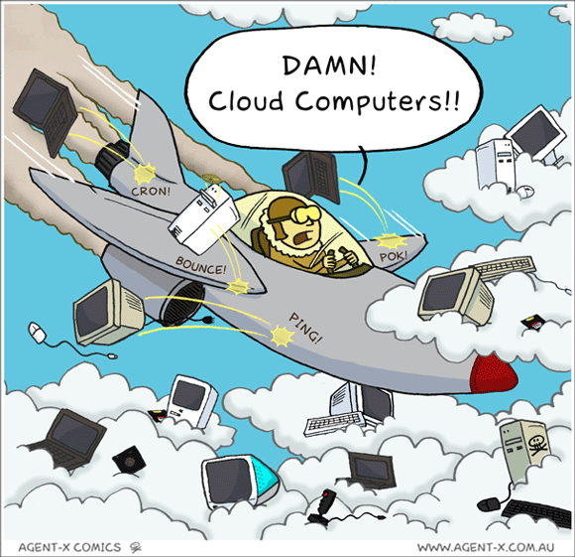
IST346: Cloud Computing and DevOps

Slide 2

Agenda
Discussion
Content
Cloud Computing
Devops
Wrap-Up

Slide 3
Discussion Questions
Define IaaS, PaaS, SaaS, DaaS and FaaS.
Why is it easier to scale a service in the cloud?
Why is cost both an advantage and disadvantage in cloud computing?
What is the difference between a hot site, cold site and warm site? Which has the highest cost? Longest recovery time?
What is CAMS?
How does Infrastructure as Code related to DevOps?
Now that you’ve studies Cloud Computing and DevOps, how are these two terms related?
Notes:
Give students 1-2 minutes for each question. Its important to provide them with the opportunity to answer the questions based on the reading, labs, and assigned homework.

Slide 4

Lab Debrief
Lab I

Slide 5
Course Content
Dfhkalsjdf
Asdf
Fasdhfsad
sadf

Slide 6
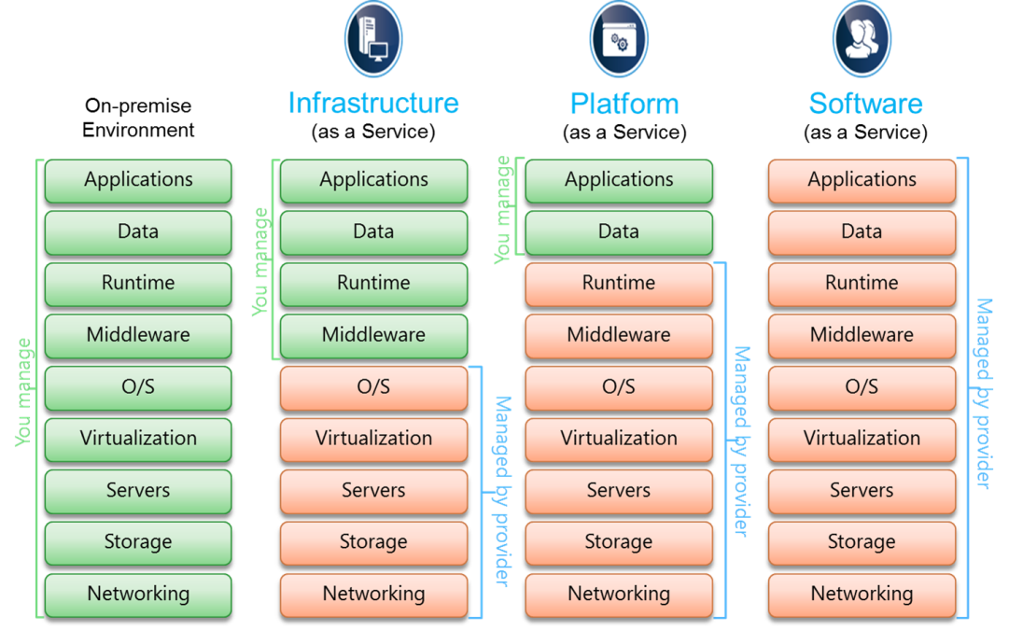
Cloud Service Models

Slide 7
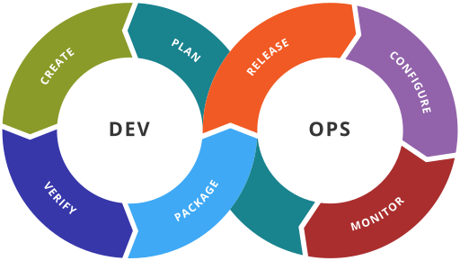
The DevOps Cycle
https://en.wikipedia.org/wiki/DevOps#/media/File:Devops-toolchain.svg

Slide 8
Group Activity
Cloud Offering Research

Slide 9
Details of Group Activity
Divide into groups of 2-3
Find a company on the internet who offers:
IaaS, PaaS, SaaS, FaaS, DaaS
It cannot be a company we discussed already!
For each, provide a name and evidence of how it fits the definition.

Slide 10

Your To-Do List
What to work on for next class
Notes:
ALWAYS CONSULT THE SYLLABUS

Slide 11

Exit Ticket
Share one thing you learned today that you didn’t know before class!

Slide 12

Questions?

