Slide 1
IST346 Cloud Computing

Slide 2
What is This “Cloud” thing?

Slide 3
Cloud Computing
“The practice of using a network of remote servers hosted on the Internet to store, manage, and process data, rather than a local server or a personal computer.”
In other words, having someone else host your servers and/or services for you.

Slide 4
Cloud Services Overview
Typically utilizes Virtualization or Containers to keep costs down while offering a larger number of services.
Shared resource model helps make the best use of hardware.
Providers have varying chargeback models to customers:
By amount of data stored (per mb/gb/tb)
By bandwidth used (mb/hr, gb/week, gb/month, etc..)
By resources used (ram, cpu)
By number of users accessing the service
Or combinations of all of the above.

Slide 5
Benefits of Cloud Services
Costs - Helps companies avoid up front costs of infrastructure
Anywhere/anytime - You can use the service whenever and wherever you wish (provided you have an internet connection)
Management - Servers/services can be partially or fully managed by the cloud provider
Network - Cloud computing can deliver increased bandwidth
Economies of Scale - Cloud providers take advantage of the sharing of redundant resources to reduce costs and increase scale.
Scalability - In addition it is easy to scale cloud services because providers have already invested in infrastructure.
Deployment - quick deployment compared to in house solutions.
Backup – Backup and recovery are sped up and simplified since the data resides at the cloud provider.

Slide 6
Drawbacks to Cloud Services
Big data - Not easy to move huge datasets in and out of the cloud.
Control - Reduced control for customers who want or need it.
Integration - The silo effect exists; when you have multiple cloud services hosting your data, integration across them and with your own network can be daunting (if possible at all).
Security – how do you know your data is safe?
Costs - Increased long term costs over in house solutions.
Customization - Can reduce flexibility of services offered
Support - Places reliance on cloud provider to fix issues
Features – often features are not on par with in house solutions
Regulatory Compliance – some industries are not permitted to store data off premises.

Slide 7
Cloud Service Models

Slide 8
Cloud Services on the Internet
Cloud computing is an extension of the service model to the ubiquities of the internet.
Don’t want to deal with datacenters or servers? Try Infrastructure as a Service!
Don’t want to bother with the infrastructure and the components required by your service? Try Platform as a Service!
Heck, don’t want to bother with any of it? Then Software as a Service is for you!

Slide 9
Infrastructure as a Service (IAAS)
The most basic cloud-service model
Provides you with virtual infrastructure, for example servers and data storage space.
Virtualization plays a major role in this mode, by allowing IaaS-cloud providers to supply resources on-demand extracting them from their large pools installed in data centers.
High level of flexibility, but requires greater IT skillsets.
Sales Pitch: “Let us handle your hardware (as virtual machines). You handle the rest”
Examples: Amazon EC2, GoGrid, RackSpace

Slide 10
Platform as a Service (PAAS)
Cloud providers deliver you the development environment for services where the user can develop and run in-house built applications.
These services might include an operating system, a programming language execution environment, databases and web servers.
Still offers shops flexibility to develop and customize their applications, but requires less of a skillset than IAAS as they no longer need to know how to setup and manage the infrastructure and Operating Systems.
Containers in the cloud are an example of PaaS
Sales Pitch: “We give you a setup so you can install or build your own app. No need to worry about the system administration.”
Examples: Google App Engine, Heroku, Microsoft Azure App Service, Docker Cloud

Slide 11
Software as a Service (SAAS)
Provides you with access to already developed applications that are running in the cloud.
The access is achieved by cloud clients and the cloud users do not manage the infrastructure where the application resides, eliminating with this the way the need to install and run the application on the cloud user’s own computers.
This is method requires the least amount of IT skillsets in house, but also reduces or eliminates flexibility and control over how the service should function.
Sales Pitch: “We give you the apps, all you need to do is your job!”
Examples: Salesforce.com, Office 365, Google Apps, Quickbooks Pro online, Draw.io

Slide 12
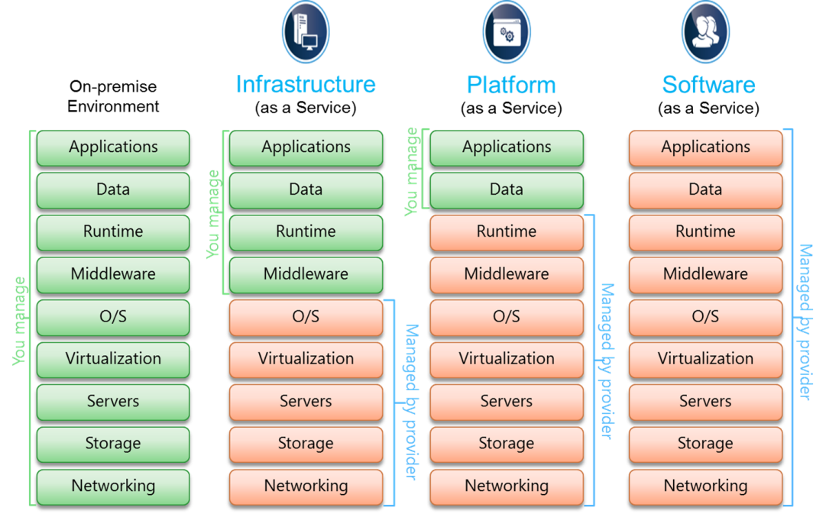
Cloud Service Models Comparison

Slide 13
Other Models
FaaS – Functions as a Service / Serverless computing.
Run your code in the cloud without the worry of managing IaaS or even PaaS / Containers
Ideal for microservices architecures
Examples: AWS Lambda, OpenFaaS, Google Cloud Functions
DaaS – Desktop as a Service
Cloud-based VDI (Virtual desktop infrastructure)
Examples: Mac-In-Cloud, Windows Virtual Desktop, VMWare Workspaces

Slide 14
The Cloud and D.R. (Disaster Recovery)

Slide 15
DR sites in the Cloud
The Claim:
“Cloud Computing delivers faster recovery times and multi-site availability at a fraction of the cost of conventional disaster recovery.”
Can provide bare-metal recovery that includes all services and data
Ability for more rapid recovery than typical failover sites
Potential for automated failover
Allows for backing up of data off site
Increased mobility, you can connect to “the cloud” from anywhere.

Slide 16
Hot Sites
Hot site - commercial disaster recovery service that allows a business to continue computer and network operations in the event of a computer or equipment disaster.
Example: If an enterprise's data center becomes inoperable, they can quickly switch all data processing operations to a hot site with little to no downtime.
Provides complete duplication of primary environment and will be available at all times.
More expensive, but faster to recover a business in the event of a disaster.

Slide 17
Warm Sites
A warm site is backup site that is setup similar to a hot site, but requires work to render it functional in the event of a disaster.
Backup environment are not constantly operational or processing. Also may require networking changes to redirect server/service requests to the backup site.
Requires intervention and cannot accomplish seamless failover, but cheaper to employ than a hot site.
While they don’t offer immediate failover, warm sites are typically easier to maintain than hot sites due to lack need for real-time replication or complex networking schemes.

Slide 18
Cold Sites
A cold site is a type of disaster recovery service that provides backup, but the site isn’t configured to take over in the event of a disaster.
Downtimes are to be expected and may require considerable amount of work for bringing a site online.
A cold site is less expensive, but it takes longer to get an enterprise in full operation after the disaster.

Slide 19
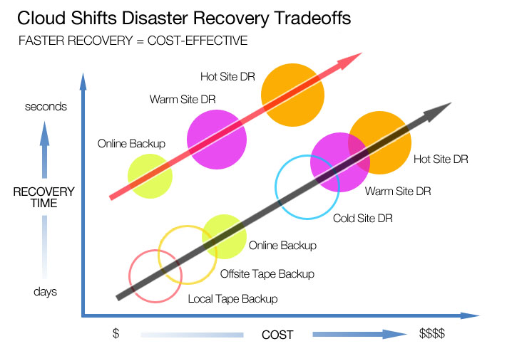
Costs vs. Recovery Time

Slide 20
SLAs and the Cloud

Slide 21
Service Level Agreements - Cloud
SLAs set expectations for both parties (client and cloud provider)
Identifies the specific parameters and minimum levels required for each element of a service.
Affirms your ownership of data stored on a cloud provider’s system, and your rights to get it back.
Details the infrastructure and security standards to be maintained.
Specifies your rights and costs to continue and discontinue use of the service.

Slide 22
What do we need to be concerned with?
Availability (e.g. 99.99% during work days, 99.9% for nights/weekends)
Performance (e.g. maximum response times)
Security / privacy of the data (e.g. encrypting all stored and transmitted data)
Disaster Recovery expectations (e.g. worse case recovery commitment)
Location of the data (e.g. consistent with local legislation)
Access to the data (e.g. data retrievable from provider in readable format)
Portability of the data (e.g. ability to move data to a different provider)
Support and Problem Resolution (e.g. call center)
Change Management process (e.g. changes – updates or new services)
Dispute mediation process (e.g. escalation process, consequences)
Exit Strategy with expectations on the provider to ensure smooth transition

Slide 23
Lessons to be learned with SLAs
Read cloud provider’s SLA very carefully.
Devil’s in the details, if you don’t read it you won’t know that they aren’t getting your data back right away until the event of a failure, in which case it’s too late.
Get technical staff involved to validate SLAs against common outage scenarios.
Just like IT staff should have outage and DR plans for on-premise services, they should help develop the same for your cloud vendors.
Have contingency plans in place for worst case scenarios.
Have a business continuity plan in place for when something really bad happens to your cloud vendor’s service. Blindly putting the trust of your entire business in a vendor’s hands is asking for trouble.

Slide 24
DevOps

Slide 25
What is DevOps?
A set of practices to reduce the time between making a change to a system and realizing that change in production (whether on-premises or in the cloud) without sacrificing quality of system stability.
Historically slowed down by:
Transitioning to Dev / Test / Prod environments
Pet Servers
Organizational Culture / Mindset
Siloed teams
Notes:
So finally now that we understand how systems come together, how data science products are deployed, and the complexities with managing the process we can now define DevOps because we can see the need for it.

Slide 26
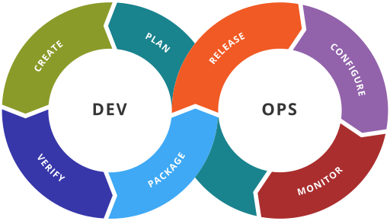
The DevOps Cycle
https://en.wikipedia.org/wiki/DevOps#/media/File:Devops-toolchain.svg

Slide 27
Core Values of DevOps - CAMS
Culture – breaking down barriers between teams, shortening feedback loops
Automation – productivity gains in deployment, systems thinking
Measurement – basing decisions on data instead of guessing
Sharing – tooling, discoveries and lessons among the team
Notes:
CAMS was first coined by Damon Edwards and John Willis at DevOpsDays Mountainview 2010 It is an acronym describing the core values of the DevOps Movement: Culture, Automation, Measurement, and Sharing.
[READ BULLETS]

Slide 28
DevOps Goals
Systems thinking - imagine your systems as a whole not as parts
Culture of ownership – everyone involved has ownership over the entire system and process
Shortening feedback loops - take less time to fix problems and achieve goals.
Culture of experimentation and learning - no fear of making changes as you should be able to test them easily.
Notes:
Systems thinking - imagine your systems as a whole not as parts
Culture of ownership – over the entire system and process. Everyone on the team has the same vested interest whether you’re a DBA, Developer, Data Scientist, Systems Administrator
Shortening feedback loops - take less time to fix problems and achieve goals. Try not to bog yourself down in bureaucracy and process.
Culture of experimentation and learning - focus on learning from your mistakes, and setup a technology environment which encourages and supports this.

Slide 29
Infrastructure as Code Methodology for DevOps
A
Treat your infrastructure as if it were code!
Store configurations, dependencies and scripts to bootstrap your systems in a source code management (SCM) system like Git.
This allows you set-up and tear down environments quickly and easily and deploy your systems in Dev, Test or Production.
Servers are commodity / utility resources, and not at all strategic. A perfect scenario for cloud computing!
Notes:
In the Infrastructure as Code methodology we our systems infrastructure as if it were code!
We Store configurations, dependencies and scripts to bootstrap your systems in a source code management (SCM) system like Git.
This allows you set-up and tear down environments and dependencies quickly and easily and deploy your systems in Dev, Test or Production.
In the grand scheme of things the servers (hardware and networks) are simply a commodity or utility and have no strategic value at all.

Slide 30

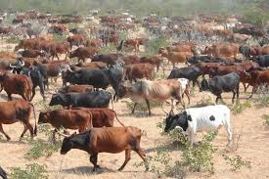
Recall: Treat Servers like Cattle, Not Pets
Pet servers
Few of them
Are given names like mail.mycompany.com
Are built to solve the task at hand (email)
When they are “sick” we “nurse them back to health”
Cattle servers:
Lots of them
Are given numbers like s0045.mycompany.com
Are built to do the same thing: compute and storage
When they are “sick” we “take them out of commission” and replace with another.
Cloud Computing Mindset
Notes:
A big mantra of DevOps is “Treat Servers like Cattle, Not Pets” It’s important to recognize we’re talking about HARDWARE here not the applications running on the hardware. We want the underlying infrastructure to be a commodity of storage network and compute . So the when we can design our application so that it is free to scale. The big internet companies like Google, Facebook, and Yahoo learned this early on.

Slide 31
Essential DevOps Toolbox for IaC
Source Code Management (git, subversion, mercurial)
Virtualization / Containerization (VMWare, Vagrant, Docker, CoreOS)
Configuration Management (Ansible, Chef, Puppet, Docker-Compose)
Orchestration (Kubernetes, Mesos, Rancher, Docker Swarm)
Continuous Integration / Continuous Delivery (Jenkins, TeamCity)
Monitoring / Logging (Monit, Nagios, ELK Stack)
Notes:
There are tools which help us execute the philosophy behind DevOps.
Source Code Management tools like Git allow us to work collaboratively, store multiple versions of our code and configurations, manage releases, and track changes to not only our applications but our infrastructure dependencies too.
Virtualization and Containerization tools are a key component which allows us to treat our servers like cattle, abstracting away an application’s dependencies so that they can be deployed easily to different hardware.
Configuration Management tools allow us to manage complete environment tools allow us to control and manage an application’s dependencies as a whole. In addition these tools allow us to push changes to existing systems.
Orchestration tools are best thought of as the combination of containerization + configuration management. These platforms abstract away the compute, network and storage of your hardware resources into a virtual pool of resources which can be allocated to your application as needed. Orchestration tools represent the next logical progression of containerization and configuration management and many of them incorporate such technologies into their platform.
Continuous Integration / Continuous Delivery tools pick up code commits from source code management tools and execute a task. They can test committed code to ensure no new bugs were introduced, or work with orchestration tools to automatically deploy an application to a test environment for use by beta testers. Likewise, they can even deploy changes into production!
Monitoring / Logging – one of the core values of devops is measurement, and these tools assist with that. They help us determine if services crash and why, and can perform auto-restarts. They can collect useage data (telemetry) so we can measure how our users interact with our applications – valuable information which can be used to create new features and enhancements.
ELK Elasticsearch Logstash Kibana

