Slide 1
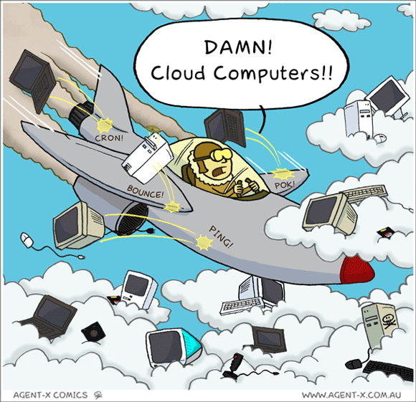

IST346:
Cloud Computing
Cloud Models
The Cloud for DR

Slide 2
What is This “Cloud” thing?

Slide 3
Cloud Computing
“The practice of using a network of remote servers hosted on the Internet to store, manage, and process data, rather than a local server or a personal computer.”
In other words, having someone else host your servers and/or services for you.

Slide 4
Cloud Services Overview
Typically utilizes Virtualization to keep costs down while offering a larger number of services.
Shared resource model helps make the best use of hardware.
Have varying chargeback models to customers:
By amount of data stored (per mb/gb/tb(
By bandwidth used (mb/hr, gb/week, gb/month, etc..)
By resources used (ram, cpu)
By number of users accessing the service

Slide 5
Benefits of Cloud Services
Costs - Helps companies avoid up front costs of infrastructure
Anywhere/anytime - You can use the service whenever and wherever you wish (provided you have an internet connection)
Management - Servers/services can be partially or fully managed by the cloud provider
Network - Cloud computing can deliver increased bandwidth
Scale - Cloud providers take advantage of the sharing of redundant resources to reduce costs and increase scale
Deployment - quick deployment compared to in house solutions.
Backup – Backup and recovery are sped up and simplified since the data resides at the cloud provider.

Slide 6
Drawbacks to Cloud Services
Big data - Not easy to move huge datasets in and out of the cloud.
Control - Reduced control for customers who want or need it.
Integration - The silo effect exists; when you have multiple cloud services hosting your data, integration across them and with your own network can be daunting (if possible at all).
Security – how do you know your data is safe?
Costs - Increased long term costs over in house solutions.
Customization - Can reduce flexibility of services offered
Support - Places reliance on cloud provider to fix issues
Features – often features are not on par with in house solutions

Slide 7
Cloud Service Models

Slide 8
Cloud Services on the Internet
Cloud computing is an extension of the service model to the ubiquities of the internet.
Don’t want to deal with datacenters or servers? Try Infrastructure as a Service!
Don’t want to bother with the infrastructure and the components required by your service? Try Platform as a Service!
Heck, don’t want to bother with any of it? Then Software as a Service is for you!

Slide 9
Infrastructure as a Service (IAAS)
The most basic cloud-service model
Provides you with virtual infrastructure, for example servers and data storage space.
Virtualization plays a major role in this mode, by allowing IaaS-cloud providers to supply resources on-demand extracting them from their large pools installed in data centers.
High level of flexibility, but requires greater IT skillsets.
Sales Pitch: “Let us handle your hardware (as virtual machines). You act as the SA and handle the rest”
Examples: Amazon EC2, GoGrid, RackSpace

Slide 10
Platform as a Service (PAAS)
Cloud providers deliver you the development environment for services where the user can develop and run in-house built applications.
These services might include an operating system, a programming language execution environment, databases and web servers.
Still offers shops flexibility to develop and customize their applications, but requires less of a skillset than IAAS as they no longer need to know how to setup and manage the infrastructure and Operating Systems.
Sales Pitch: “We give you a setup so you can install or build your own app. No need to worry about the system administration.”
Examples: Google App Engine, Force.com, Microsoft Azure / .Net
LAMP (Linux, Apache, MySQL, (Php/Perl/Python))

Slide 11
Software as a Service (SAAS)
Provides you with access to already developed applications that are running in the cloud.
The access is achieved by cloud clients and the cloud users do not manage the infrastructure where the application resides, eliminating with this the way the need to install and run the application on the cloud user’s own computers.
This is method requires the least amount of IT skillsets in house, but also reduces or eliminates flexibility and control over how the service should function.
Sales Pitch: “We give you the apps, all you need to do is your job!”
Examples: Salesforce.com, Office 365, Google Apps,
Quickbooks Pro online

Slide 12
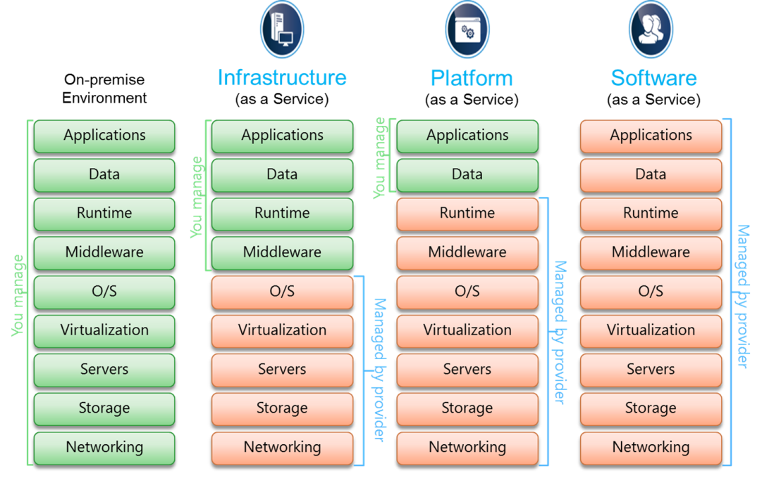
Cloud Service Models Comparison

Slide 13
The Cloud and D.R. (Disaster Recovery)

Slide 14
DR sites in the Cloud
The Claim:
“Cloud Computing delivers faster recovery times and multi-site availability at a fraction of the cost of conventional disaster recovery.”
Can provide bare-metal recovery that includes all services and data
Ability for more rapid recovery than typical failover sites
Potential for automated failover
Allows for backing up of data off site
Increased mobility, you can connect to “the cloud” from anywhere.

Slide 15
Hot Sites
Hot site - commercial disaster recovery service that allows a business to continue computer and network operations in the event of a computer or equipment disaster.
Example: If an enterprise's data center becomes inoperable, they can quickly switch all data processing operations to a hot site with little to no downtime.
Provides complete duplication of primary environment and will be available at all times.
More expensive, but faster to recover a business in the event of a disaster.

Slide 16
Warm Sites
A warm site is backup site that is setup similar to a hot site, but requires work to render it functional in the event of a disaster.
Backup environment are not constantly operational or processing. Also may require networking changes to redirect server/service requests to the backup site.
Requires intervention and cannot accomplish seamless failover, but cheaper to employ than a hot site.
While they don’t offer immediate failover, warm sites are typically easier to maintain than hot sites due to lack need for real-time replication or complex networking schemes.

Slide 17
Cold Sites
A cold site is a type of disaster recovery service that provides backup, but the site isn’t configured to take over in the event of a disaster.
Downtimes are to be expected and may require considerable amount of work for bringing a site online.
A cold site is less expensive, but it takes longer to get an enterprise in full operation after the disaster.

Slide 18
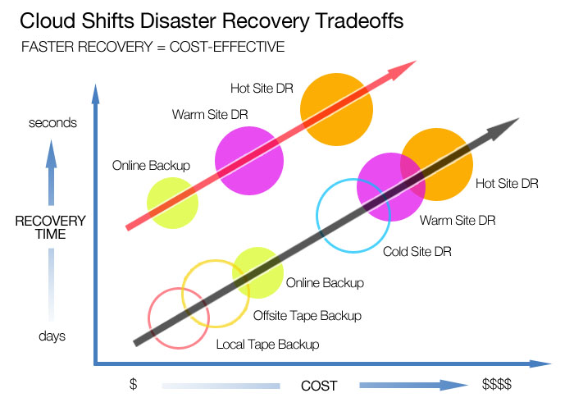
Costs vs. Recovery Time

Slide 19
SLAs and the Cloud

Slide 20
Service Level Agreements - Cloud
SLAs set expectations for both parties (client and cloud provider)
Identifies the specific parameters and minimum levels required for each element of a service.
Affirms your ownership of data stored on a cloud provider’s system, and your rights to get it back.
Details the infrastructure and security standards to be maintained.
Specifies your rights and costs to continue and discontinue use of the service.

Slide 21
What do we need to be concerned with?
Availability (e.g. 99.99% during work days, 99.9% for nights/weekends)
Performance (e.g. maximum response times)
Security / privacy of the data (e.g. encrypting all stored and transmitted data)
Disaster Recovery expectations (e.g. worse case recovery commitment)
Location of the data (e.g. consistent with local legislation)
Access to the data (e.g. data retrievable from provider in readable format)
Portability of the data (e.g. ability to move data to a different provider)
Support and Problem Resolution (e.g. call center)
Change Management process (e.g. changes – updates or new services)
Dispute mediation process (e.g. escalation process, consequences)
Exit Strategy with expectations on the provider to ensure smooth transition

Slide 22
Lessons to be learned with SLAs
Read cloud provider’s SLA very carefully.
Devil’s in the details, if you don’t read it you won’t know that they aren’t getting your data back right away until the event of a failure, in which case it’s too late.
Get technical staff involved to validate SLAs against common outage scenarios.
Just like IT staff should have outage and DR plans for on-premise services, they should help develop the same for your cloud vendors.
Have contingency plans in place for worst case scenarios.
Have a business continuity plan in place for when something really bad happens to your cloud vendor’s service. Blindly putting the trust of your entire business in a vendor’s hands is asking for trouble.

Slide 23
Questions?
“If your hot computing Cloud bumps into a cold computing Cloud, do you get Lightning computing, followed by stormy computing and network outages?”

