Slide 1
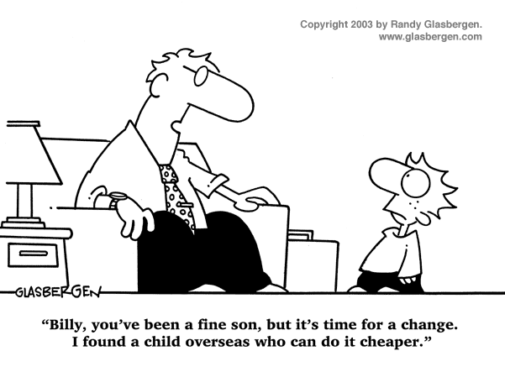
IST346: Data and Database Management, Backupa

Slide 2

Agenda
Discussion
Content
Databases
CAP Theorem
Backups
Wrap-Up

Slide 3
Discussion Questions
What are the 5 types of databases?
What is the CAP Theorem?
What is Polyglot Persistence?
What is eventual consistency?
Explain the 3-2-1 data management strategy
Why are off site backups important?
Of Differential or Incremental, which offers a quicker recovery time and why?
Notes:
Give students 1-2 minutes for each question. Its important to provide them with the opportunity to answer the questions based on the reading, labs, and assigned homework.

Slide 4

Lab Debrief
Lab H

Slide 5

Partition Tolerance
If your data are distributed across these 4 servers and one of these servers becomes unavailable:
In the system available to read/write?
Is the data you read consistent?

Slide 6
Database Systems and CAP
Consistency
Partition
tolerance
Availability
Relational
Single-master
CA
CP
X
AP
Eventual consistency

Slide 7
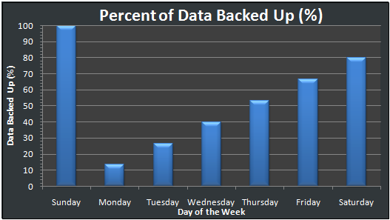
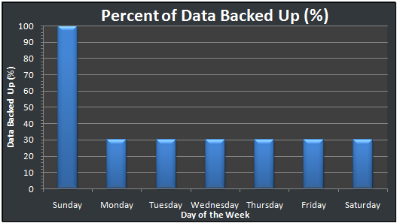
Differential vs. Incremental
Differential
Incremental

Slide 8
Group Activity
Backup Strategies

Slide 9
Backup Strategy #1
Backup
Sunday L0
Monday – Saturday L1 (Diff)
Each week, an L0 is saved for a year.
Week 52 is saved as year-end backup (not reused)
Can this strategy Restore
A file from 4 days ago?
A file from 5 weeks ago?
A file from Last July, that was deleted in August?

Slide 10
Backup Strategy #2
Backup
Full 1st Day of each month
Differential each remaining day of the month.
Media on 1st day of the month not reused.
Can this strategy Restore
A file from 25 days ago?
A file from 60 days ago?
A file from 1 year ago that was around for 2 months.

Slide 11

Your To-Do List
What to work on for next class
Notes:
ALWAYS CONSULT THE SYLLABUS

Slide 12

Exit Ticket
Share one thing you learned today that you didn’t know before class!

Slide 13

Questions?

