Slide 1
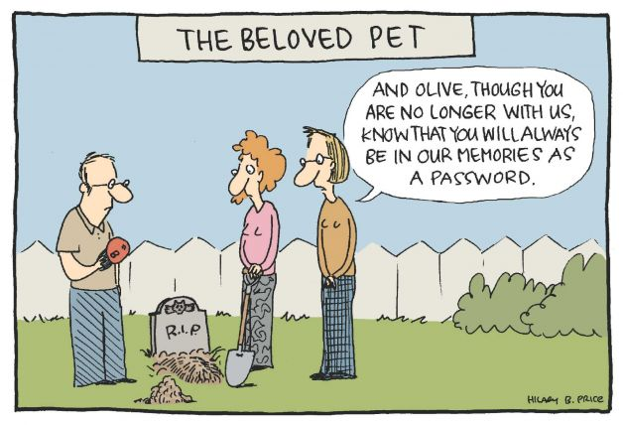

IST346:
Information Security Policy
Monitoring and Logging

Slide 2
Today’s Agenda
Overview of Information Security
SA Activities Surrounding Information Security
Incident Management
System Monitoring and Logging

Slide 3
An overview of Information Security

Slide 4
Security is the relationship among
Assets
Vulnerabilities
Threats
What you’re trying to secure
What you’re securing from
Your weaknesses

Slide 5
Assets
The user’s identity – login account
Network bandwidth – denial of service, bot-nets
Storage / Disk space - warez
Data – the most important asset of them all
Reputation – one incident can ruin a reputation.

Slide 6
Vulnerabilities
Bad default, or weak passwords passwords.
Unused services with open ports.
Un-patched software vulnerabilities.
Transmitting data in clear text.
Open networks
Physical access to systems.
The users themselves

Slide 7
Vulnerabilities - Social Engineering
The human element of security
Users are the weakest link
Preys on people’s inherent trust in others
Kevin Mitnick - Famous Hacker
Author of “The Art of Deception” and “No Tech Hacking”
One of his many social engineering stories
http://www.youtube.com/watch?v=8L76gTaReeg

Slide 8
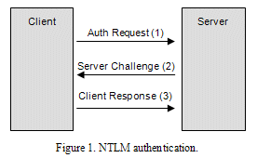
Vulnerabilities - Pass the Hash
Hacking technique that allows an attacker to authenticate to a remote server/service by using the underlying NTLM hash of a user's password, instead of requiring the associated plain text password as is normally the case.

Slide 9
Threats
Financial motives
Identity theft
Phishing
Spam
Extortion
Botnets
Political motives
Danish sites hacked after Mohammed cartoons.
Personal motives
Just for fun.
Insider revenge.

Slide 10
Goals of Security:
Data Protection
System Integrity
System Availability
Data Integrity
Keep data safe
Keep data accurate
Keep systems operational
Keep systems accurate
“To protect and to serve your systems and data.”

Slide 11
Can you beat “them”?
Indefinitely – No. The odds are against you.
One in the “herd“ will be lost due to:
Software exploit
Bad practice
Dedicated Hacker
All servers shouldn’t be lost.
Why?
You don’t choose all of the applications that run in the env.
You don’t write all of the applications that run in the env.
We aren’t all security experts
Compromise – it happens.

Slide 12
Reducing Risks

Slide 13
What we can do?
Defense in Depth
Secure systems at all levels:
OS hardening
Application Hardening
Network Segmentation
Detection of changes
Credential Security
Encrypting data/traffic
Log aggregation (prevents covering of ones tracks)
Review Logs regularly
Security scanning (open ports, suspicious activity)
Security audits (physical, credentials, permissions, pen-tests)
Notes:
Tyranny of the defaults

Slide 14
OS / Server Hardening
Secure the physical system.
Install only necessary software.
Keep security patches up to date.
Delete or disable unnecessary user accounts.
Use secure passwords.
Disable remote access except where necessary.
Setup least privilege access.
Run publicly accessible services in a jail.
Configure firewall on each host.
Document security configuration.
Secure password management.
Use secure management endpoints
Using a management framework (AD?)
Reduce/Remove elevated credentials

Slide 15

Reducing/Removing Elevated credentials
Limited User < Local Administrator < System
Credentials are in Memory
Log Off
Clear text Passwords
Password Hashes
15+ char.
Service configuration
Creating specialized service accounts
Limited users preferred, Local Administrators are a compromise
Don’t run services as your “admin” account

Slide 16
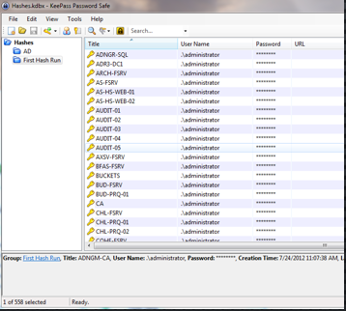
Credential & Password Management
15 + Characters
Length > Complexity
What do you mean password management?
There are two common password management Methods…
Consistent Passwords Reuse
Efficient for you and a Hacker
Passwords are written down
Where?
Is it Encrypted?
DR?
Alternatives - Unique random passwords
USB with Secure Password storage, 2nd factor using Encryption
Rubric – “decoder ring”
Beware of “homemade” hashing functions

Slide 17
Encryption – what is this?
Unencrypted data is called plain text ;encrypted data is referred to as cipher text
Encryption is the conversion of data into a form, called a cipher text, that cannot be easily understood by unauthorized persons or systems.
Decryption is the process of converting encrypted data back into its original form, so it can be understood.
To read an encrypted file, you must have access to a secret key or password that enables you to decrypt it.

Slide 18
Encryption - SSL
Offers secure transmission between client and server at the lowest level – socket level, sits atop TCP.
Two types:
Self-signed – certificate created by the host/service you are connecting to.
CA issued – an intermediate Certificate Authority issues a certificate that both the server and client “trust”
Certificate Authorities can be both public and private.
*Internet-based services ultimately require a Public CA to assure a proper trust chain be established.
Intranet-based services can utilize a Private CA as the trust can be established within the organization.
*Clients trust public CAs if they are able to obtain their public key in the browser certificate store.

Slide 19
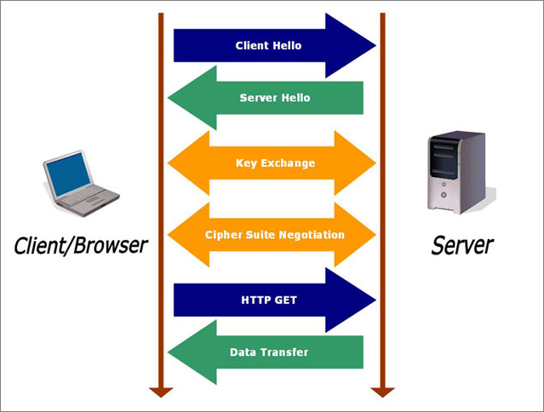
SSL – how it works on the web
Client request
Server response
Key exchange
Cipher negotiate
Client http get
Data transfer

Slide 20
Defenses
Vulnerability mitigation
Use secure authentication systems.
Deploy software in secure configuration.
Patch security flaws quickly.
Restrict physical access to systems
Attack mitigation
Firewalls to prevent network attacks.
IDS to detect attacks.
Virus/spyware scanners.
Disk Encryption
Two-factor authentication
System Administrator & User Education and Awareness
Prevent Social engineering
Prevent Credential Theft

Slide 21
Two-Factor Authentication
Example factors are:
Something the user knows (password, PIN)
Something the user has (token, smart card, cell phone)
Something the user is (biometric characteristic, Physical Location- GPS)
RSA Secure ID, Google Authenticator, Duo Security
Differences?
RSA – Type your full password prior to Logon
Smart Card – don’t type your password, just a PIN
Still In Memory on the Destination

Slide 22
Considering the pivot Points
Pivoting
They will be inside the Datacenter
They will be looking for the next Hop
When a server is hacked – what else will fall?
Does this server NEED to talk to anything else?
What’s on it?
What could it be used for?
Do you have any other lines of defense?

Slide 23
Security Policy / Incident Reporting

Slide 24
Security Policies
User Level Policies
Users must sign before receiving resources.
Acceptable Use Policy
Monitoring and Privacy Policy
Remote Access Policy
Business Level Policies
Network Connectivity Policy
Log Retention Policy

Slide 25
What is an Incident?
Any violation of security policy:
Unauthorized access of information
Unauthorized access to machines
Embezzlement
Virus or worm attack
Denial of service attacks
Email spam or harassment

Slide 26
Incident Response Goals
Determine if a security breach occurred.
Contain intrusion to prevent further damage.
Recover systems and data.
Prevent future intrusions of same kind.
Investigate and/or prosecute intrusion.
Prevent public knowledge of incident.

Slide 28
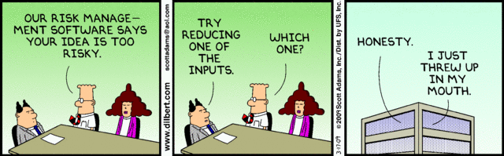
IST346:
Disaster Recovery
Data Integrity
Backups

Slide 29
Today’s Agenda
Risk Analysis
Disaster Recovery
Business Continuity
Data Integrity
Backups

Slide 30
Risk Analysis

Slide 31
Risk Analysis: Some basic terms
Disaster any event that causes a massive outage to services and/or a loss of data.
Severity of any disaster depends on:
How many people are affected (size)
Which aspects of the business are affected (cost)
Risk the expected value of the disaster happening in the future.
Risk is measured as a probability

Slide 32
User Errors
Disk Failure
System Failure
Power Failure
Network Failure
Security Breach
Natural Disaster
SA Errors
Types of Disasters

Slide 33
Ways we mitigate disasters
Fault Tolerance the property that enables a service to continue operation amidst a failure
Redundancy the duplication of components in a system to increase reliability
Backups copies of point in time data stored separately from the source.
Snapshots point in time copies of data stored on the same source.
Service Contracts lower vendor response times in your service contracts. Store parts on the shelf.

Slide 34
Disaster Mitigation
Accidental File Deletion
Snapshots
Disk Failures
RAID 1,5, etc…
Power Failures
UPS
System Failures
Clustering
Backups
Natural Disasters
Off-site Redundancy
Off-site backups
Backups
Generators
Hot-spares

Slide 35
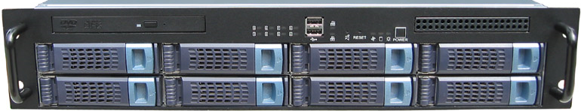
Example: Calculating risk
Example:
8 Drive disk array
Lifetime 5 years (43,829 hours)
MTBF for each drive is 200,000 hours
Array Rebuild rate 10 hours.
Warranty: 4 hour response, 48 hour replacement of spare parts
Risk:
RAID 0: MTBF = 200,000/8 = 25,000
Almost guaranteed chance it will fail over its lifetime 43,829/25,000 (high risk)
Of course you would almost certainly use RAID 5 in this case…

Slide 36
Example: Calculating risk
Risk:
RAID 5: System does not fail until you lose 2 disks thanks to one level of redundancy.
So where is the risk? Losing another drive in the window between when one fails and the array is rebuilt with the replacement drive.
Risk window: your response to the fault + vendor response time + time for replacement part + array rebuild time
Risk window: 4 + 4 + 48 + 10 = 66 hours
MTBF of remaining array 200,000/6 = 33,333
Risk Rate: 66/33,333 = 0.2% or 1 in 500.

Slide 37
Example: Calculating risk
Risk Rate:
Is a 0.2% chance of failure an acceptable amount of risk?
How can we lower the amount of risk in this case?
If we can lower the risk by a factor of 10 to 0.02% for a cost of $25,000 is it worth it?
What does the acceptability of this risk (or any risk) depend upon?
For example, are these two risks the same?
0.2% chance of failing a course vs. A 0.2% chance of dropping out of school.

Slide 38
Budgeting for Risk Mitigation
Risk Budget = Risk Rate * (Estimated cost of disaster – Estimated cost of mitigation)
Example (from before) when that storage array becomes unavailable it will cost the company $10,000/day and be down for 10 business days.
Risk budget = 0.002 * ($100,000 – $0) = $2,000
That $2,000 could be spent on hot-spare and perhaps a RAID6 configuration.

Slide 39
Budgeting for Risk
Single Events
Cost should datacenter be destroyed: $60 million
Risk of Flood one in 1 million
Risk of Earthquake one in 3000
Flood Risk budget = (0.000001)*$60,000,000 = $60
Earthquake Risk budget = (0.000333 )*$60,000,000 = $20,000
So, you should budget and plan for an earthquake but not a flood. Why?

Slide 40
Budgeting for risk
A small on-line retailer cannot make $$$ when their internet connection is down.
It goes down, on average for 2.5 hours each month (every 30 days), in periodic intervals. As per the ISP’s Terms of Service.
The company estimates they lose an average of $15,000 for each hour their connection is down.
What is the Rate of failure for this internet connection?
2.5 hours / 30*24 hours = 0.0035 This is the risk rate each month
What is the loss of business each month?
2.5 * $15,000 = $37,500 /month
What should the monthly Risk budget be?
0.0035 * ($37,500 - $0) = $131.50
It makes sense to get a secondary internet connection if you can find one for less than $131.50/month.

Slide 41
Disaster Recovery and Business Continuity

Slide 42
Disaster Recovery Plan
Defined: The process that allows a company to recover all systems, data, services, etc. May take hours, days, or weeks depending on number of systems used and their complexity.
Help prevent a IT Disaster From Happening in the 1st place:
Implement fault tolerance components and a solid backup and recovery strategy
Types of Fault Tolerance components:
RAID’ed hard drives
Redundant paths to your IPS or redundant IPS’
Backup power via UPS or generator (or both)
Mirrored copies of data located off-site
Mirrored servers (clusters)
VMWare or imaged servers
Read manuals and pay attention to what you are doing.
Isolate systems from other systems or to restate, don’t run multiple services on the same server.

Slide 43
What is a Disaster Recovery Plan?
A DR Plan…
Considers potential disasters.
Describes how to mitigate potential disasters.
Makes preparations to enable quick restoration of services.
Identifies key services and how quickly they need to be restored and in what order.
Only High-Risk / High cost plans should be considered

Slide 44
Disaster Recovery Plans
Define (un)acceptable loss.
Data? Productivity? Re-Creatable data? At what cost?
Back up everything.
Backup data, metadata (config), and instructions on how to restore your system.
Organize everything.
Can you find the backup tapes you need when disaster strikes? Make sure everything is clearly labeled.

Slide 45
Disaster Recovery Plans
Protect against disasters.
Natural disasters with high probability and many more.
Document what you have done.
Plan must be detailed enough for people to follow in a disaster w/o additional info. Hardcopies are key.
Test, test, test.
A disaster recovery plan that has not been tested is not a plan; it's a proposal.

Slide 46
Disaster Recovery Plan Ideas
Many places have a DR plan that says something like “buy new hardware, re-install our OS, applications, then restore our databases or data files from the previous backups”
What’s wrong with this plan ?
How long do you think this will take, a week, 2 weeks, a month?
What ‘data’ do you need to include? Is it up-to-date at your “DR” location?
To protect against or minimize data loss, data can be ‘copied’ either periodically (asynchronous) or in real-time (synchronous) from one server to another for DR processes.
Ideally the servers should be in different buildings, campuses, or even states as to guard against large scale natural disasters.

Slide 47
Asynchronous Replication
Defined: Data is refreshed or synchronizes periodically (most commonly done once per day) during periods of inactivity (night).
Advantages of asynchronous replication
Typically is less expensive. Don’t need to invest in sometimes expensive data replication software. Can use free tools, ex: Robocopy.
Can be used to restore data from.
If your data files are only refreshed nightly, the target location can be used to restore data from in the event a user deletes or corrupts data during the day or a user deletes a file.
Disadvantages:
Data is not kept 100% up-to-date at secondary site. If you run a bank or hospital, this may cause health, legal, or financial issues !

Slide 48
Synchronous Replication
Defined: Data is replicated from primary site to secondary site in “real-time - automatically”. No period sync process
Advantages of synchronous replication
Data is always up-to-date at secondary site. Don’t need to worry about what ‘work’ needs to be re-entered by your users.
If you are replicating from SAN to SAN, you may be able to use some of the DR hardware at secondary site for non-production purposes (allows your servers to do double-duty) such as to run reports. If needed, this DR hardware can quickly be re-setup for production need. Works great if you are using virtualization.
Disadvantage:
Costs money, may requires additional products (cost), and adds complexity to running systems

Slide 49
Business Continuity
The organization’s ability to continue to function during and after the disaster.
Think of BC as your fallback plan for the disaster.
It is not the same as disaster recovery, but ultimately a part of it.
Example:
Labor Day storm 1998. Power was out for 10 days.
The company I worked for had a BC plan. They’d better they were in the business of selling generators!
Sales and Rentals would be processed manually (on paper) and then recorded into the system when it came back on-line.

Slide 50
Business Continuity, another example
Snowstorm in 1997. Computers across an entire organization’s site were down when snow took out their terrestrial satellite links (wide area network for them at the time.
The company I worked for had about 2000 employees and manufactured medical diagnostic equipment, so had to perform support for doctors offices, hospitals, and surgeons daily.
The customer service departments kept printed and bound copies of all of the service manuals for every piece of equipment the company had ever designed at their desks. When the network was down they could not access the electronic manuals, so the were able to fallback to the printed copies.

Slide 52
Monitoring and Logging (Security-focused)

Slide 53
Something we do to Services
Service Monitoring
Service Logging
Observing service activity in real-time
This is done by a computer, not a human.
Important events are passed on to a human (notification).
Keeping a historical records of service activity
This data grows over time and can become quite large.
Only referred to when needed to troubleshoot a problem or trace down a security incident.

Slide 54
Why Bother?
Why do we Monitor?
Why do we Log?
To detect / identify security incidents.
To find out when someone accesses a service that is not supposed to.
To determine if actions need to be taken.
Help to find out the extent of a security breach.
Help us predict security attacks.
Provide historical data or trends.
Report on suspicious activity.
If you’re not measuring it you aren’t managing it

Slide 55
How Monitoring and Logging Work
Server
Log
Access Info
Service
Network Activity
Internal Service Monitor
External Service Monitor
Security Event
Security Event
SA

Slide 56
What to Monitor, what to Log?
Monitor for a condition.
Send alert when the condition is met.
Log the condition whether it sends an alert or not.
Examples: (Why would you monitor/log these?)
User accesses financial database that is not a member of that department.
User attempts to login 50 times in 2 minutes.
User logs in from IP addresses originating from multiple countries (in a short time span)
Unusually high traffic to a service from multiple locations.

Slide 57
Better Security Monitoring
Normal
Normal: When a security incident occurs, you send an alert.
Proactive Monitoring
Proactive: When a user has attempted to login multiple times, send an alert and disable their account for 10 minutes.
Automated Responses
Normal: When an incident occurs, you send an alert.
Automated: When the user has had multiple failed login attempts, disable their account for 10 minutes and send the user and the admins an alert. If this reoccurs, disable the account until further investigation by a human.

Slide 58
Questions?
Security fail (from an actual website):
In addition to your password, please set a passphrase: What is your preferred internet password?

