Slide 1
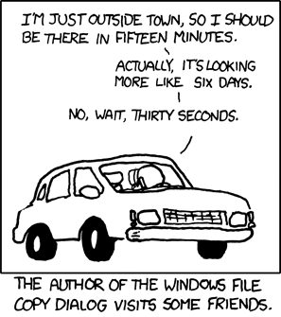

IST346:
Storage
File Systems
File Services

Slide 2
Today’s Agenda
Take a look at data storage options at the enterprise level.
Discuss the various file systems
Overview file-oriented services
Demo walk-thru of storage allocations on servers.

Slide 3
Data Storage

Slide 4
Why Data Storage?
Information is a the center of all organizations.
Organizations need to store data. Lots of it.
What Kinds of Data?
Documents and Files
(Reports, Proposals, Letters, Presentations, etc.)
Databases
Customer Information, Orders, Inventory
Multimedia
Video, Audio
Email !!!!!

Slide 5
Some Storage Stats for the iSchool (2009)
Service | Total Allocation | Average*
Email | 405 GB | 1.4 GB / User*
Personal Files | 238GB | 1.8 GB / User*
Configuration Data | 12GB | 94 MB / User*
Shared File Space | 202GB | 870 MB / User*
Video | 145GB | 1.1 GB / User*
iLMS (iSchool Blackboard) | 430GB | 323 MB / User +
TOTAL | > 1.4 TB | ~ 1GB / User
This ONLY represents the information the users generate and does not include operating system files, application files, etc.
*Based on 230 users +Based on 1550 users

Slide 6
Another way to look at it.

Slide 7
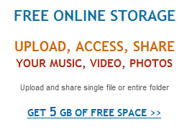
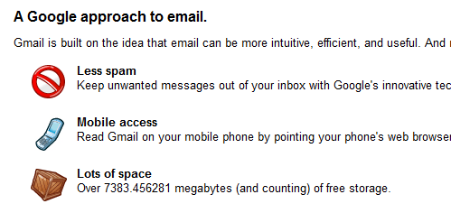
You might be thinking….
1GB per user is NOTHING, considering:

Slide 8
Disk Components
Traditional disks are made of a few basic components
Spindle : common mounting platform for all platters.
Platters : disc type material where data is stored
Heads : Actual ‘arm’ that moves in and out of the record to read data.
Track : location on the platter where data is stored. Each track has the same radius from the spindle on a disk
Sector : pie-shaped slice of the platter. Used to sub-divide the platter for quickly locating blocks of data.
Cylinder : same tracks on multiple platters.

Slide 9
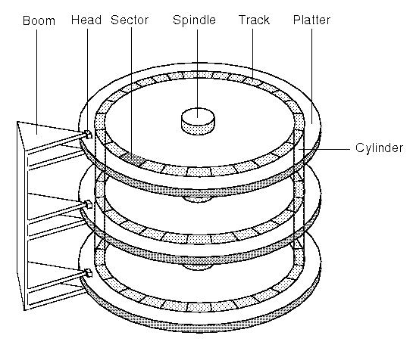
Disk components

Slide 10
A new storage approach: SSD
SSD: Solid State Disk/Drive
Differs from traditional disks as there are no moving parts…no platters, no mechanics, so fewer failures.
Utilize dram or eeprom memory boards to store bits
Some use their own CPUs to manage data storage.
Faster for accessing data than traditional disks since seek time is eliminated
Much more expensive per GB (for now) than traditional spinning electromagnetic disks

Slide 11
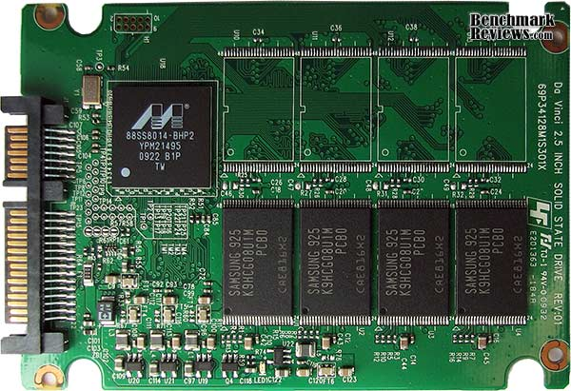
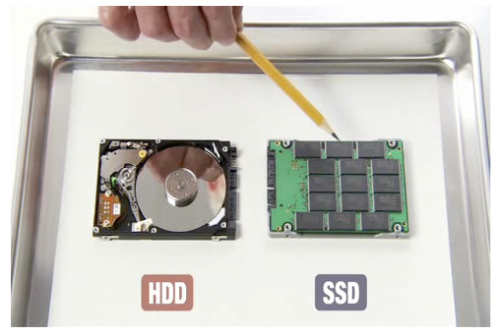
The internals of an SSD

Slide 12
The Fallacy of Enterprise Storage
For every 1GB of user storage (files, email) you need:
An additional 1GB for every full backup you do.
At most another 1GB for fault-tolerance.
1GB per user is now 8GB when part of:
RAID1 (Mirroring) for fault tolerance (1GB)
Weekly full off site backups (4GB)
With two months of backups on the shelf (2GB)

Slide 13
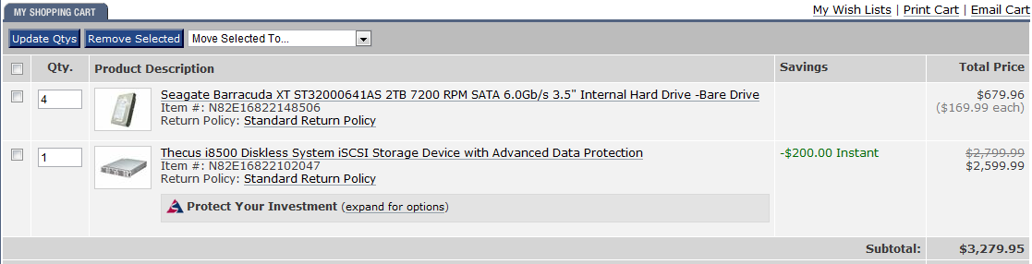
The Fallacy of Enterprise Storage
Disk Drives are Cheap, Storage is not (a simple example)
2TB Drive = $170
8TB Array = $3,280 (actual 6TB usable in RAID5)
19X more expensive, for only 3X the storage!

Slide 14


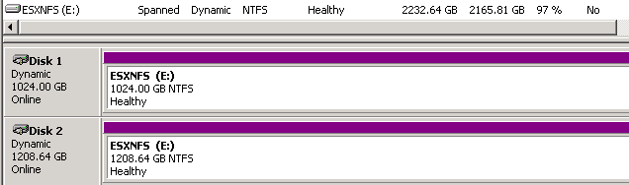
Storage Terminology - Volumes
Volume – the chunk of storage as seen by the server.
A single hard drive (or logical disk) can be one volume.
One hard drive (or LD) can be multiple volumes. We call this partitioning the disk.
Many hard disks can be combined into one logical volume.

Slide 15
Storage Terminology - File Systems
Before a volume can be used it must be formatted with a File System.
A File System is the method for storing and organizing files and data on the volume.
Formatting is the act of setting up an empty file system on a volume.
Some file systems implement journaling, which writes to the volume in batches, improving performance and reducing the chances for errors.
Popular File Systems EXT3, ZFS, NTFS, HFS (Mac), FAT

Slide 16
Putting it all together Disk to File System.
Disk(s)
RAID
Logical Drive
Part.
Logical Volume
Format
File System

Slide 17
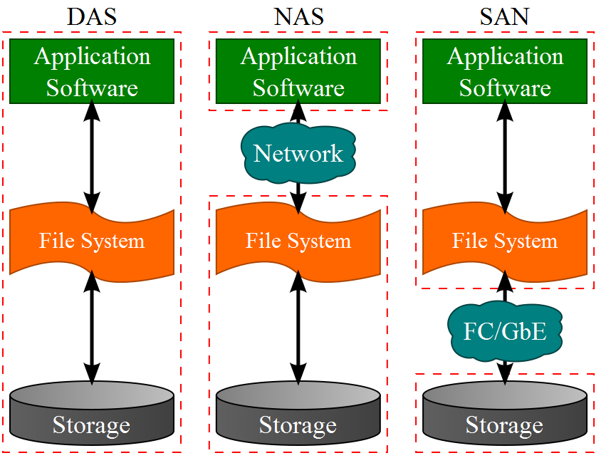
DAS, NAS, and SAN Oh My!
*Taken from Wikipedia Commons

Slide 18
RAID
Redundant Array of Inexpensive Disks
A technique to provide storage that is larger, more reliable and faster than what a single disk drive can provide.
The RAID array of Physical Disks is treated as one logical Disk. (known as a LUN, logical unit number)
Some RAID supports the use of Hot Spares in the event of a drive failure.

Slide 19
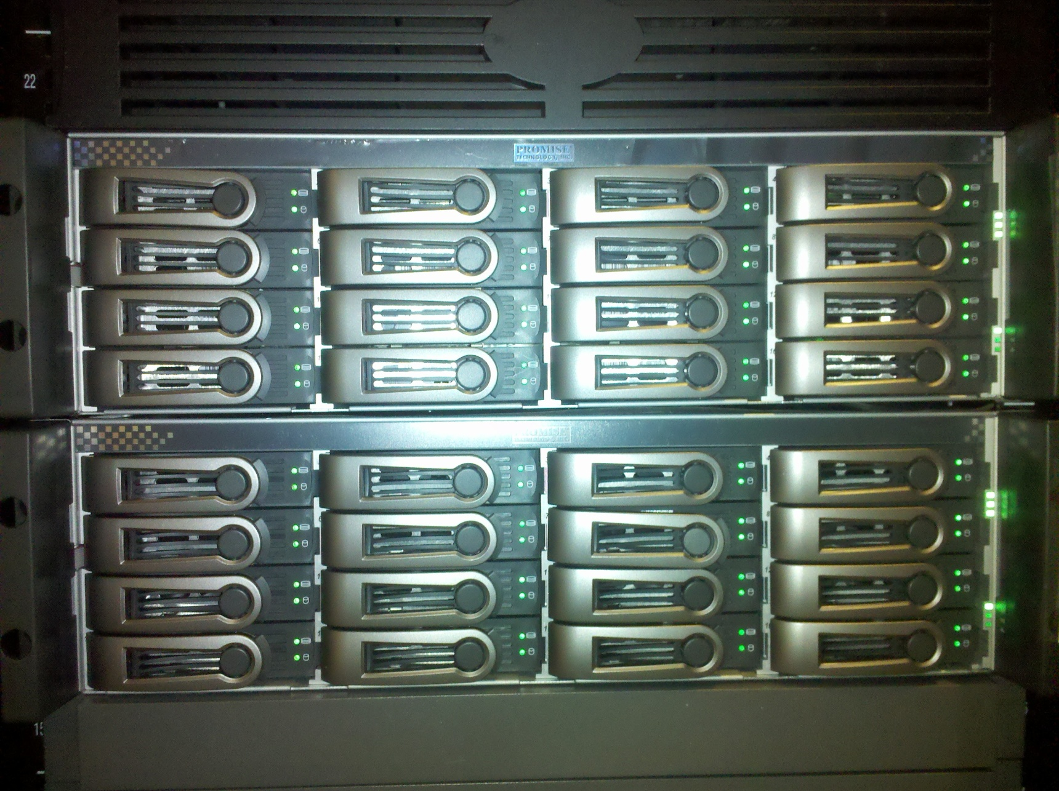
Disk Arrays in Servers

Slide 20
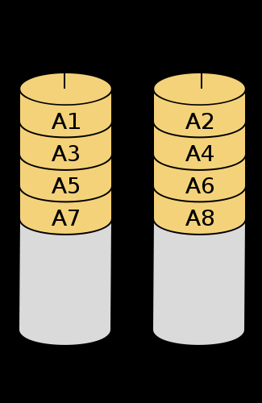
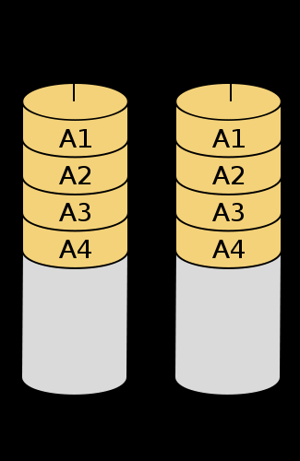
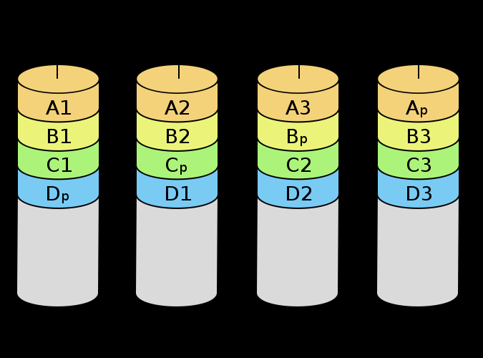
RAID Levels (most common)
Level | Description | Min # Disks | Space Efficiency | Fault Tolerance?
0 | Striping | 2 | N | No
1 | Mirroring | 2 | 1 | Yes
5 | Parity Striping | N | N-1 | Yes
6 | Dual Parity Striping | N | N-2 | Yes
10 | Mirrored Stripe | N (Even) | N/2 | Yes
RAID0
RAID1
RAID5

Slide 21
Calculating RAID capacity and MTBF
Example: One of your servers has a storage array with 8 500GB drives, configured in RAID 5 with one hot spare. According to the manufacturer, the MTBF for the drives are 1.2 Million hours.
What is the total capacity of the array?
What is the MTBF? For this server?
Notes:
MTBF – mean time between failures

Slide 22
Calculating RAID capacity and MTBF
Total Capacity: 8 total drives – 1 hot spare = 7 drives. RAID 5 has a space efficiency of N-1, so 7-1 = 6. There are 6 drives in used in the array’s capacity for a total of 6 * 500GB = 3.0 TB
Mean Time Between Failure (MTBF): 1.2 million / 8 drives = 150,000 hours (17 years)

Slide 23
Managing Storage – Considerations?
Consider storage a Community resource
Charge units for their use
Plan for the future
Monitor growth trends, changes
Be able to chart storage use over time.
Its one thing to know you need more storage, it is an entirely different thing to know why.
Dedicate resources to cleaning up
Help users archive what the no longer need.

Slide 24
Questions?
If it’s true that we are here to help others, then what exactly are the others here for?

