Slide 1
IST346
Data Storage

Slide 2
Data Storage

Slide 3
Why Data Storage?
Information is a the center of all organizations.
Organizations need to store data. Lots of it.
What Kinds of Data?
Documents and Files
(Reports, Proposals, Letters, Presentations, etc.)
Databases
Customer Information, Orders, Inventory
Multimedia
Video, Audio
Email !!!!!

Slide 4
Before We Begin… Bits and Bytes
One Byte is approximately a single character: This is 16 bytes (includes the spaces)
1 KB = 2^10 Bytes, Approx. 1000 Bytes 10-15 sentences of text
1 MB = 2^20 Bytes, Approx. 1 Million Bytes Typical Song in MP3 format is about 3MB
1 GB = 2^30 Bytes, Approx. 1 Billion Bytes Mpeg4 Movie in 1080p is around 2GB
1 TB = 2^40 Bytes, Approx. 1 Trillion Bytes

Slide 5
Some Storage Stats for the iSchool (2009)
Service | Total Allocation | Average*
Email | 405GB | 1.4 GB / User*
Personal Files | 238GB | 1.8 GB / User*
Configuration Data | 12GB | 94 MB / User*
Shared File Space | 202GB | 870 MB / User*
Video | 145GB | 1.1 GB / User*
iLMS (iSchool Blackboard) | 430GB | 323 MB / User +
TOTAL | > 1.4 TB | ~ 1GB / User
This ONLY represents the information the users generate and does not include operating system files, application files, etc.
*Based on 230 users +Based on 1550 users

Slide 6
Another way to look at it.

Slide 7
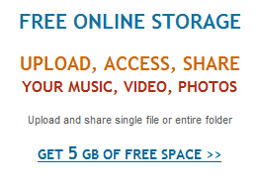
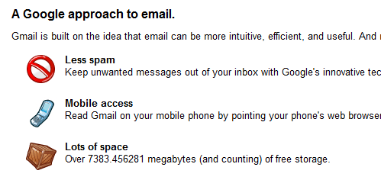
You might be thinking….
1GB per user is NOTHING, considering:

Slide 8
The Fallacy of Enterprise Storage
For every 1GB of user storage (files, email) you need:
An additional 1GB for every full backup you do.
At most another 1GB for fault-tolerance.
1GB per user is now 8GB when part of:
RAID1 (Mirroring) for fault tolerance (1GB)
Weekly full off site backups (4GB)
With two months of backups on the shelf (2GB)

Slide 9
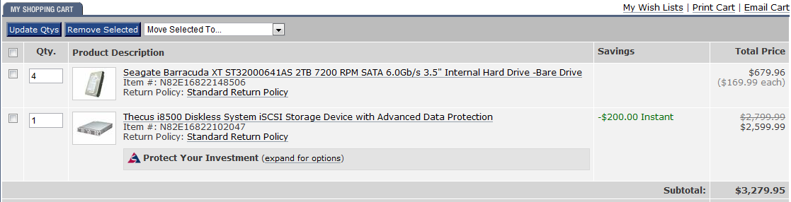
The Fallacy of Enterprise Storage
Disk Drives are Cheap, Storage is not (a simple example)
2TB Drive = $170
8TB Array = $3,280 (actual 6TB usable in RAID5)
19X more expensive, for only 3X the storage!

Slide 10
Physical Disks

Slide 11
Disk Components
Traditional disks are made of a few basic components
Spindle : common mounting platform for all platters.
Platters : disc type material where data is stored
Heads : Actual ‘arm’ that moves in and out of the record to read data.
Track : location on the platter where data is stored. Each track has the same radius from the spindle on a disk
Sector : pie-shaped slice of the platter. Used to sub-divide the platter for quickly locating blocks of data.
Cylinder : same tracks on multiple platters.

Slide 12
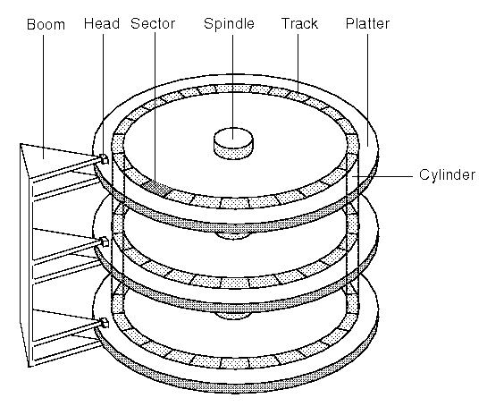
Disk components

Slide 13
A new storage approach: SSD
SSD: Solid State Disk/Drive
Differs from traditional disks as there are no moving parts…no platters, no mechanics, so fewer failures.
Utilize dram or eeprom memory boards to store bits
Some use their own CPUs to manage data storage.
Faster for accessing data than traditional disks since seek time is eliminated
Much more expensive per GB (for now) than traditional spinning electromagnetic disks

Slide 14
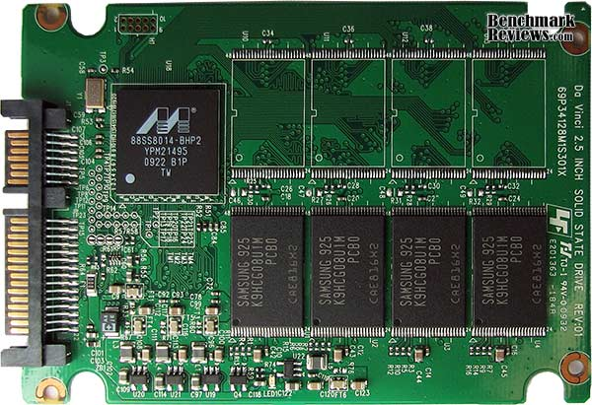
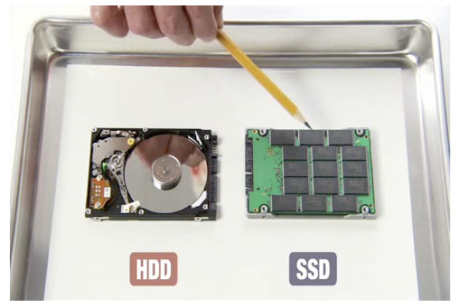
The internals of an SSD

Slide 15
Logical Disks and Storage

Slide 16


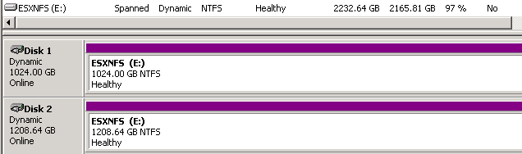
Storage Terminology - Volumes
Volume – the chunk of storage as seen by the server.
A single hard drive (or logical disk) can be one volume.
One hard drive (or LD) can be multiple volumes. We call this partitioning the disk.
Many hard disks can be combined into one logical volume.

Slide 17
Storage Terminology - File Systems
Before a volume can be used it must be formatted with a File System.
A File System is the method for storing and organizing files and data on the volume.
Formatting is the act of setting up an empty file system on a volume.
Some file systems implement journaling, which writes to the volume in batches, improving performance and reducing the chances for errors.
Popular File Systems EXT4, ZFS, NTFS, HFS (Mac), zFAT

Slide 18
Putting it all together Disk to File System.
Disk(s)
RAID
Logical Drive
Part.
Logical Volume
Format
File System

Slide 19
Logical Storage Systems
DAS – Direct Attached Storage
Connects to one host
NAS – Network Attached Storage
Connects to many hosts over common communications network (TCP/IP)
SAN – Storage Area Network
Connects to many hosts over dedicated network for storage.
iSCSI or
Fibre Channel.

Slide 20
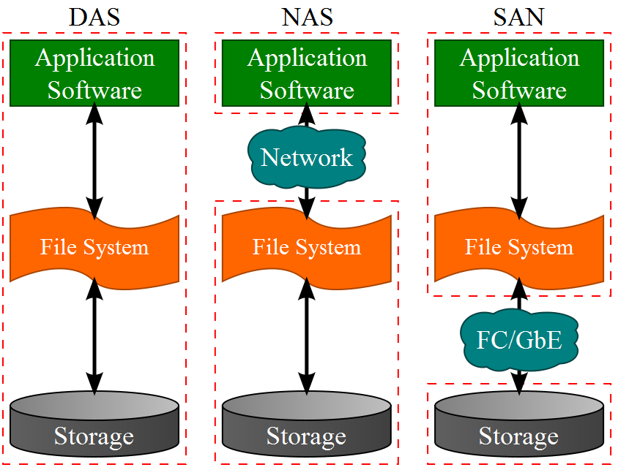
DAS, NAS, and SAN Oh My!
*Taken from Wikipedia Commons

Slide 21
RAID
Redundant Array of Inexpensive Disks
A technique to provide storage that is larger, more reliable and faster than what a single disk drive can provide.
The RAID array of Physical Disks is treated as one logical Disk. (known as a LUN, logical unit number)
Some RAID supports the use of Hot Spares in the event of a drive failure.

Slide 22
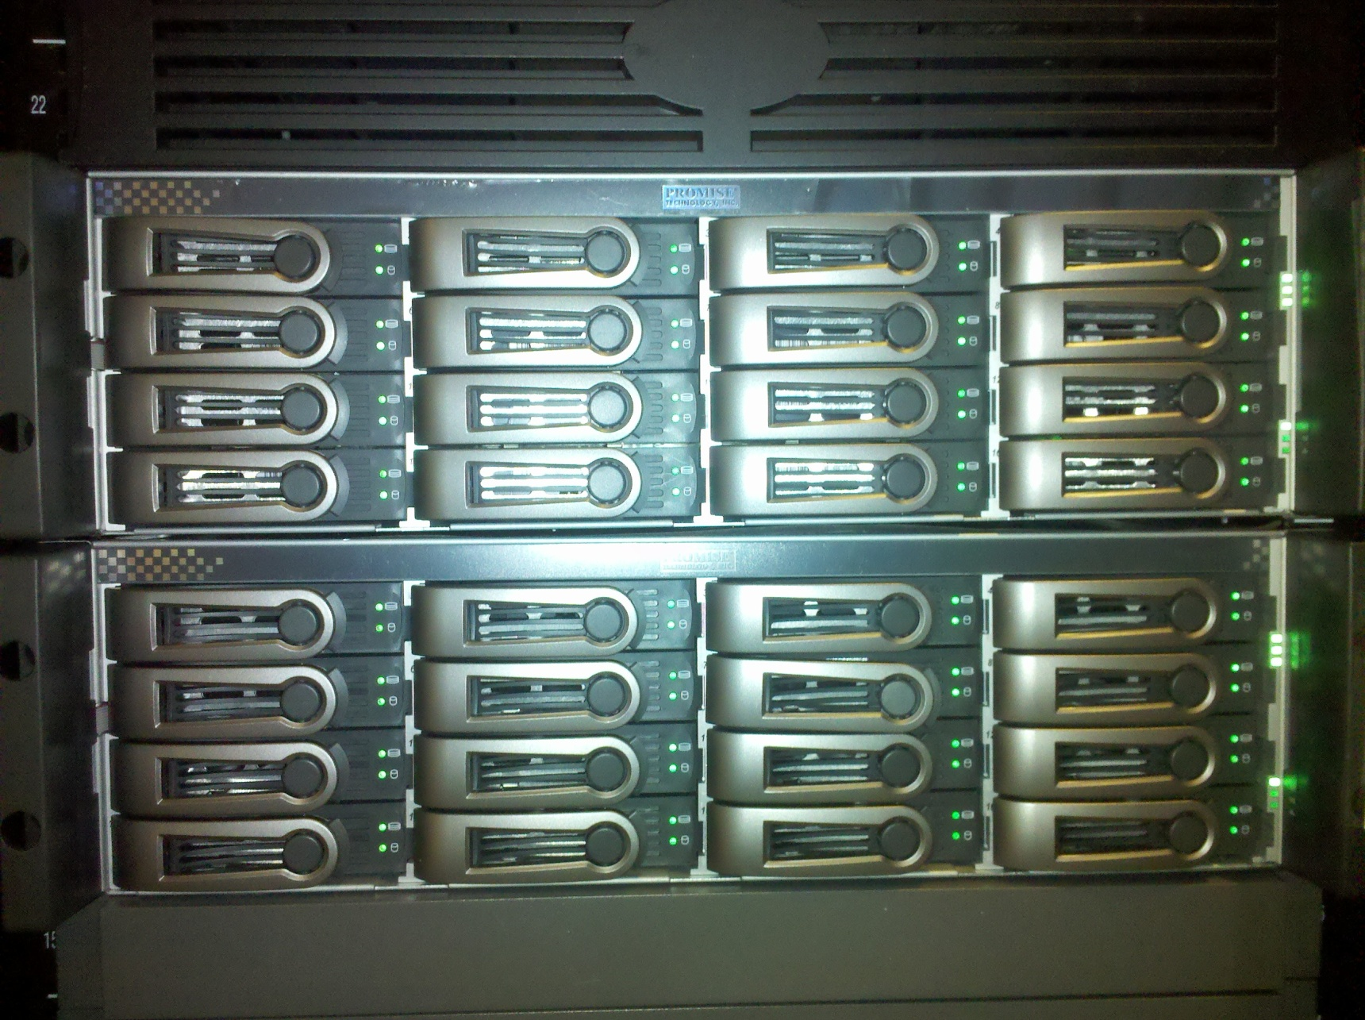
Disk Arrays in Servers

Slide 23
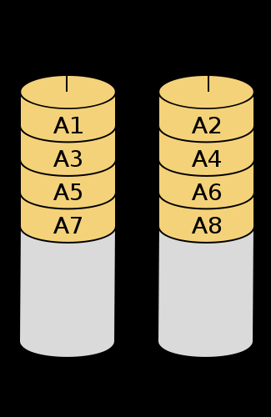
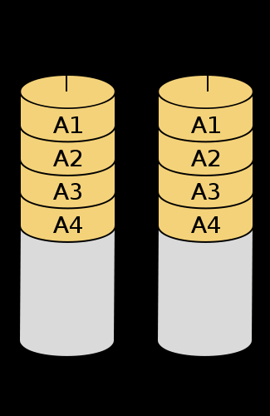
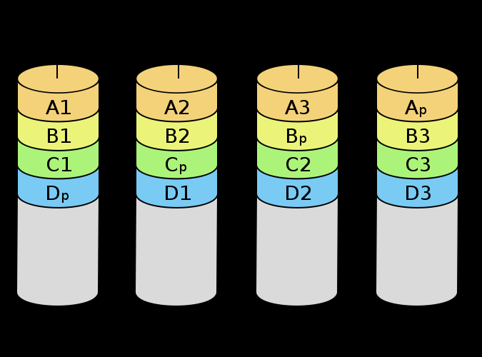
RAID Levels (most common)
Level | Description | Min # Disks | Space Efficiency | Fault Tolerance?
0 | Striping | 2 | N | No
1 | Mirroring | 2 | 1 | Yes
5 | Parity Striping | N | N-1 | Yes
6 | Dual Parity Striping | N | N-2 | Yes
10 | Mirrored Stripe | N (Even) | N/2 | Yes
RAID0
RAID1
RAID5

Slide 24
Calculating RAID capacity and MTBF
Example: One of your servers has a storage array with 8 500GB drives, configured in RAID 5 with one hot spare. According to the manufacturer, the MTBF for the drives are 1.2 Million hours.
What is the total capacity of the array?
What is the MTBF? For this server?
Notes:
MTBF – mean time between failures

Slide 25
Calculating RAID capacity and MTBF
Total Capacity: 8 total drives – 1 hot spare = 7 drives. RAID 5 has a space efficiency of N-1, so 7-1 = 6. There are 6 drives in used in the array’s capacity for a total of 6 * 500GB = 3.0 TB
Mean Time Between Failure (MTBF): 1.2 million / 8 drives = 150,000 hours (17 years)

Slide 26
Managing Storage – Considerations?
Consider storage a Community resource
Charge units for their use
Plan for the future
Monitor growth trends, changes
Be able to chart storage use over time.
Its one thing to know you need more storage, it is an entirely different thing to know why.
Dedicate resources to cleaning up
Help users archive what the no longer need.

Slide 27
NAS File Services
Network attached storage requires a service to share files with clients
SMB – Server Message Block
Windows File Sharing
Samba on Linux
NFS – Network File System
Used by Unix/Linux systems to share files

