Slide 1
IST346
Data and Database Systems

Slide 2
Agenda
Data
Databases
Backup

Slide 3
Data

Slide 4
A Organization’s Most Important Asset… is It’s Data!!!
Data Drives the Business
Identify trends so you can respond
Use knowledge as competitive advantage

Slide 5
Prevalence of Data
Data are everywhere!
There has been an explosion of data over the past few years.
There are new varieties of data.
Business data → Sales and Orders
user generated → Tweets and Posts
device generated → Phones and IoT
And there are different mediums than before.
Structured text → unstructured text → multimedia

Slide 6
Data Explosion: A Sample Growth of Organizational Data Over Time
Business Data
Web/Clickstream
Social Networks
Mobile
Sensor/IoT
Data Volume
1980
1990
1995
2000
2005
2010
2015
2020
Years

Slide 7












What About Devices?
2020 50B
Billions of Devices
2019 42.1B
50
2017 28.4B
2016 22.9B
2018 34.8B
40
2014 14.2B
2015 18.2B
30
2009 IoT Inception
20
2012 8.7B
1992 1M
2003 0.5B
10
2013 11.2B
0
1988
1992
1996
2000
2004
2008
2012
2016
2020
Notes:
The number of devices connected to the internet has already surpassed the global population. This trend will continue until there are an estimated 50 Billion devices… or approximately 6 devices per every single person on the planet!

Slide 8
Data Have Always Held Value
The more data, the greater the chance for value
But the more effort is required to extract that value

Slide 9
Recall: Layers of a Modern Data-Oriented Application
Presentation
Code and layout responsible for the user interface
Business Logic
Data Access
Create, read, update and delete (CRUD) operations
Database
Transformational logic at the heart of what the application actually does
Data storage and retrieval

Slide 10
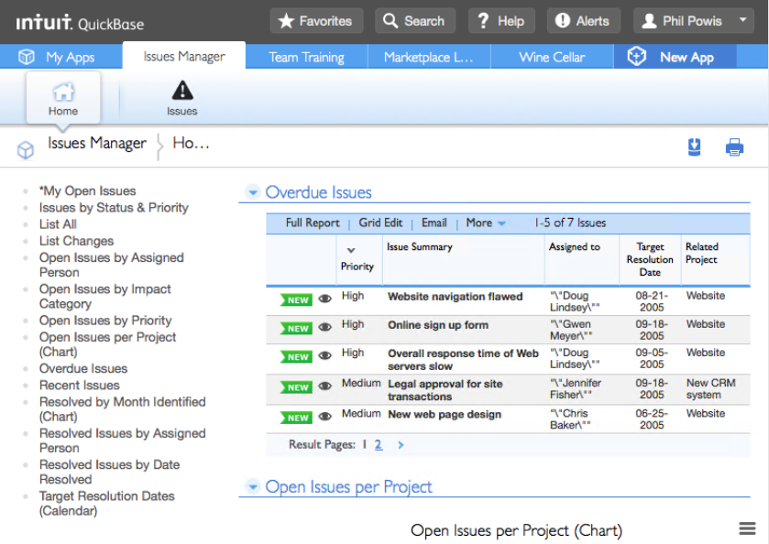
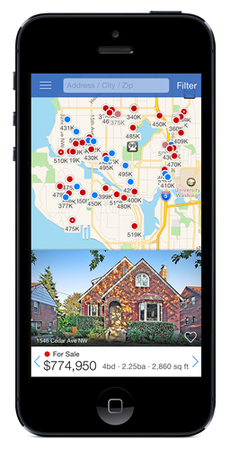
Presentation Layer
User interface concerns
Web: HTML and CSS
Mobile: Xcode interface builder/ Android studio
Notes:
Any code responsible for user interface concerns is considered the presentation layer. In web applications the presentation layer is HTML and CSS. In mobile you build the layout using tools like Xcode or Android studio.

Slide 11
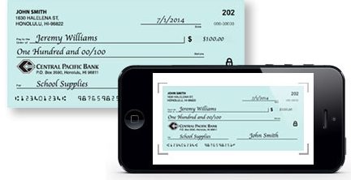
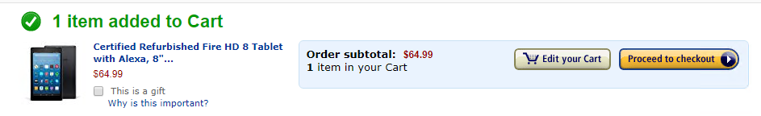
Business Logic Layer
Main transformational logic of the application; part of the application’s functionality
Written in a programming language: Java, JavaScript, Python, C#, and so on

Slide 12
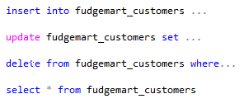
Data Access Layer
Responsible for CRUD operations
Typically, this is code that transforms operations into the DSL (domain-specific language) to communicate with the database (typically SQL)

Slide 13
Database
A generic term for the storage, management and retrieval of data
Many Types Exist
Serve Several Purposes

Slide 14
Types of Databases

Slide 15
Relational Databases
Based on Relational theory, data are stored as rows in tables.
Very proven database model with wide adoption in industry
Uses custom query language SQL
Does not scale easily horizontally
Use cases
You need data consistency
Ad-Hoc Reporting and Querying
Products
Oracle, Postgres, SQL Server, MySQL

Slide 16
Key-Value Stores
Basically a persistent hash map
Simple
Fast reads and writes
No secondary indexes
Scales Horizontally
Use cases
Data model is simple
All you need is CRUD (Create/Read/Update/Delete)
Caching frameworks
Challenges
Difficult to perform complex queries
Products
DynamoDB, Riak, Redis

Slide 17
Columnar Stores
Data in tables are stored by column instead of by row
Storage not wasted on null values
Fast operations on columns such as aggregation of data
Scales horizontally
Use cases
Data analytics, big data sets
Timeseries data
Challenges
Key design is not trivial
Need to split data according to how it will be queried
Products
HBase, Cassandra, MemSQL

Slide 18
Document Stores
Nested structures of hashes and their corresponding values
Very flexible schema
No need to normalize
Use cases
Applications where the schema is likely to change
When you don’t need the flexible query of relational, but need better performance
Challenges
Complex queries with joins are slow
Documents which reference themselves and other circular dependencies
Products
MongoDB, CouchDB, RavenDB

Slide 19
Graph Data Stores
Nodes and edges
Good fit for highly interconnected data
Allows for explicit relationships among data items
Based on Graph theory
Use cases
When your data look like a graph or hierarchy
Challenges
Does not scale well horizontally
Very specific use cases—know when to use it!
Products
Neo4j, SQL Server Graph Tables

Slide 20

When You Treat Every Data Problem Like a Nail, The Same Database System Becomes a Hammer

Slide 21
One Size Does Not Fit All
There is no one database management system that can handle the complexity and variety of data found today.
This is why different systems exist to manage different types of data that vary in:
Structure
Size
Rate of change
We’ve learned the hard way that not all data problems are nails, and there is more than just the hammer.

Slide 22
So How Do You Choose?
What type of data model is it? Graph? Timeseries? Real-time? Historical?
Do you need a schema (structure)? Does it require schema on write or on read?
Would you benefit from integrity constraints, or do you need to guarantee writes?
Do you have cross-cutting query concerns?
Do you need to scale out?

Slide 23
Don’t Settle for One— Polyglot Persistence!
Today’s enterprises have many databases:
Product catalog and blog in MongoDB
Redis for your shopping cart and web page cache
Cassandra for audit and activity logs
MySQL for order processing and payments
Hadoop for data analytics
Neo4j for your social graph
Hammer. Nail. Screwdriver. Screw. Use the right tool for the job!

Slide 24
Polyglot Persistence
Pros
Cons
There is better performance and scalability.
It is cloud friendly in today’s world of microservices.
Using the best tool for the job! Stop forcing that square peg into that round hole!
No interoperability: You must connect the databases together.
You must decide where data should be stored.
There is increased complexity and administrative burden.
Notes:
In the This is the future. In

Slide 25
Databases and Scalability

Slide 26



DBMS Scaling: Up vs. Out
Vertical “Scale Up”
Horizontal “Scale Out”
Add more resources to an existing system running the service
Easier, but limited scale
Single point of failure
Run the service over multiple systems, and orchestrate communication between them
Harder, but massive scale
Overhead to manage nodes

Slide 27

It’s very hard to scale out a relational database. But why?
Notes:
Week1 – slide 20 - Formatted with blank layout and the layout as per original. Font size taken as 42pts.

Slide 28
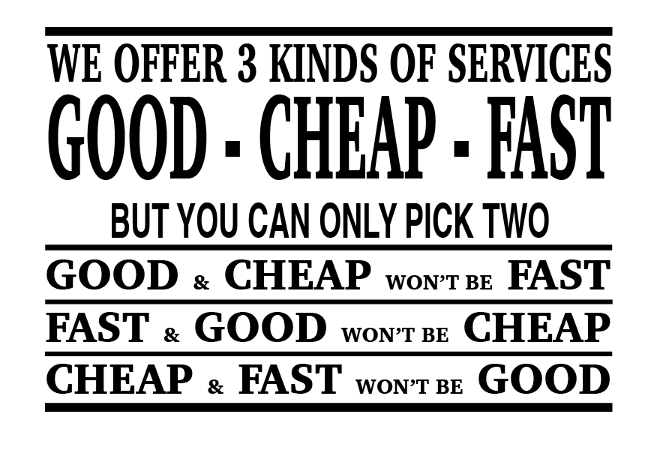

Slide 29
CAP Theorem of Distributed Data Stores
Eric Brewer: You can only have two of the following three guarantees:
Data consistency: all nodes see the same data at the same time
Data availability: assurances that every request can be processed
Partition tolerance: network failures are tolerated, the system continues to operate
Relational systems are designed to be consistent and available and therefore cannot be partition tolerant.
If I deposit money in an ATM that is disconnected from the network, how can my bank know about that deposit?

Slide 30
Why Can’t You Have It All?
Node 1
Node 2
Suppose we lose partition tolerance between nodes.
We must ignore any updates the nodes receive, or sacrifice consistency, or we must deny service until it becomes available again.
If we guarantee availability of requests, despite the failure:
We gain partition tolerance (the system still works), but lose consistency (nodes will get out of sync).
If we guarantee consistency of data, despite the failure:
We gain partition tolerance (again, system works) but lose availability (data on nodes cannot be changed, failure is resolved).
Notes:
http://www.infoq.com/articles/cap-twelve-years-later-how-the-rules-have-changed

Slide 31
Database Systems and CAP
Consistency
Partition
tolerance
Availability
Relational
Single-master
CA
CP
X
AP
Eventual consistency

Slide 32
CAP: All Kinds of Database Systems
RDBMSs like Oracle, MySQL, and SQL Server:
Focus on consistency and availability (ACID principles), sacrificing partition tolerance (and thus they don’t scale well horizontally)
Use cases: business data, when you don’t need to scale out
Single-master systems like MongoDB, HBase, Redis, and HDFS:
Provide consistency at scale, but data availability runs through a single node
Use cases: read-heavy; caching, document storage, product catalogs
Eventual Consistency systems like CouchDB, Cassandra, Redis and Dynamo:
Provide availability at scale but do not guarantee consistency
Use cases: write heavy, isolated activities: shopping carts, orders, social media

Slide 33
ACID vs. BASE
ACID
BASE
Atomic: Everything in a transaction succeeds, or the entire transaction is rolled back.
Consistent: A transaction cannot leave the database in an inconsistent state.
Isolated: Transactions cannot interfere with each other.
Durable: Completed transactions persist, even when servers restart and so on.
Basic availability: Data can be read and written to any node.
Soft-state: Nodes may change over time, even without direct updates.
Eventual consistency: At some point all nodes will have the same data.

Slide 34
Backups and Data Integrity

Slide 35
3-2-1 Data Strategy
3 Copies of your data
2 Copies are backups (one is “live”)
1 Backup Copy is Off-Site

Slide 36
Why Backups?
Data gets lost
People delete data by mistake (or on purpose)
Archival Purposes
Legal Issues / Subpoenas
Data gets corrupted
Systems crash / Disks fail
Notebooks get lost / stolen
You need your backups to be reliable.

Slide 37
Multiple Ways to Backup
Image Backups
“Classic” Tape Backups
Disk-to-disk-to-tape backups (D2D2T)
Disk-to-disk-to-disk backups (disks are cheap)
Offsite Backup services (backup over the internet)

Slide 38
Why restores?
Most Common: Accidental File Deletion / corrupt data
So common that snapshot technology is used.
Mac time machine / Windows File History / system restore
Pull from Archives
Historical snapshots of data.
Need recovery of user’s files or email after they’ve left the org.
Least Common: Storage Failure
Fault-Tolerant system (RAID) failure
Loss of data and loss of service, too

Slide 39
Data Integrity
Data Integrity – ensuring your data is accurate.
How does it become corrupted?
Viruses / Malware
Buggy Software
Hardware failures
User Error
How to you ensure data integrity?
Hashing – compare file to its checksum MD5/SHA256
Keep anti-malware software current
Backing up inaccurate data is useless!

Slide 40
Types of Backups
A full backup (level 0) is a complete copy of a partition.
A differential backup (level 1) is an archive of only the files that have changed since the last full backup.
An incremental backup (level 2, 3, etc) is an archive of only the file that have changed since the last backup (not necessarily full backup.
Backup | Sun (F) | Mon | Tue | Wed | Thu | Fri | Sat
Full | 2TB | 2TB | 2TB | 2TB | 2TB | 2TB | 2TB
Diff. | 2TB | 1GB | 1.2GB | 1.6GB | 1.9GB | 2.3GB | 2.8GB
Incr. | 2TB | 1GB | 0.2GB | 0.4GB | 0.3GB | 0.4GB | 0.5GB

Slide 41
Differential or Incremental?
Differential backup Advantages: quicker recovery time, requiring only a full backup and the latest differential backup to restore the system. Disadvantage: for each day elapsed since the last full backup, more data needs to be backed up, especially if a majority of the data has been changed.
Incremental backup Advantages: quicker backup times, as only changed files need to be saved. Disadvantage: longer recovery times, as the latest full backup, and all incremental backups up to the date of data loss need to be restored.

Slide 42
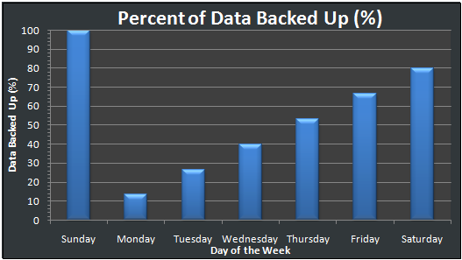
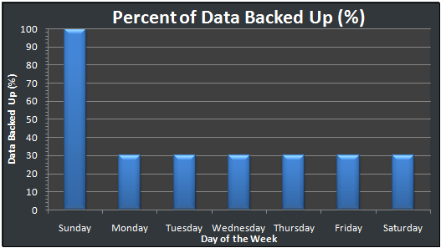
Differential vs. Incremental
Differential
Incremental

Slide 43
Testing Backups
Periodically test your backups by performing restores.
Why? The only way you know your backups are working is to restore data from them and test.
Backups are no good if you can’t restore from them.
Backups are one of the most understated processes in IT management but one of the more important.

Slide 44
Backup Strategy
You can’t backup everything all the time and keep it around forever.
It’s just not realistic.
You need a combination of short-term and long-term backups.
What if you need files from 12 months ago?
You should draft a backup and restore SLA
Through the SLA, customers know what to expect
Plan your backups around the SLA
Mitigate risk
Don’t store your backups next to your servers!
The restore requirements govern your backup strategy.

Slide 45
Backup Strategy #1
Backup
Sunday L0
Monday – Saturday L1 (Diff)
Each week, an L0 is saved for a year.
Week 52 is saved as year-end backup (not reused)
Can this strategy Restore
A file from 4 days ago?
A file from 5 weeks ago?
A file from Last July, that was deleted in August?

Slide 46
Backup Strategy #2
Backup
Full 1st Day of each month
Differential each remaining day of the month.
Media on 1st day of the month not reused.
Can this strategy Restore
A file from 25 days ago?
A file from 60 days ago?
A file from 1 year ago that was around for 2 months.

