Slide 1
Processing & Filtering (Iso-Seq3)
WT
TG
S1
S2
S3
S4
S5
S6
S7
S8
S9
S10
S11
S12
CCS Reads
FLNC Reads
Poly-A FLNC Reads
FL Transcripts
Alignment
Merge into 1 set and proceed
Mapped Transcripts
Minimap2
Collapse & Quantification
Unique Transcripts (Isoform)
Cupcake
Demultiplex
RNA-Seq Support
FANTOM CAGE peaks
polyA motifs
Annotation
Annotated Transcriptome
SQANTI2
TAMA

Slide 2
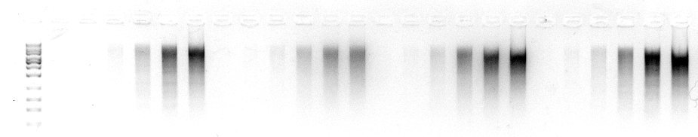
K17
S18
O23
L22
L
10 12 14 16 18 20
10 12 14 16 18 20
10 12 14 16 18 20
10 12 14 16 18 20

Slide 3
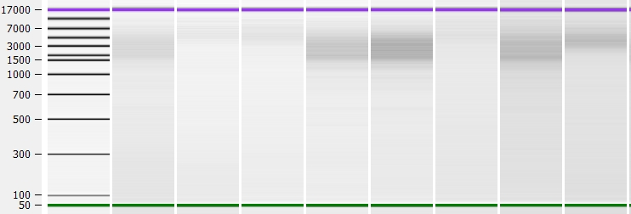
a
K17
O23
S18
L22
F1 F2
F1 F2
F1 F2
L
F2 F1
b
c
K17 F1
K17 F2
d
e
Final K17
Final K23

Slide 4
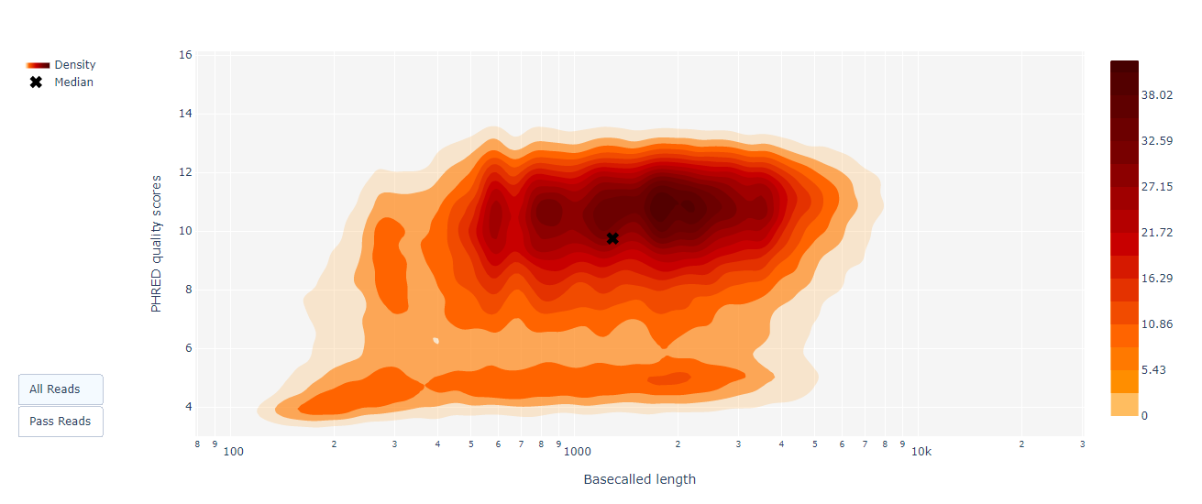
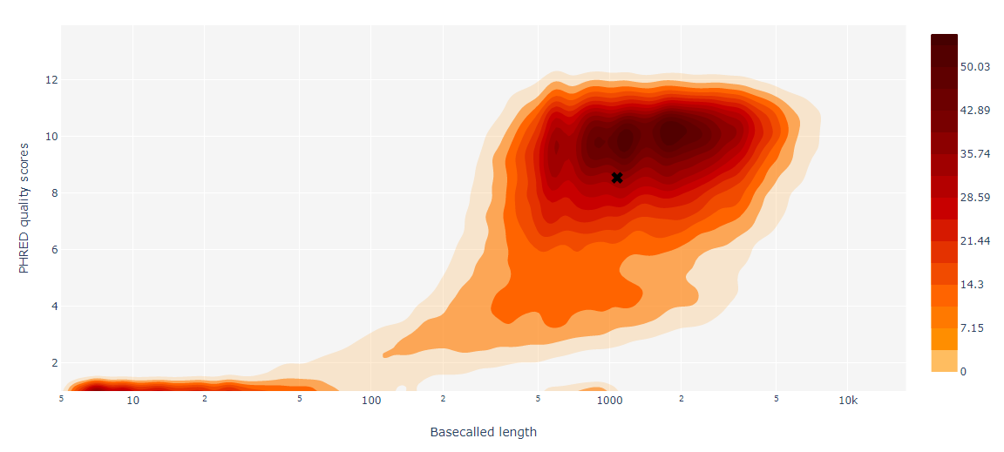
a
b

Slide 5
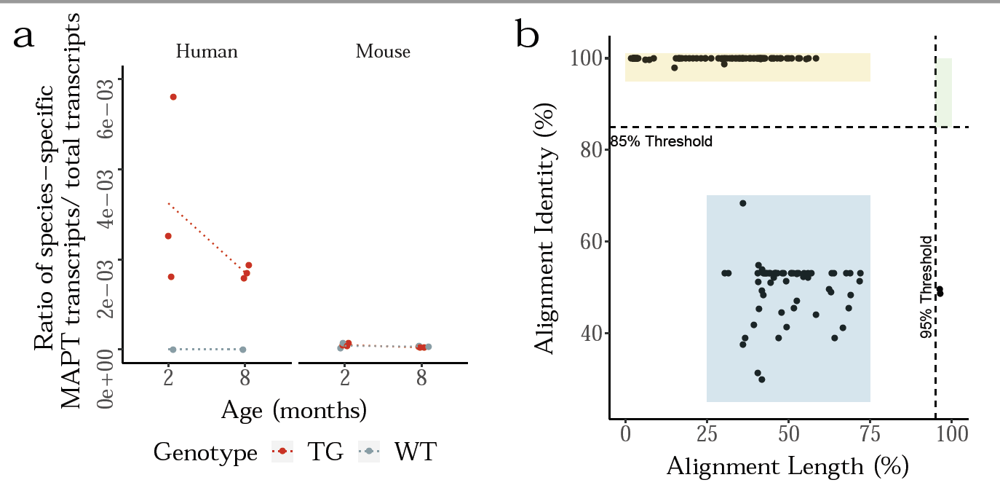
c
d

