Slide 1
RNA Sample 1
1. Reverse Transcription & Amplification
1st Stranded Synthesis
PCR Optimisation
Large Scale PCR
2. cDNA purification and enrichment
1x Ampure PB
Bead Purification
0.4x Ampure PB Bead Purification
3. Library Preparation
Pooling 1.0x and 0.4x Fractions
Equimolar Pooling of Samples
SMRTbell Template Preparation
Anneal & Bind SMRTbell Templates
Sequence

Slide 2
RNA Sample 1
RNA Sample n
1. Reverse Transcription & Amplification
1st Stranded Synthesis (Barcode 1)
1st Stranded Synthesis (Barcode n)
PCR Optimisation
PCR Optimisation
Large Scale PCR
Large Scale PCR
2. cDNA purification and enrichment
1x Ampure PB
Bead Purification
0.4x Ampure PB Bead Purification
1x Ampure PB
Bead Purification
0.4x Ampure PB Bead Purification
3. Library Preparation
Pooling 1.0x and 0.4x Fractions
Pooling 1.0x and 0.4x Fractions
cDNA Capture
Equimolar Pooling of Samples
SMRTbell Template Preparation
Anneal & Bind SMRTbell Templates
Sequence

Slide 3
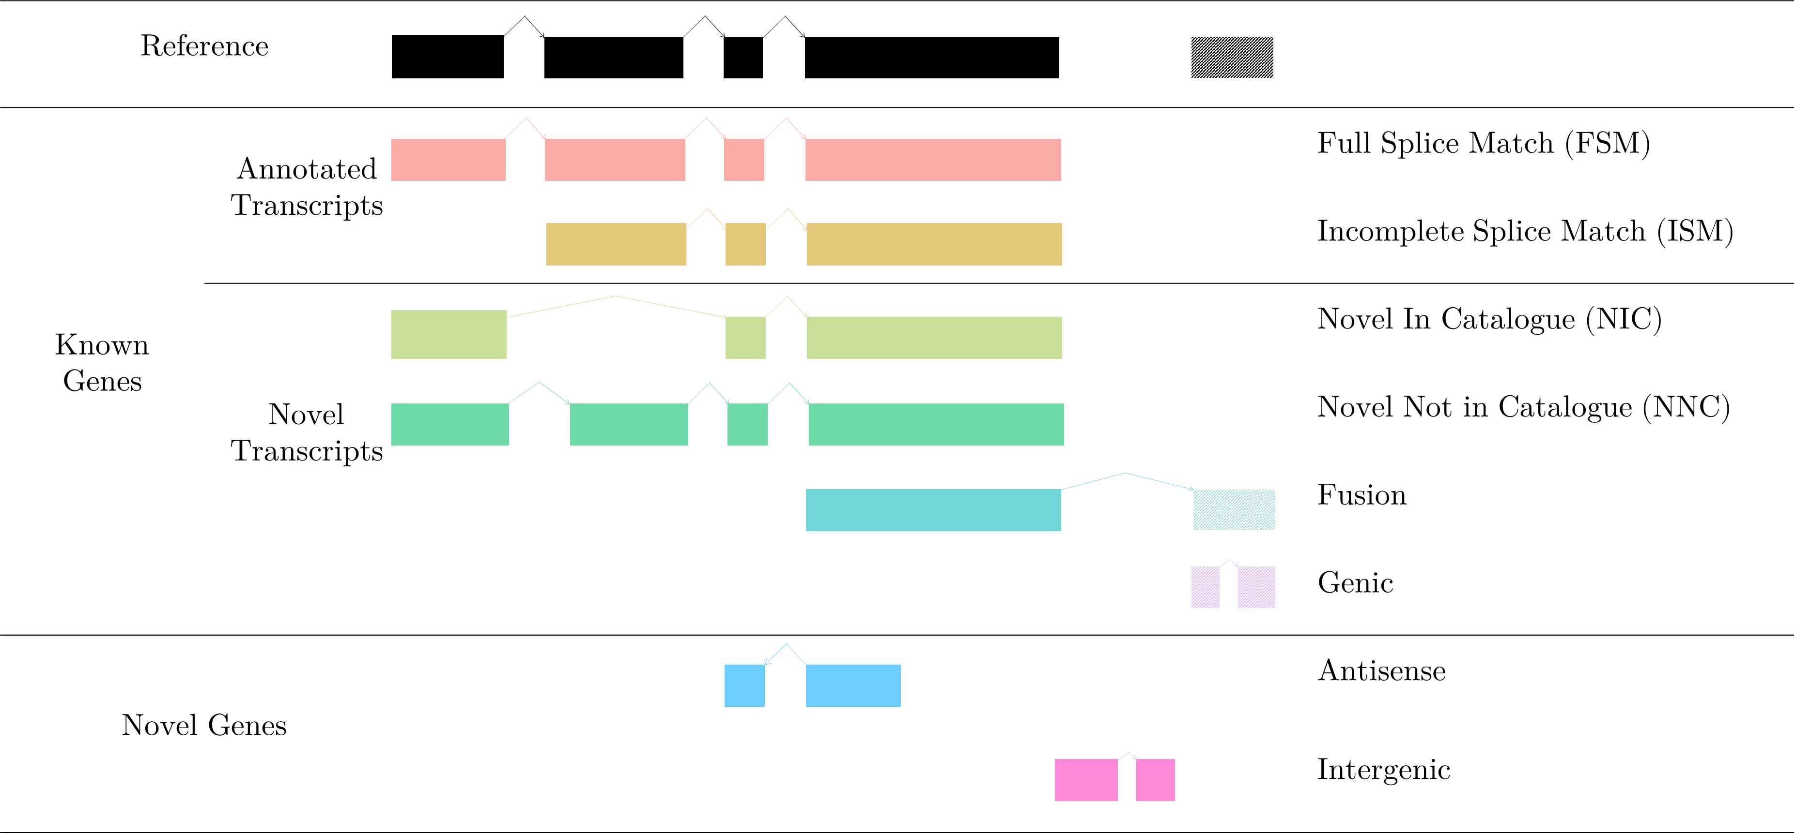

Slide 4
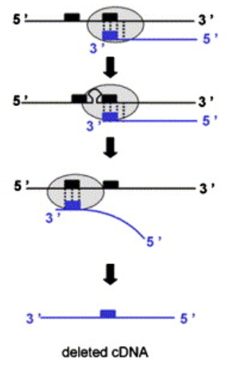
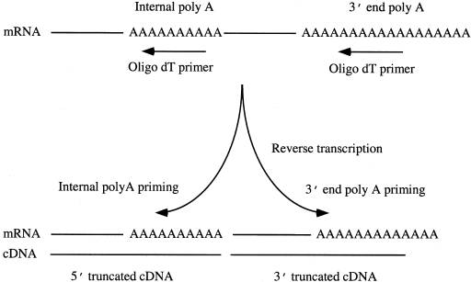
a
b

Slide 5
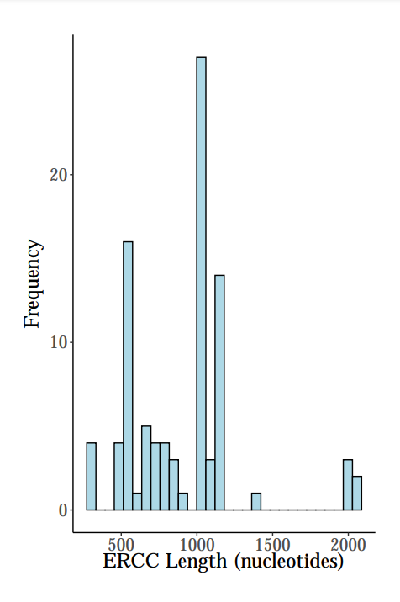
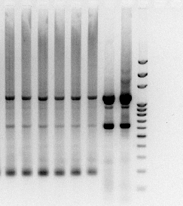
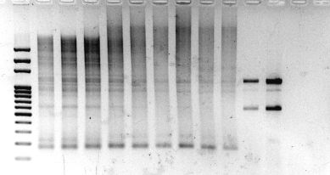
a
b
cDNA + ERCC ERCC
13 14 15 16 17 18 13 16 L
3000
2000
1500
1000
700
600
500
400
300
200
100
c
cDNA + ERCC
ERCC -ve
L 10 11 12 13 14 15 16 17 18 16 18 16 18
3000
2000
1500
1000
700
600
500
400
300
200
100

Slide 6
5’
polyA 3’
T(30)CATGAGACGCAACTATCGGTGACGAA
16bp Barcode
5’
polyA 3’
AAGCAGTGGTATCAACGCAGACGTACXX
XX
T(30)CATGAGACGCAACTATGGTGACGAA
5’
polyA 3’
AAGCAGTGGTATCAACGCAGAGTACXX
TTCGTCACCATAGTTGCGTCTCATGXX
T(30)CATGAGACGCAACTATGGTGACGAA
AAGCAGTGGTATCAACGCAGAGTACXX
A(30)GTACTCTGCGTTGATACCACTGCTT
TTCGTCACCATAGTTGCGTCTCATGXX
T(30)CATGAGACGCAACTATGGTGACGAA
5’AAGCAGTGGTATCAACGCAGAGTACXX
A(30)GTACTCTGCGTTGATACCACTGCTT3’
3’ TTCGTCACCATAGTTGCGTCTCATGXX
T(30)CATGAGACGCAACTATGGTGACGAA5’

Slide 7
a)
Plus strand
ONT
5’ AAGCAGTGGTATCAACGCAGAGTACATGGG
Minus strand
3’ TTCGTCACCATAGTTGCGTCTCATGTACCC
A(30)GTACTCTGCGTTGATACCACTGCTT 3’
ONT
T(30)CATGAGACGCAACTATGGTGACGAA5’
16bp Barcode
b) Without Multiplexing
Strand | Sequence
Plus strand start | AATGTACTTCGTTCAGTTACGTATTGCTAAGCAGTGGTATCAACGCAGAGTACATGGG
Plus strand end | AAAAAAAAGTACTCTGCGTTGATACCACTGCTT
Minus strand start | AATGTACTTCGTTCAGTTACGTATTGCTAAGCAGTGGTATCAACGCAGAGTACTTTTTTTT
Minus strand end | CCCATGTACTCTGCGTTGATACCACTGCTT
c) With Multiplexing
Strand | Sequence
Plus strand start | AATGTACTTCGTTCAGTTACGTATTGCTAAGCAGTGGTATCAACGCAGAGTACATGGG
Plus strand end | AAAAAAAA<Barcode>GTACTCTGCGTTGATACCACTGCTT
Minus strand start | AATGTACTTCGTTCAGTTACGTATTGCT<Barcode>AAGCAGTGGTATCAACGCAGAGTACTTTTTTTT
Minus strand end | CCCATGTACTCTGCGTTGATACCACTGCTT

Slide 8
Isoform | Associated Gene | Structural Category | Associated Transcript | Length | FL Sample 1 | FL Sample 2
PB.1.1 | Gene 1 | FSM | ENMUST1 | 3000 | 10 | 10
PB.1.2 | Gene 1 | ISM | ENMUST1 | 1500 | 100 | 90
PB.1.3 | Gene 1 | ISM | ENMUST2 | 2400 | 20 | 20
PB.1.4 | Gene 1 | ISM | ENMUST3 | 2900 | 5 | 4
PB.1.5 | Gene 1 | ISM | ENMUST3 | 2190 | 5 | 2
PB.1.6 | Gene 1 | FSM | ENMUST4 | 2420 | 1000 | 1250
PB.1.7 | Gene 1 | FSM | ENMUST4 | 2560 | 1 | 4
Isoform | Associated Gene | Structural Category | Associated Transcript | Length | FL Sample 1 | FL Sample 2
PB.1.1 | Gene 1 | FSM | ENMUST1 | 3000 | 110 | 100
PB.1.3 | Gene 1 | ISM | ENMUST2 | 2400 | 20 | 20
PB.1.4 | Gene 1 | ISM | ENMUST3 | 2900 | 10 | 6
PB.1.7 | Gene 1 | FSM | ENMUST4 | 2560 | 1001 | 1254

