Slide 1
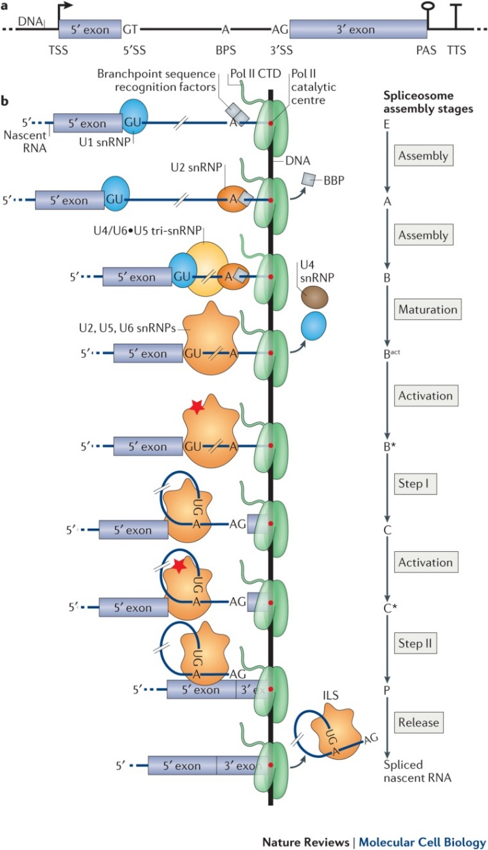

Slide 2
Whole Transcriptome
Targeted Transcriptome
Tg4510
(AD mouse model – tauopathy)
WT
2months
4months
6months
8months
2months
4months
6months
8months
TG
N = 12 (3 replicates)
N = 24 (3 replicates)

