Slide 1

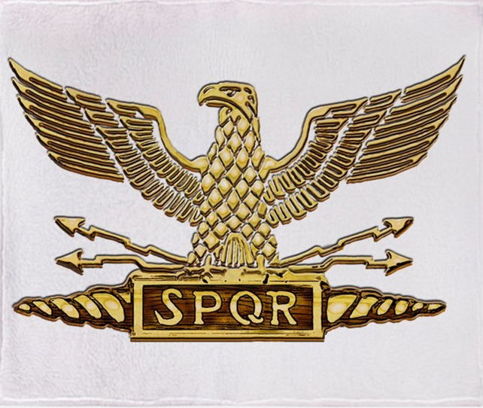
~Republic of Rome~
Honors & Awards
Created by: DragonDisciple

Slide 2
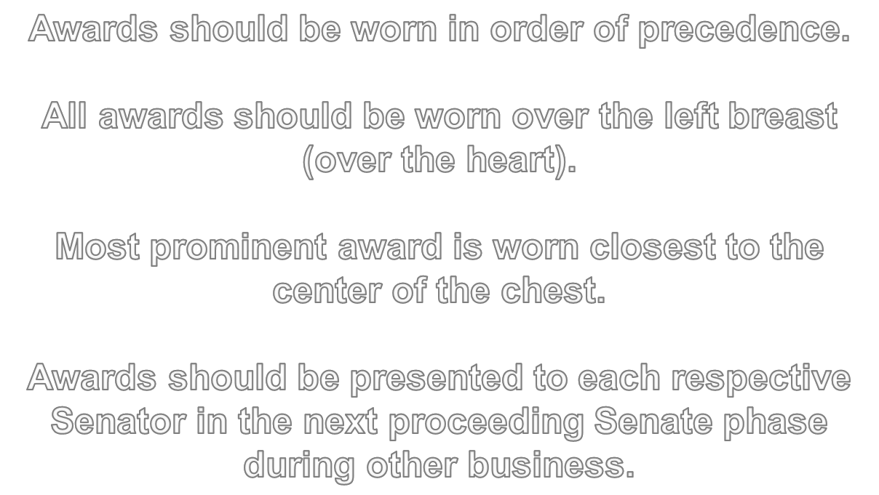
The following awards are shown in order of precedence

Slide 3




Bravery Awards
Awarded to a Consul Commander that wins a war with four or more Disaster/Standoff Numbers
Awarded to any Commander that fights a war with a base number of 5 or less

Slide 4




Courage Awards
Awarded to any Commander that wins a battle against a war with an enemy strength of 20 or greater
Awarded to any Commander that wins a battle against a war with an enemy strength of 15 or greater but less than 20

Slide 5




Conspicuous Service Awards
Awarded to a Consul Commander that wins a war without taking any losses
Awarded to any single Consul Commander that fights in 5 or more wars

Slide 6




Awards for Gallantry
Awarded to a Consul Commander that wins a war that previously ended in Disaster, Standoff, Stalemate or Defeat
Awarded to any single Consul Commander that wins a war that liberates a captured Roman province

Slide 7


Awards of the Admiralty
Awarded to a Consul Commander that wins a naval battle

Slide 8




Awards of Sacrifice
Awarded to any Commander that is captured in battle
Awarded to any commander that accumulates a total of 8 or more death chit draws over any number of wars

Slide 9




Campaign Awards
Awarded to a Consul Commander that fights in the Punic Wars
Awarded to a Consul Commander that fights in the Illyrian Wars

Slide 10




Campaign Awards
Awarded to a Consul Commander that fights in the Gallic Wars
Awarded to a Consul Commander that fights in the Macedonian Wars

Slide 11




Campaign Awards
Awarded to a Consul Commander that fights in the Syrian Wars
Awarded to a Consul Commander that fights in the Jugurthine Wars

Slide 12




Campaign Awards
Awarded to a Consul Commander that fights in the Lusitanian Wars
Awarded to a Consul Commander that fights in the Numantine Wars

Slide 13




Campaign Awards
Awarded to a Consul Commander that fights in the Mithridatic Wars
Awarded to a Consul Commander that fights in the Parthian Wars

Slide 14




Campaign Awards
Awarded to a Consul Commander that fights in the Alexandrine Wars
Awarded to a Consul Commander that fights in the Invasion of Germania

Slide 15




Campaign Awards
Awarded to a Consul Commander that fights in the Invasion of Britannia
Awarded to a Consul Commander that fights in the Invasion of Partha

Slide 16




Campaign Awards
Awarded to a Consul Commander that fights in the Cantabrian Wars
Awarded to a Consul Commander that fights in the Dalmation Wars

Slide 17









Roman Order Awards
Awarded to a Consul Commander that fights in notable revolts and boarder security operations
Added to the Defense Medal for the particular operation

Slide 18


Roman Order Awards
Awarded to a Consul Commander that fights in any revolt (1.07.333). Revolts are not eligible for campaign medals.

Slide 19










Supplementary Awards
Added to an applicable medal (1-19) where the award recipient already has a medal of the same type
Added to a campaign medal (once only) when one or more wars are fought in an active matching set
Added to a campaign medal when the respective enemy leader is fought with the war

Slide 20
Example Award Set

Slide 21


