Slide 1
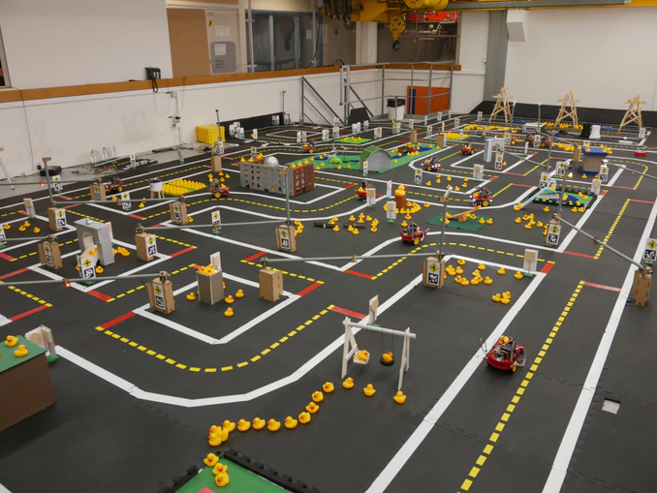
Summary about Duckietown
Szilárd Kósa
szilard.kosa97@gmail.com

Slide 2
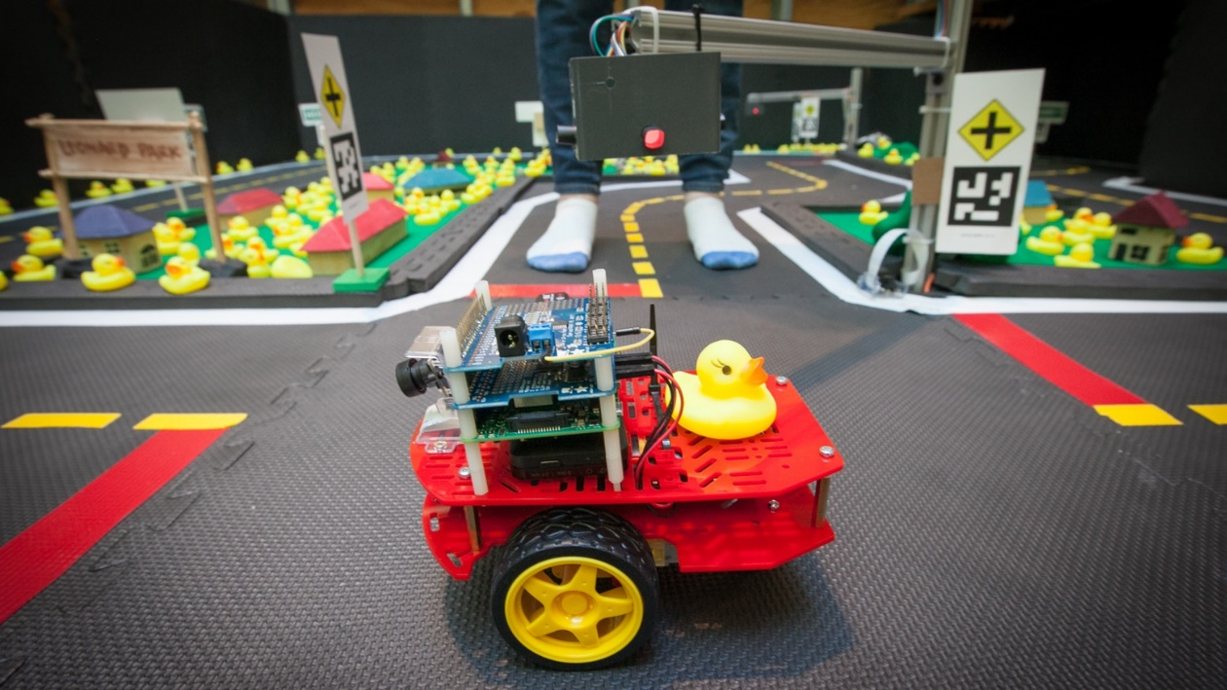
How did it start?
2016: It started as a graduate class at MIT. A group of over 15 Postdocs and 5 professors were involved in the initial development.
2017: The platform reached several universities around the globe, including NCTU in Taiwan, Tsinghua in China, ETH Zürich, Université de Montréal, and TTI Chicago.
2018: A kickstarter campaign was launched to make it easier for people to acquire the hardware.

Slide 3
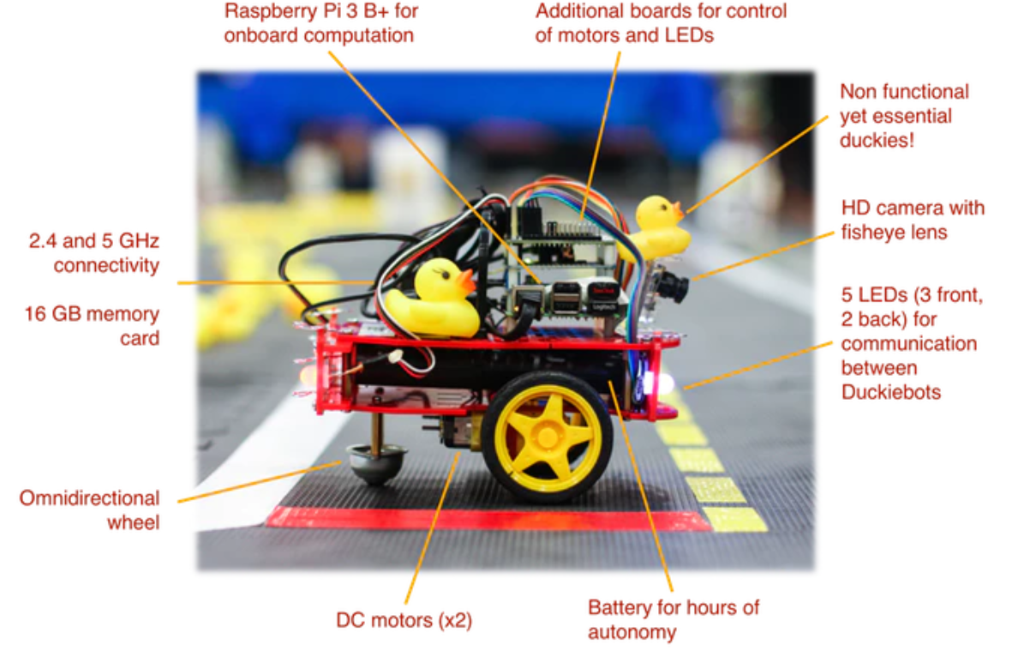
Duckiebot

Slide 4
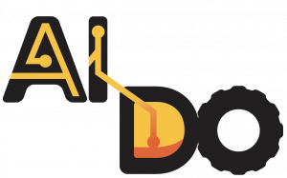
Competitions
2018 dec: first AI Driving Olympics (AI-DO) at the Neural Information Processing Systems conference (NIPS) in Montreal
2019 may: AI-DO II at the International Conference on Robotics and Automation (ICRA)
2019 fall: AI-DO III (in a conference to be confirmed)

Slide 5
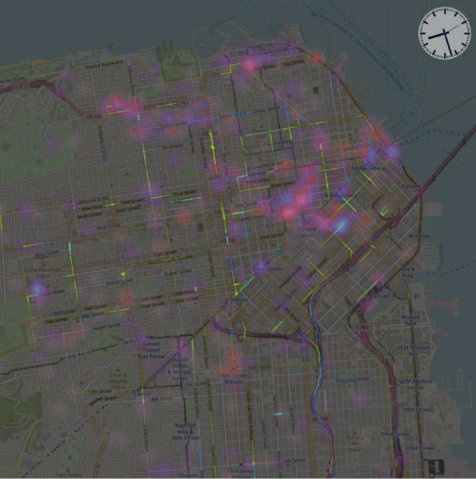
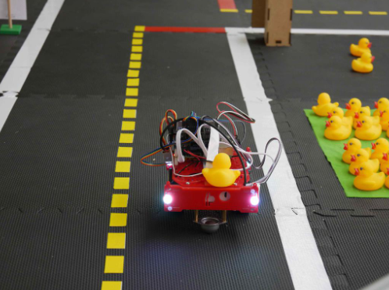
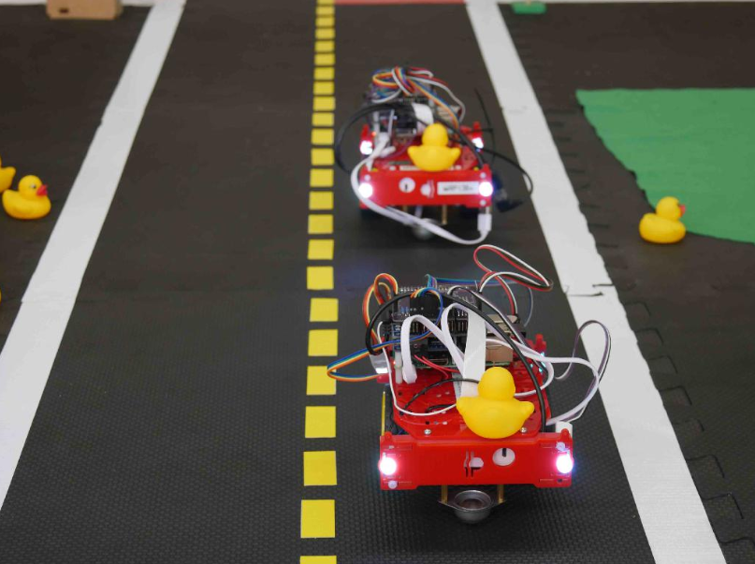
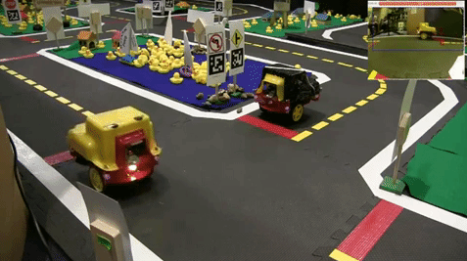
Challenges
Autonomous Mobility on Demand- Fleet management
Embodied Autonomous Mobility on Demand
Navigation with intersections, traffic lights, etc.
Lane following
Lane following + others
To debut at AI-DO 2

Slide 6
How can one participate?
Accounts needed:
Docker Hub account
Duckietown account
Supported platforms: Ubuntu 16, Ubuntu 18, Mac OS X
Docker
Git
Duckietown Shell
https://docs.duckietown.org/DT18/AIDO/out/index.html

Slide 7
Embodied Challenges Solution Baselines
Classical Duckietown Baseline (ROS)
Reinforcement Learning Baseline (PyTorch)
Imitation Learning from Simulation Baseline (tensorflow)
Imitation Learning from Logs Baseline (tensorflow)

Slide 8
AI-DO II
Feb 15, 2019 Local evaluations and training in simulator:Get started right away and evaluate your algorithms locally
Apr 1, 2019 Submissions open: Submit your algorithms to our challenges server and see how you place in the standings.
Apr 15, 2019 Challenge evaluation criteria finalized: Now that we’ve calibrated the rules and evaluation criteria to match the quality of the submissions you can fine tune your approach
May 1, 2019Real Robot Evaluations: For those who do not have access to their own Duckiebot and Duckietown, we hope to provide opportunities for testing of algorithms through online submission and remote running on Duckietown “robotariums” in Zurich, Chicago, or Montreal.
*Note: The success of this process is dependant on the number or competitors and availability of robotarium volunteers. We thank you for your understanding.
May 20-22, 2019 Final testing opportunity in our demo Duckietown at ICRA: Test your submission on a Duckiebot ahead of the live competition
May 22, 2019 (afternoon) Live competition at ICRA: Come one come all to watch the final runs of the top ranking competitors

Slide 9
Plans for the next two weeks
Exploring past solutions
Review the educational resources

Slide 10
Sources
AI-DO: https://docs.duckietown.org/DT18/AIDO/out/index.html
Main website: https://www.duckietown.org/
Educational resources: https://www.duckietown.org/instructors/classes/educational-resources
Interactive tutorials: https://www.duckietown.org/research/ai-driving-olympics/get-started

