Slide 1
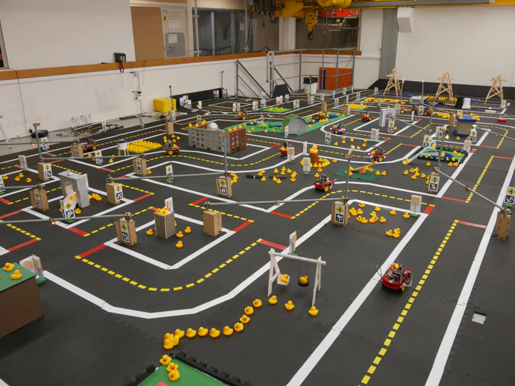
Getting started with Duckietown
Szilárd Kósa
https://github.com/SzilardKosa/RLProject

Slide 2
Last two weeks’ progress
1st week:
Getting ready for a submit:
Installing Ubuntu 16
Installing Docker/Git/Duckietown Shell
Submitting for the Try your luck challenge
2nd week:
Getting to know the OpenAI Gym
Learning about RL
Trying out Q learning

Slide 3
Errors during Ubuntu install
UEFI vs BIOS boot mode
Bootable USB stick (Rufus): UEFI/GPT only
https://askubuntu.com/questions/726972/dual-boot-windows-10-and-linux-ubuntu-on-separate-hard-drives
Booting into Grub command shell
https://www.linux.com/learn/how-rescue-non-booting-grub-2-LINUX?fbclid=IwAR1ON5BraY58Pet2wELcd0Dpy9p4n76zthOiwg1XVA8BEoVx0MtPfw252Dc

Slide 4
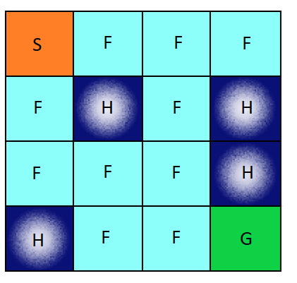
Q-learning example with OpenAI Gym
FrozenLake-v0
http://deeplizard.com/learn/video/QK_PP_2KgGE

Slide 5
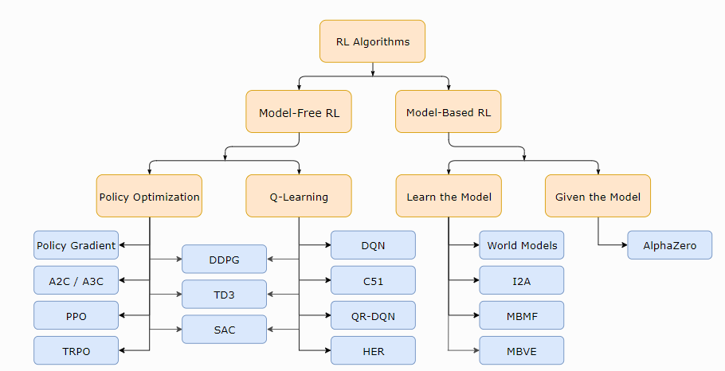
Plans for the next two weeks
Trying out basic RL algorithms
Policy optimization
Q-learning

Slide 6
Plans for the next two weeks
Trying out the SAC algorithm for the autonomous driving task
https://towardsdatascience.com/learning-to-drive-smoothly-in-minutes-450a7cdb35f4

