Slide 1
Developer Blog

Slide 2
Docker container
One docker container
Two docker image

Slide 3
Models
Blog
  Id
  Title
  Description

Slide 4
Models
User
  Id
  Name
  Gender
  Age

Slide 5
Services
BlogService
  GetAllBlogs
  AddBlog
  UpdateBlog
  DeleteBlog

Slide 6
Services
UserService
  GetAllUsers
  AddUser
  UpdateUser
  DeleteUser

Slide 7
Controllers
BlogController
  Get ("/api/blogs")
  Post ("/api/blogs")
  Put ("/api/blogs/{id}")
  Delete ("/api/blogs/{id}")

Slide 8
Controllers
UserController
  Get ("/api/users")
  Post ("/api/users")
  Put ("/api/users/{id}")
  Delete ("/api/users/{id}")

Slide 9
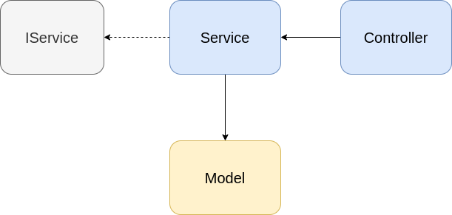
Arhitect

