Slide 1
Design Patterns C#

Slide 2
Builder pattern
Why is good to use Builder pattern?
More maintainable code
More readable code
Reduce errors during the creation of an object

Slide 3
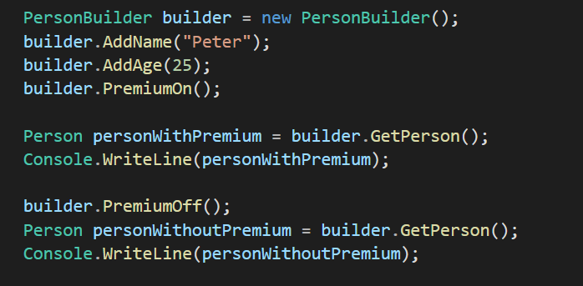
Builder pattern - Usage

Slide 4
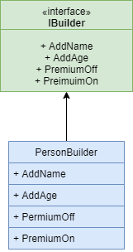
Builder pattern - Architect

Slide 5
Adapter pattern
When does Adapter pattern come handy?
A class needs to be reused that does not have an interface that a client requires.
Allow a system to use classes of another system that is incompatible with it.
Allow communication between a new and already existing system which are independent of each other.

Slide 6
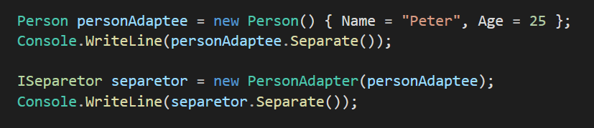
Adapter pattern - Usage

Slide 7
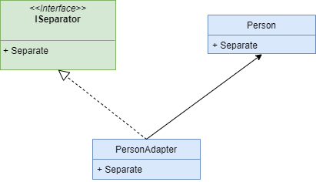
Adapter pattern - Architect

Slide 8
Observer pattern
What are the advantages of the observer pattern?
It supports the principle of loose coupling between objects that interact with each other
It allows sending data to other objects effectively without any change in the Subject or Observer classes
Observers can be added/removed at any point in time

Slide 9
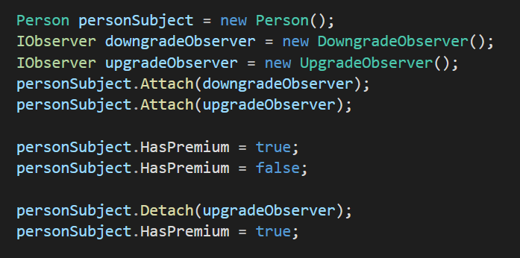
Observer pattern - Usage

Slide 10
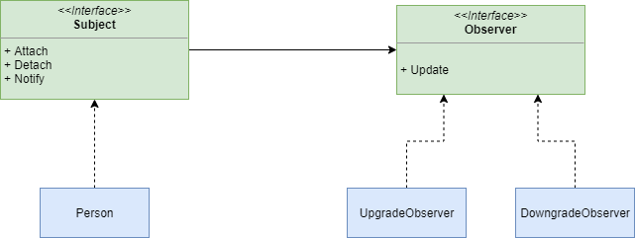
Observer pattern - Architect

