Slide 1
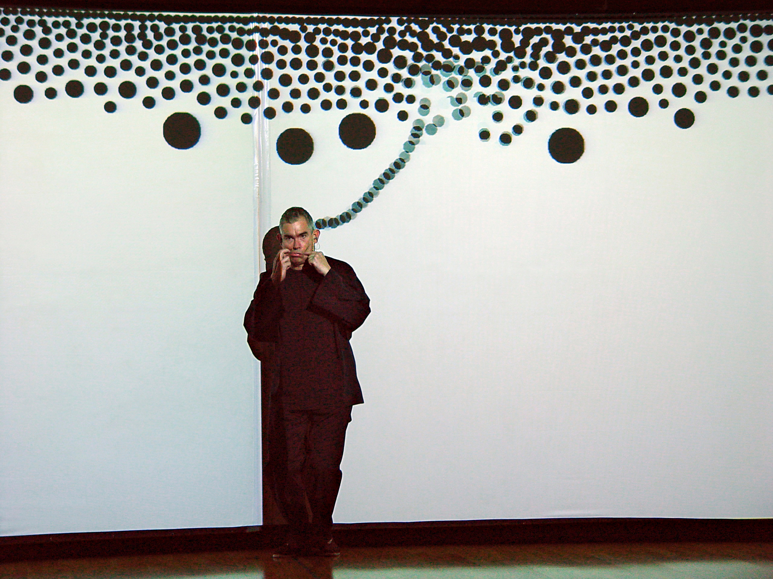
workshops in creative coding
Theodoros Papatheodorou

Slide 2
introduction

Slide 3
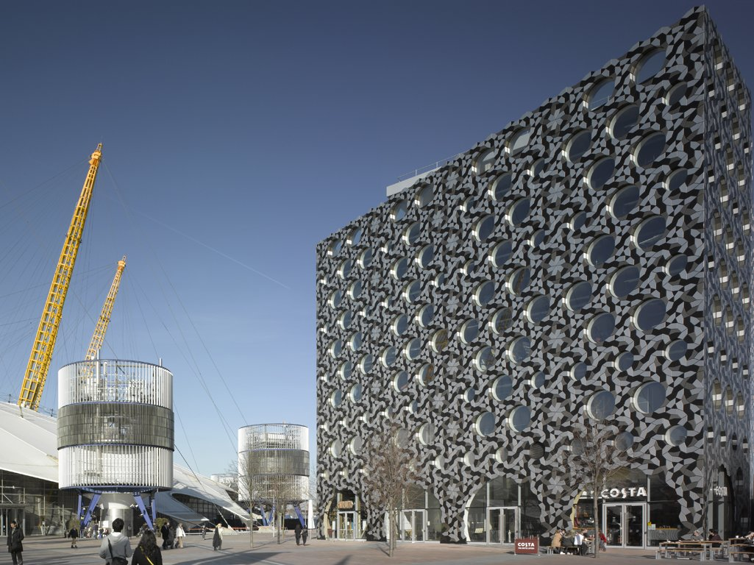

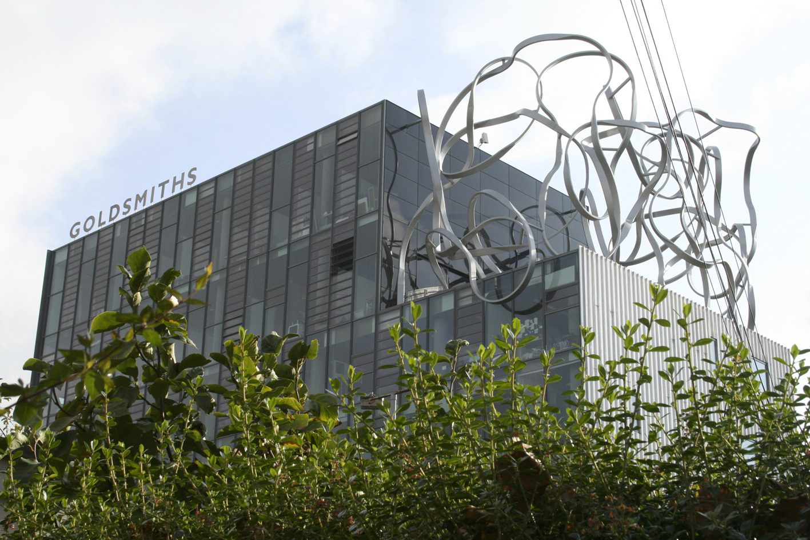

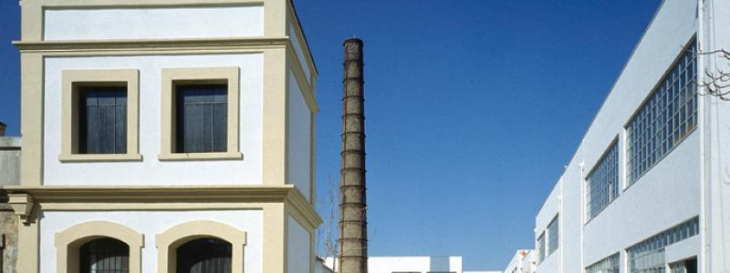


Slide 4
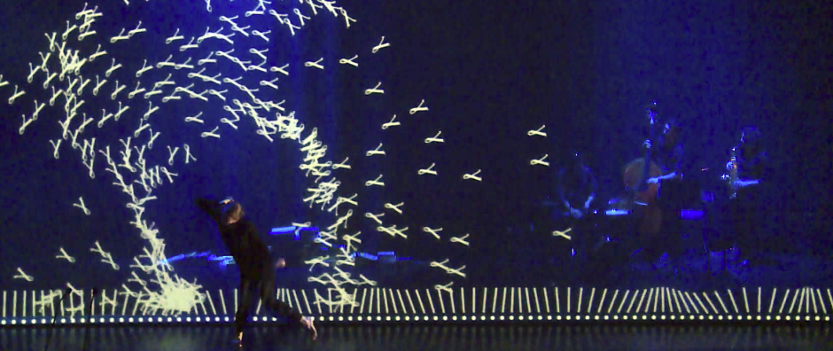

interactive projections &
computer vision
in live performance

Slide 5
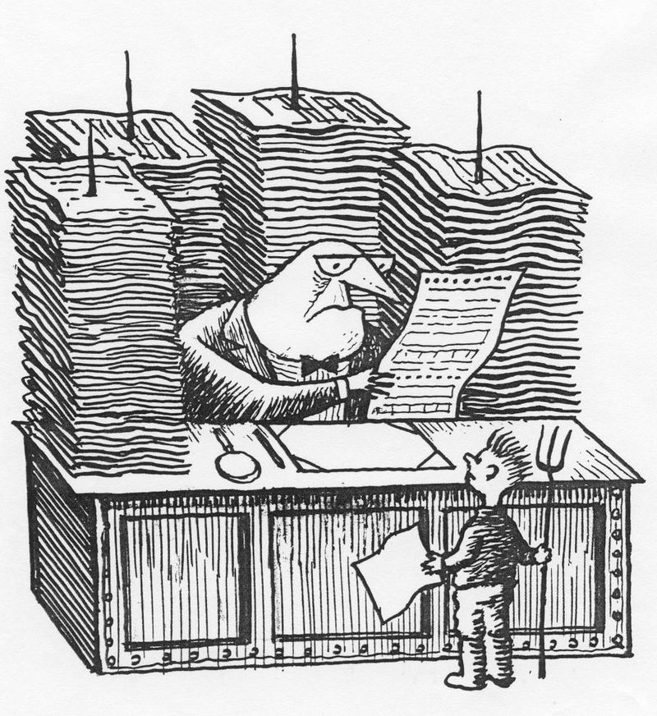
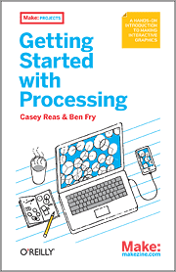
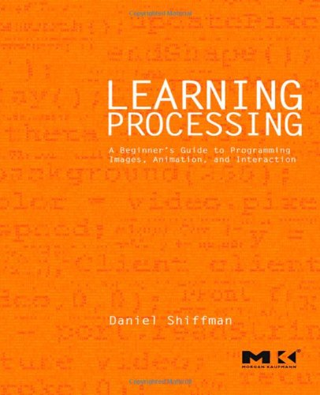
bureaucratic
email: t.papatheodorou@rave.ac.uk
class website: https://github.com/lobodelmar/workshops-in-creative-coding

Slide 6
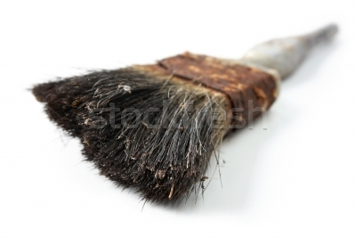
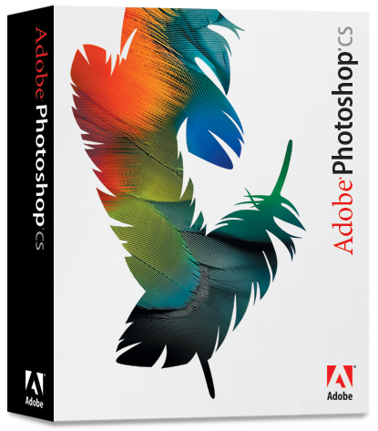
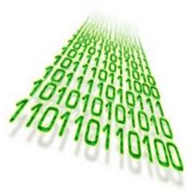
why code?
Tradition of artists creating their own tools as old as art itself.
Software revolution and
the “Photoshop effect”
From paint to code
Notes:
Ιστορικά υπήρχε άμεση επαφή του καλλιτέχνη με τα ίδια του τα εργαλεία (gourounotrixes-pinela, xrwmata apo dika tous ylika, kounelokolla)
Αντί να αποσπούν τον καλλιτέχνη, ενίσχυαν την σχέση του με τα υλικά και την τεχνική του
Η λογισμική επανάσταση εξασθένησε την σχέση του καλλιτέχνη με τα εργαλεία του (το εφέ του Photoshop στον πολιτισμό)
- why not exceed the limitations of proprietary software?
- each form of media can assume new qualities
Αφού το πεδίο είναι πια ψηφιακό, άρα πρέπει να κινηθούμε σε επίπεδο κώδικα
---------------
This monopoly impacting creative diversity among student work.
Art schools that encourage FOSS the work is bolder and better.
We must learn to be multi-OS, multi-arch, learn several languages, read source code and use GNU/Linux (raspberry pi)
FOSS tools readily fit the user.
Unix or Unix-like systems allow for interoperability.
Would artists 200 years ago accept a company's logo on their canvas?

Slide 7
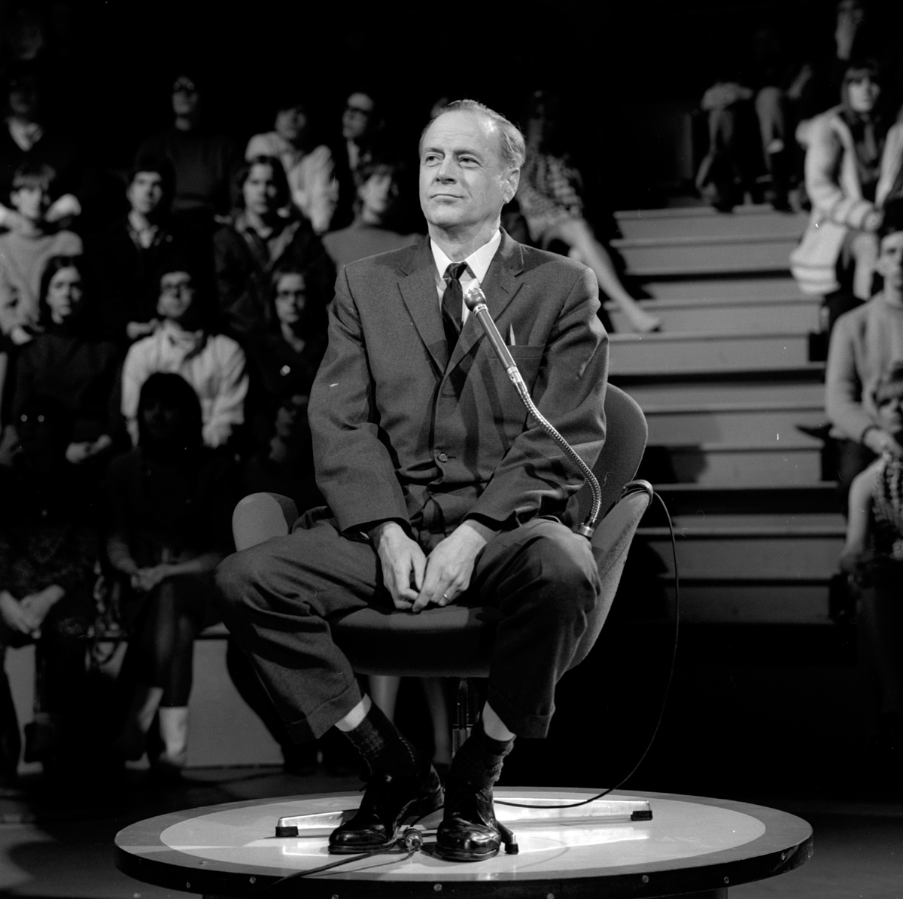
Notes:
Marshall McLuhan's “hot” & “cool” media
Hot: high-def, high-res εμπειρίες γεμάτες με πληροφορία
Cold: low-def που καλούν τον θεατή να καλύψει τα κενά
Τεραστια ποσα ξοδεύονται για “hot” και σχετικά λίγα για “cold”
http://en.wikipedia.org/wiki/Marshall_McLuhan#Hot_and_cool_media

Slide 8
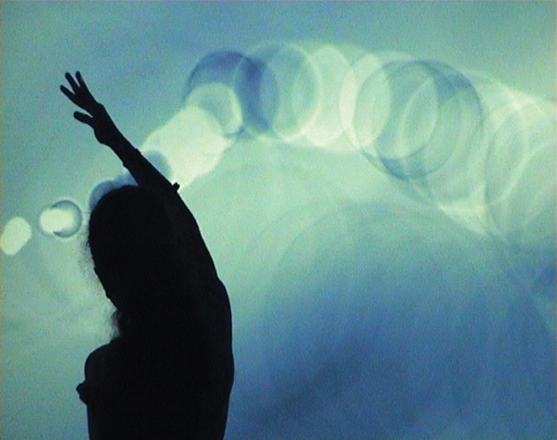
code + arts conclusions
observer vs. observed
new modes of expression
computer more than a projector
non-linear narrative
New ways of I/O
exceed limits of proprietary packages
gateway to new media
computer becomes a medium, not a tool
Notes:
Διαδραστική τέχνη
Καλούμε τον παρατηρητή να γίνει συμμέτοχος
Θαμπώνουμε τα όρια μεταξύ αντικειμενου και υποκειμενου
Υπολογιστής όχι απλά μηχανισμός παρουσίασης περιεχομένου αλλα δυναμικής δημιουργίας
Νέοι τρόποι I/O
Προσαρμογή στον παρατηρητή
Αλλαγή της ροής του έργου
Πιο εκφραστικά εργαλεία

Slide 9
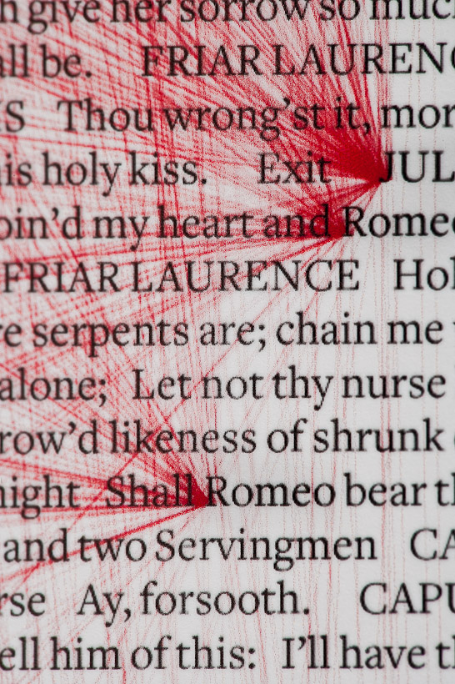
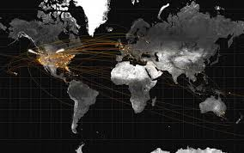
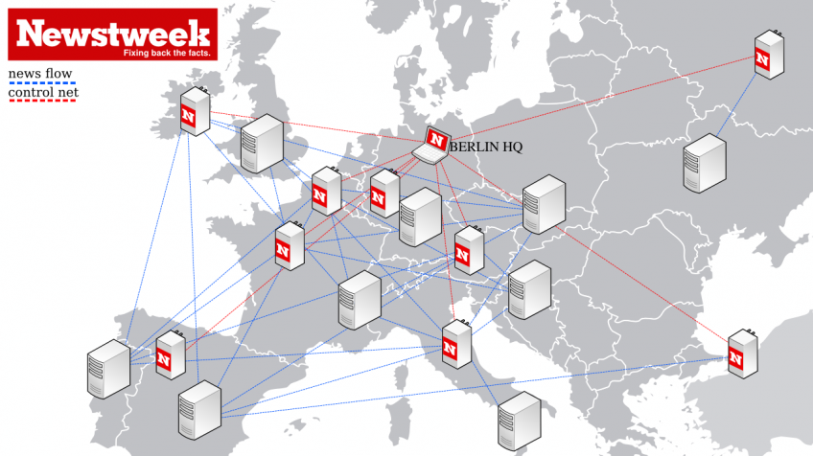
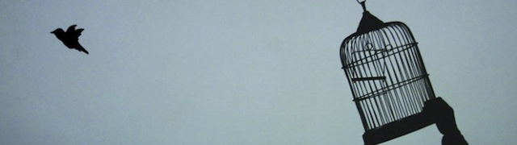
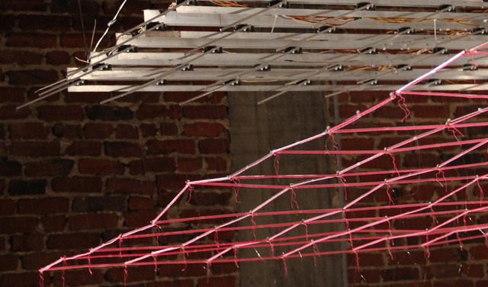
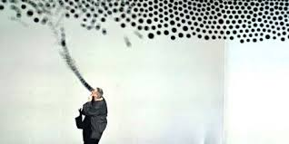
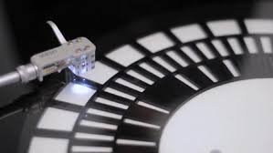
programming + art examples

Slide 10
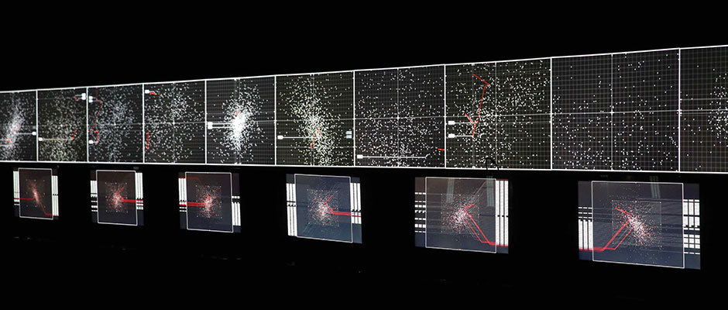
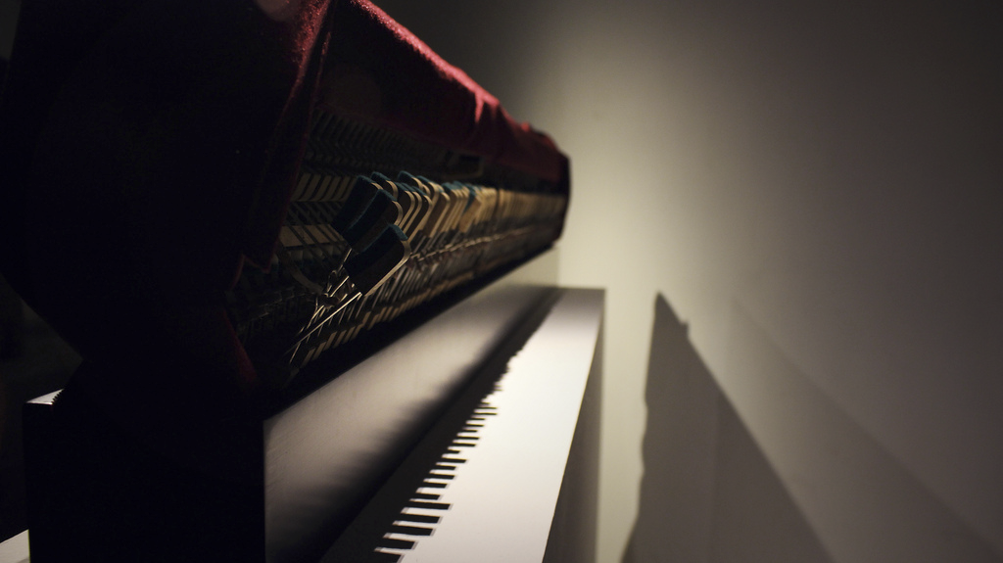
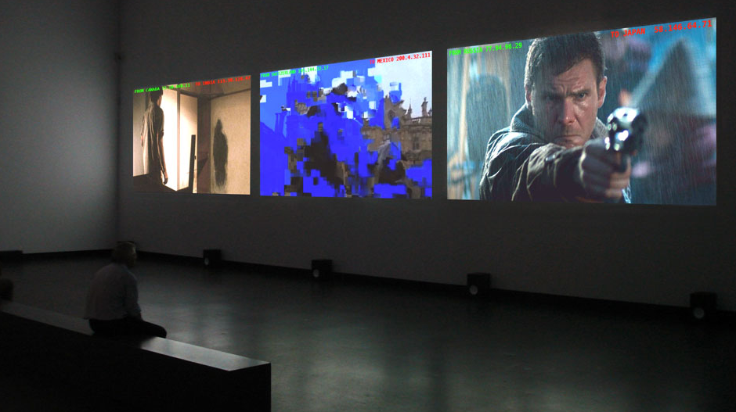
programming + art examples (cont)

Slide 11

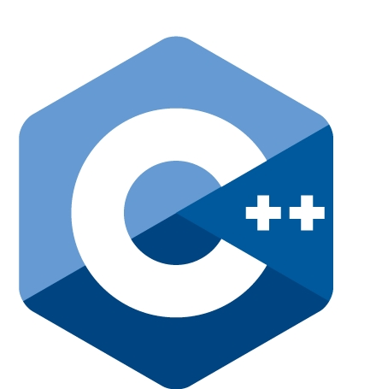
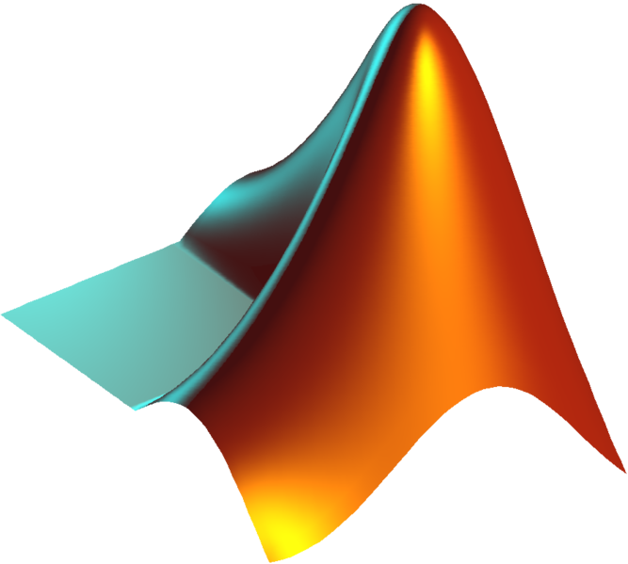
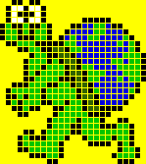





Why so many programming languages?
Most are not suitable for all uses
Many are designed for specific tasks:
  Educational - LOGO, Basic.
  Musical – Max, Supercollider
  Network - javaScript, PHP
  Scientific - Fortran, MatLab
  Military, space - A++, ADA
  Micro-chip - picBasic, Assembler

Slide 12
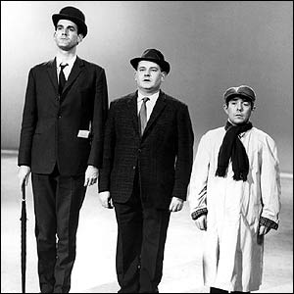

Some languages are lower level than others
“Level” = How close is the language to the architecture of the machine
closer to the architecture
                lower level
                foreign to the human eye
Low level languages have a limited vocabulary.
However, they are faster to execute and demand less resources from the processor.
Notes:
So for example a low level language like C will not have a function for drawing a line but rather depend on the local operating system to provide that API, for the programmer that means that without knowing the API’s there is nothing you can actually do, and once you know them, they are different for every platform and change with the New OS releases.

Slide 13
machine language and assembly
(low level languages)
calculating the Fibonacci number in Assembly:
fib: mov edx, [esp+8] cmp edx, 0 ja @f mov eax, 0 ret
@@: cmp edx, 2 ja @f mov eax, 1 ret
@@: push ebx mov ebx, 1 mov ecx, 1
@@: lea eax, [ebx+ecx] cmp edx, 3 jbe @f mov ebx, ecx mov ecx, eax dec edx jmp @b
@@: pop ebx ret
calculating the Fibonacci number in machine language:
8B542408 83FA0077 06B80000 0000C383
FA027706 B8010000 00C353BB 01000000
B9010000 008D0419 83FA0376 078BD98B
C84AEBF1 5BC3
The only language that can run directly on the processor without modifications.
We would never write programs in this language.

Slide 14

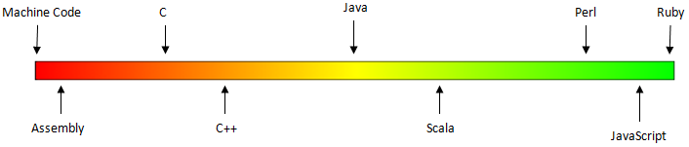
intermediate level languages for general use
a vocabulary of about 30 terms that sound more familiar:
  while
  for
  if/ else”

Slide 15
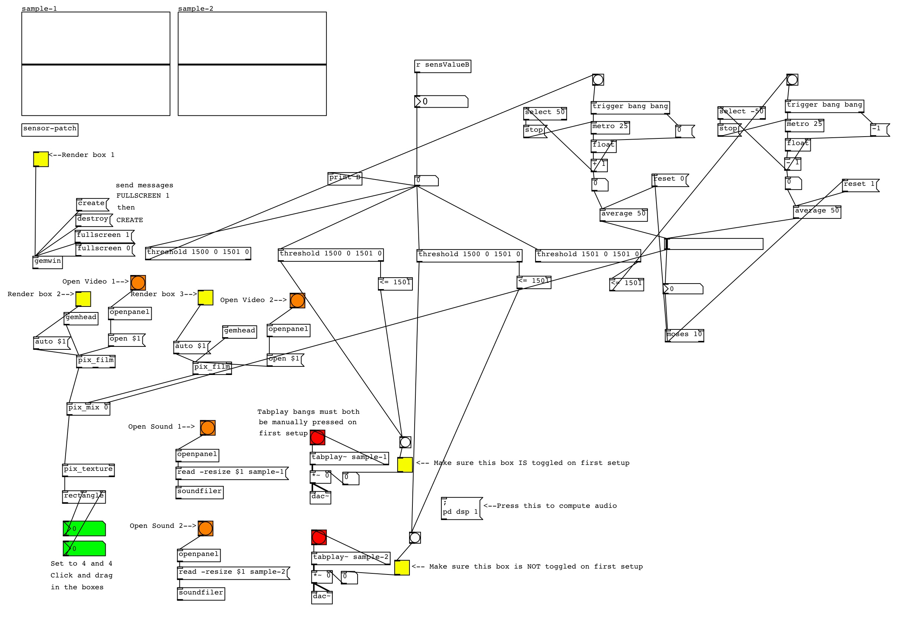
high-level languages
Vocabulary with hundreds of words
More abstract way of programming
  Instead of dealing with positions on top of the processor, we use objects, variables, etc.
  We can even design behaviors visually
They use elements from natural language
  making programming more natural
  source code more easy on the eye
Abstract languages are punished:
  they use more memory and computer resources

Slide 16

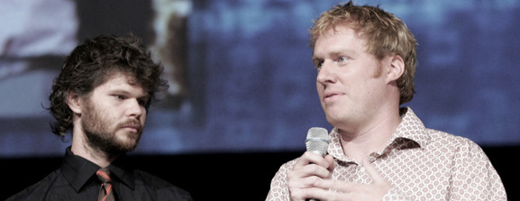
Processing
Made for artists and designers at MIT
Easy to learn and simple, but very powerful
Free software
Vast array of libraries
Runs on websites & on many platforms (including phones)
A lot of online help
It's fun!
Fry & Reas

Slide 17
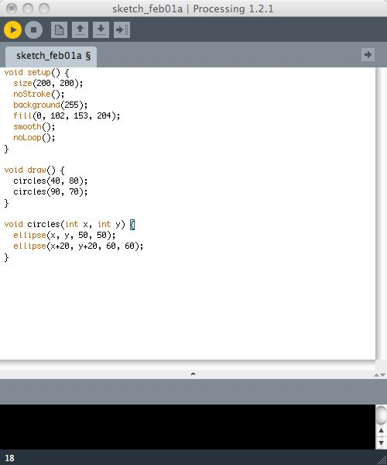

IDE
Processing
Java
Virtual Machine Code
Operating System

Slide 18

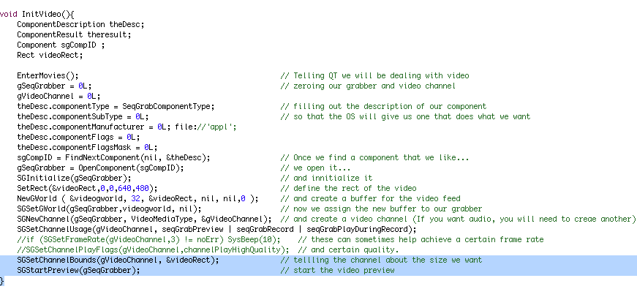
Processing hides all the ugliness
(of low level programming)
* minimum code required to connect to a webcam in the C language

Slide 19
...while in Processing
video = new Capture(this, width, height);

Slide 20
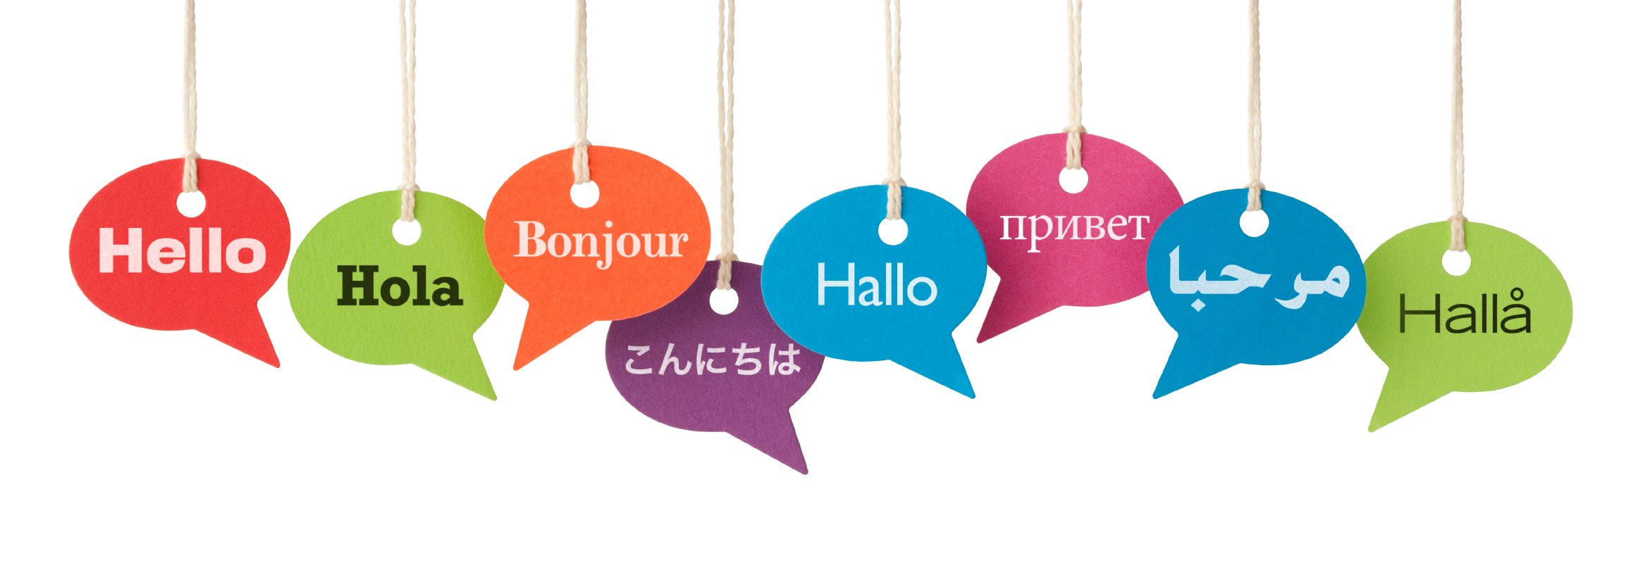
like any human language it requires practice

Slide 21
Raed tihs snetecne*
* the brain can overcome errors
in language, a machine can't

Slide 22
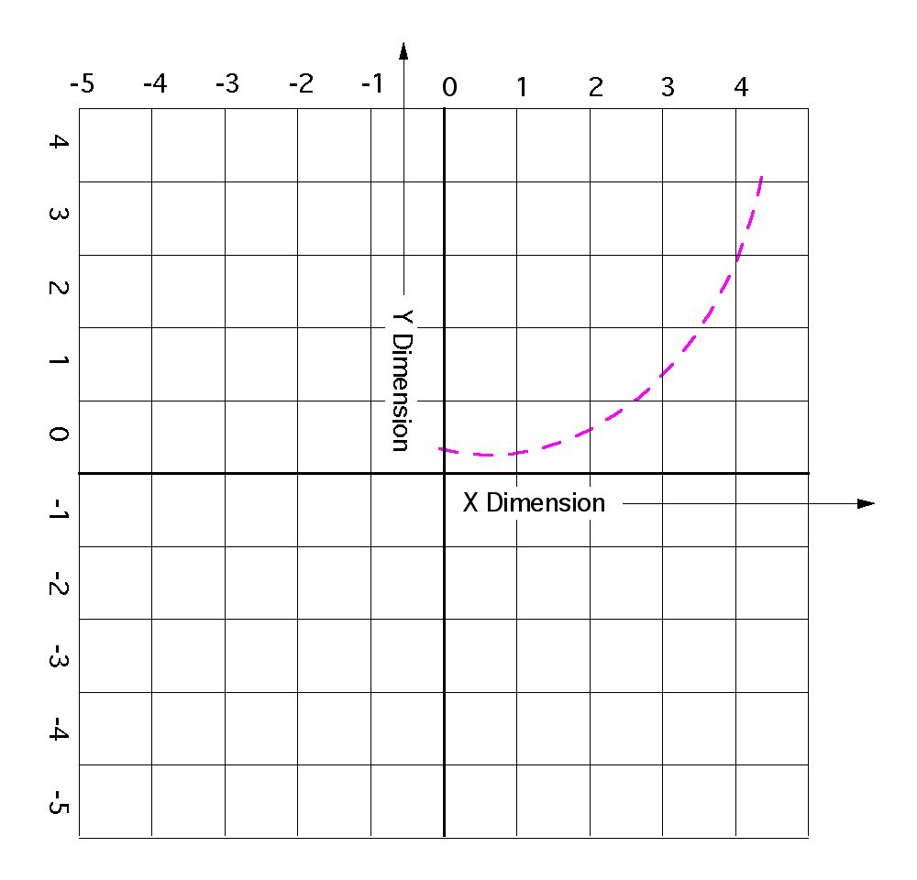
mathematical coordinate system
Notes:
Since Processing a very visual programming language, the first thing for us to establish is the coordinate system
If you remember from high school the charts use to have 4 quadrants with 0 in the middle

Slide 23
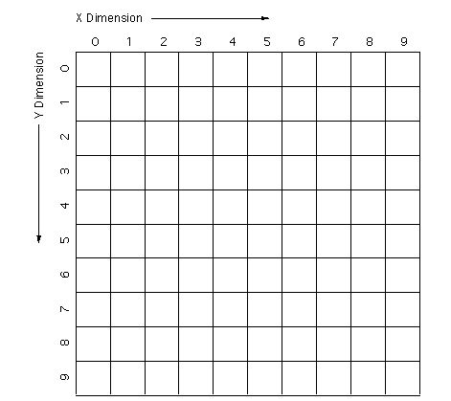
computer coordinates

Slide 24
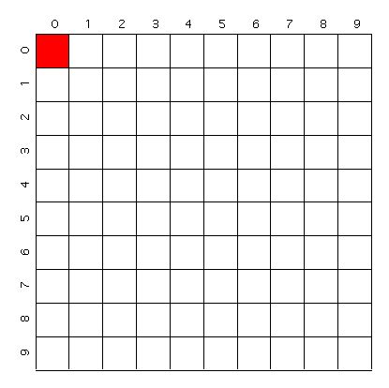

a point
syntax – point(x,y);
point(0,0);

Slide 25
;

Slide 26
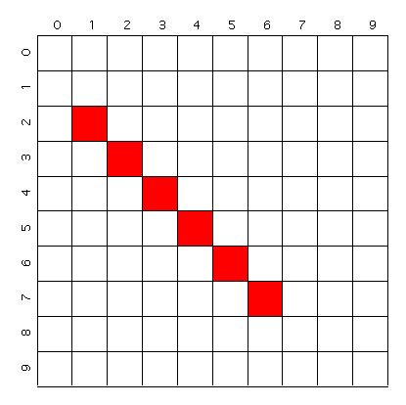
a line
syntax – line(fromX, fromY, toX, toY);
line(1,2,6,7);

Slide 27
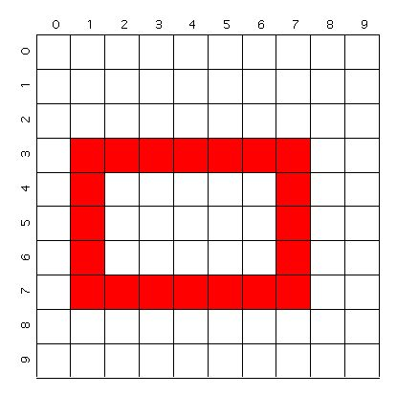
rectangle
syntax – rect(topLeftX, topLeftY, width, height);
rect(1,3,7,5);

Slide 28
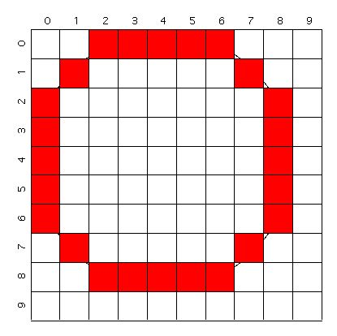
ellipse / circle
syntax - ellipse(centerX,centerY,width,height);
ellipse(4,4,9,9);

Slide 29
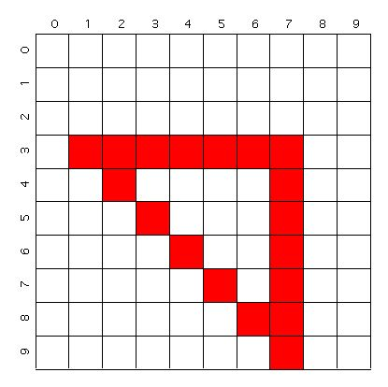
triangle
syntax -
triangle(point1X, point1Y, point2X, point2Y, point3X, point3Y);
triangle(1,3,7,3,7,9);

Slide 30
some useful commands
size(width, height);
  specifies the size of the canvas
  placed at the top of the sketch
background(grayLevel); or background(R,G,B);
specifies the color of the canvas
  takes values from 0 to 255
  0 = black
  255 = white
small or CAPITAL letters? it's important!
  Size(100,100); would lead to an error

Slide 31
some commands affect the look of shapes and affect everything that follows
noFill();
  no fill color in the shapes
fill(grayLevel);
  the filling of the shape should be...(0-255).
noStroke();
  no stroke lines around the shapes
stroke(grayLevel);
  the color of lines should be...(0-255)
strokeWeight(number);
  specifies the thickness of the stroke

Slide 32
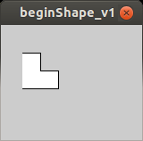
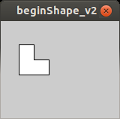

making your own shapes
beginShape();
vertex(20, 20);
vertex(40, 20);
vertex(40, 40);
vertex(60, 40);
vertex(60, 60);
vertex(20, 60);
endShape();
beginShape();
vertex(20, 20);
vertex(40, 20);
vertex(40, 40);
vertex(60, 40);
vertex(60, 60);
vertex(20, 60);
endShape(CLOSE);
beginShape_v1
beginShape_v2

Slide 33

create this
(and upload it on the web)
commands you must use (not necessarily in this order): fill(x) size(x,y) ellipse(x,y,width,height) noStroke() background(x)
homocentricRings

