Slide 1
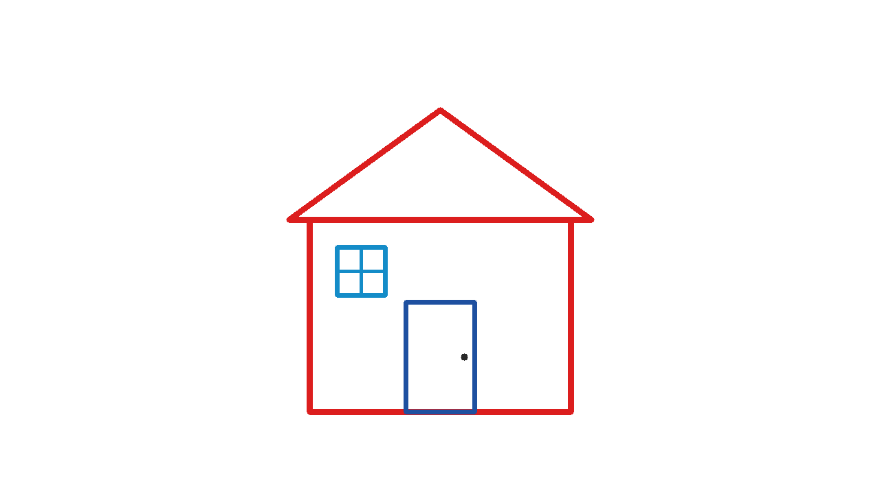
airboard
A whiteboard you draw
in the air
Sample board
An AI assisted university project
01
Notes:
Introduce airboard as a university prototype that turns a webcam into a drawing input. It is meant for sharing a quick sketch in class. The pictured house is a generated sample board from the project, not a camera result or an AI answer. Source: evaluation/generate_boards.py and evaluation/test_boards/sk_02_house.png.

Slide 2
Who it is for
Students
Sketch a math idea or diagram
while explaining it to someone.
Classroom presenters
Use a laptop webcam for a quick visual explanation.
A drawing tablet is optional.
02
Notes:
The intended users are students and classroom presenters. These are intended use cases, not results from a user study. Ask the class to imagine explaining a diagram without switching to a drawing tablet. The project uses an ordinary webcam. Mouse mode is a fallback for a demonstration when the camera cannot start.

Slide 3
Drawing gestures
Gesture | Action
Index finger up | Draw
Index and middle fingers up | Erase
Open hand | Hover
Fist held for one second | Clear the board
w switches the view. s saves a PNG. q exits.
03
Notes:
Show each pose slowly with the palm facing the camera and fingers upright. The classifier uses image-space finger positions, so rotation, occlusion, lighting and distance can affect it. A continuously observed fist clears once after one second. Tracking loss restarts that hold. Source: core/gestures.py and airboard.py.

Slide 4
How drawing works
01
Webcam
MediaPipe tracks 21 hand landmarks.
02
Gesture
Finger positions choose a drawing mode.
03
Smoothing
EMA blends the current and previous position.
04
Canvas
OpenCV overlays strokes or shows a white board.
Alpha 1.0 follows raw points. Alpha 0.5 blends them equally.
04
Notes:
Walk through the implementation in four stages. MediaPipe supplies 21 hand landmarks. The gesture classifier chooses a mode. The exponential moving average blends the current fingertip with the preceding smoothed point. OpenCV writes the strokes to a separate canvas and composites the display. Alpha 1.0 follows raw coordinates, while 0.5 blends equally. Smoothing trades responsiveness for reduced jitter; no real camera improvement percentage is claimed. Sources: core/hand_tracking.py, core/smoothing.py, core/canvas.py. MediaPipe Hands: https://chuoling.github.io/mediapipe/solutions/hands.html.

Slide 5
Notebook pages
Original writing stays beside the text
Multiple pages with automatic saving
Local recognition with Apple Vision
Editable words and PDF export
b: notebook n: new page t: recognize e: edit f: PDF
Handwriting recognition still needs a real writing trial.
05
Notes:
Press b for notebook view. Press n for a new page and comma or period to turn pages. Press t for Apple Vision recognition on macOS. Original ink stays available beside editable text. Press e to edit, Escape to finish, u to undo a text change, and f to export a PDF. Recognition runs locally. A printed-text fixture passed. Handwriting quality still needs a real writing trial. Sources: core/notebook.py, core/handwriting.py, core/notebook_export.py and tests/test_notebook.py.

Slide 6
How AI helped build it
Antigravity
Created the first implementation and draft materials.
ChatGPT
Reviewed the code, reproduced bugs, and helped repair them.
Claude has a planned architecture review role.
The project log records only confirmed contributions.
06
Notes:
Antigravity supplied the initial implementation and report/slides draft. ChatGPT independently inspected the code, reproduced errors, and helped repair them. Claude has a planned architecture-review role. The final log records only verified actions, so the deck does not credit unconfirmed work as completed. Sources: user conversation, independent review evidence, AGENTS.md after repair.

Slide 7
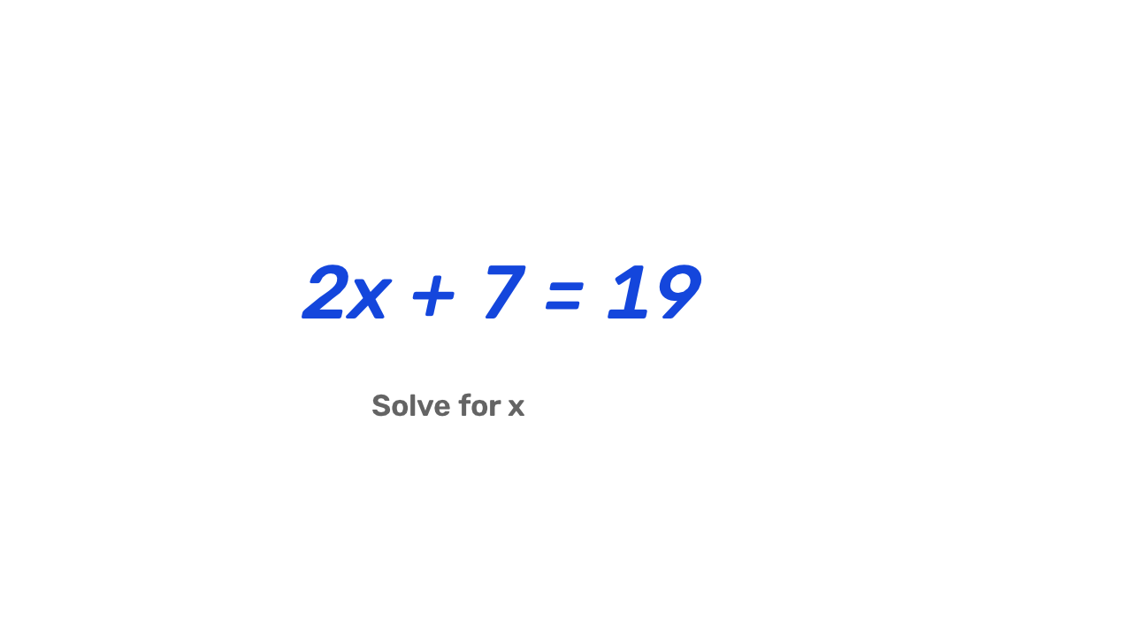
Optional AI board interpretation
Press a to send the board
to both providers in parallel.
Missing keys and errors stay visible.
Demo mode makes no AI request.
Sample input board
Matching answers can still be wrong.
Live model quality has not been measured.
07
Notes:
Press a to submit the board PNG to Claude and OpenAI in parallel. Each provider needs its own API key in .env and account access to the configured model. Missing credentials and network errors are visible. --mock-ai exercises the interface only and makes no interpretation claim. A matching final answer is not proof of correctness. No live provider accuracy or latency is claimed in this project report. Sources: agents.py. OpenAI vision: https://developers.openai.com/api/docs/guides/images-vision?api-mode=chat. Claude vision: https://platform.claude.com/docs/en/build-with-claude/vision.

Slide 8
What we checked
Software checks
Still to measure
Gesture state transitions
PNG export and stroke color
AI failures and comparison logic
Notebook saving and text editing
Real camera accuracy
Lighting and distance behavior
Live AI answer quality
Demo performance on the classroom laptop
Synthetic tests support debugging. Field trials support performance claims.
08
Notes:
The software regression tests check timer reset, smoothing, PNG export, API error handling, final-answer comparison and concurrent dispatch. Synthetic gesture and trajectory experiments are labeled simulations. Real camera accuracy, lighting/distance robustness and live-model quality still require field trials. These checks establish specific software behavior rather than empirical camera or model accuracy. Sources: tests/, evaluation/, and the repair verification output.

Slide 9
Class demo and next steps
In class
Next
Draw a short equation or house
Hover, erase, and clear
Switch views and save
Review a notebook page
Record real gesture trials.
Compare smoothing on
the same motion.
Grade full AI replies.
Mouse mode is available if the webcam cannot start.
09
Notes:
Demo script: launch python airboard.py. Show draw, hover, erase, and a continuous one-second fist hold. Press w to show the whiteboard, then s to save. If camera permission or tracking is unavailable, use python airboard.py --mouse --mock-ai and clearly call it mouse/demo mode. Press a to show real provider output only if keys and live access have been checked; otherwise show the labeled demo or unavailable state. Next: record actual trials by lighting and distance, compare the same motion at alpha 1.0 and 0.5, and grade complete provider replies against a fixed rubric.

