Slide 1
Ine Cyber Pass

Slide 2
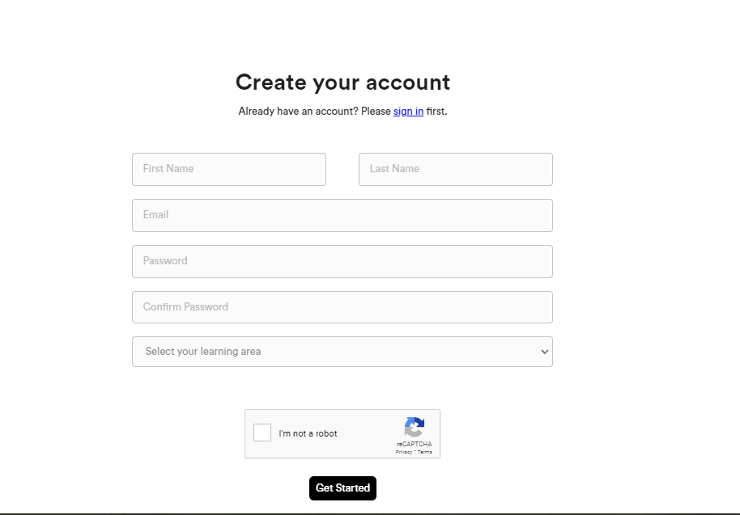
Claim Starter pass
https://checkout.ine.com/starter-pass

Slide 3
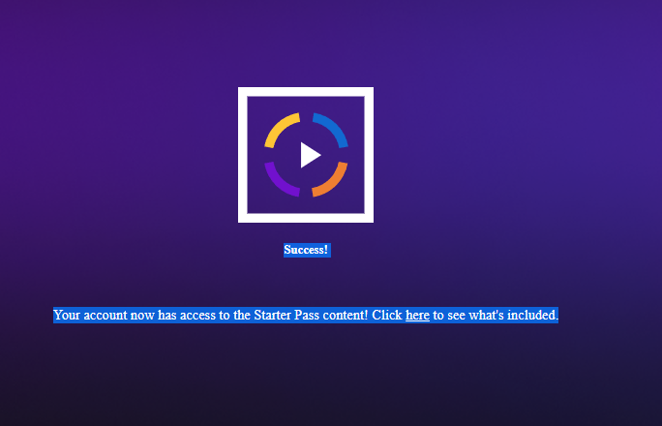
Claim Starter Pass

Slide 4
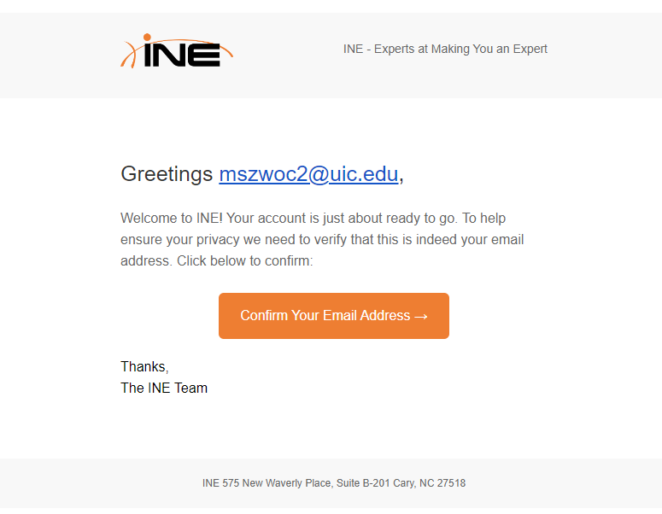
Confirm Email

Slide 5
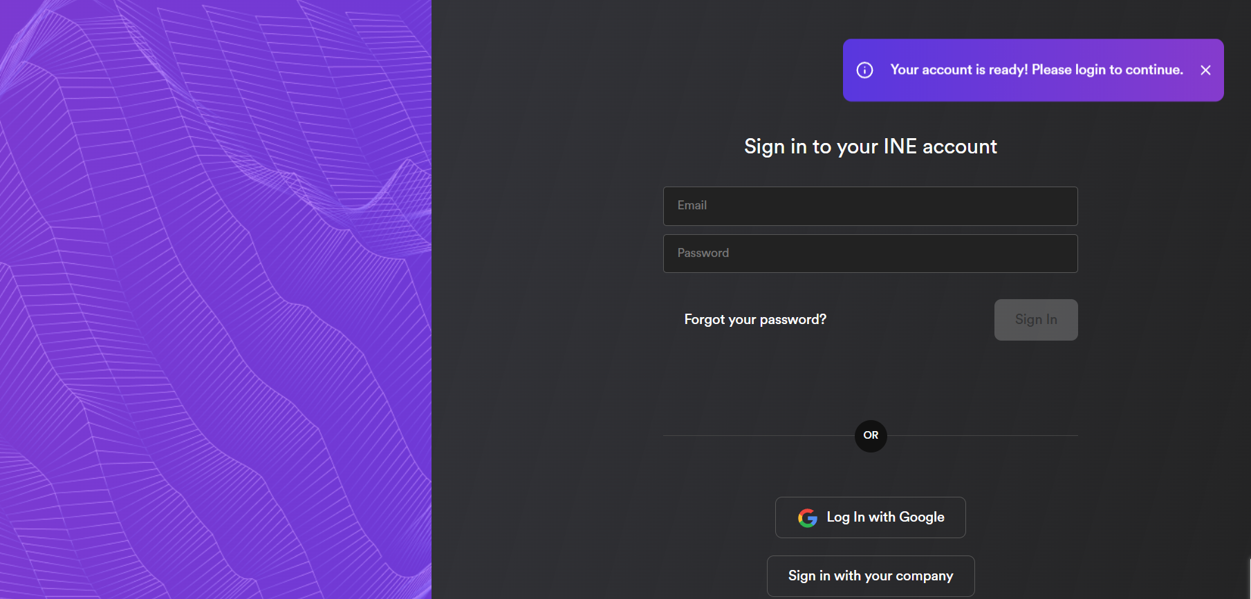
Login
https://my.ine.com/login

Slide 6
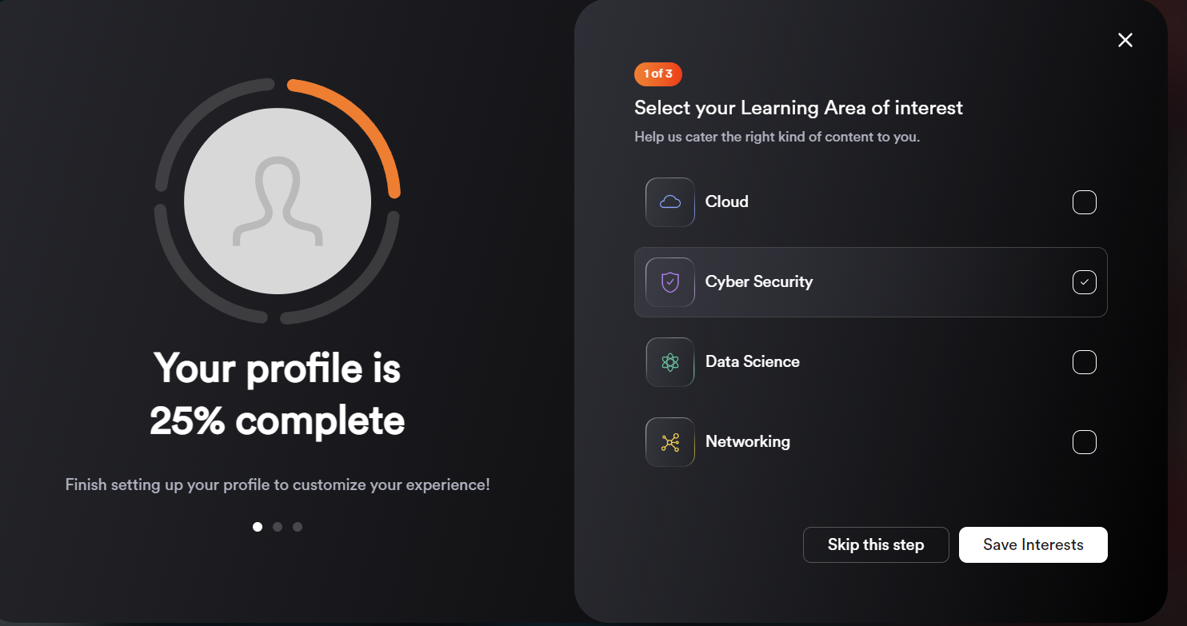
Set-up Profile
https://my.ine.com/login
Select Cyber Security

Slide 7
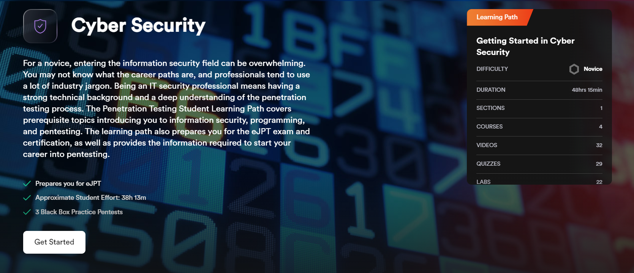
Get Started

Slide 8
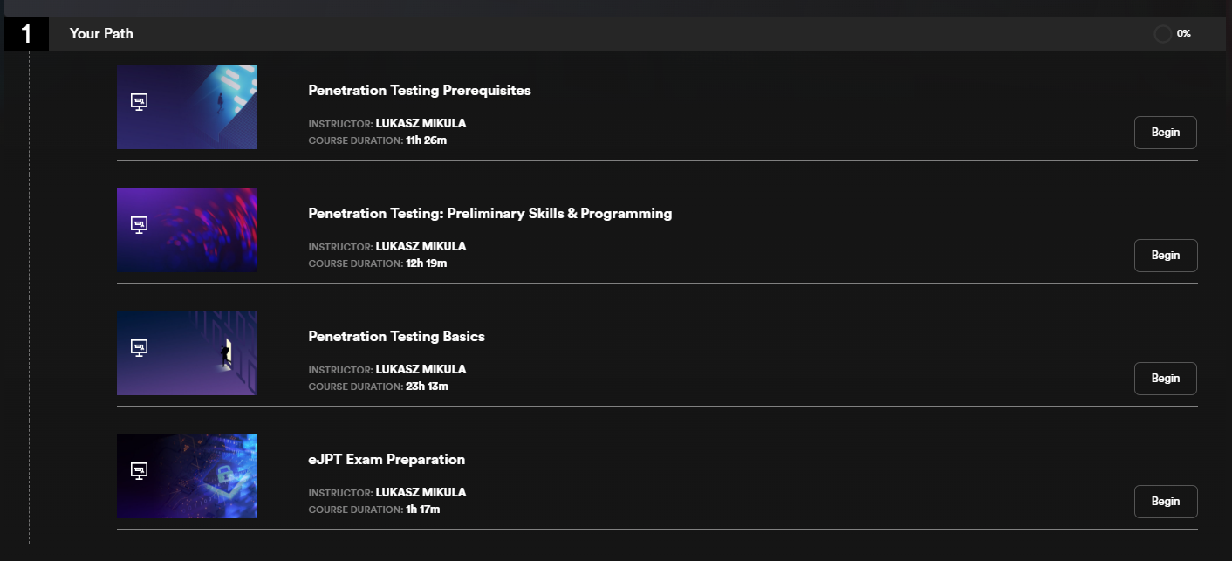
Work through Path

Slide 9
Work Through The Path
Penetration Testing Prerequisites
Kind of interesting but dense
Covers basic networking, and network skills
Penetration Testing: Preliminary Skills & Programming
Boring, but may be useful
Penetration Testing Basics
The good stuff
3 black box tests at end to test your skills

Slide 10
Work Through The Path
eJPT Exam Preparation
Not sure what exactly this content is (I took it on older platform)
eJPT is 3/10 known in H.R. Some know it, most don’t
Exam cost is $200
There are sales, such as Black Friday, Christmas, etc
Test may be worth it to reinforce skills, and to prove your skills to yourself
The only decent cert worth its money is OSCP, but its MUCH harder

