Slide 1

M.I.T.M Pt 1
UIC Cyber Sig

Slide 2



Agenda
TODAY
Traffic Sniffing
ARP
Arp Poisoning
FUTURE
LLMNR & NBT-NS Spoofing
Responder / Multi Relay

Slide 3
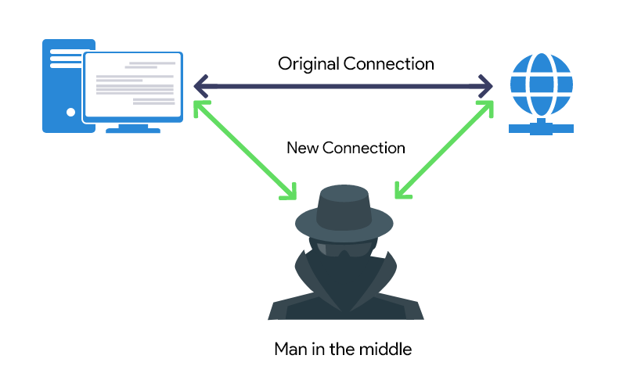
Introduction
Man-In-The-Middle Attacks occur when an Attacker positions himself in between to entities to intercept, and possibly modify data being sent back and fourth

Slide 4


Traffic Sniffing
What is it?

Slide 5
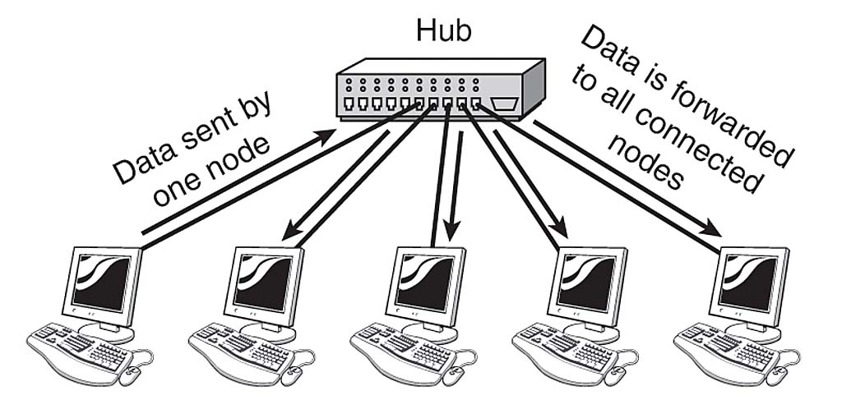

Traffic Sniffing
“Network sniffing is the practice of using a network interface on a computer system to monitor or capture information regardless of whether it is the specified destination for the information”
Switches have helped prevent this but aren’t fool proof
Wireless traffic can be captured without even being on the network! (Although WPA 2 will encrypt it)

Slide 6
Traffic Sniffing Tools
WireShark – Google it
TCPDump – Guide
+ More user friendly
+Great filters, and features like following streams
-Known to crash with higher packet counts
Command Line Tool
+ Powerful BPF Filters
+ Pretty damn hard to crash
+ Can be exported to be later viewed in Wireshark!
- Can be intimidating, check out GUIDE above

Slide 7
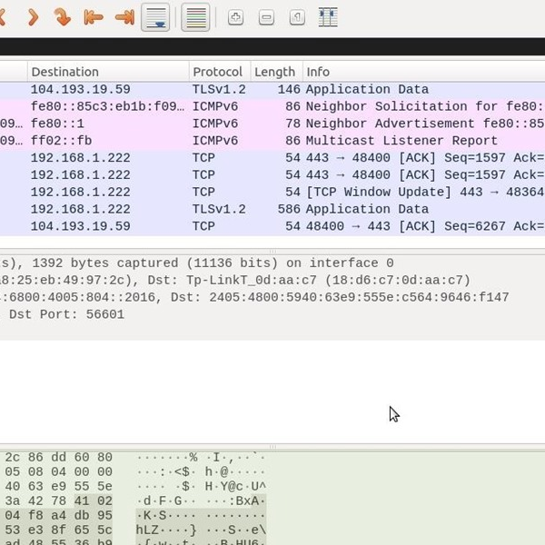
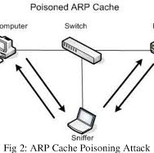
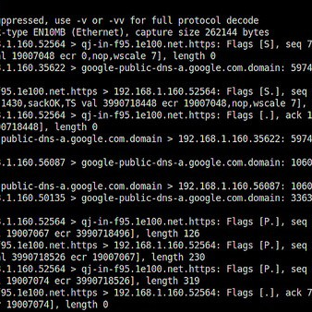
Traffic Sniffing Tools
We will use those tools to execute MITM Attacks
We will also mention more automated tools
Don’t worry examples ahead

Slide 8
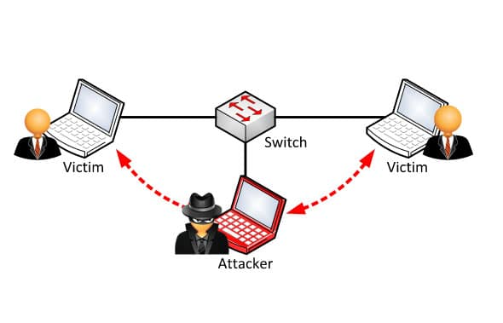
ARP Poisoning

Slide 9
ARP – Address Resolution Protocol
This protocol maps layer 3 (IP) addresses to layer 2 addresses (MAC)
Devices send an ARP request packet to a broadcast address 00:00:00:00:00:00 or ff:ff:ff:ff:ff:ff asking for specific IP.
Devices that have corresponding IP respond with their MAC
There is no verification built into the protocol

Slide 10
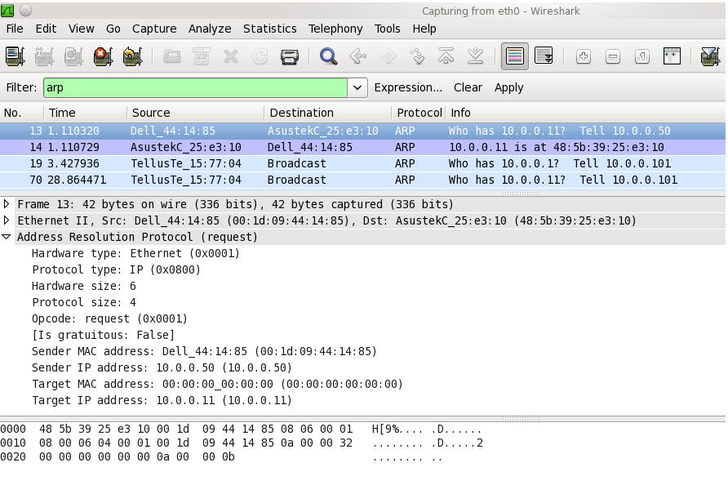

Slide 11

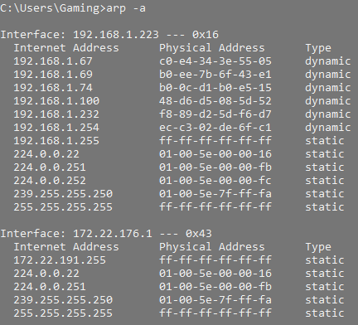
ARP – Address Resolution Protocol
Devices maintain these mappings in a table.
For Hosts, they contain an ARP Cache
For Switches, they contain a CAM table

Slide 12
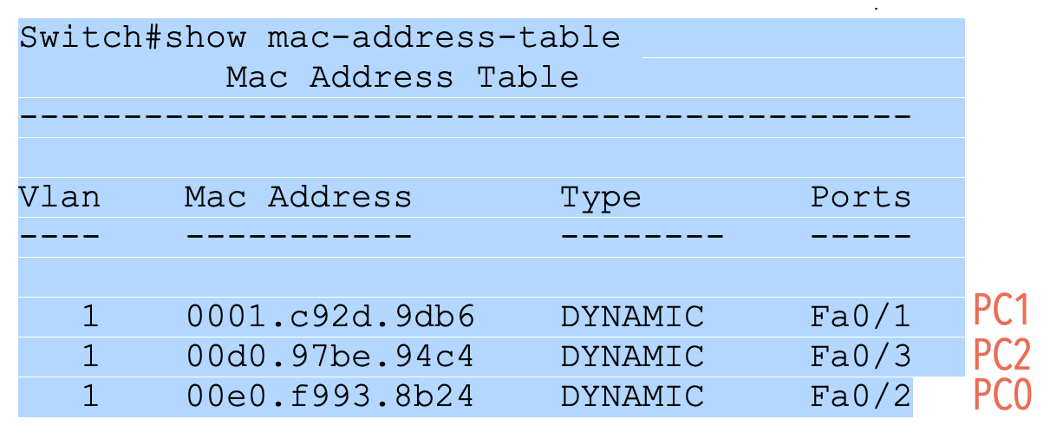

Slide 13
ARP Poisoning
Arp Entries have relatively short TTLS
Windows 15-45 seconds by default
Switches several minutes
We can inject an ARP entry by either…
Listening for Arp Requests and responding to them
Sending out gratuitous replies
Just spamming replies even though no request was ever made

Slide 14
Arp Spoof
CLI tool to poison Arp Caches
You must enable packet forwarding of the flow will be interrupted
echo 1 > /proc/sys/net/ipv4/ip_forward
You must poison both of the parties to effectively listen to the whole conversation

Slide 15
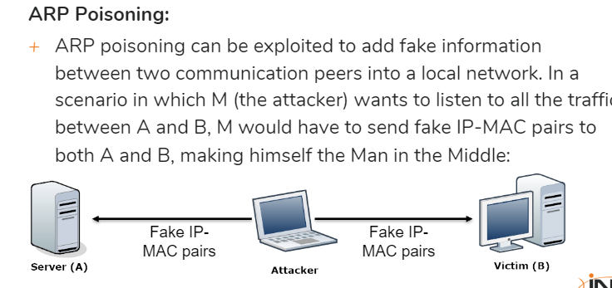

Slide 16
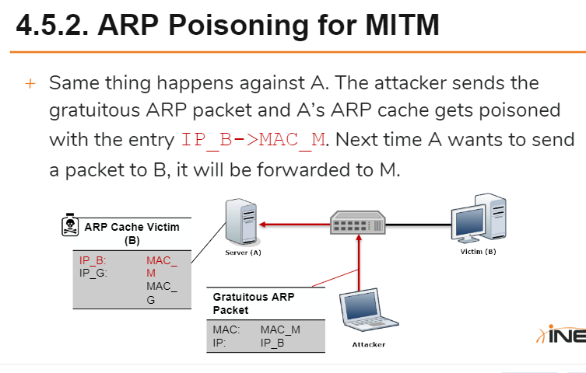

Slide 17
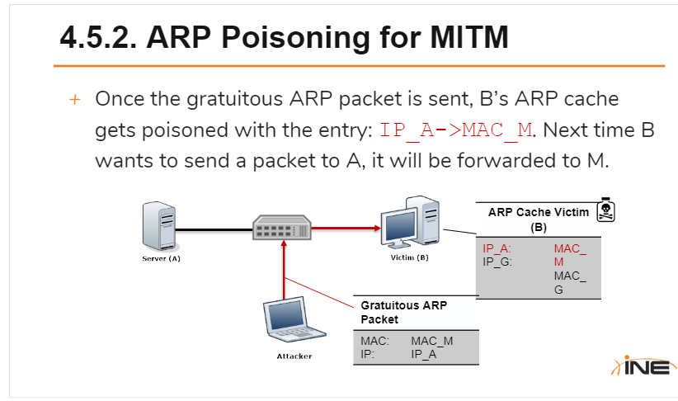

Slide 18
Live Demo Commands
arp-scan -I eth1 172.16.5.0/24
nmap -PR -sn 172.16.5.*
echo 1 > /proc/sys/net/ipv4/ip_forward
arpspoof -i eth1 -t 172.16.5.5 -r 172.16.5.1
arpspoof -i eth1 -t 172.16.5.1 -r 172.16.5.5

Slide 19
Prevention
Static Arp Tables
Not possible in larger organizations
Network Isolation
Encryption (can be bypassed)
Switch Security
Analyze packets and drop malicious ones

Slide 20


Thank You
UIC Cyber Sig

