Slide 1
Analysis reports for work place satisfaction
Szymon Szuwarowski
Viljami Lindholm

Slide 2

Background of the survey
The survey was conducted by interviewing 82 workers of our company.
We took every worker in the middle of the day and asked to fill the form out for possible better treatment
All the participants got movie tickets for their effort
Survey is in the middle of processing and after we gonna provide possible changes in company.

Slide 3
Variables of the survey
Variables | number | Id of person filling out
 | 1 | Gender (1= woman, 2=man)
 | 2 | Age (Years)
 | 3 | Family (persons)
 | 4 | Education (Level of education 1= Primary school, 2= vocational school or similar, 3= secondary school graduate, 4= applied science university, 5 = other university)
 | 5 | years_of_service (years)
 | 6 | Salary (€/month)
 | 7 | sat_management (scale 1-5)
 | 8 | sat_colleques (scale 1-5)
 | 9 | sat_workingEnvironment (scale 1-5)
 | 10 | sat_salary (scale 1-5)
 | 11 | sat_tasks (scale 1-5)
 | 12 | Healtcare (1= have used, blank = haven’t used)
 | 13 | holidayCabin (1= have used, blank = haven’t used)
 | 14 | Gym (1= have used, blank = haven’t used)
 | 15 | muscleCare (1= have used, blank = haven’t used)
Background variables 1-7
Variables of main interest 8-12 (Likert scale)
Variables of main interest13-16 (1= ever used service, blank = service never used)

Slide 4
Relevant info from describe table here
Also provide interpretations and discussion (shortly on video also)

Slide 5
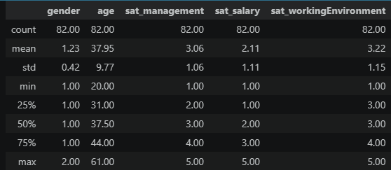
Descriptive Statistics
Szymon
Overview of the respondents' age and satisfaction levels across management, salary, and working environment

Slide 6
Overall Satisfaction Trends
Szymon
The data shows that the working environment has the highest average rating, while salary satisfaction remains the lowest among employees.

Slide 7
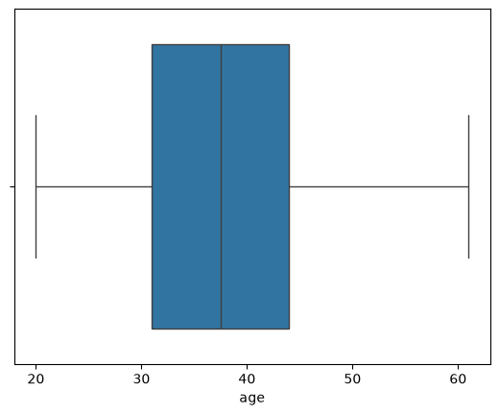
Age Distribution of Employees
Szymon
A visual representation of age spread, blue box representing most workers age and the black line form youngest to oldest.

Slide 8
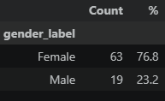
Gender Distribution Table
Szymon
Breakdown of the survey respondents by gender, displaying exact counts (n) and percentage shares.

Slide 9

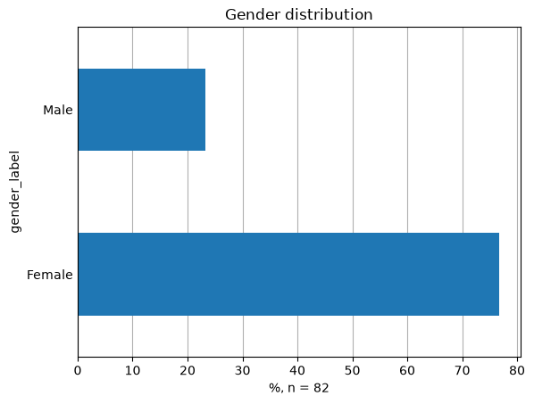
Gender Demographics
Szymon
Visualizing the gender split in our sample.

Slide 10
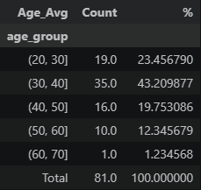
Age Categorization
Szymon
Employees were divided into specific age brackets (20-30, 30-40, etc.) to identify trends across different life stages.

Slide 11
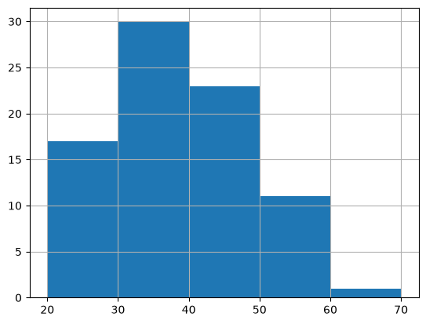
Age Group Distribution
Szymon
Histogram showing the frequency of employees within each defined age bracket.

Slide 12
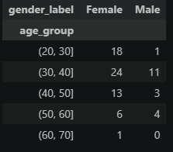
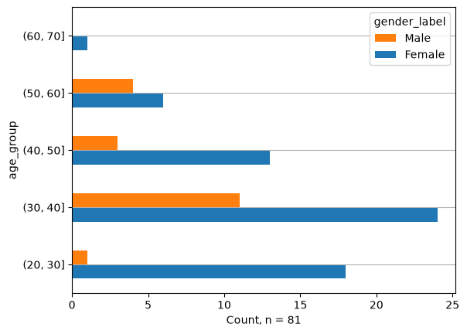
Age Groups by Gender
Szymon
Crosstabulation comparing the age distribution between male and female respondents.

Slide 13

Statistical Significance of gender vs. environment satisfaction
Szymon
Chi-square test gender vs. environment satisfaction result was 0.0092
The chi test tells us that there is statistically significant dependency in woman and men
rate of work environment. Meaning woman has rated the environment
lower then the other.

Slide 14
Statistical Significance of gender vs. Salary Satisfaction
T-Test (Gender vs. Salary Satisfaction): p = 0.0019
Because p-value was 0.0019, the t-test tells that the difference in average salary satisfaction between men and women almost statistically very significant dependency. With woman average satisfaction score being lower.

Slide 15
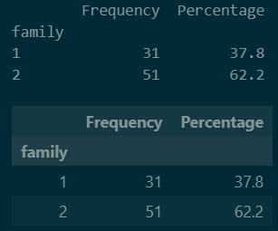
Family status categorization
Viljami Lindholm
Labels for categorys.
1 = Single
2 = Not single

Slide 16
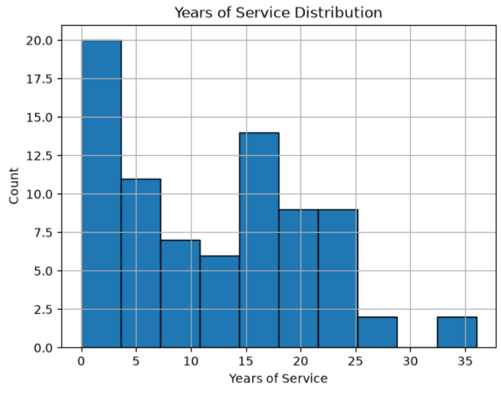
Years of service analysis
Viljami Lindholm
The dataset contains 80 employees. Doing the math the average years of service is 12.18 years.

Slide 17
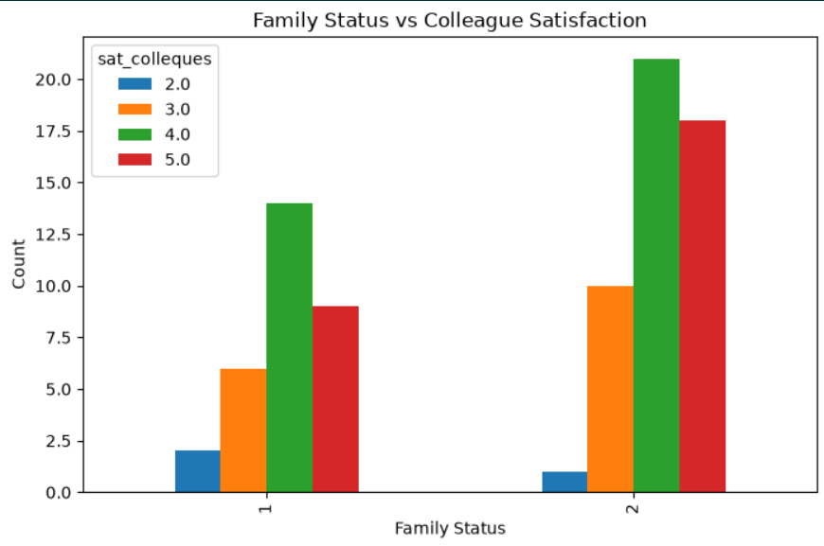
Family status & Colleaque satisfaction
Viljami Lindholm
This analysis compares family status and satisfaction with colleagues. Most responses are concentrated in the positive satisfaction categories, indicating generally good colleague relationships.

Slide 18
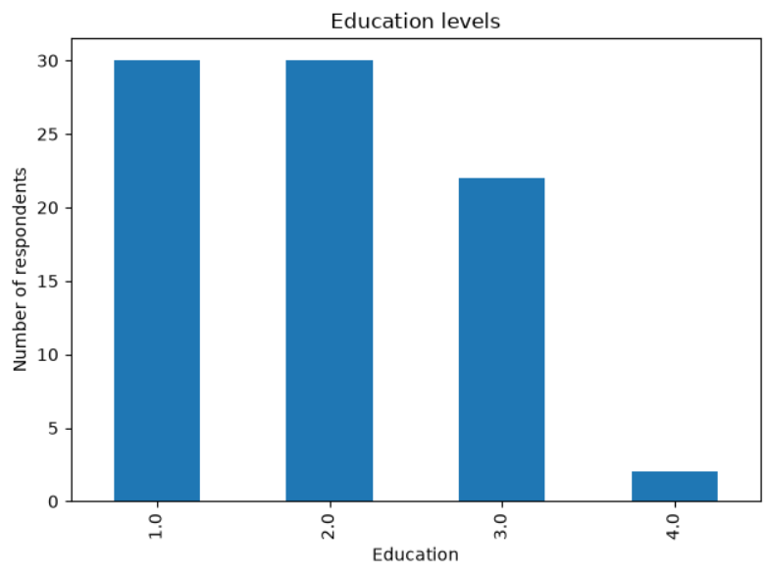
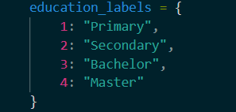
Education analysis
Viljami Lindholm
The education variable shows the distribution of education levels among employees. The largest group represents the most common educational background within the company.

Slide 19
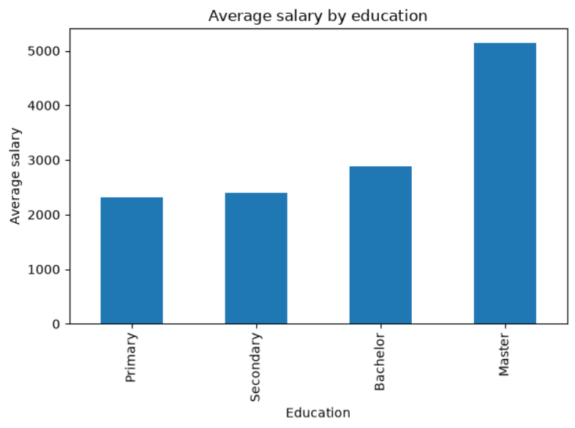
Education & Salary analysis
Viljami Lindholm
This analysis examines whether salary differs across education levels. Higher education levels may be associated with higher average salaries.

Slide 20
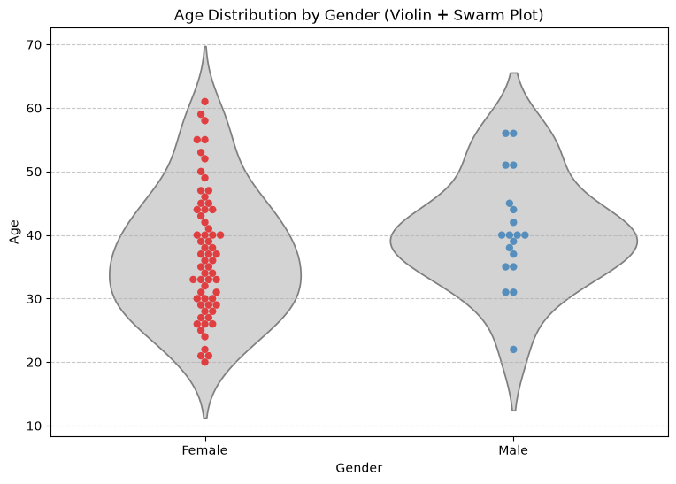
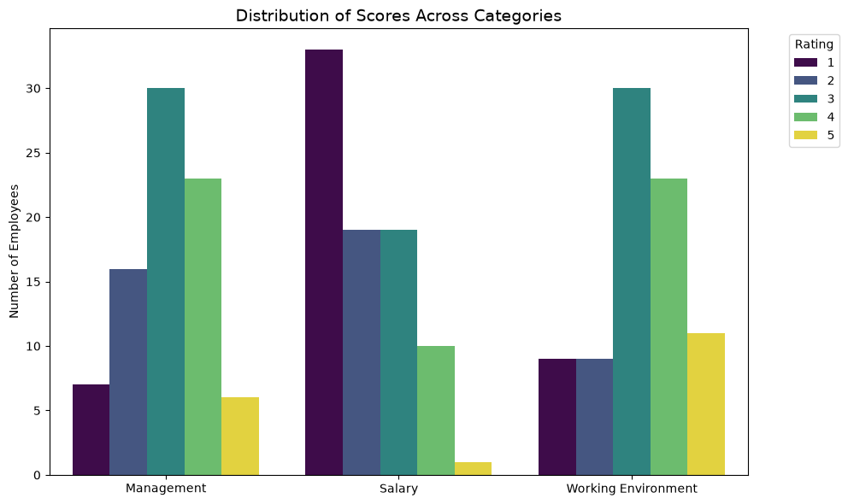
Szymon’s extra charts

Slide 21
