Slide 1

Final Project Presentation
Image classification of Stanford Dogs
Szymon Lepianka
Computational Intelligence 2022

Slide 2
Kaggle
Stanford Dogs Dataset
Over 20,000 images of 120 dog breeds

Slide 3
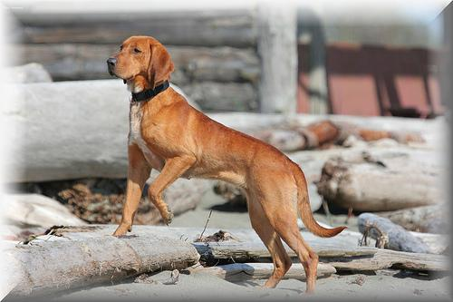
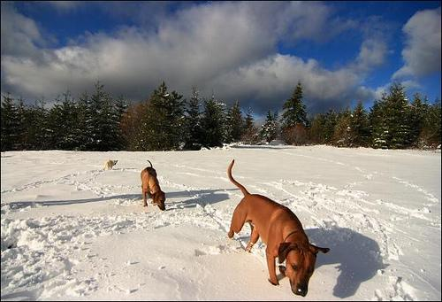
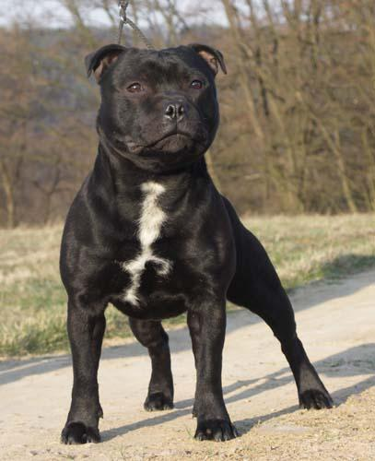
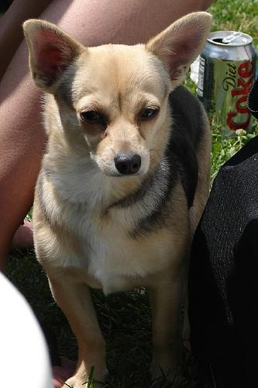
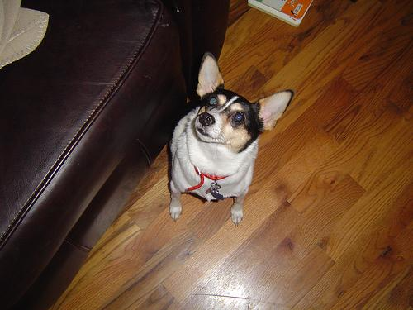
Image examples

Slide 4
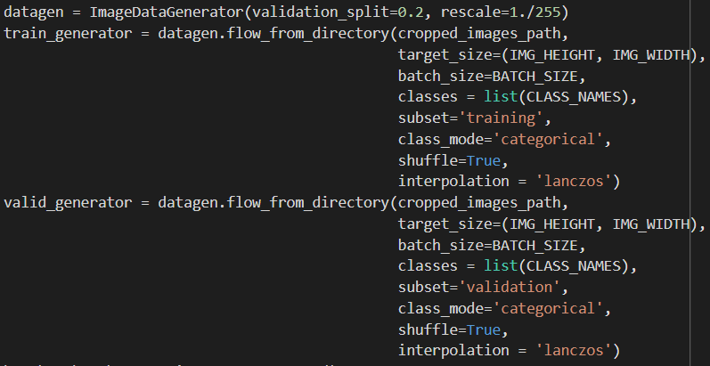
Data preprocessing
Cropping photos (based on XML files with annotations)
Resizing to 200x200
ImageDataGenerator

Slide 5
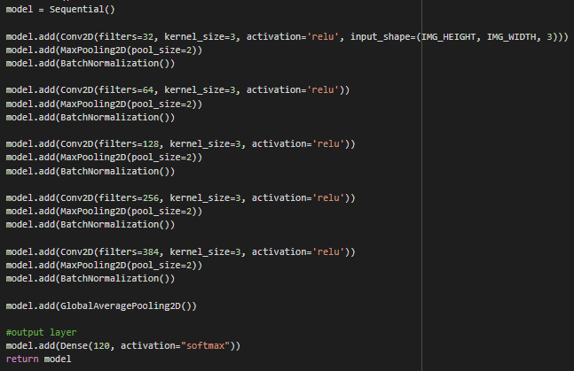
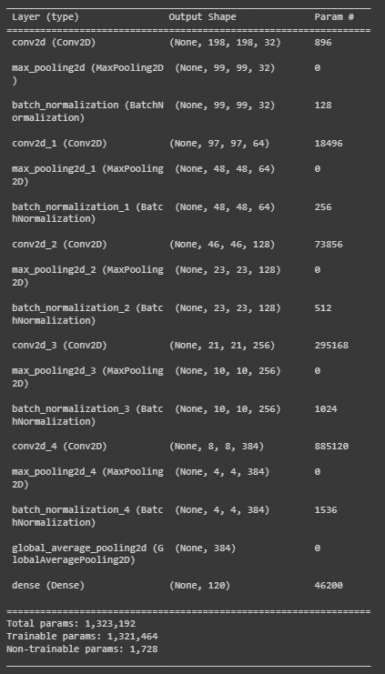
Model 1
5 Conv layers
1 Dense layer

Slide 6
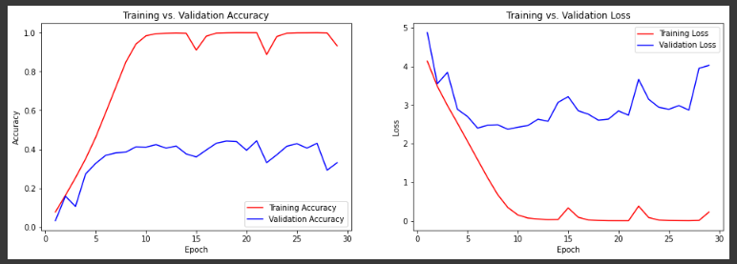
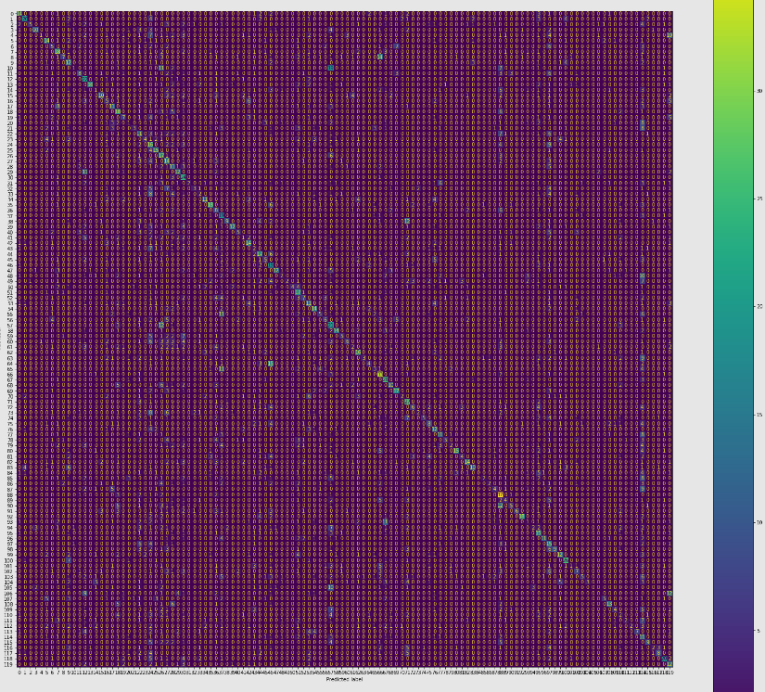
Accuracy: 33,08%

Slide 7
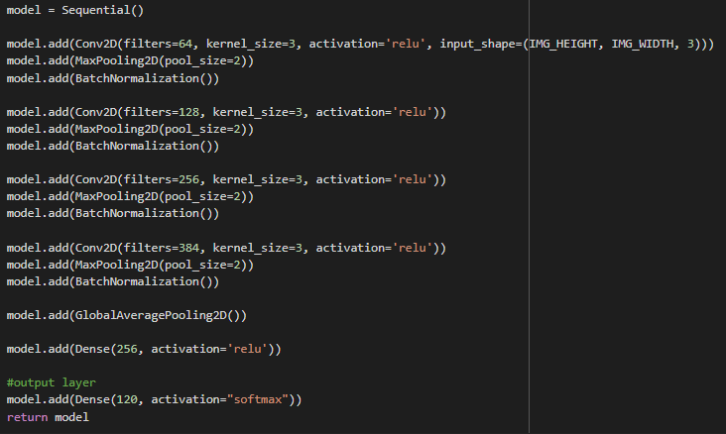
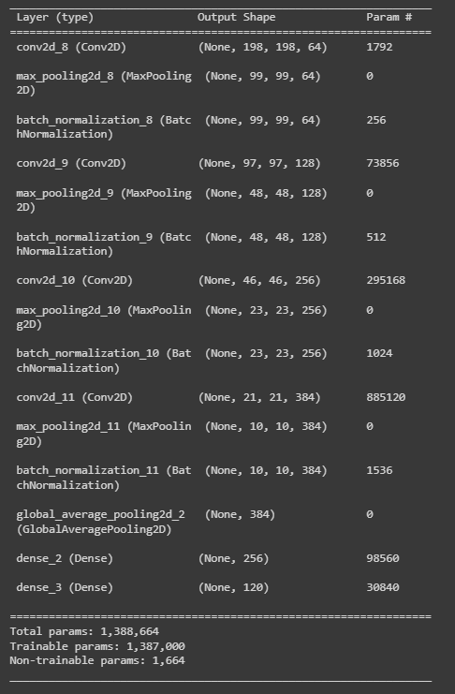
Model 2
Removed first Conv layer
Added second Dense layer

Slide 8
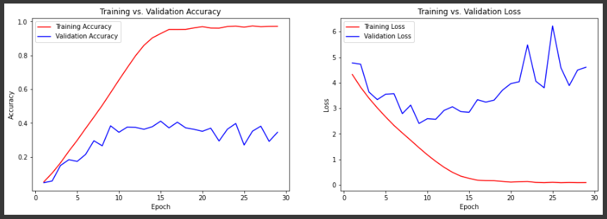

Accuracy: 34,51%

Slide 9
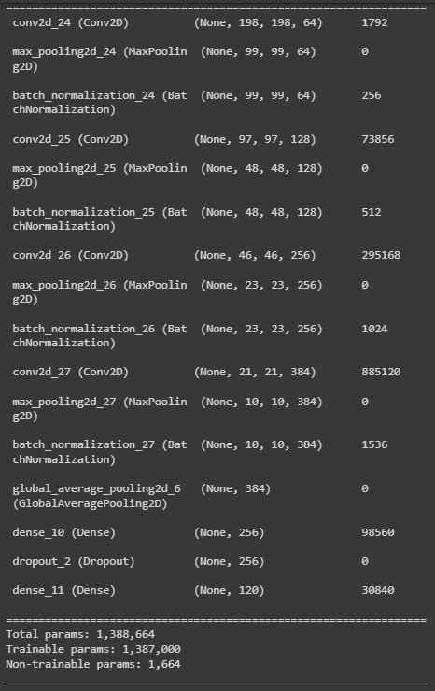
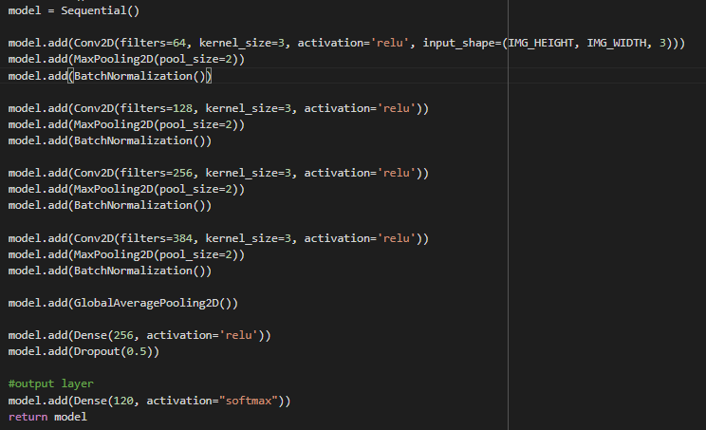
Model 3
Added Dropout after first Dense layer

Slide 10
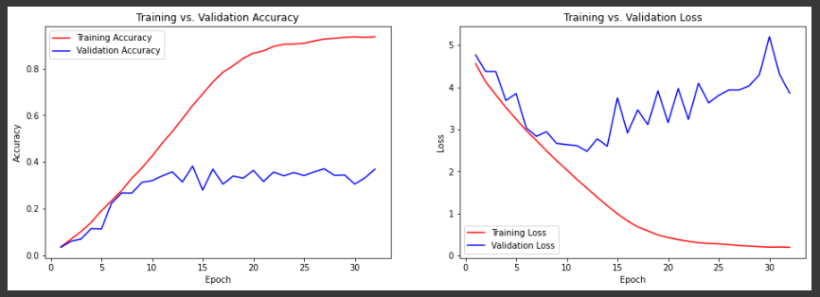

Accuracy: 36,87%

Slide 11
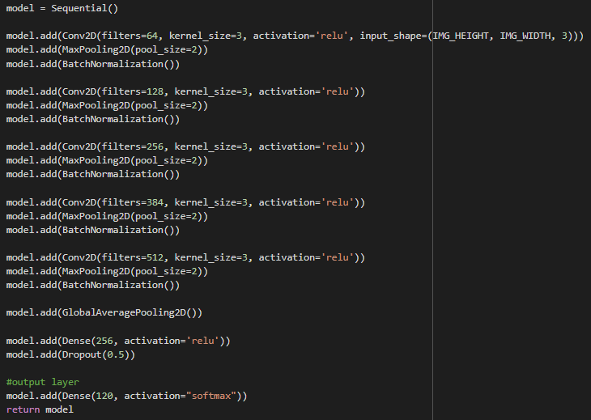
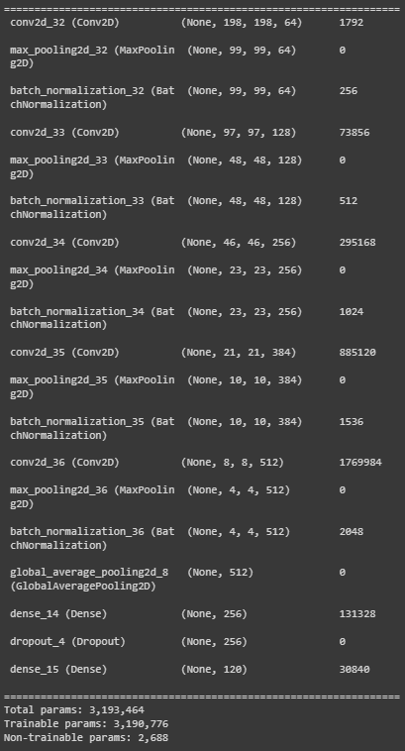
Model 4
Added (5.) Conv layer

Slide 12
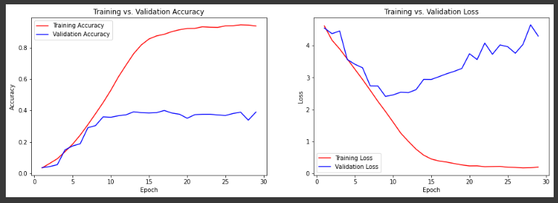

Accuracy: 38,99%

Slide 13
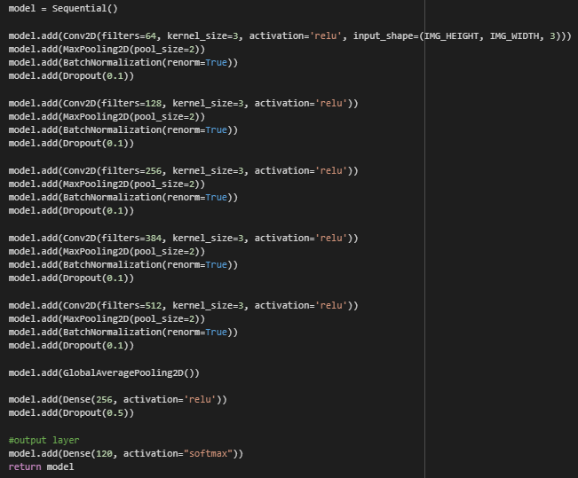
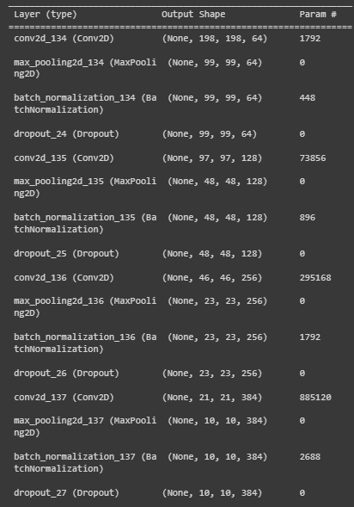
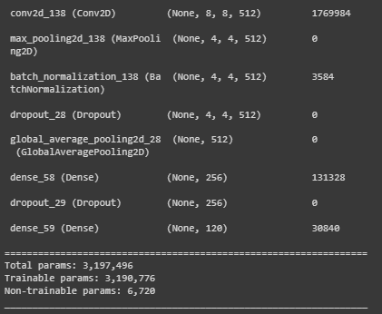
Model 5
Added Dropout after every Conv layer

Slide 14
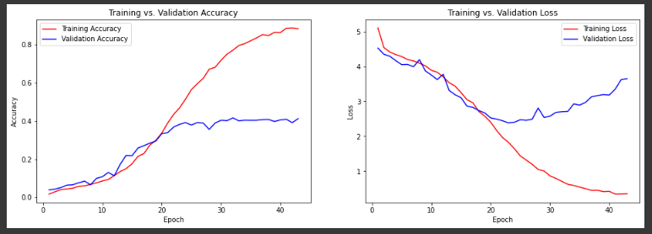

Accuracy: 41,29%

Slide 15
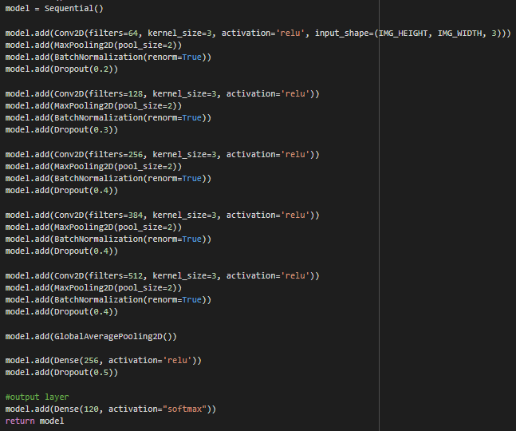
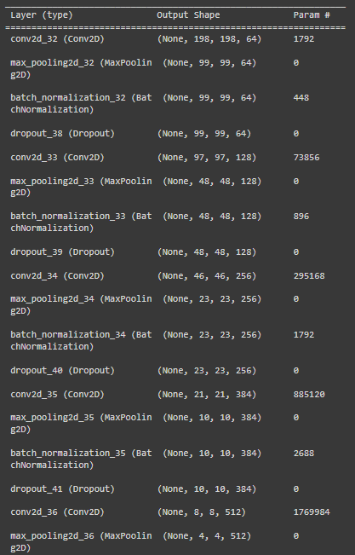
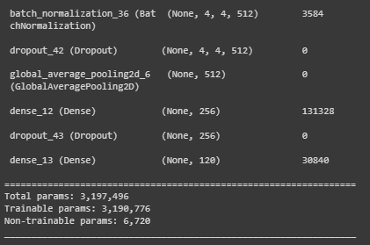
Model 7
Improved rate in Dropout layers

Slide 16
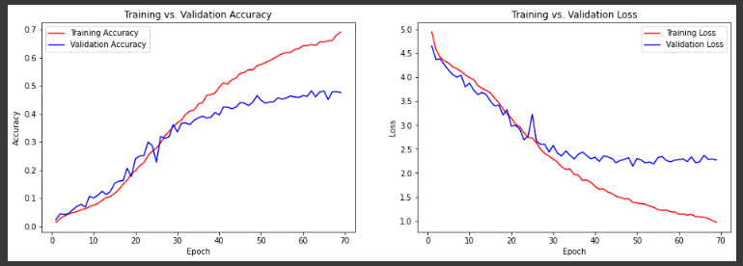

Accuracy: 47,57%

Slide 17

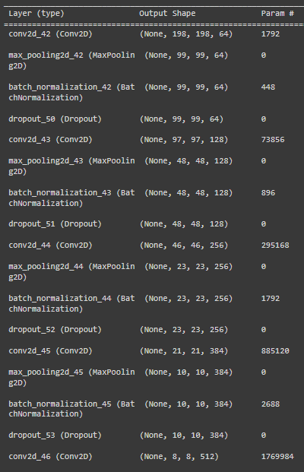
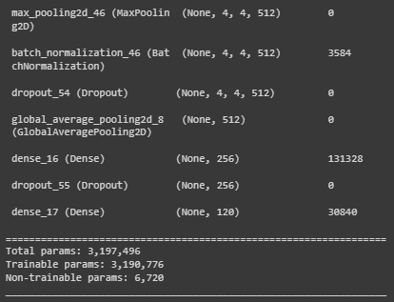
Model 8
Improved rate in Dropout layers

Slide 18
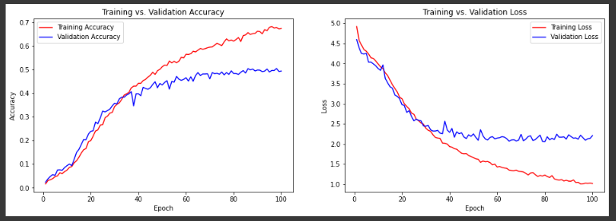

Accuracy: 49,40%

Slide 19
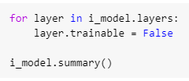
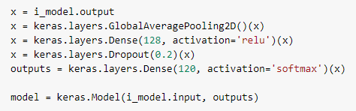
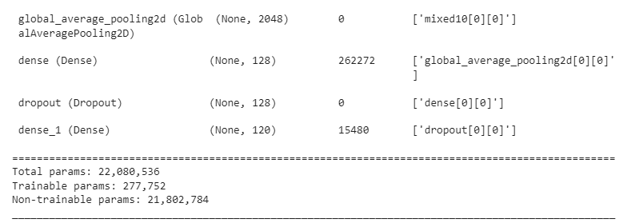
Model 9
Transfer learning with freeze layers

Slide 20
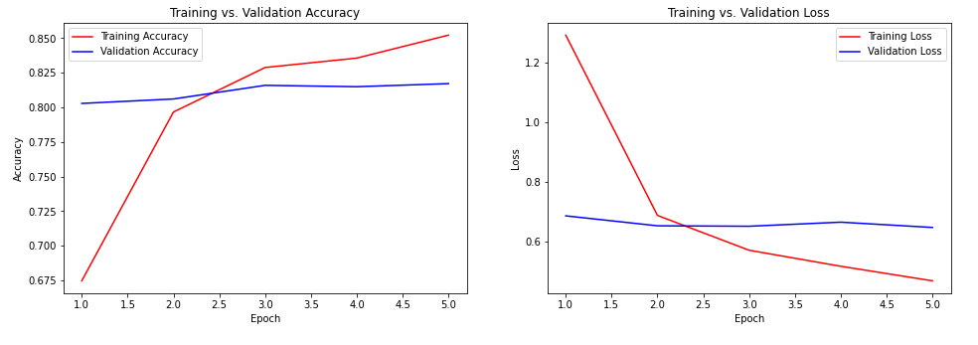

Accuracy: 81,71%

Slide 21

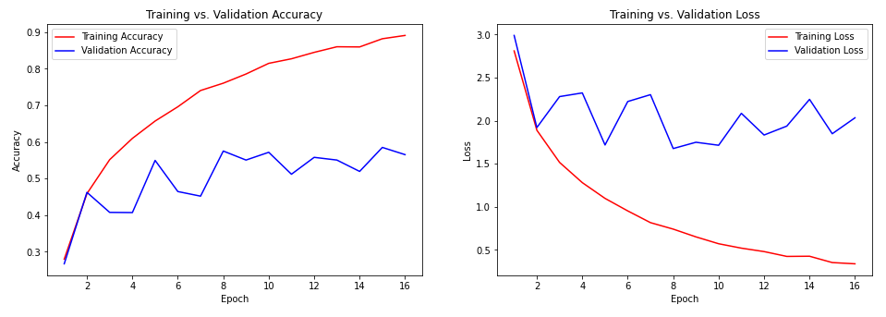

Model 10
Fine tuning with unfreeze all layers
Accuracy: 56,54%

Slide 22

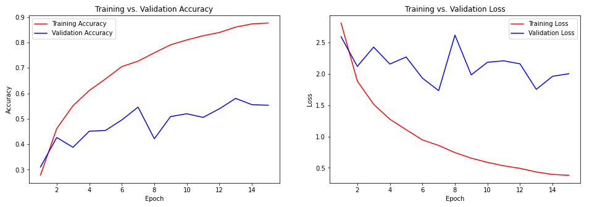
Model 11
Fine tuning with unfreeze last 9 layers
Accuracy: 55,34%

Slide 23
Additional two models added after the last class
I divided all the filter counts by 2
and then by 4

Slide 24
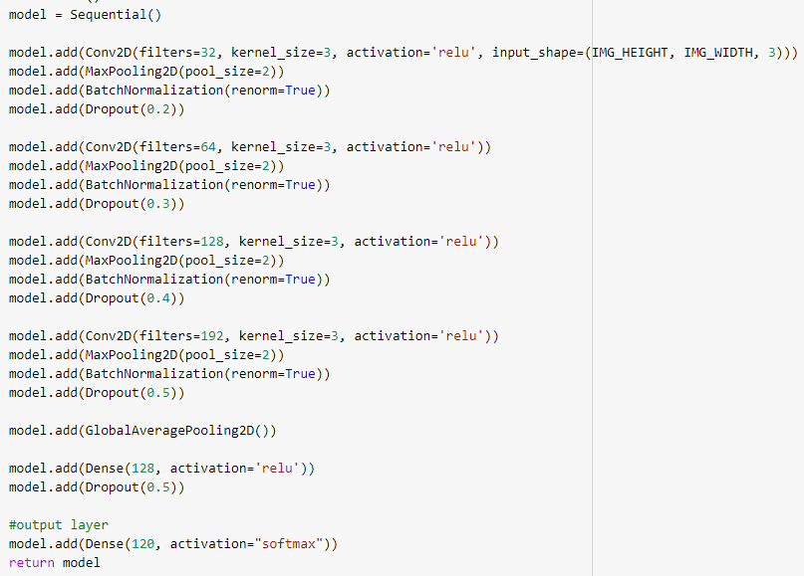
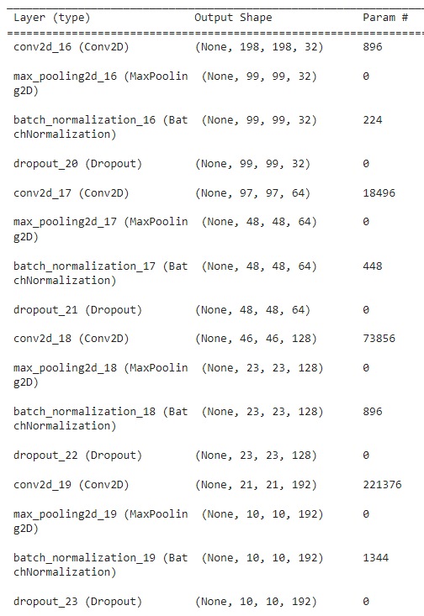
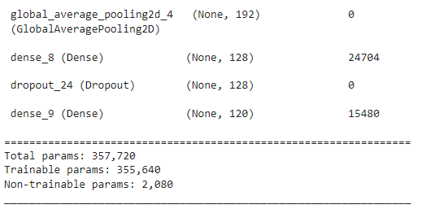
Model 12
all filters divided by 2

Slide 25
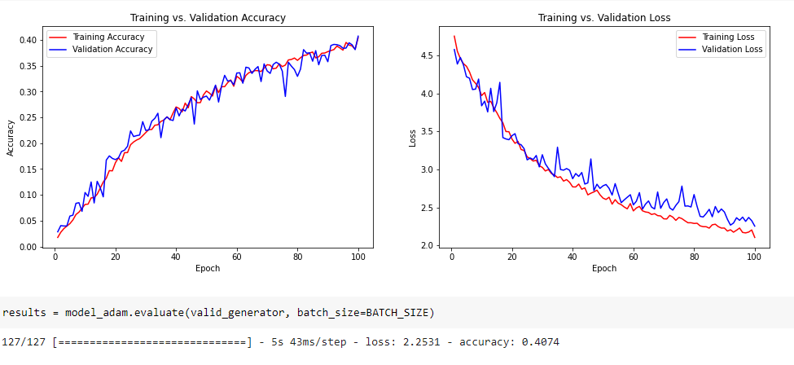
Accuracy: 40,74%

Slide 26
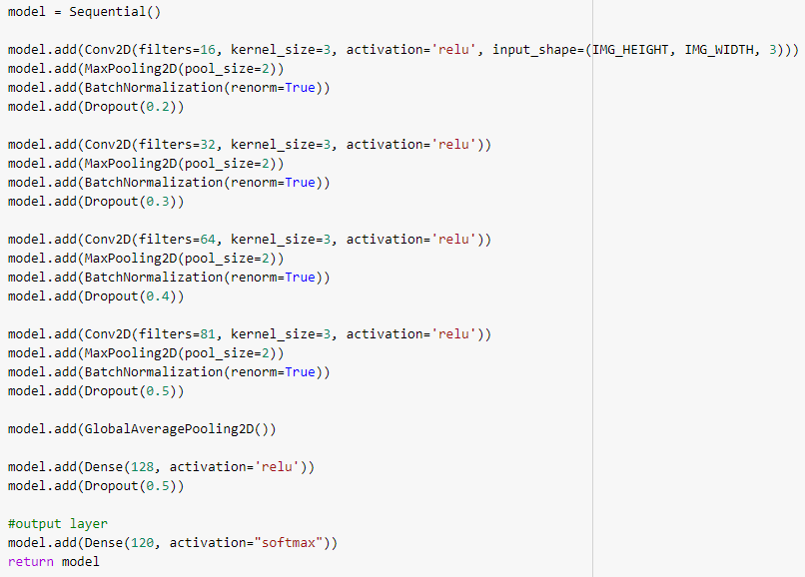
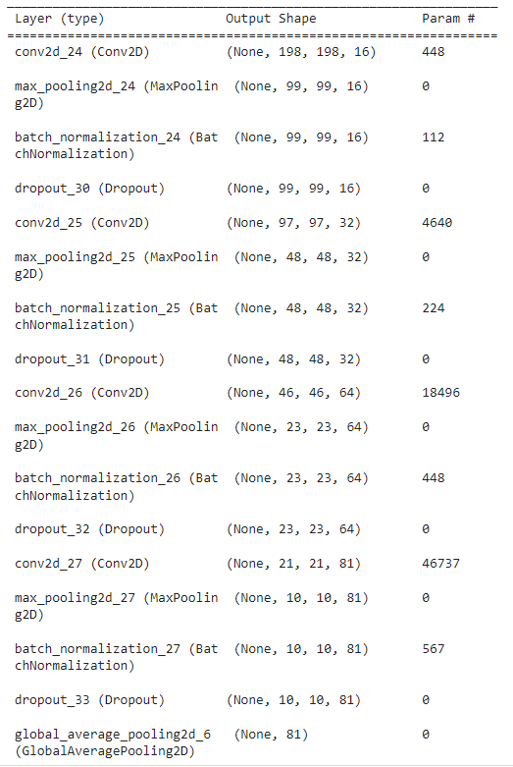
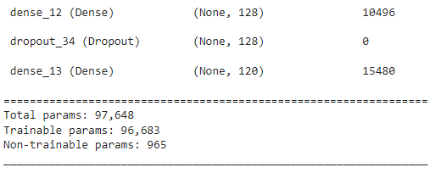
Model 13
all filters divided by 4

Slide 27
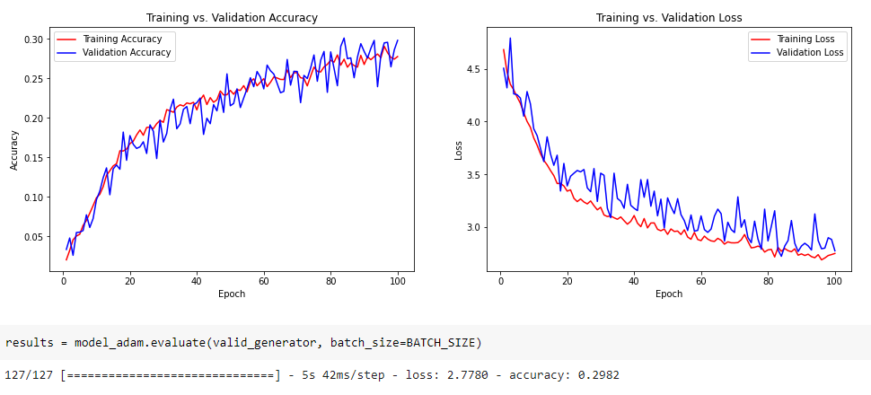
Accuracy: 29,82%

Slide 28
Summary and conclusions
I could probably get better results using this data. Model 12 (learned after the last class) shows that it works well with fewer parameters.
The best result I have obtained with my own CNN network (Model 8) is almost 50% accuracy.
I achieved the best overall result with transfer learning (InceptionV3, Model 9) - more than 81% accuracy.
The attempt to use fine-tuning was unsuccessful. I made a mistake somewhere. It is possible that I unnecessarily recompiled the model and that was the cause of the malfunction.

Slide 29
Summary and conclusions
A breakthrough in creating the project was the use of ImageDataGenerator because using numpy.array caused sessions to crash due to lack of RAM.
The models I created took a long time to learn (especially at the beginning of the project), so I decided to buy the Colab Pro to be able to do as much as possible. This significantly improved the training time of the models.
From the solutions I looked at on the Kaggle website, I haven't found a CNN model that is better than 50%.

