Slide 1

Presentation of progress
Image classification of Stanford Dogs
Szymon Lepianka
Computational Intelligence 2022

Slide 2
Stanford Dogs Dataset
Kaggle
Over 20,000 images of 120 dog breeds
Use of image data
Multiclass classification
Create a neural network (Keras CNN)
Subset selection (choose only a few classes)
Cross validation
Try a transfer learning and data augmentation
Analyze results (confussion matrix, scores etc.)

Slide 3
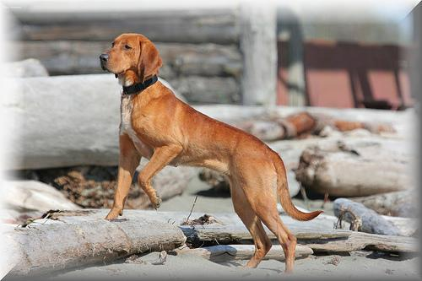
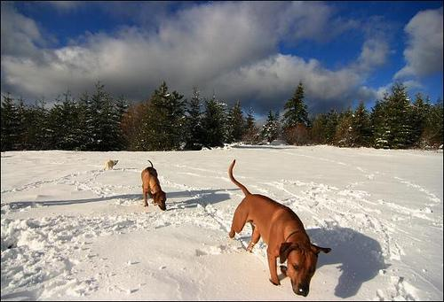
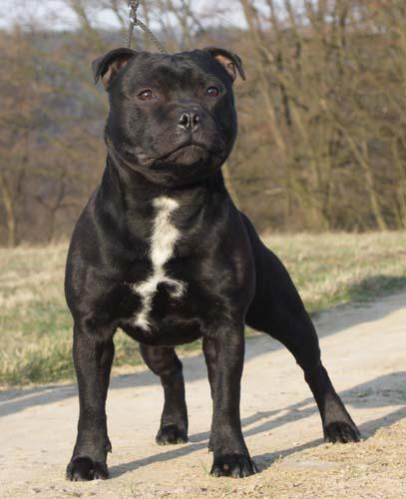
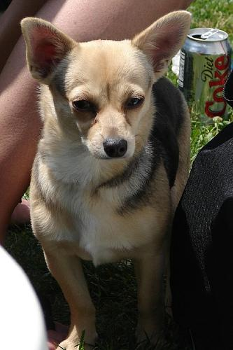
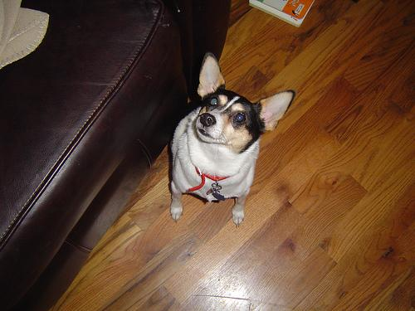
Image examples

Slide 4

Mounting Google Drive

Slide 5
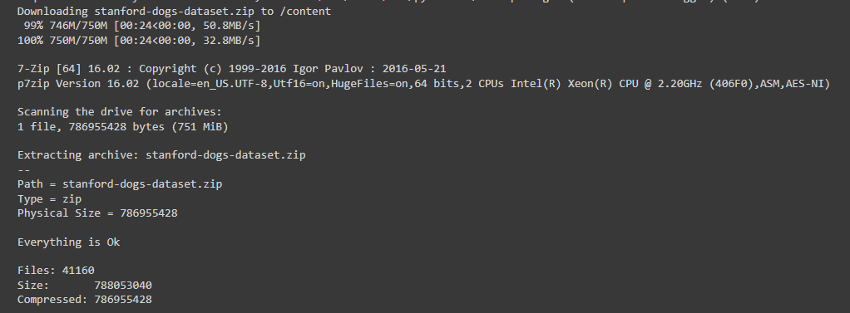
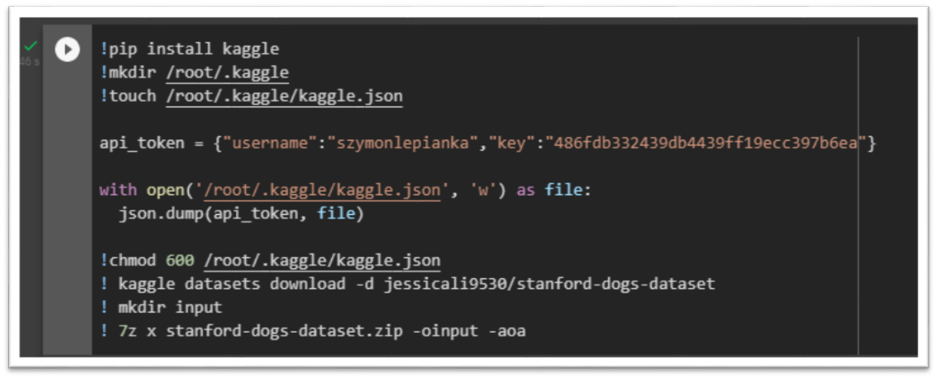
Kaggle setup

Slide 6
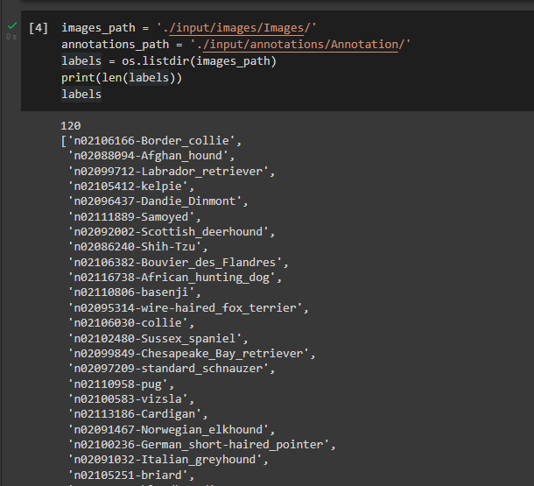
All breeds list

Slide 7
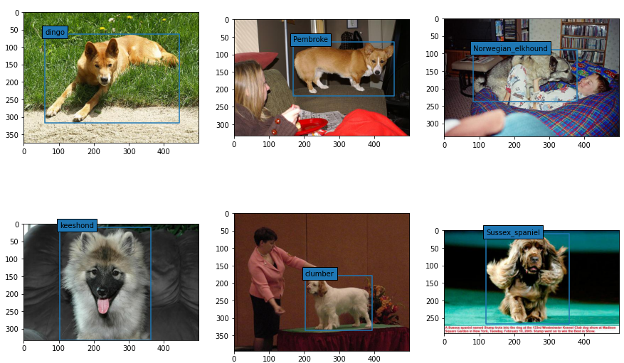
Cropping photos
The files in the Annotation folder are XML-structured. It contains the necessary information, a breed name and a bounding box. In some images, the dog does not always occupy the entire area. Therefore, these images will have to be cropped.

Slide 8
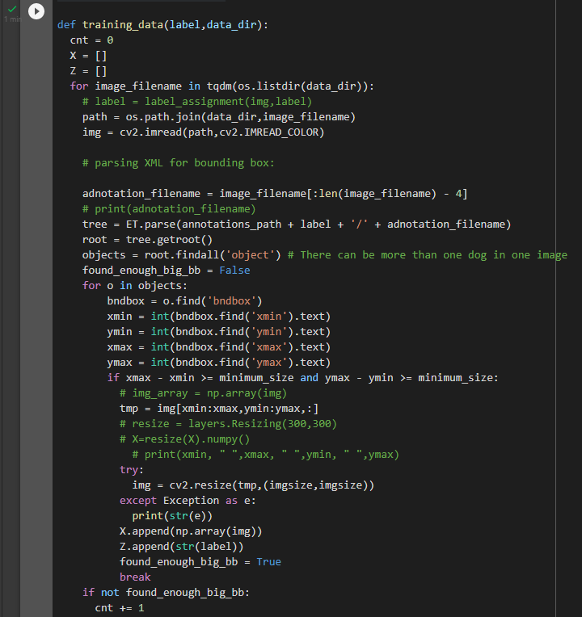
Discarding too small images

Slide 9

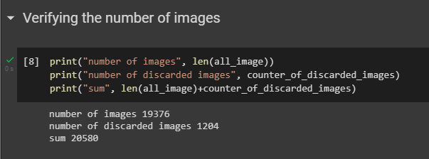

Slide 10
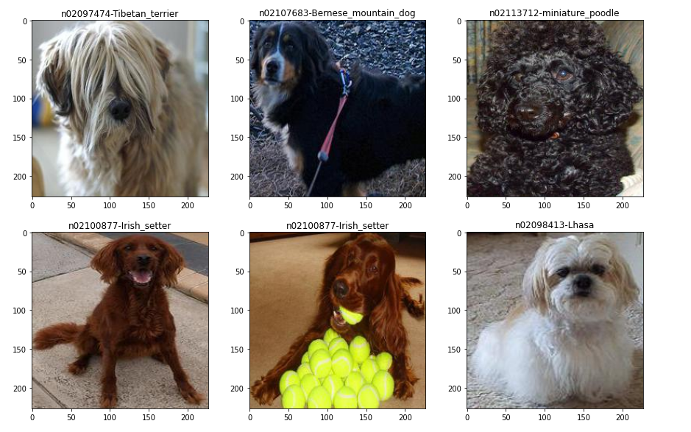
Images after cropping

Slide 11
Selecting several breeds of dogs (~10)

Slide 12
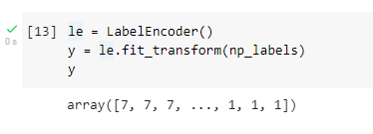
Convert class labels to numbers between 0 and n_classes – 1

Slide 13
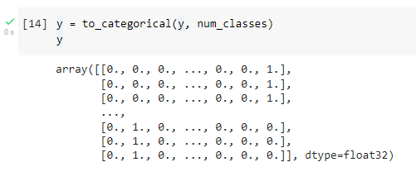
One hot encoding target variables

Slide 14

Normalizing the data

Slide 15
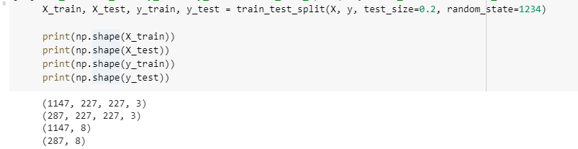
Train test split

Slide 16
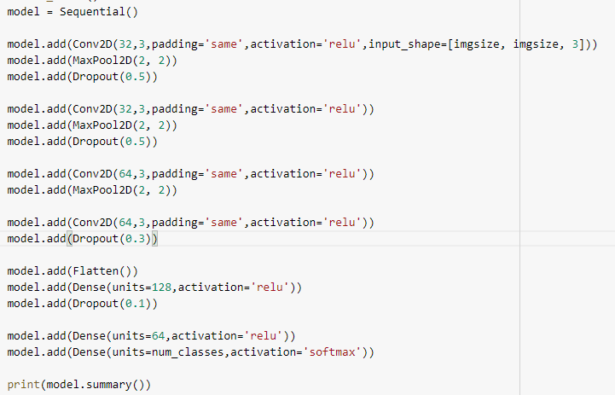
Model

Slide 17
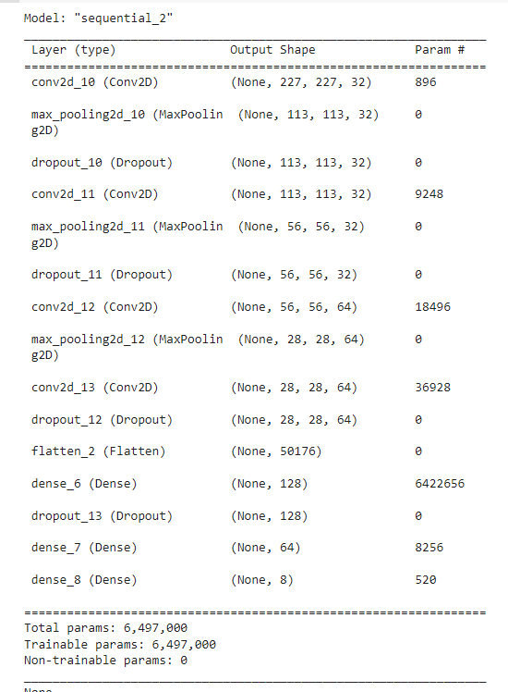
Model

Slide 18
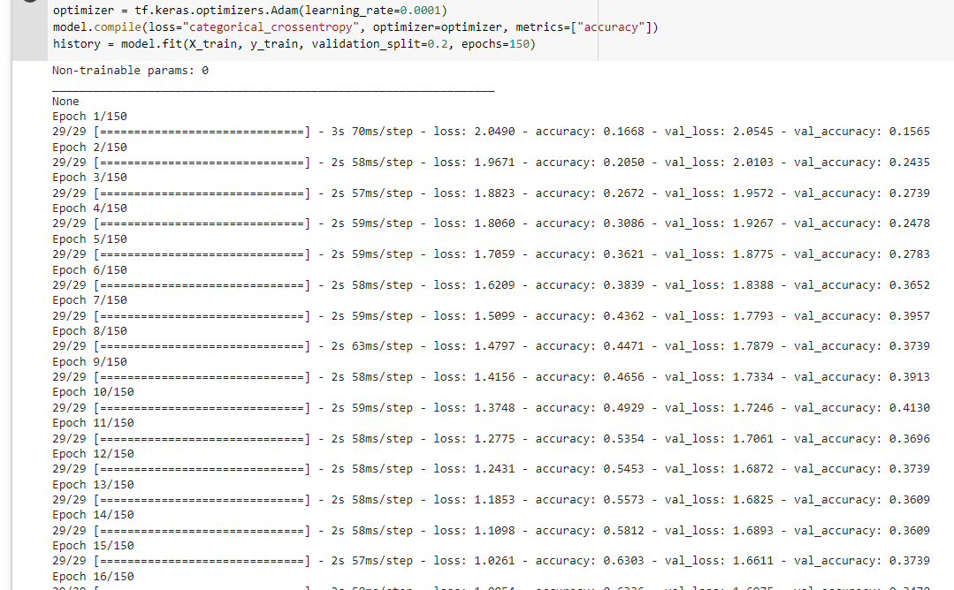
Model

Slide 19
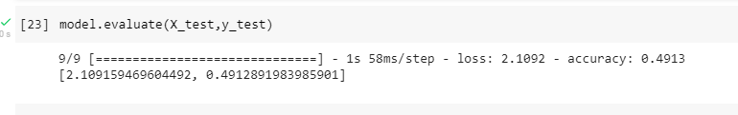
Model

Slide 20
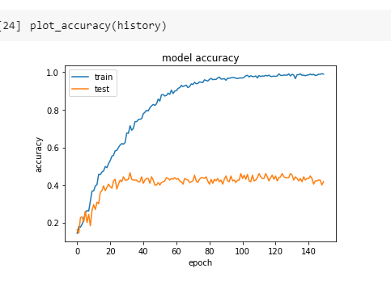
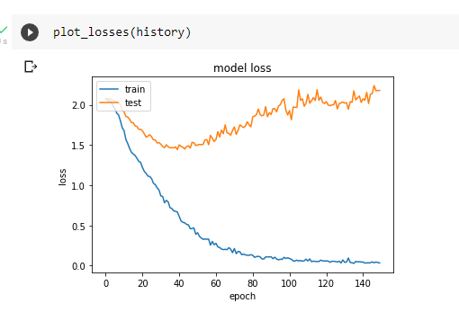
Model

Slide 21
Next steps

