Slide 1

Presentation of progress
Image classification of Stanford Dogs
Szymon Lepianka
Computational Intelligence 2022

Slide 2
Stanford Dogs Dataset
Kaggle
Over 20,000 images of 120 dog breeds
Use of image data
Multiclass classification
Create a neural network (Keras CNN)
Subset selection (choose only a few classes)
Try a transfer learning and data augmentation
Analyze results (confussion matrix, scores etc.)

Slide 3
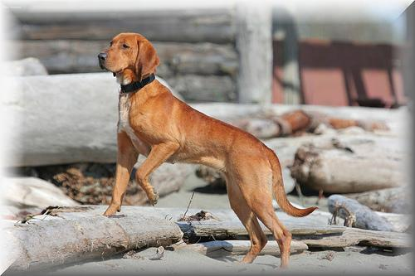
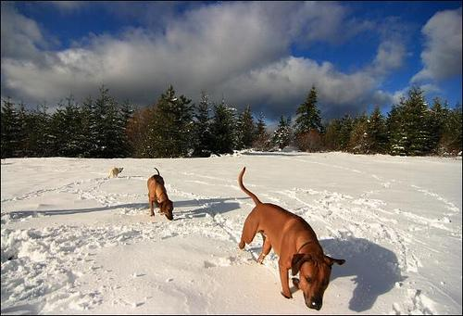
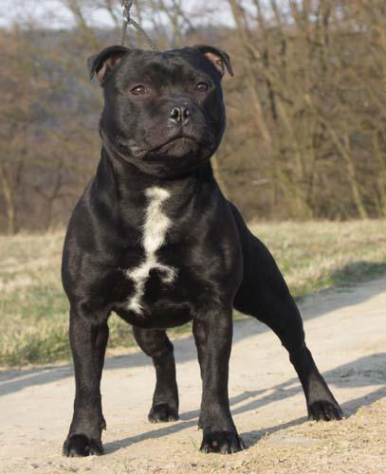
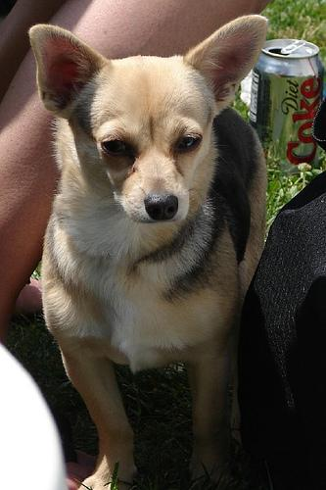
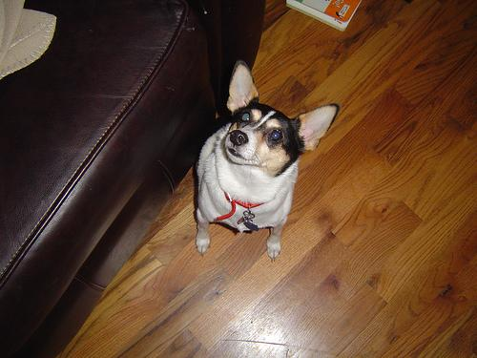
Image examples

Slide 4
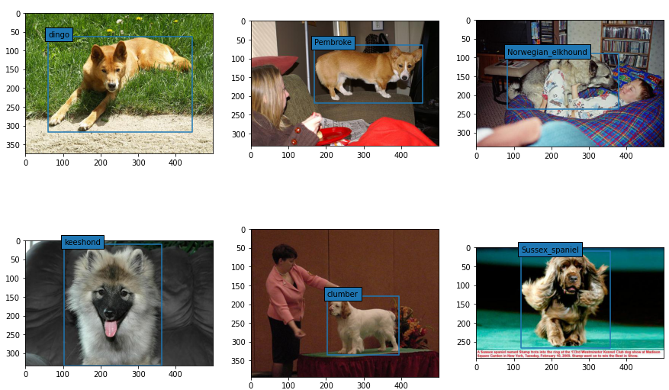
Cropping photos
The files in the Annotation folder are XML-structured. It contains the necessary information, a breed name and a bounding box. In some images, the dog does not always occupy the entire area. Therefore, these images will have to be cropped.

Slide 5
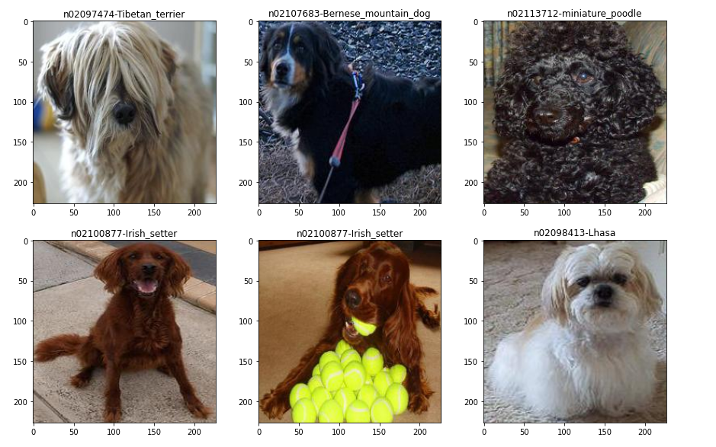
Images after cropping

Slide 6
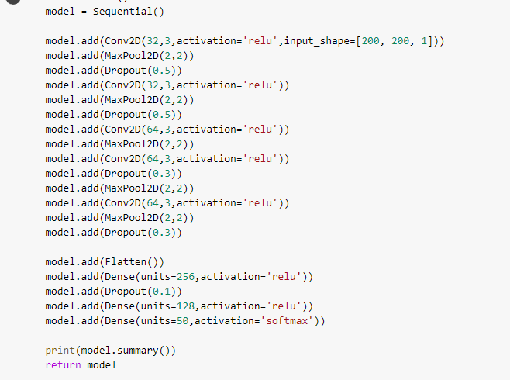
Improved model

Slide 7
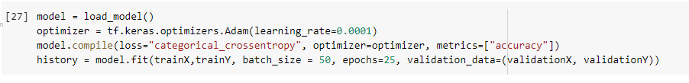
Improved model

Slide 8
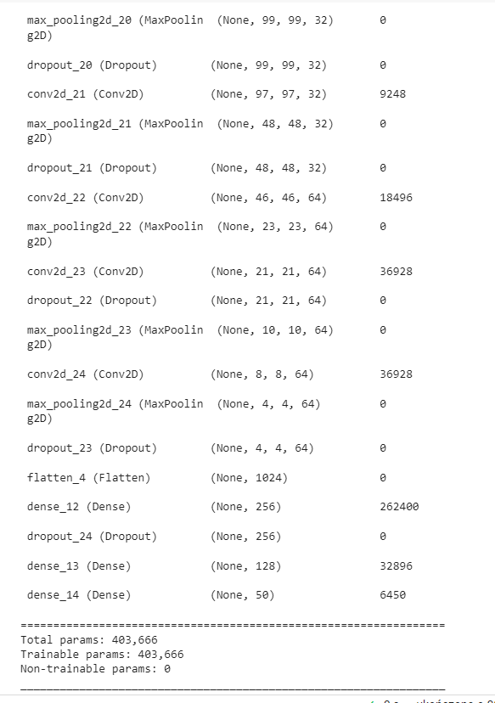
Improved model

Slide 9
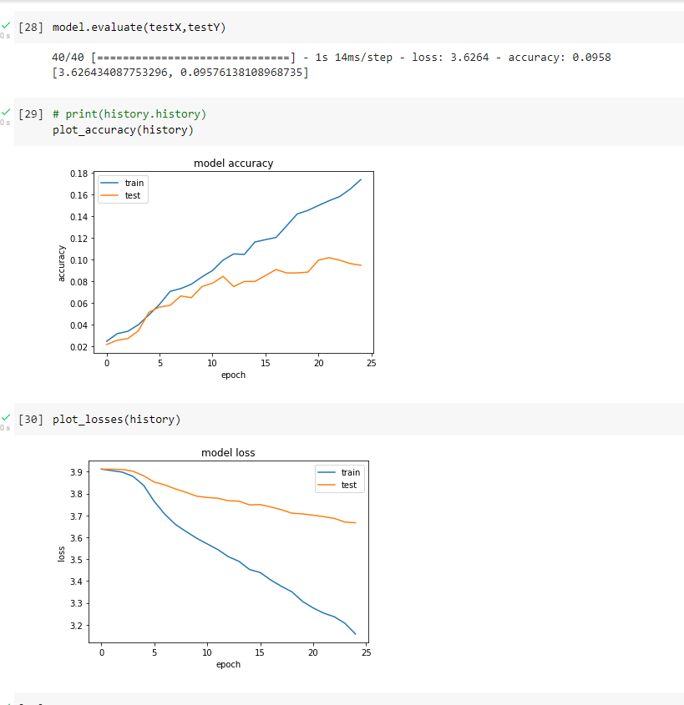
Improved model

Slide 10
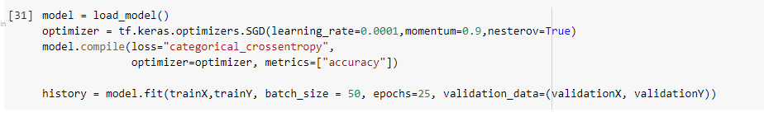
Fitting with changed optimizer

Slide 11
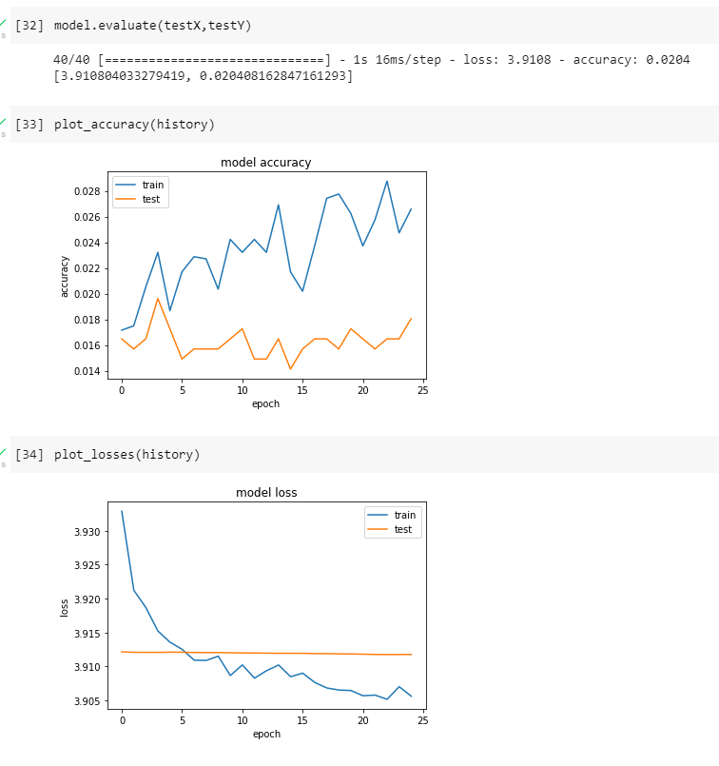
Fitting with changed optimizer

