Slide 1

Final Project Presentation
Image classification of Stanford Dogs
Szymon Lepianka
Computational Intelligence 2022

Slide 2
Kaggle
Stanford Dogs Dataset
Over 20,000 images of 120 dog breeds

Slide 3
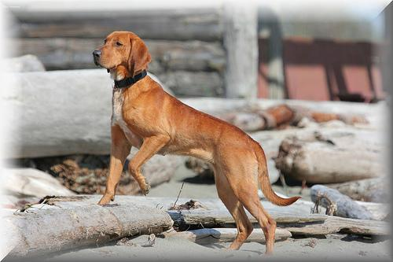
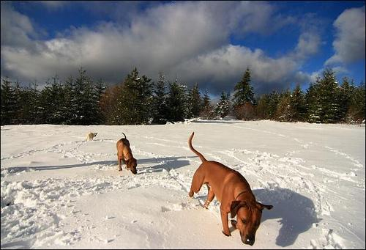
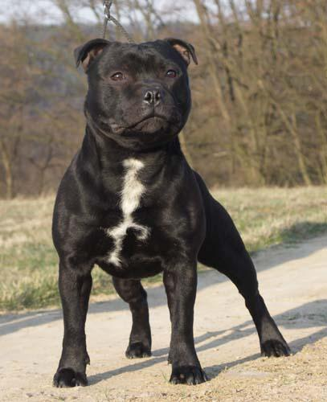
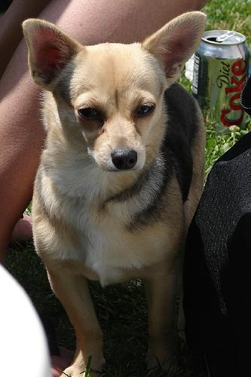
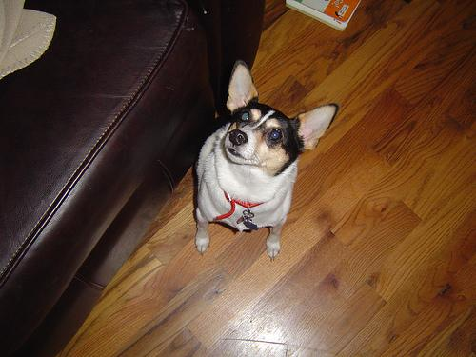
Image examples

Slide 4
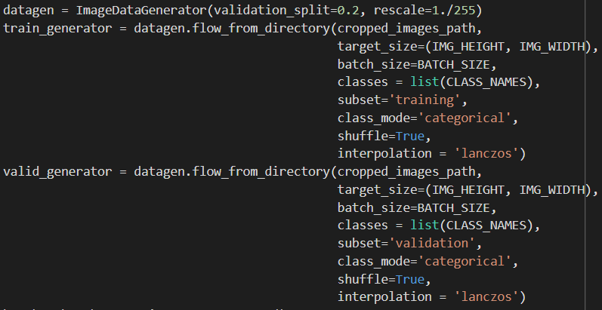
Data preprocessing
Cropping photos (based on XML files with annotations)
Resizing to 200x200
ImageDataGenerator

Slide 5
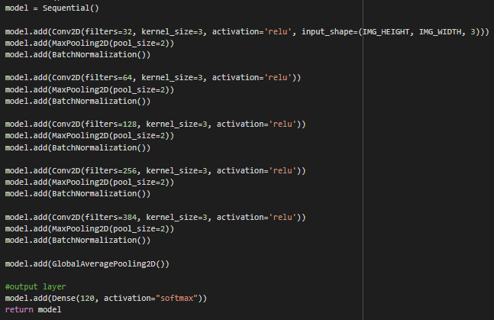
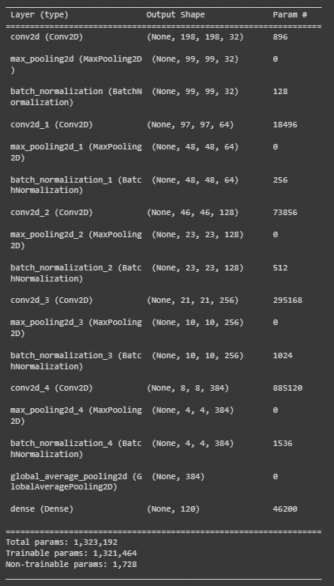
Model 1
5 Conv layers
1 Dense layer

Slide 6
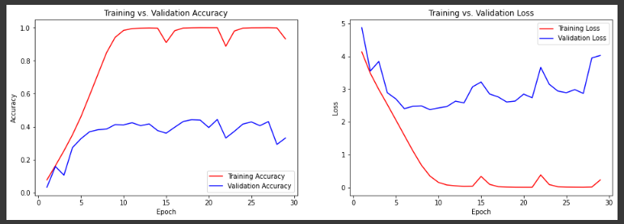
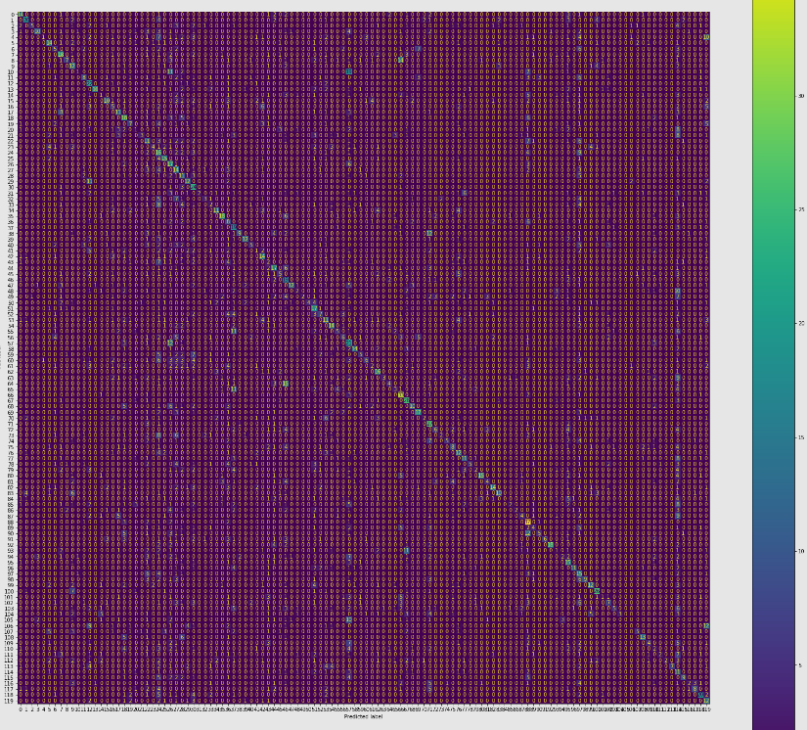
Accuracy: 33,08%

Slide 7
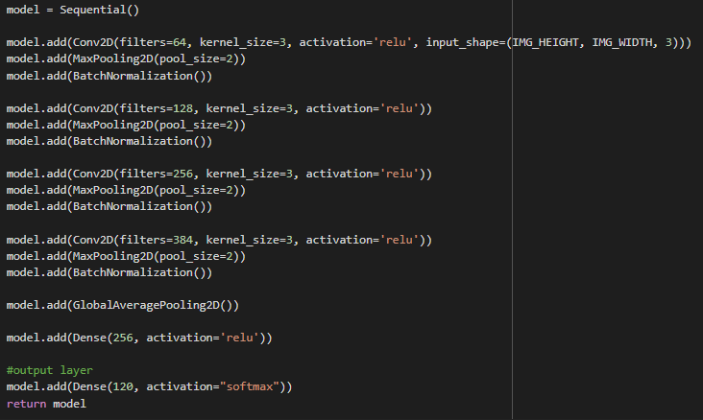
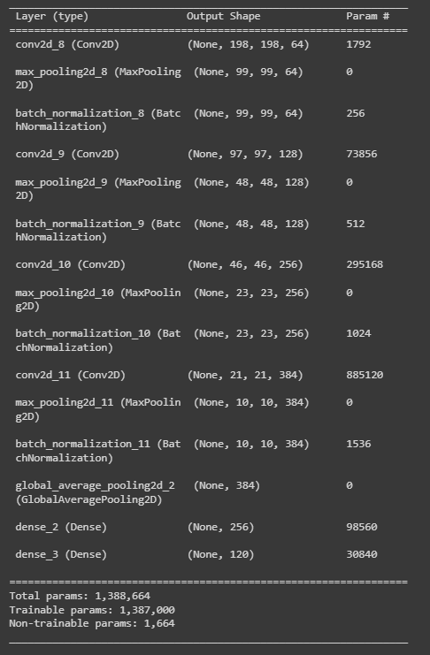
Model 2
Removed first Conv layer
Added second Dense layer

Slide 8
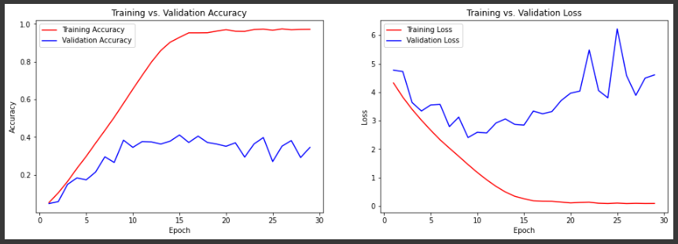

Accuracy: 34,51%

Slide 9
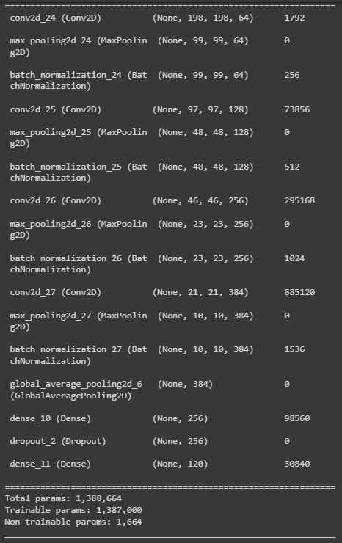
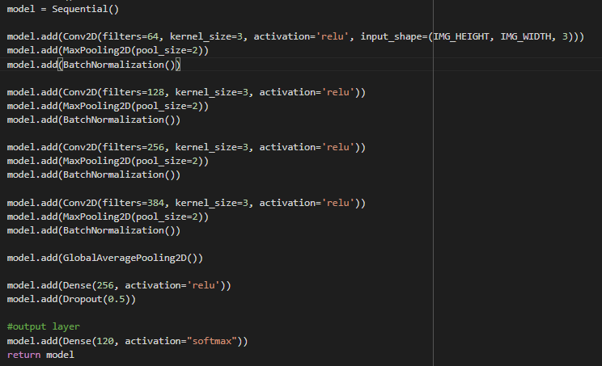
Model 3
Added Dropout after first Dense layer

Slide 10
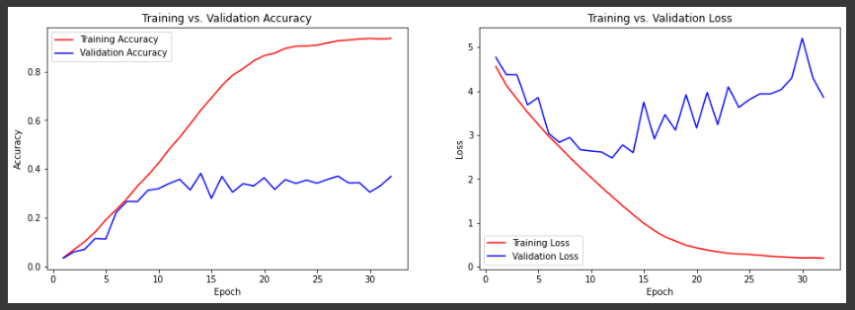

Accuracy: 36,87%

Slide 11
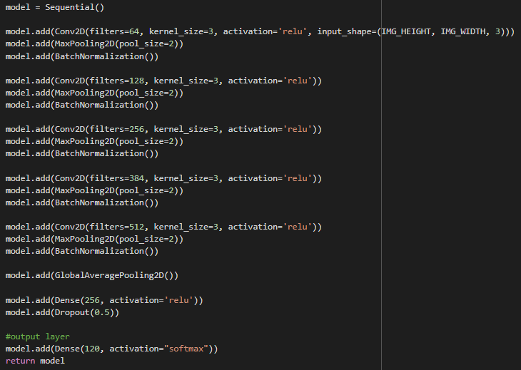
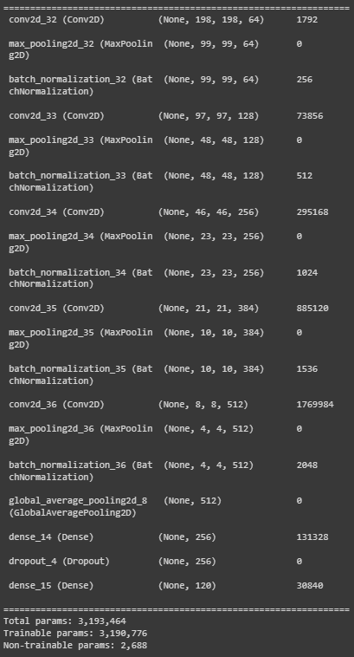
Model 4
Added (5.) Conv layer

Slide 12
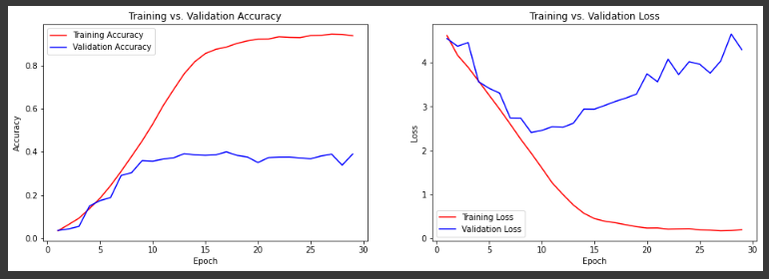

Accuracy: 38,99%

Slide 13
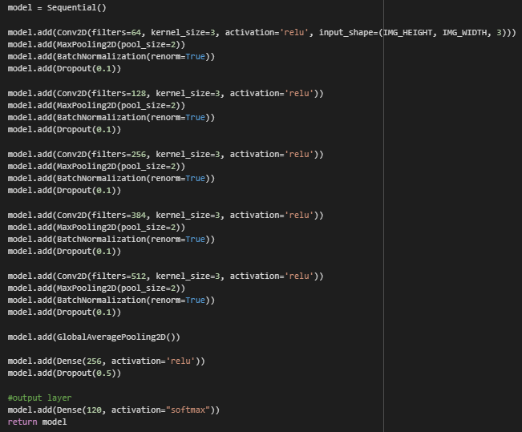
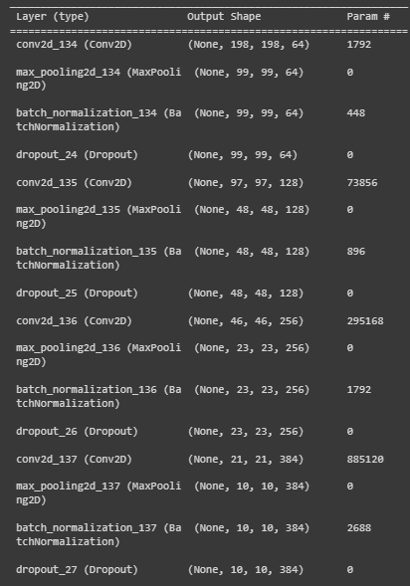
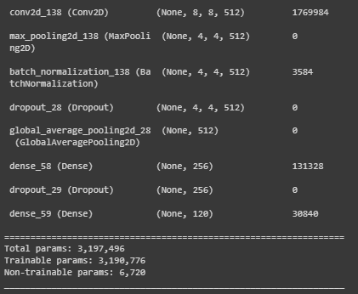
Model 5
Added Dropout after every Conv layer

Slide 14
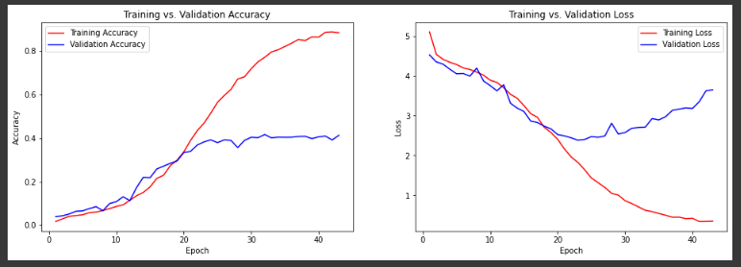

Accuracy: 41,29%

Slide 15
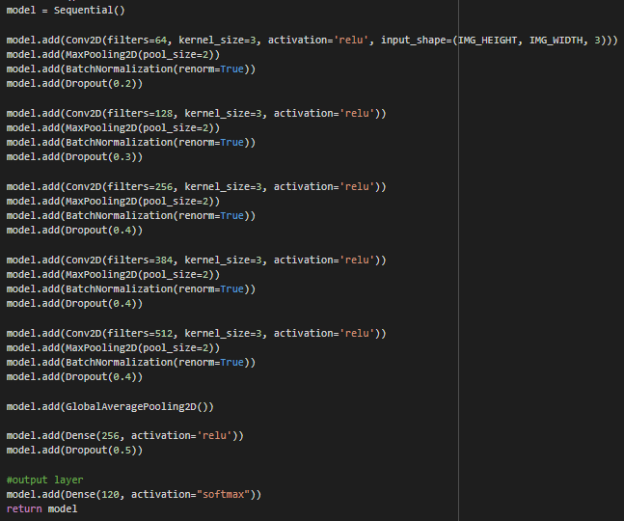
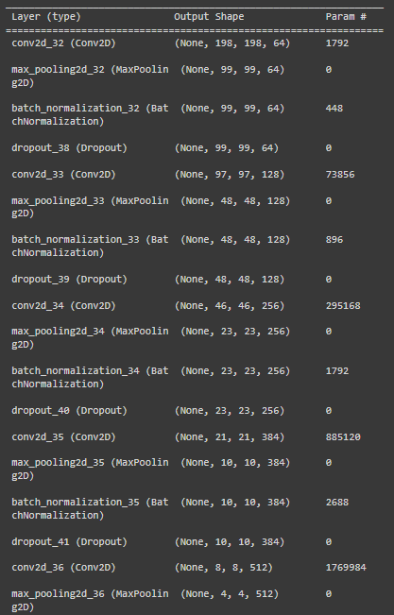
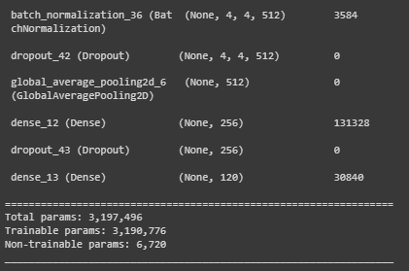
Model 7
Improved rate in Dropout layers

Slide 16
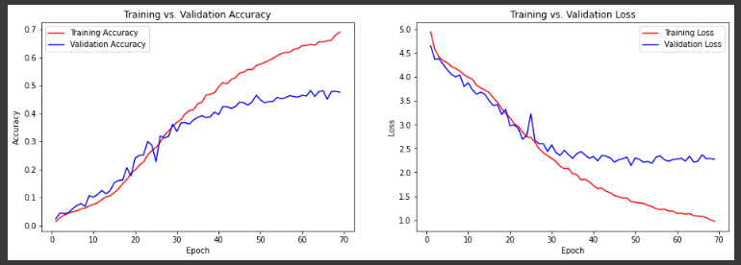

Accuracy: 47,57%

Slide 17

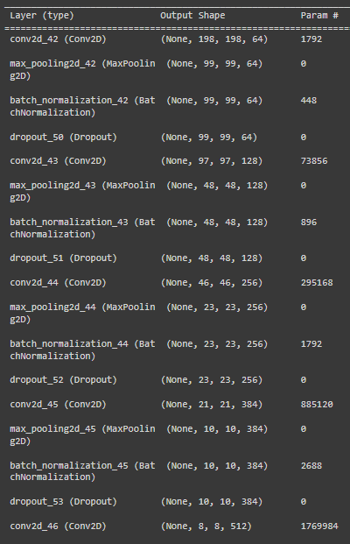
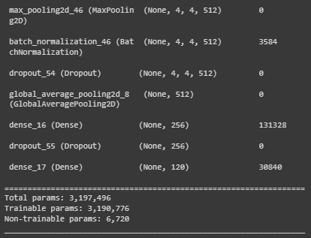
Model 8
Improved rate in Dropout layers

Slide 18
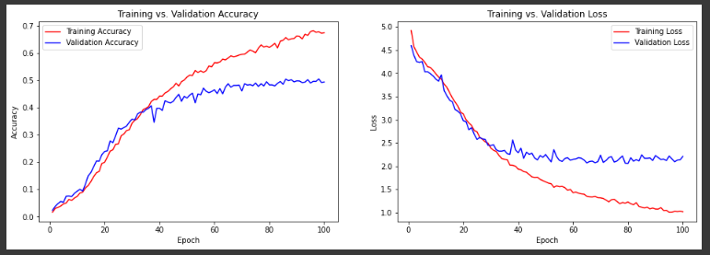

Accuracy: 49,40%

Slide 19
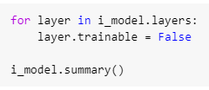
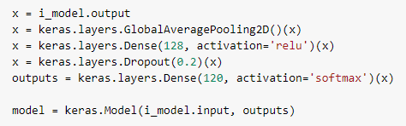
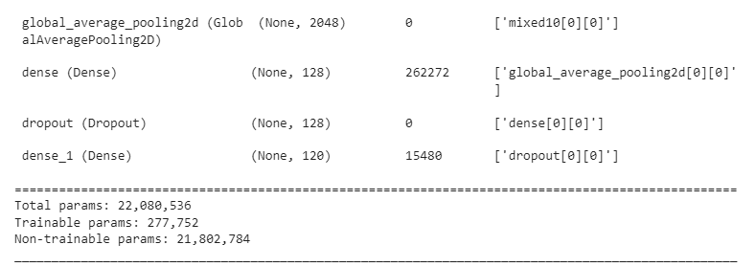
Model 9
Transfer learning with freeze layers

Slide 20
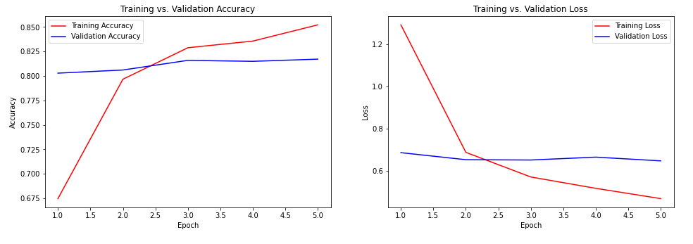

Accuracy: 81,71%

Slide 21

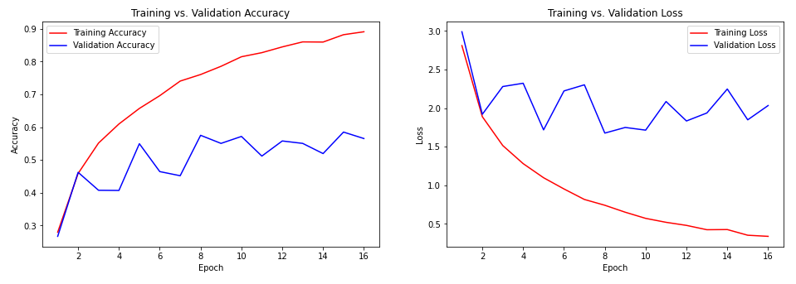

Model 10
Fine tuning with unfreeze all layers
Accuracy: 56,54%

Slide 22

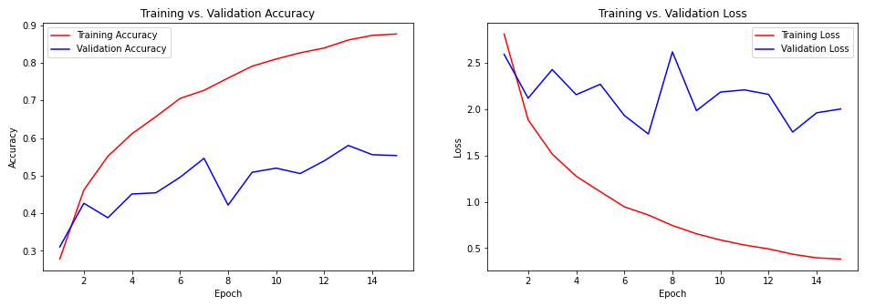
Model 11
Fine tuning with unfreeze last 9 layers
Accuracy: 55,34%

