Slide 1



HTTP
Shopping cart
UI
Web Server

Slide 2
HTTP
Shopping cart
UI
Web Server
WebSockets

Slide 3

HTTP
Shopping cart
UI
Web Server
WebSockets

Slide 4
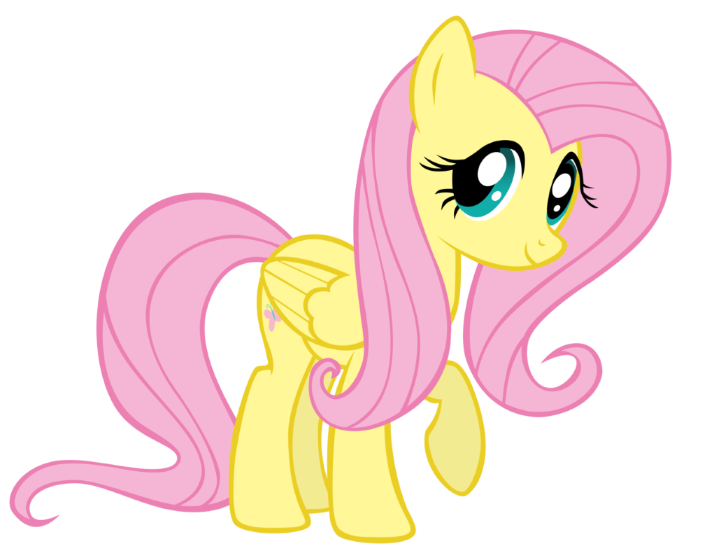
What value does the Web Server add, anyway?

Slide 5
HTTP
Shopping cart
UI
Web Server
WebSockets

Slide 6
HTTP
Shopping cart
UI
WebSockets

Slide 7
HTTP
UI
Shopping cart

Slide 8
UI
Shopping
cart
UI

Slide 9
HTTP
Shopping cart
UI

Slide 10
HTTP
Shopping cart
Batch job
UI

Slide 11
HTTP
HTTP
Shopping cart
Shipping
UI

Slide 12
HTTP
HTTP
Shopping cart
Batch job
Shipping
UI

Slide 13

HTTP
HTTP
Shopping cart
Shopping cart
Batch job
Batch job
Shipping
UI

Slide 14

So you decided to build a poor pony’s queue?

Slide 15


HTTP
HTTP
Shopping cart
Batch job
Shipping
UI

Slide 16

I have an idea!

Slide 17
HTTP
Shopping cart
Shipping
UI
UI

Slide 18
Sync
Async
Shopping cart
Shipping
UI

Slide 19

How are you going to send a message and update DB in a transaction?

Slide 20
NServiceBus.Router
Qpid Dispatch

Slide 21
Shopping cart
Shipping

Slide 22
Shipping

Slide 23
Let’s try commands

Slide 24
How does your app service know what message to send?

Slide 25
You ruined my encapsulation!

Slide 26
Messages are addressed to entities
- Pat Helland

Slide 27
What happens if you get a duplicate message?

Slide 28
Outbox?

Slide 29

Shipping

Slide 30

Shipping

Slide 31
A
B

Slide 32
You can’t distinguish a duplicate from a retry after failed publish

Slide 33
See? Told you it can be simpler than your Outbox

Slide 34
You need to make ALL side effects idempotent, not only the state change

Slide 35
Aggregate
Process Manager

Slide 36






Input
Core
Output

