Slide 1
Exactly once delivery in face of failures
Check if delivered?
Process
Mark as delivered
Notes:
Azazon FIFO does it wrong

Slide 2

Process
Queue
App
Ack

Slide 3
Process
Queue
App
Check if delivered?
Mark as delivered
Process
Ack

Slide 4

Billing
Client
Orders
SubmitOrder
AddItem
ItemAdded
Shipping
Notes:
Pragmatist 1

Slide 5
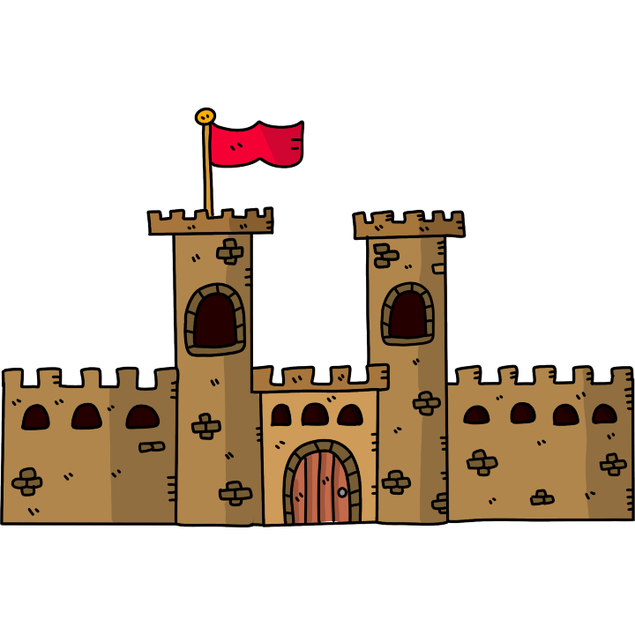

Hat by Angelus (Own work) [CC BY-SA 3.0 or GFDL], via Wikimedia Commons
Notes:
https://commons.wikimedia.org/wiki/File:Napoleonic_hat.svg
https://pixabay.com/en/tower-castle-medieval-door-tile-1417887/

Slide 6
Order XYZ
ID = 123
Item 123
Item 234
ID = 234
Item 345
ID = 345

Slide 7

Process
Queue
App
Check if delivered?
Mark as delivered
Process
Ack
Hat by Angelus (Own work) [CC BY-SA 3.0 or GFDL], via Wikimedia Commons
Notes:
https://commons.wikimedia.org/wiki/File:Napoleonic_hat.svg

Slide 8
Process
Queue
App
Check if processed?
Mark as processed
Process
Ack
Notes:
https://commons.wikimedia.org/wiki/File:Napoleonic_hat.svg

Slide 9



Slide 10




Slide 11


Publish
Persist
Persist
Publish

Slide 12
Publish
Persist if not duplicate

Slide 13
Frontend
Front-4
Orders
Billing
Orders-8
Front-4
Orders-9

Slide 14
AddItem
ID = 123
ItemAdded
ID = 234
Orders
AddItem
ID = 123
ItemAdded
ID = 456

Slide 15
Check if processed?
Process
Mark as processed
Notes:
Azazon FIFO does it wrong

Slide 16
Transport Transaction
Receive
Deduplicate
Outbox Transaction
Dispatch
Mark as Dispatched
Commit
Execute Handler
Send Message
Store Data
Send Message
Store Messages
Commit

