Slide 1

WCF Web APIs
REST in the shade of WCF

Slide 2
Agenda
Co to jest REST?
Powrtórka z HTTP
Architektura WCF Web APIs
POST, GET, href, PUT, DELETE
Przykładowa architektura aplikacji RESTowej
Meta-dane

Slide 3
REST
Client - server
Stateless
Cacheable
Layered
Uniform interface

Slide 4

Request
GET /index.html
Host: www.example.com
Response
HTTP/1.1 200 OK
Date: Mon, 23 May 2005 22:38:34 GMT
Server: Apache/1.3.3.7
Last-Modified: Wed, 08 Jan 2003 23:11:55 GMT
Etag: „3f80f-1b6-3e1cb03b”
Content-Length: 438
Content-Type: text/html; charset=UTF-8
Notes:
Client - server
Stateless
Cacheable
Layered
Uniform interface

Slide 5
WCF Web APIs
WCF
Processor #2
Resource (POCO)
Processor #1

Slide 6



Latte, large,
to go
Order 123
Here’s $5
Here’s the receipt
Status of order 123?
Still preparing
Status of order 123?
Ready

Slide 7
Client
POST /order HTTP/1.1
Host: restbucks.net
Content-Type: application/xml
Content-Length: 216
<order xmlns="http://schemas.restbucks.net/order">
<drink>latte</drink>
</order>
Service
201 Created
Location: http://restbucks.net/order/1234
ContentType: application/xml
<order xmlns="http://schemas.restbucks.net/order">
...

Slide 8
Client
Service
GET /order/1234 HTTP/1.1
Host: restbucks.net
200 OK
ContentType: application/xml
<order xmlns="http://schemas.restbucks.net/order">
<drink>Latte</drink>
...

Slide 9
click me

Slide 10
Hypermedia
HTTP
URI

Slide 11
Client
Order
Resource
/order/{orderId}
/order/{orderId}
Receipt
Resource
/receipt/{orderId}
/receipt/{orderId}
Payment
Resource
/payment/{orderId}
/payment/{orderId}

Slide 12
Client
Order
Resource
/order/{orderId}
/order/{orderId}
order
Payment
Resource
/payment/{orderId}
receipt
Receipt
Resource
/receipt/{orderId}

Slide 13
Client
200 OK
ContentType: application/vnd.restbucks+xml xmlns="http://schemas.restbucks.net/order">
<drink>Latte</drink>
<link href=„payment/1234” rel=„http://relations.restbucks.net/payment”/>
</order>
Service
PUT /payment/1234 HTTP/1.1
Host: restbucks.net
Content-Type: application/xml
Content-Length: 216
<payment xmlns="http://schemas.restbucks.net/order">
<cardNumber>...</cardNumber>
</order>

Slide 14
Repositories
Domain objects
Mappers
Representations
Activities
Resources
Infrastructure
WCF Web APIs
WCF
IIS

Slide 15
<meta>

Slide 16
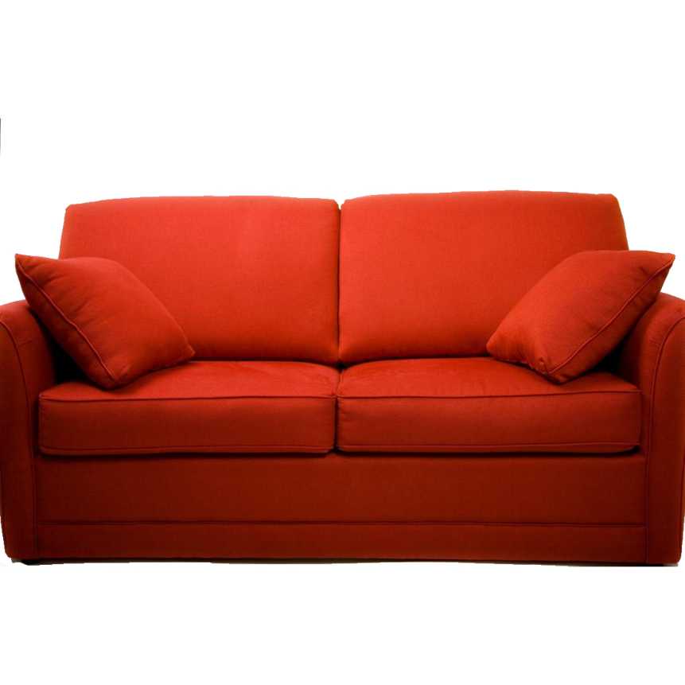
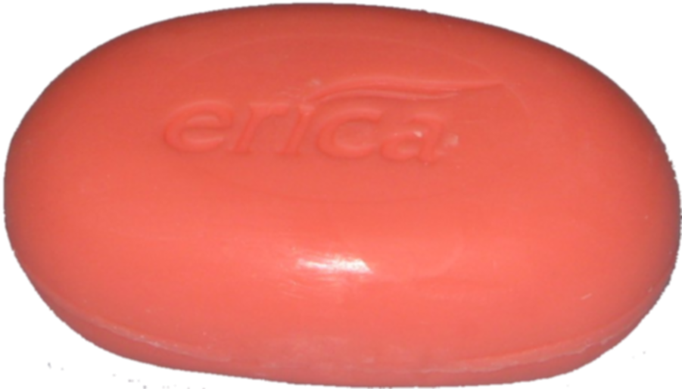
vs
Notes:
Headers
Intermediaries
WSDL
End to end security
Auth
Transactions
Reliability

Slide 17
Q
A
&

