Slide 1
Before/After Project

Slide 2
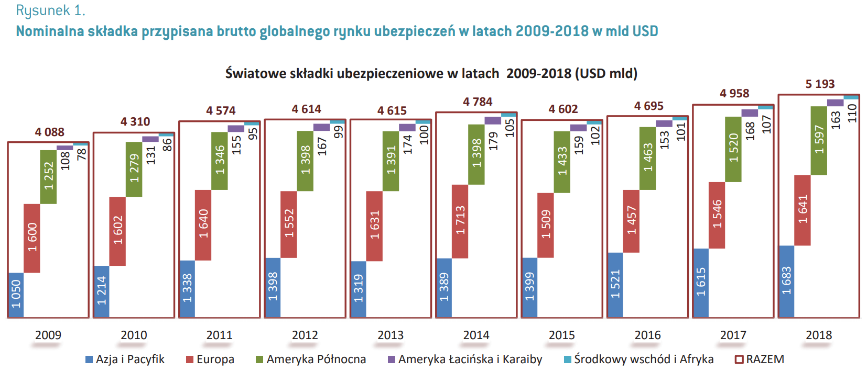
What’s wrong with the chart?
Too much information at a glance
Unnecessary shades below years
Values are very hard to compare
Not print-friendly colors
Hard to read text orientation
Mislocation of legend

Slide 3
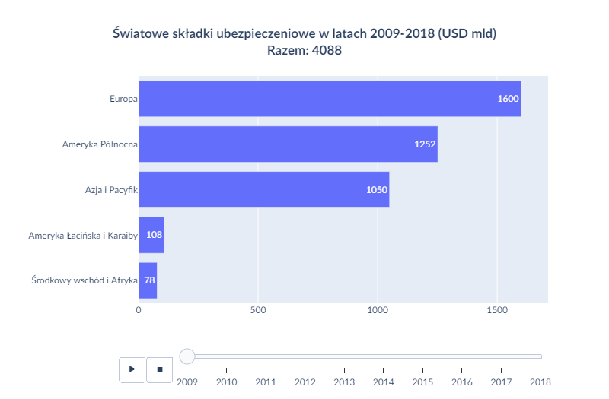
Solution

Slide 4
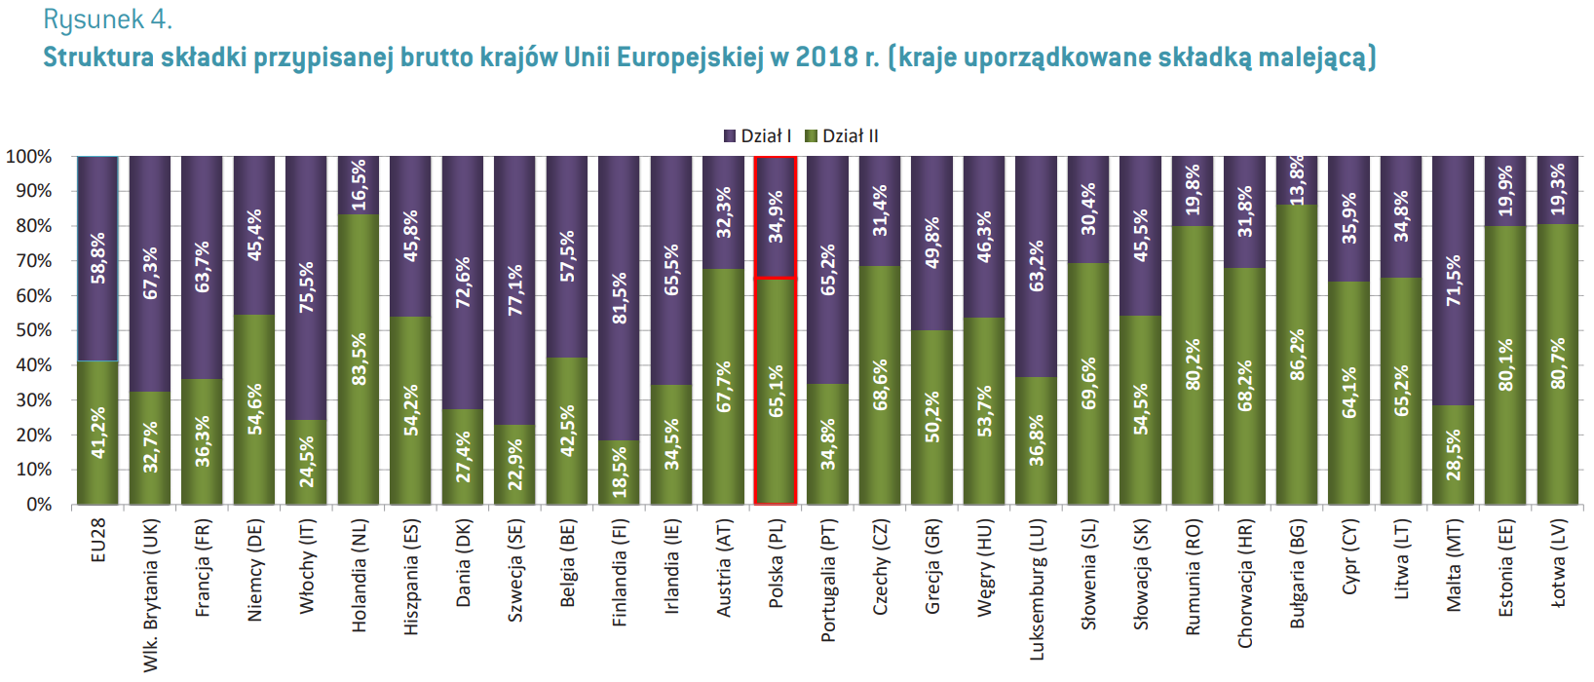
What’s wrong with the chart?
Too much information at a glance
Unnecessary shades
Hard to read text orientation
Mislocation of legend

Slide 5
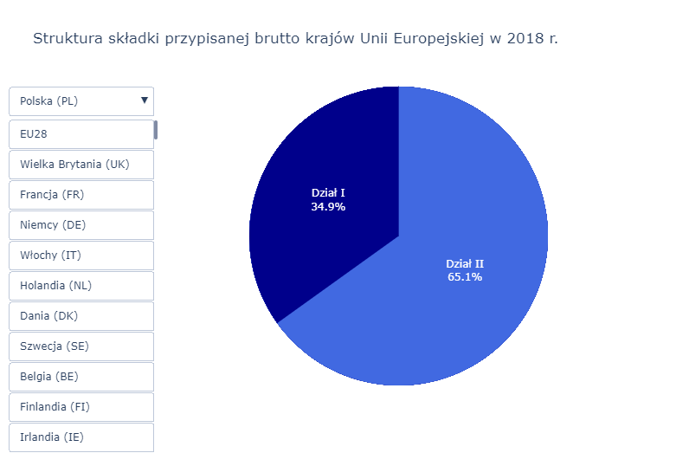
Solution

Slide 6
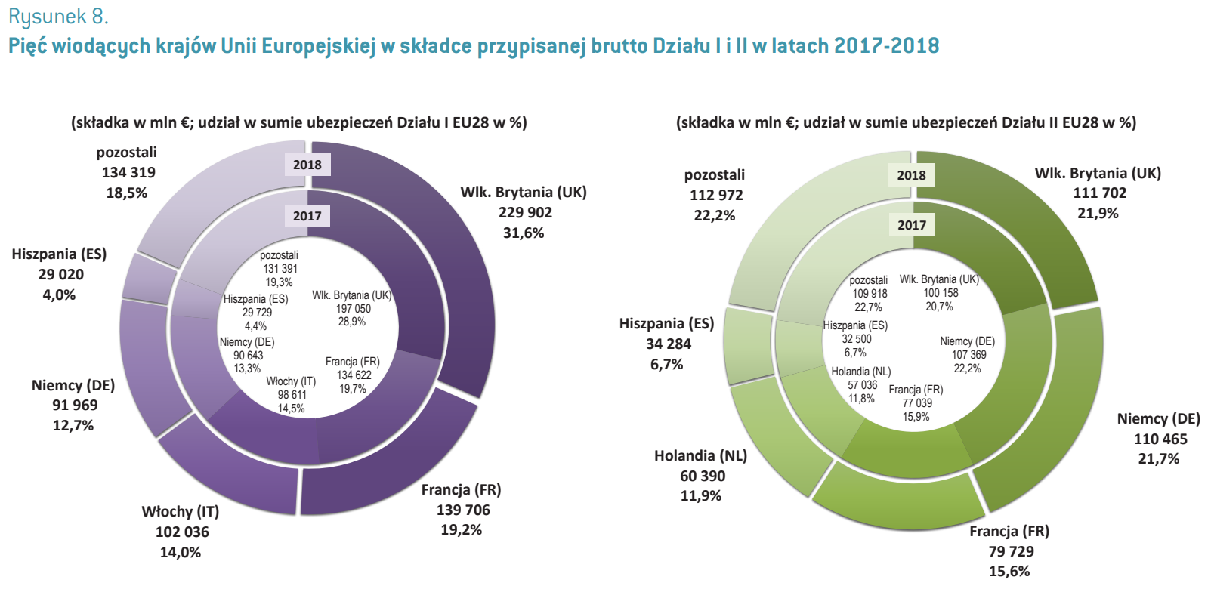
What’s wrong with the chart?
Too much information at a glance
Values are very hard to compare
Color shades are too similar
Comparing values on donut charts is misleading

Slide 7
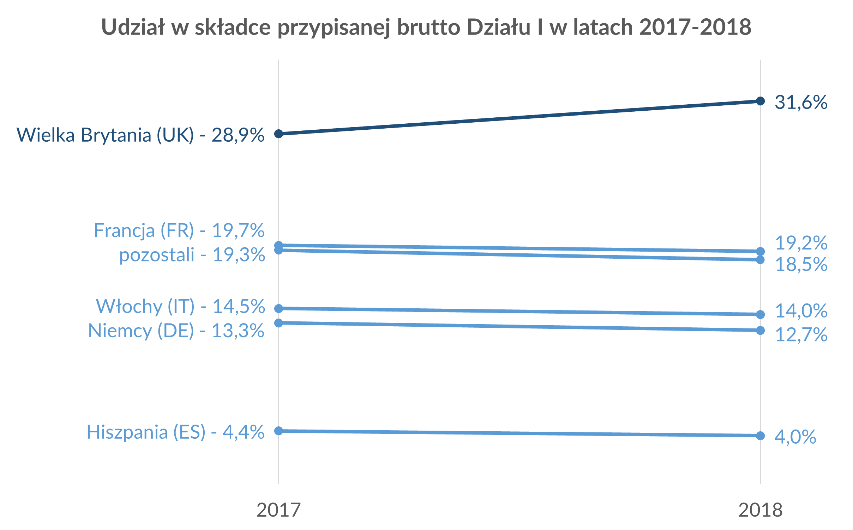
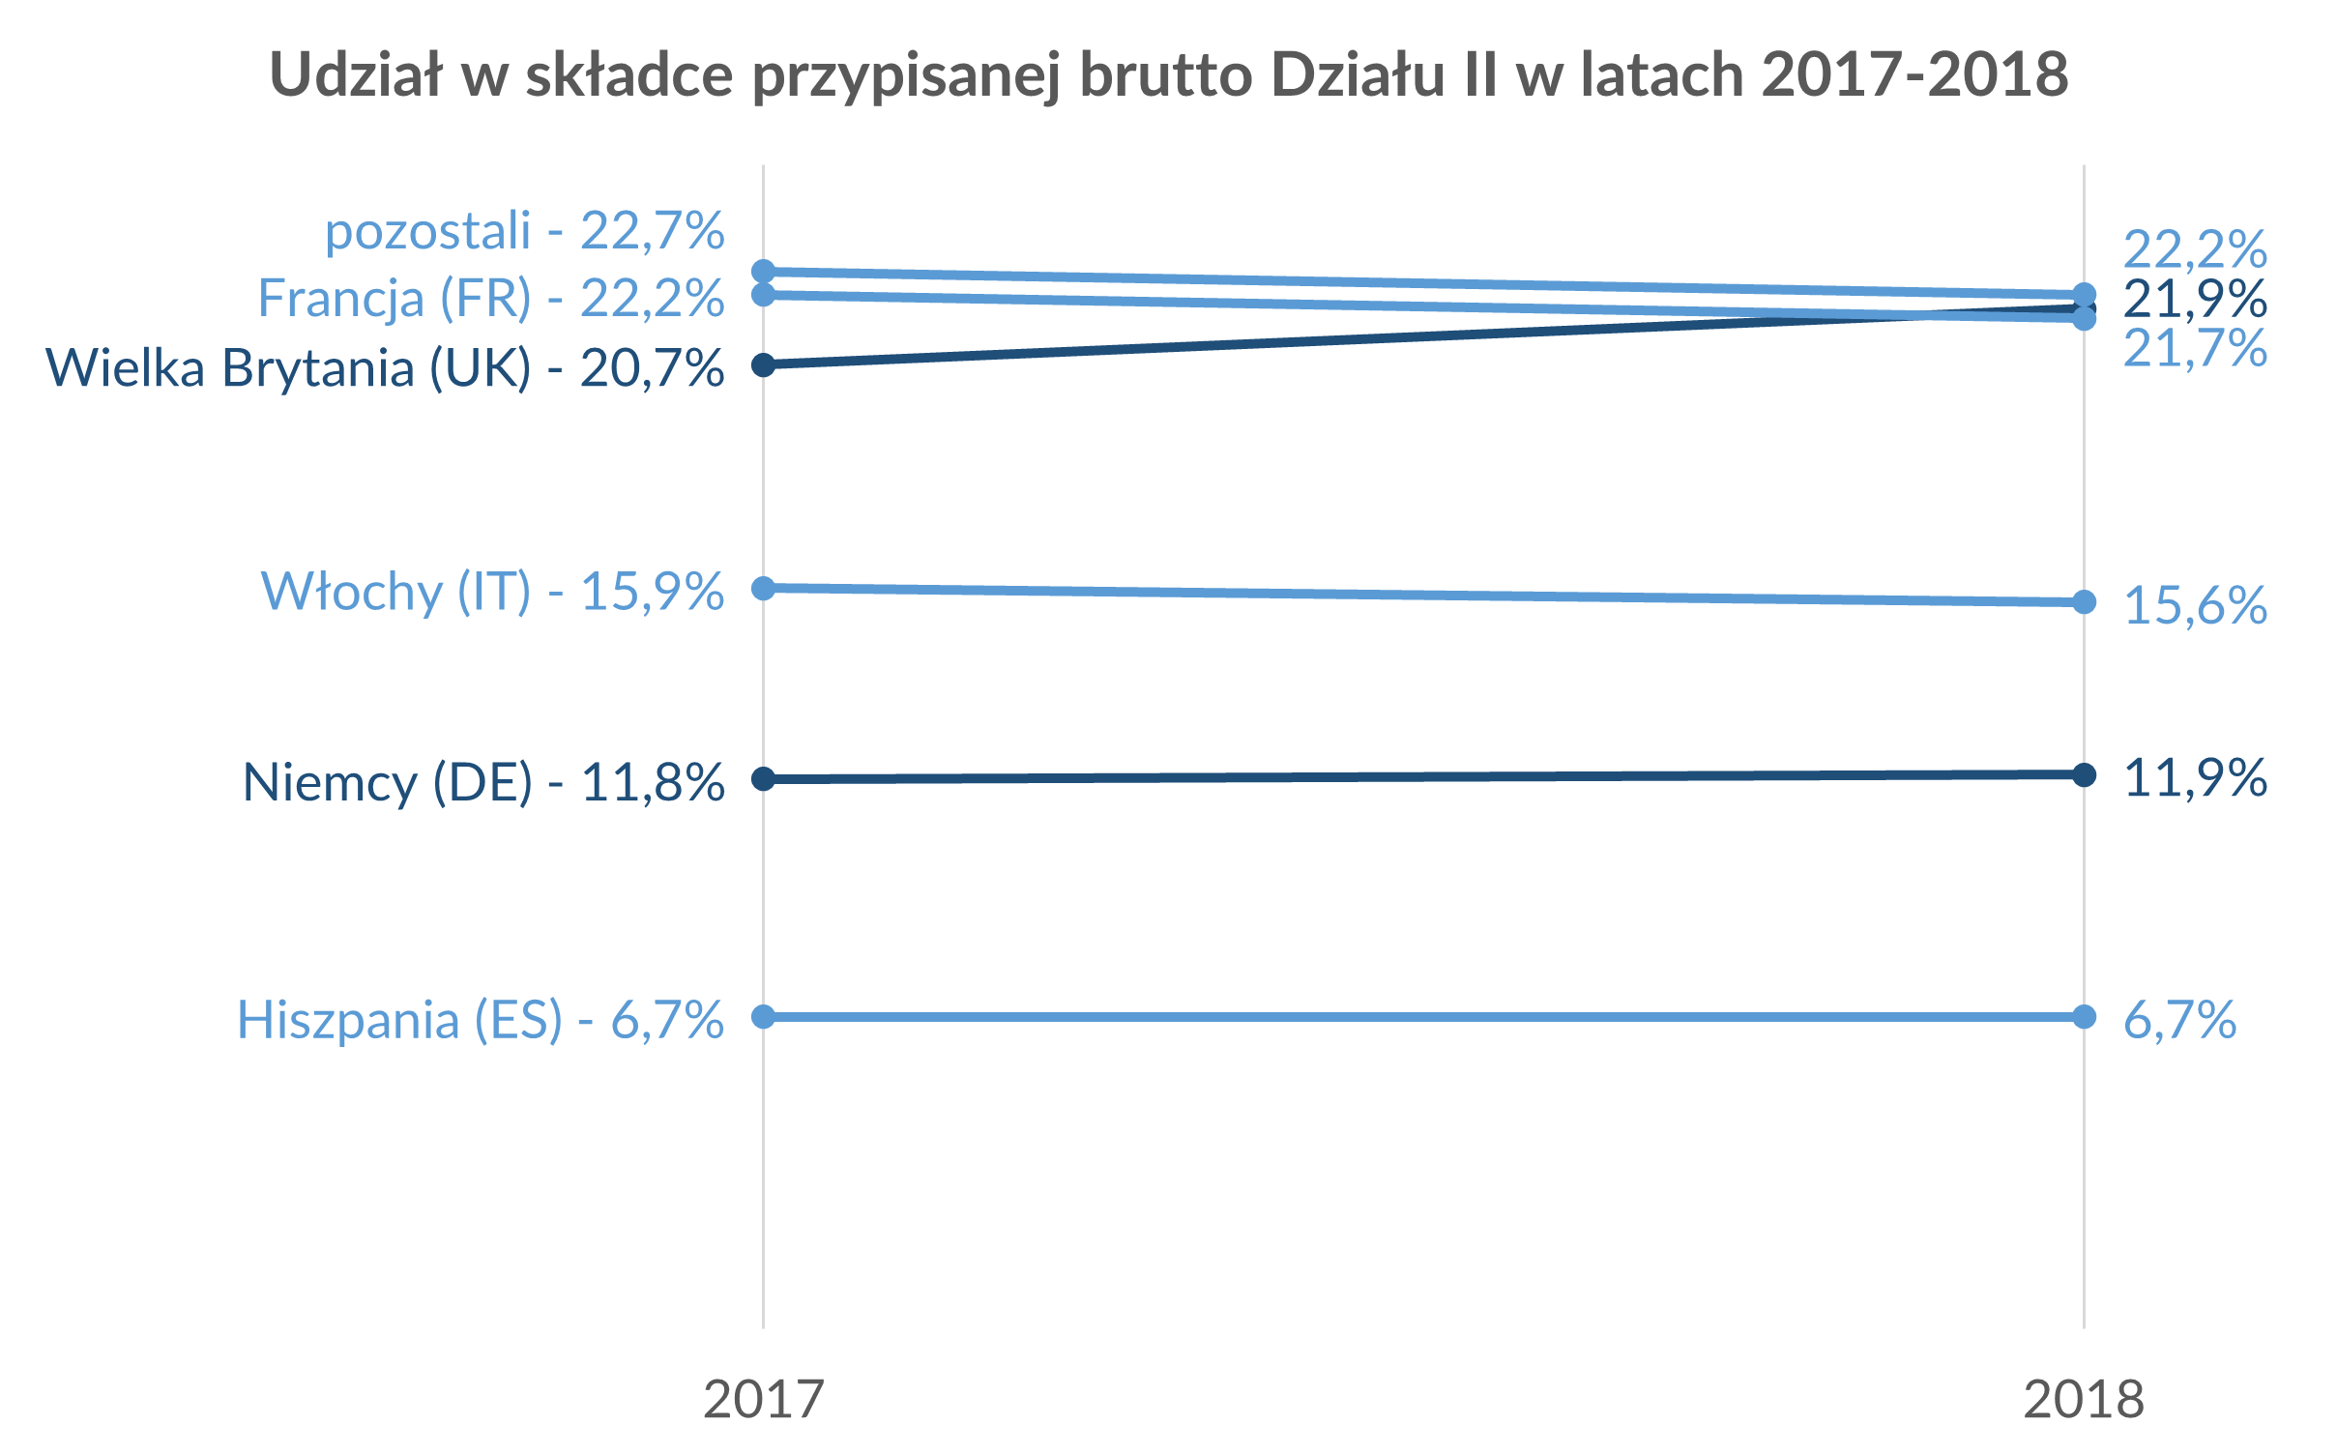
Solution

Slide 8
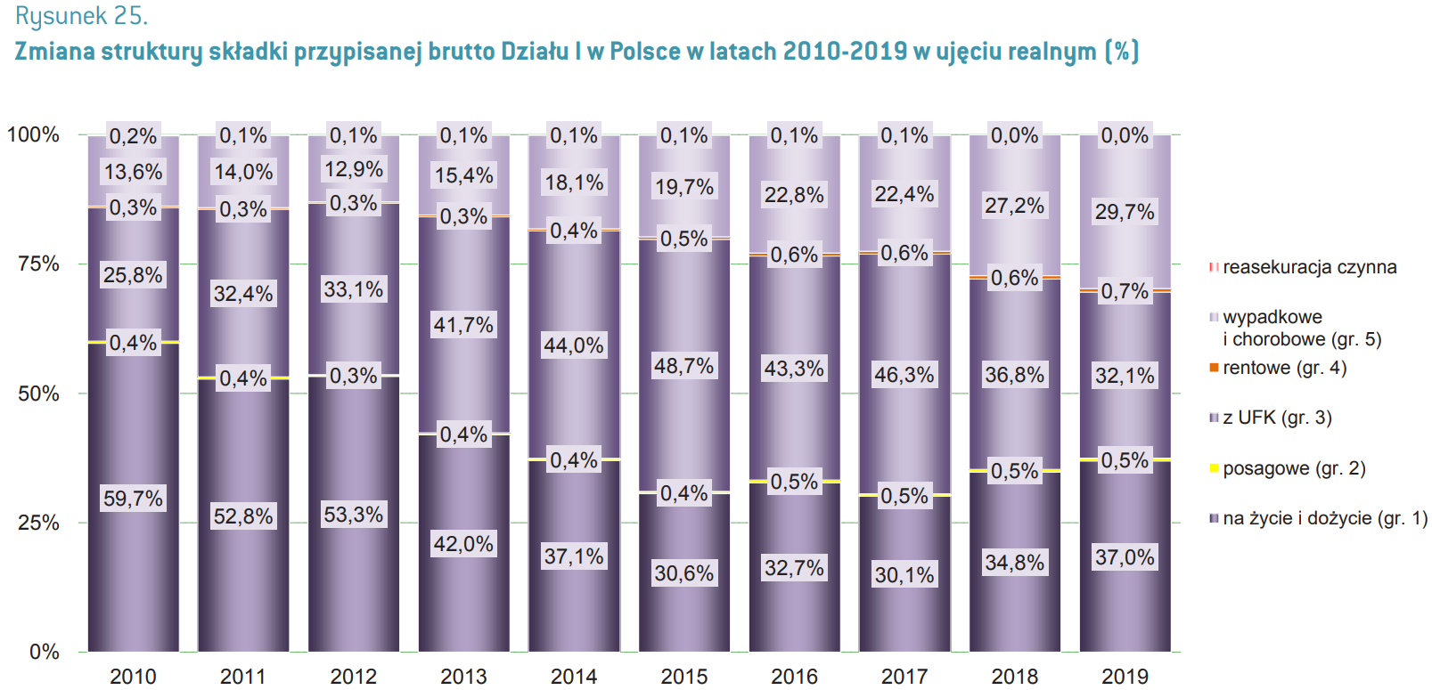
What’s wrong with the chart?
Too much information at a glance
Unnecessary shades
Not print-friendly colors
Small values that are barely visible
Color shades are too similar
Mislocation of legend

Slide 9
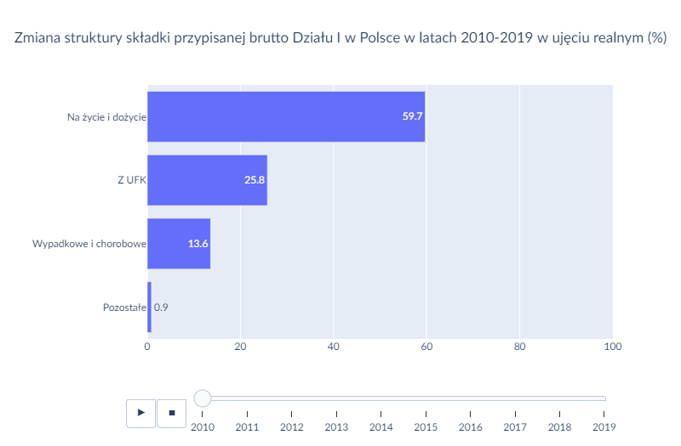
Solution

Slide 10
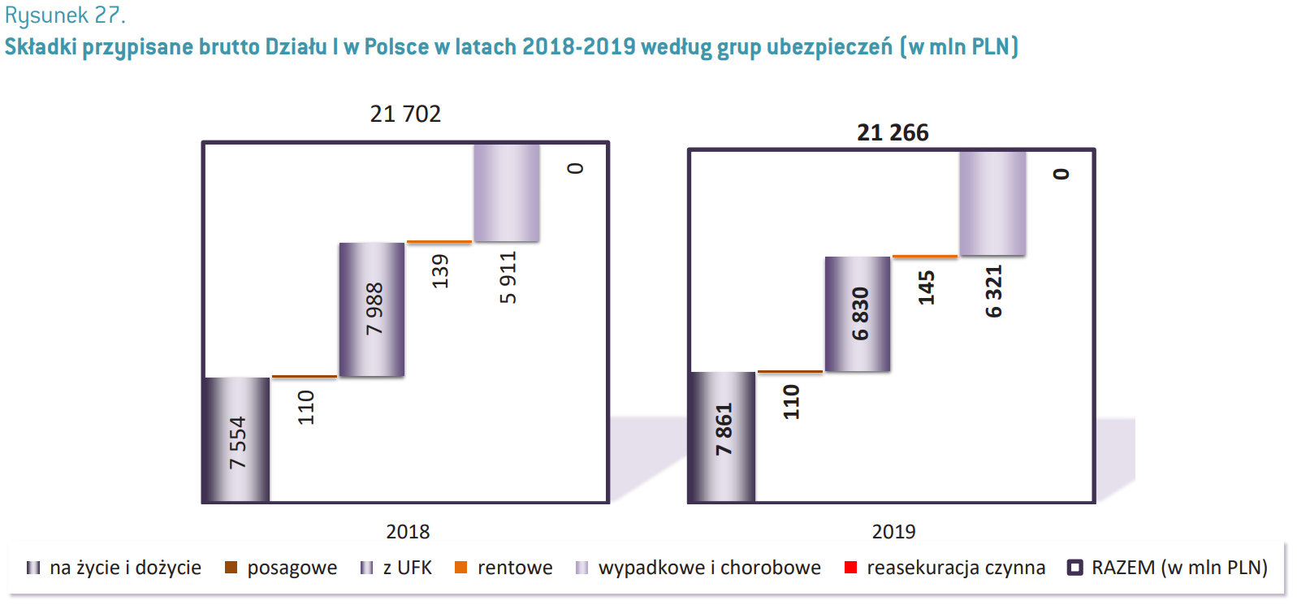
What’s wrong with the chart?
Unnecessary shades
Values are very hard to compare
Not print-friendly colors
Including value that equals 0
Hard to read text orientation
Mislocation of legend

Slide 11
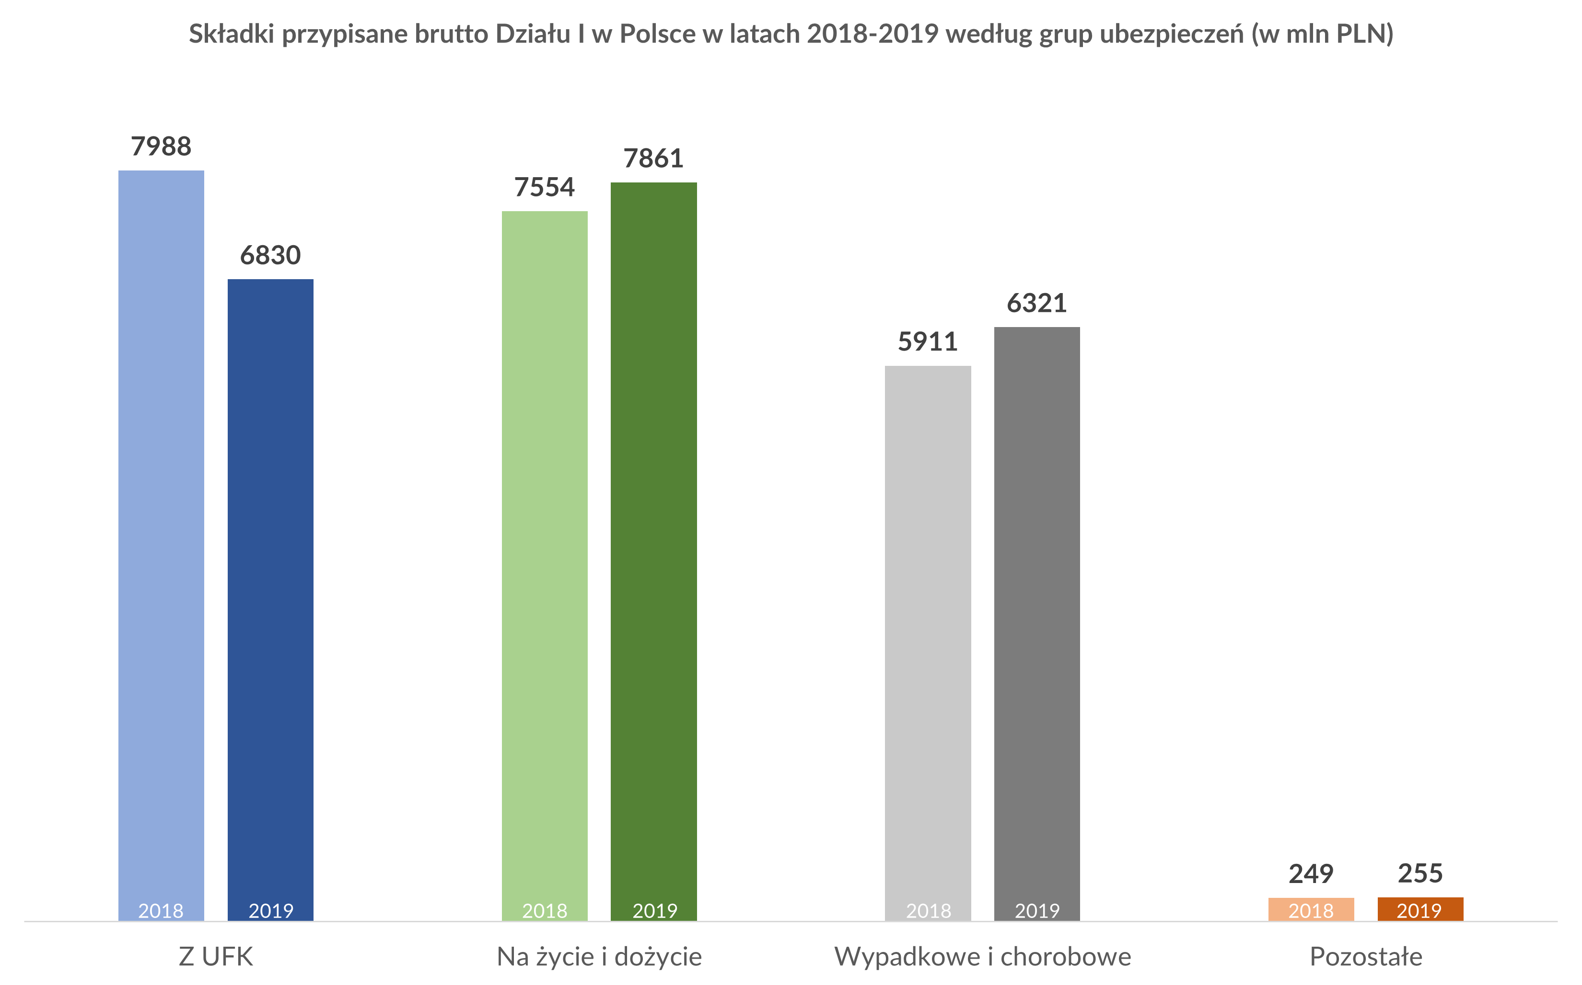
Solution

Slide 12
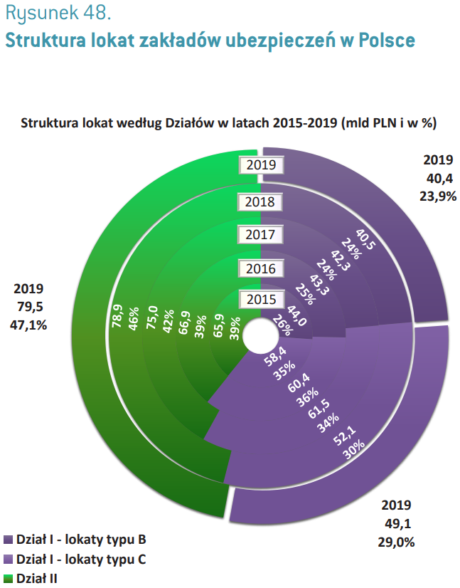
What’s wrong with the chart?
Too much information at a glance
Unnecessary color shade changes
Comparing values on donut charts is misleading
Not print-friendly colors
Hard to read text orientation
Mislocation of legend

Slide 13
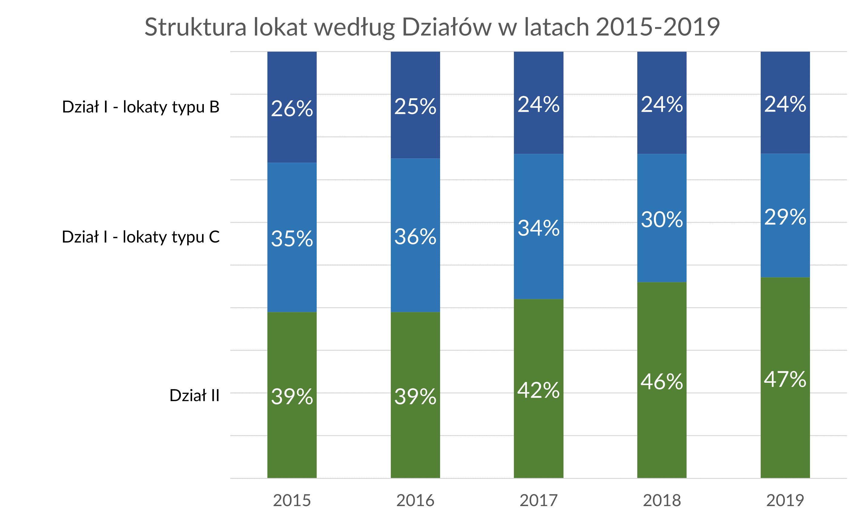
Solution

Slide 14
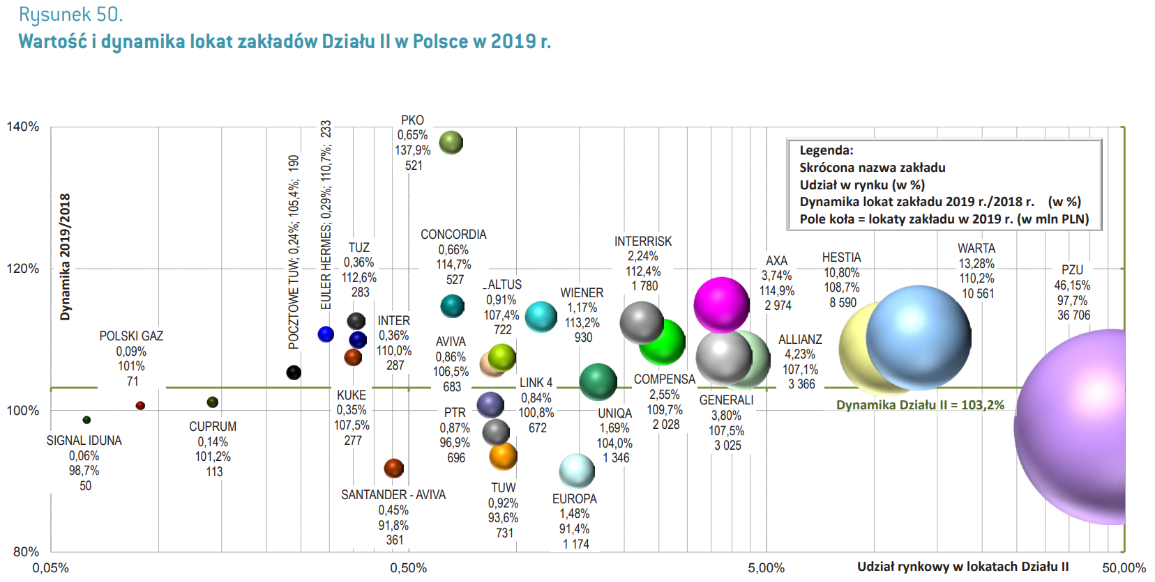
What’s wrong with the chart?
Way too much information at a glance
Unnecessary shades
Colors doesn’t mean anything
Values are very hard to compare
Not print-friendly colors
Hard to read text orientation
Mislocation of legend
Visualizing three types of data on one chart

Slide 15
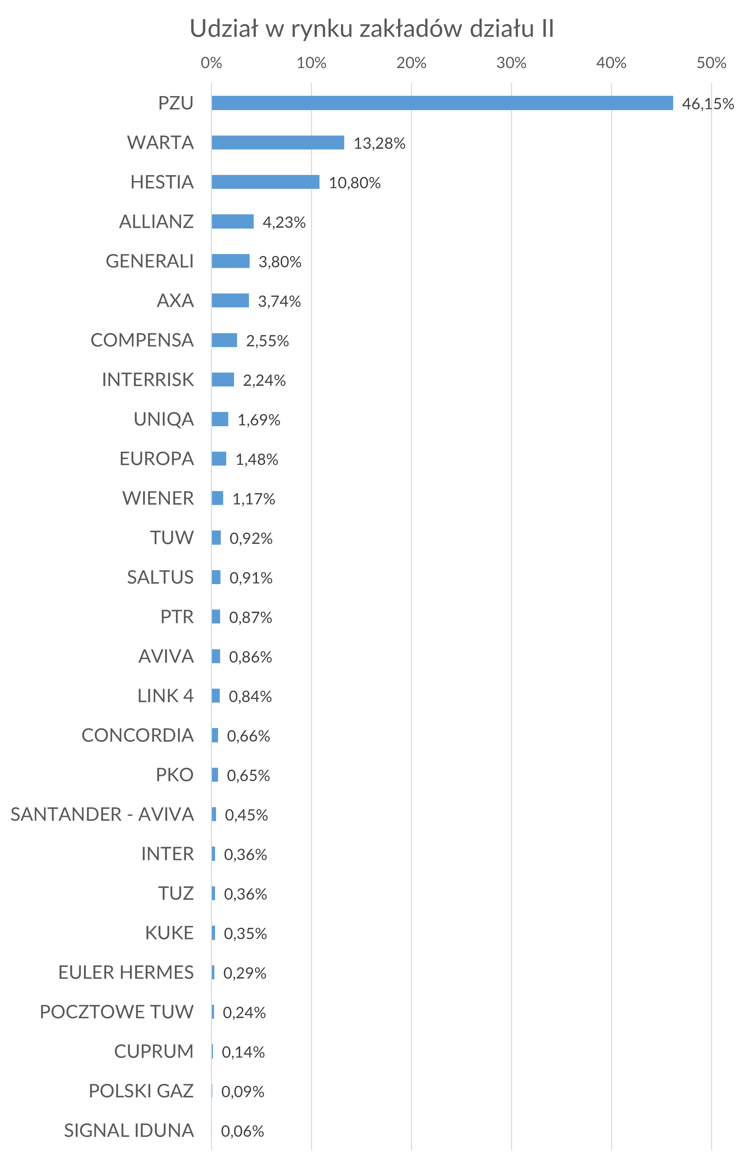
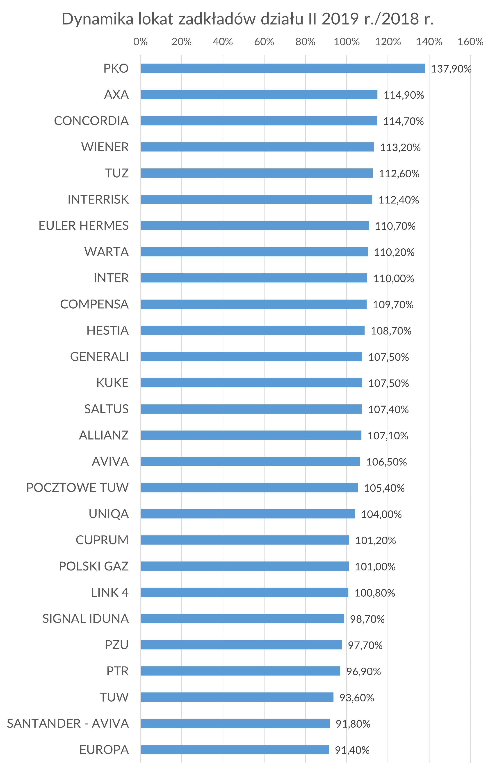
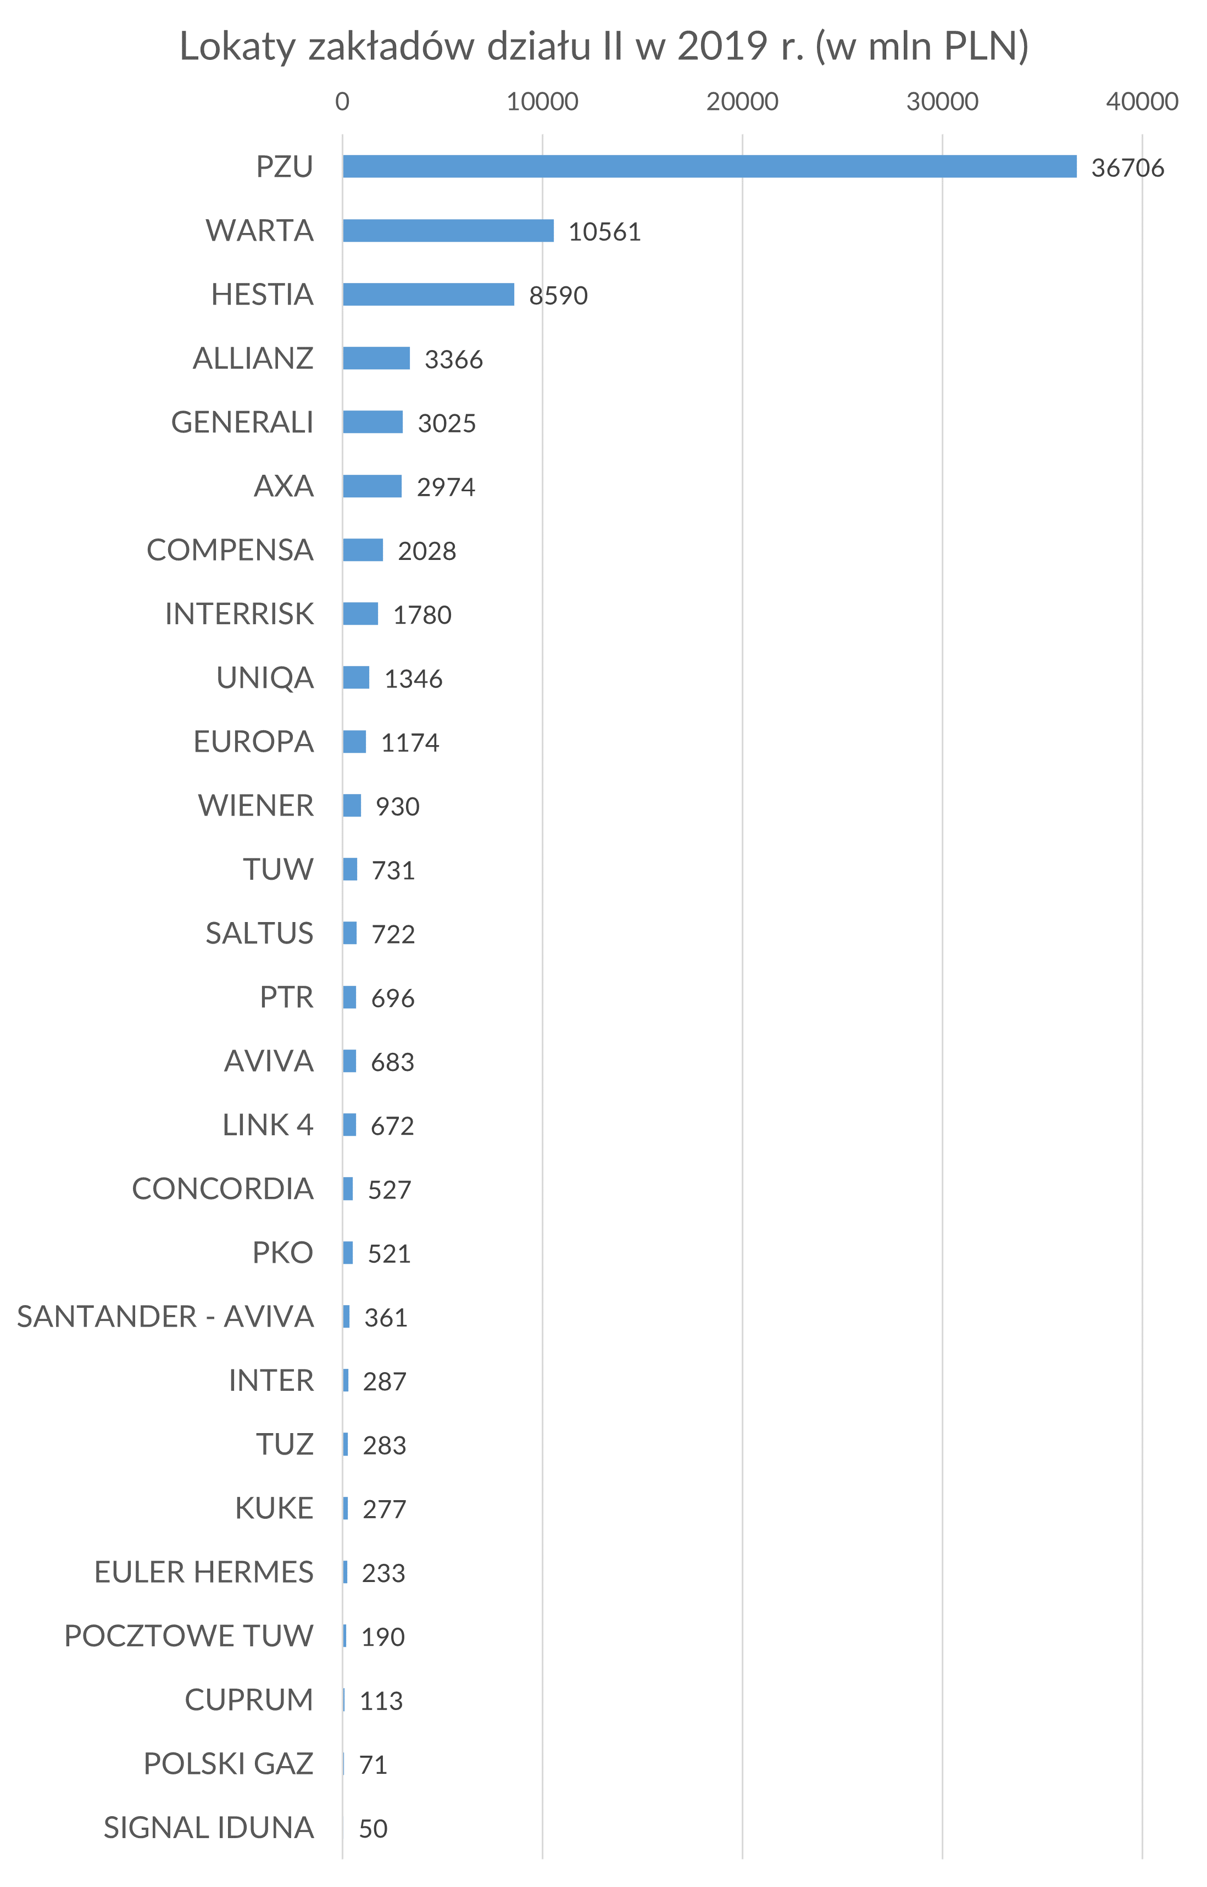
Solution

Slide 16
Link to report
https://piu.org.pl/wp-content/uploads/2020/10/Raport-roczny-PIU-2019.pdf

