Slide 1

Value at risk

Slide 2
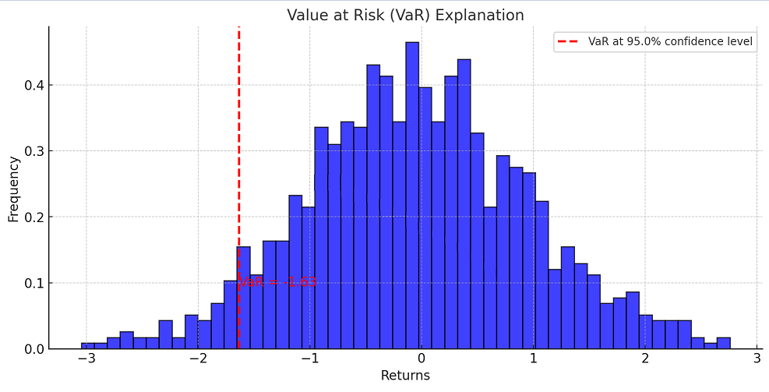
Value-at-Risk
One of the most popular measure for describing market risk is Value-at-Risk. We use it to calculate the reserve we need to cover potential losses that may occur at a certain probability.
The mathematical definition is as follows:
For a random variable X that measures the return of our portfolio and a significance level α:

Slide 3

DATA
We have downloaded the data from Yahoo Finance.
We will use indexes as follows: S&P 500, DAX, FTSE 100, NIKKEI 225.

Slide 4
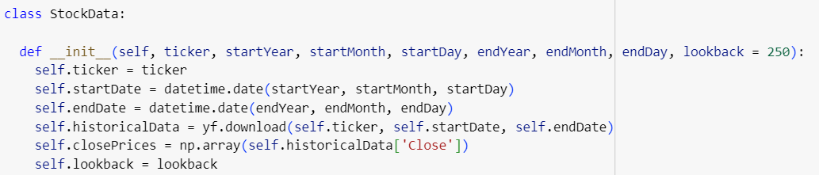
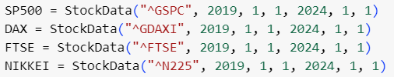
DATA

Slide 5
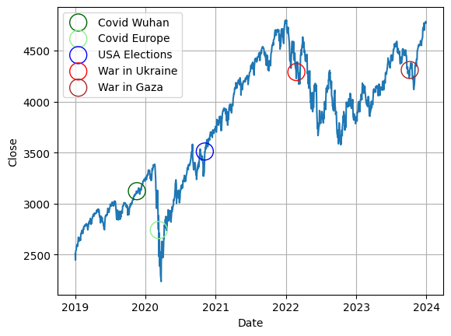
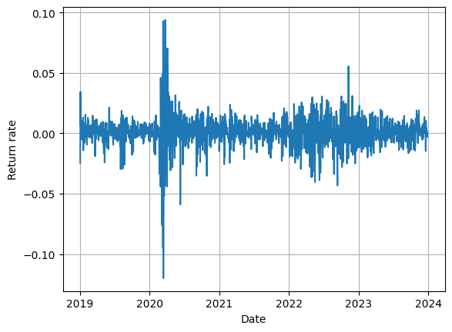
S&P 500 1.01.2019-1.01.2024
World events:
Covid in Wuhan
Covid in Europe
USA elections
War in Ukraine
War in Gaza

Slide 6
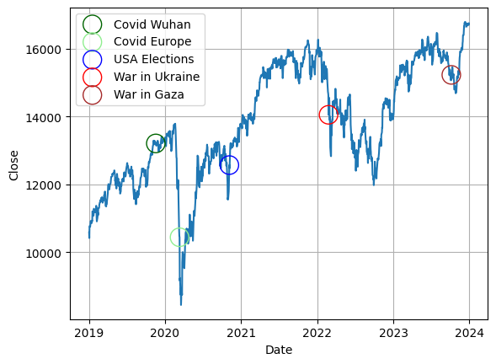
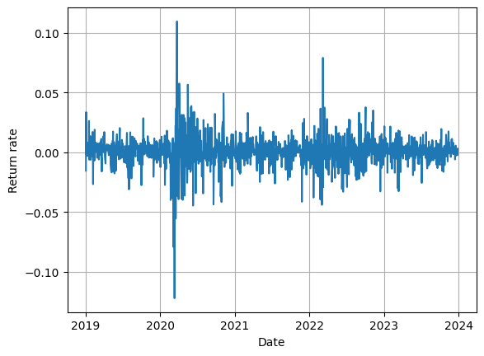
DAX 1.01.2019-1.01.2024
World events:
Covid in Wuhan
Covid in Europe
USA elections
War in Ukraine
War in Gaza

Slide 7
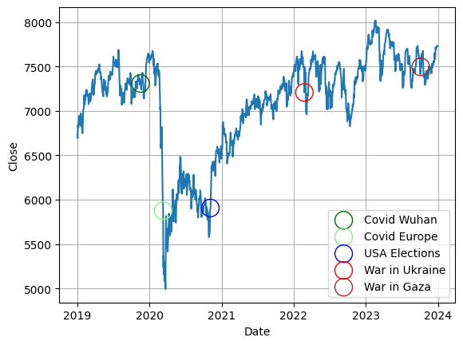
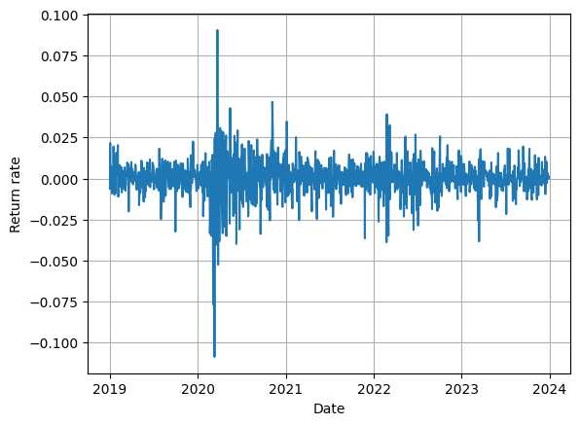
FTSE 100 1.01.2019-1.01.2024
World events:
Covid in Wuhan
Covid in Europe
USA elections
War in Ukraine
War in Gaza

Slide 8
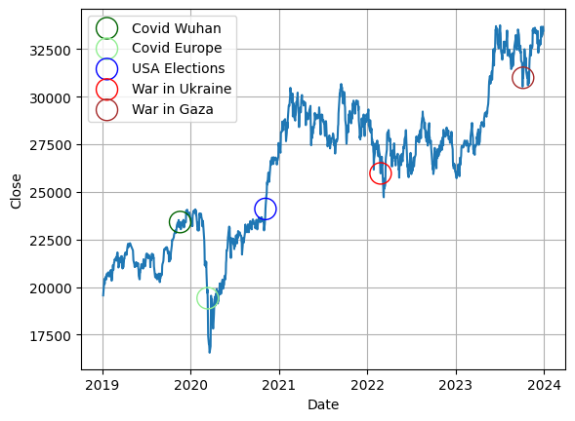
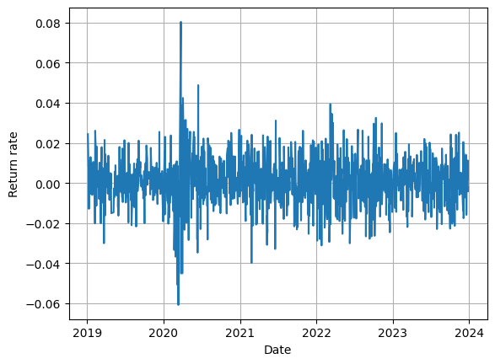
NIKKEI 225 1.01.2019-1.01.2024
World events:
Covid in Wuhan
Covid in Europe
USA elections
War in Ukraine
War in Gaza

Slide 9

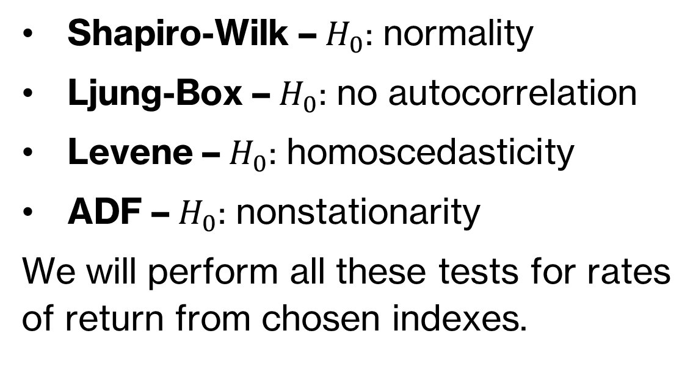
Tests
Shapiro-Wilk – $H_{0}$: normality
Ljung-Box – $H_{0}$: no autocorrelation
Levene – $H_{0}$: homoscedasticity
ADF – $H_{0}$: nonstationarity
We will perform all these tests for rates of return from chosen indexes.

Slide 10
Results
Below we present the table with p-values of tests which were described in the previous slide performed on our 4 indexes:
Test | S&P 500 | DAX | FTSE 100 | NIKKEI 225
Shapiro-Wilk | 1.27e-30 | 2.54e-29 | 7.43e-30 | 1.42e-15
Ljung-Box | 1.96e-53 | 7e-08 | 7.78e-10 | 0.14
Levene | 1.32e-27 | 5.77e-25 | 1.31e-28 | 6.35e-09
ADF | 5.81e-19 | 4.25e-23 | 1.96e-12 | 0.0

Slide 11


Estimators
Let $x$ denote vector of simulated one-day P&L scenarios and n its length. By $\overline{x}$ we denote mean and by $\overline{σ}$ we denote standard estimator of standard deviation. For price with index i we calculate n previous return rates. Then we create $x$ by multiplying every return rate by the price with i-th index.

Slide 12



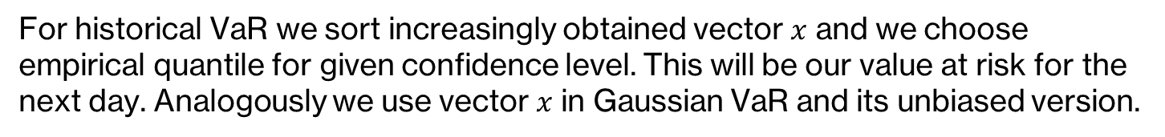
Estimators
- Historical VaR
- Gaussian VaR
- Unbiased Gaussian VaR
For historical VaR we sort increasingly obtained vector $x$ and we choose empirical quantile for given confidence level. This will be our value at risk for the next day. Analogously we use vector $x$ in Gaussian VaR and its unbiased version.

Slide 13
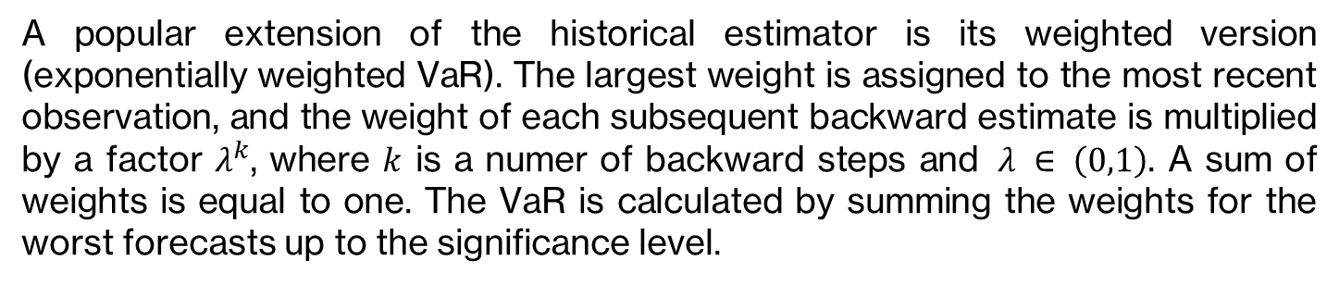
Weighted historical VaR
A popular extension of the historical estimator is its weighted version (exponentially weighted VaR). The largest weight is assigned to the most recent observation, and the weight of each subsequent backward estimate is multiplied by a factor $λ^{k}$, where $k$ is a numer of backward steps and $λ ∈ \left(0,1\right)$. A sum of weights is equal to one. The VaR is calculated by summing the weights for the worst forecasts up to the significance level.

Slide 14
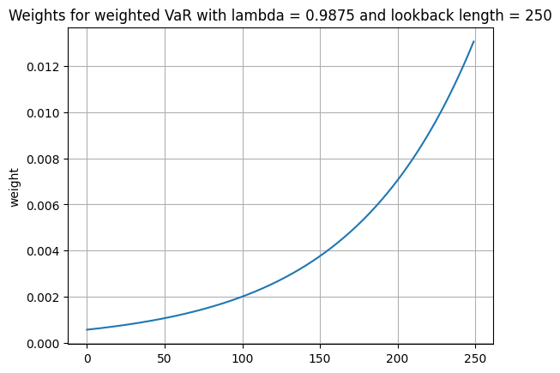
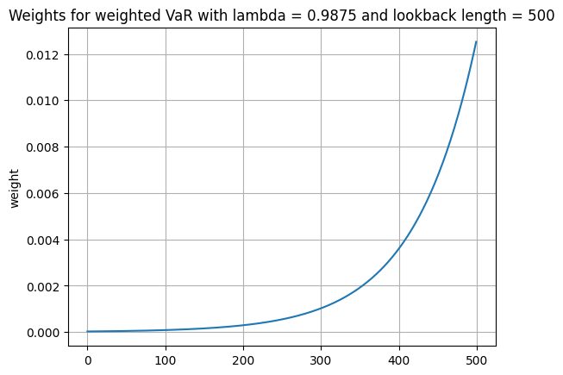
Weighted historical VaR

Slide 15

Pros and cons of estimators
Historical VaR is very intuitive and popular estimator
Gaussian VaR is easy to implement
Unbiased Gaussian VaR is an unbiased estimator
Weighted historical VaR can better reflect events
It is highly dependent on forepast events
We assume normality of return rates
It is unbiased only when we assume normality of return rates
Outcome is highly dependent on chosen lambda

Slide 16
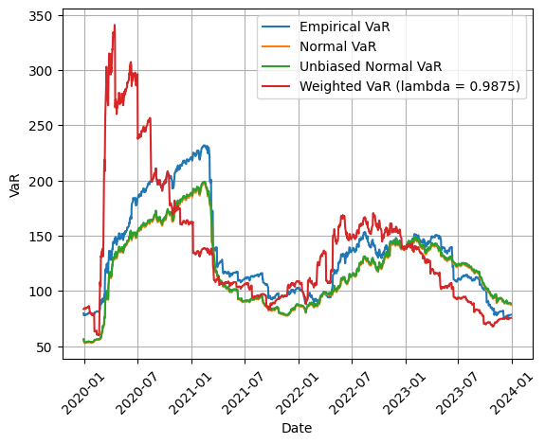
S&P 500 1-Day 99% VaR
Lookback 250 days

Slide 17
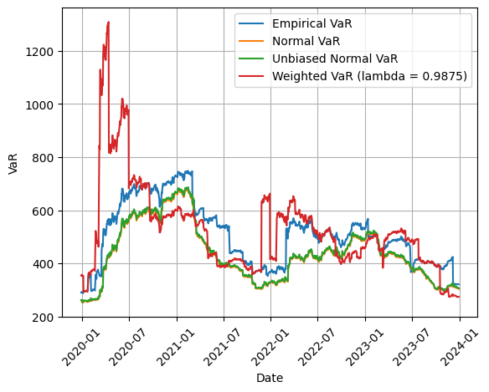
DAX 1-Day 99% VaR
Lookback 250 days

Slide 18
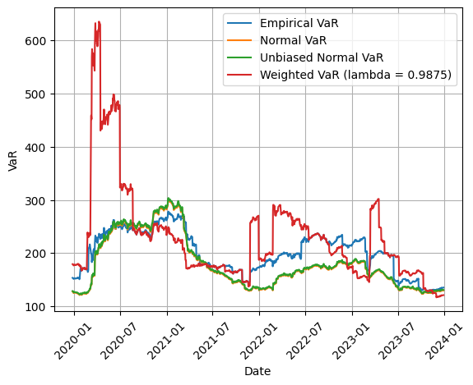
FTSE 100 1-Day 99% VaR
Lookback 250 days

Slide 19
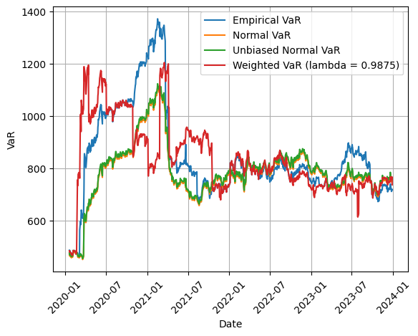
NIKKEI 225 1-Day 99% VaR
Lookback 250 days

Slide 20
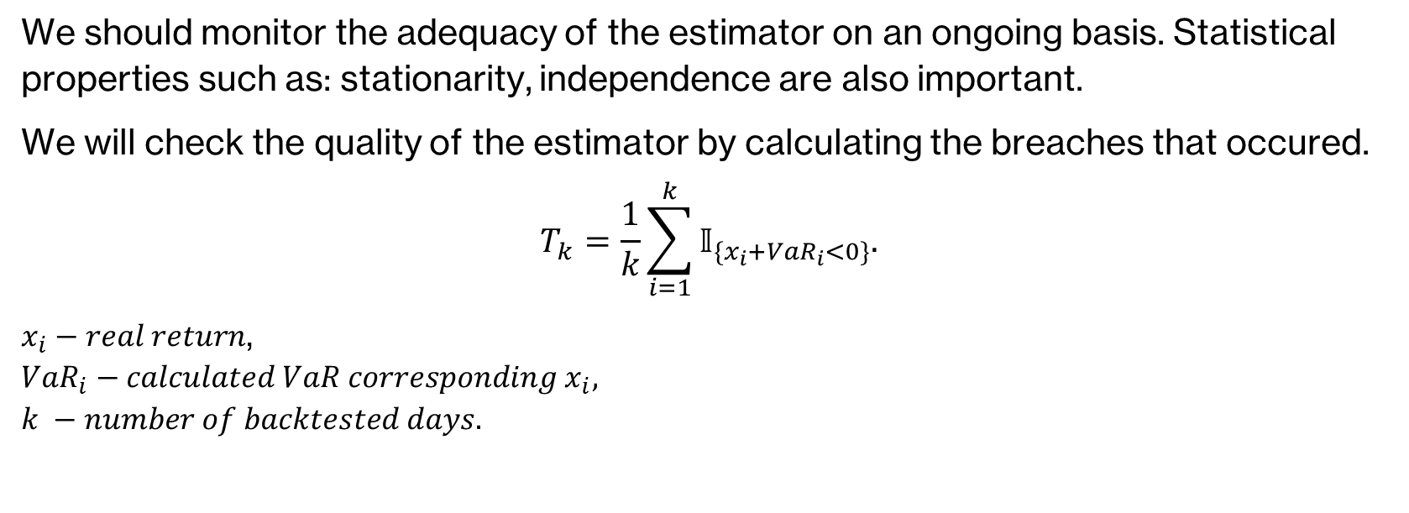
Model monitoring - backtesting
We should monitor the adequacy of the estimator on an ongoing basis. Statistical properties such as: stationarity, independence are also important.
We will check the quality of the estimator by calculating the breaches that occured.
$$T_{k}=\frac{1}{k}\sum_{i=1}^{k}{𝕀_{{\{x}_{i}+VaR_{i}<0\}}.}$$
$x_{i}−real return$, $$VaR_{i}−calculated VaR corresponding x_{i}, \\ k −number of backtested days.$$

Slide 21
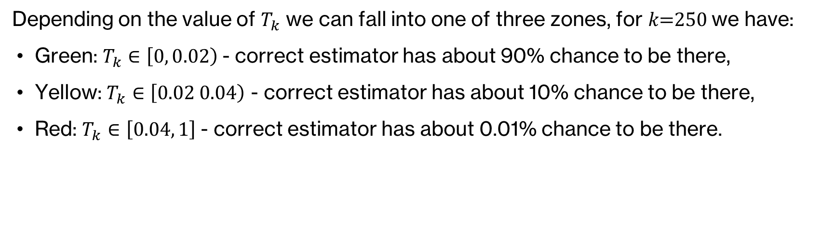
Backtesting
Depending on the value of $T_{k}$ we can fall into one of three zones, for 𝑘=250 we have:
Green: $T_{k}∈\left[0, 0.02\right)$- correct estimator has about 90% chance to be there,
Yellow: $T_{k}∈\left[0.02 0.04\right)$ - correct estimator has about 10% chance to be there,
Red: $T_{k}∈\left[0.04, 1\right]$- correct estimator has about 0.01% chance to be there.

Slide 22
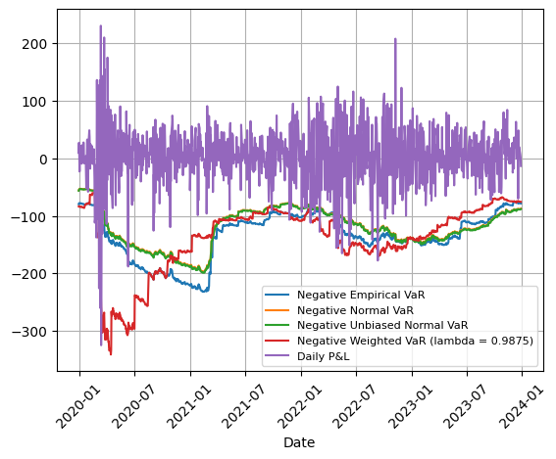
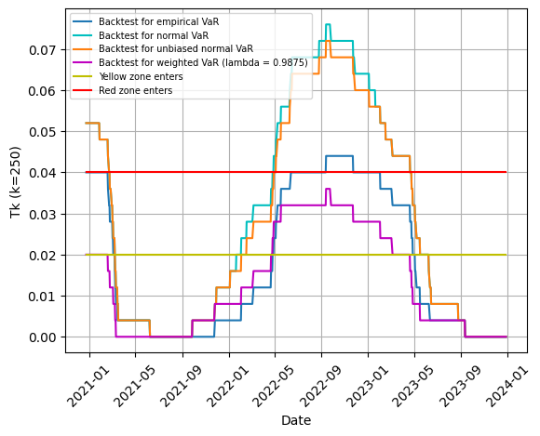
Backtesting
S&P 500

Slide 23
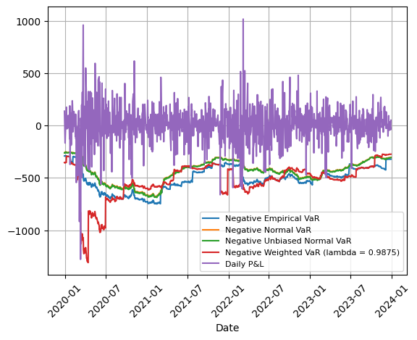
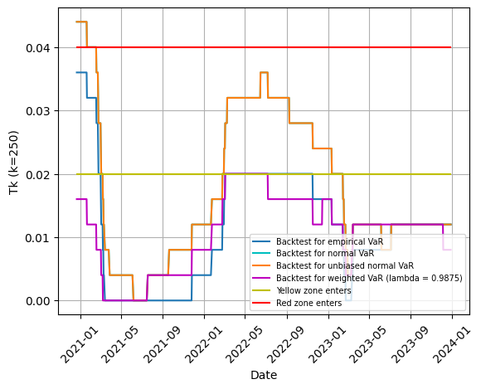
Backtesting
DAX

Slide 24
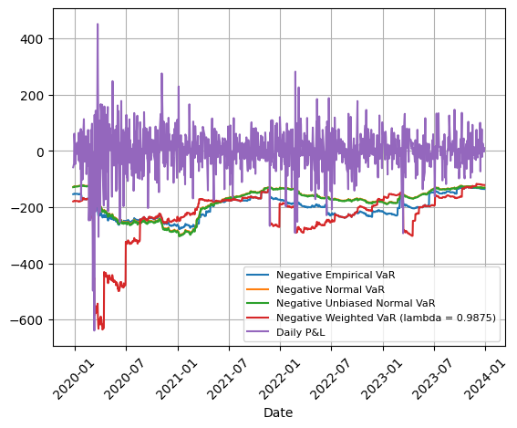
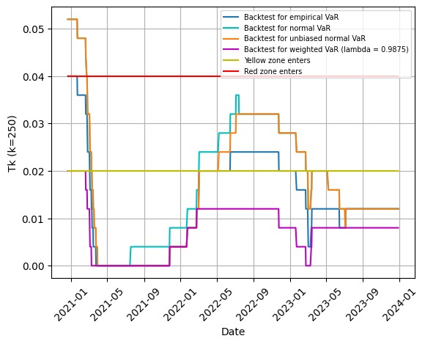
Backtesting
FTSE 100

Slide 25
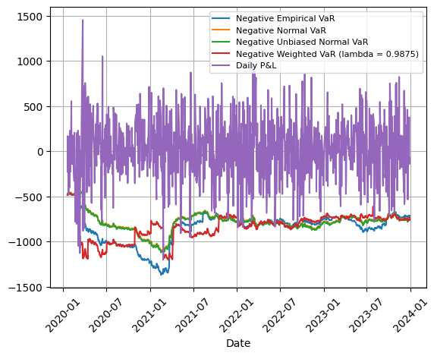
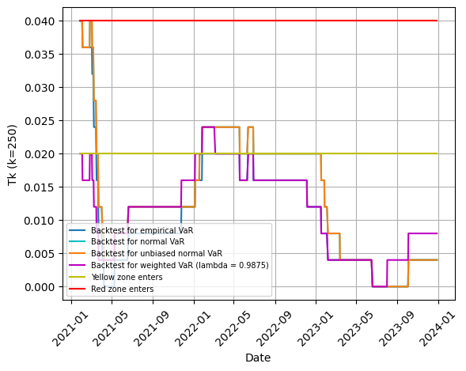
Backtesting
NIKKEI 225

Slide 26
Backtesting
 | S&P 500 | DAX | FTSE 100 | NIKKEI 225
Empirical | 21 | 17 | 19 | 17
Normal | 32 | 23 | 25 | 19
Unbiased normal | 31 | 23 | 24 | 19
Weighted | 14 | 12 | 10 | 14
Backtesting can be done for all calculated VaRs (𝑘=1007), in which case:
the green zone ends with 13 breaches
the yellow zone starts with 14 breaches
the red zone starts with 24 breaches

Slide 27
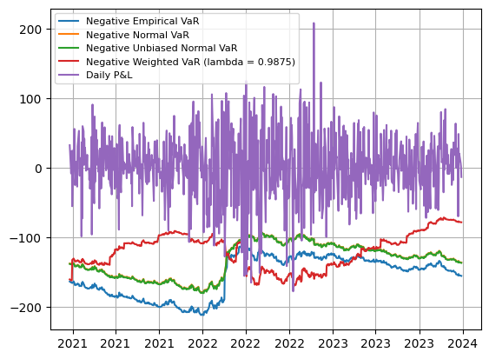
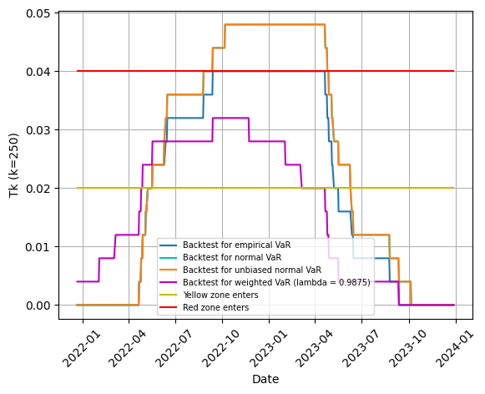
Backtesting for VaR’s lookback = 500 days
S&P 500

Slide 28
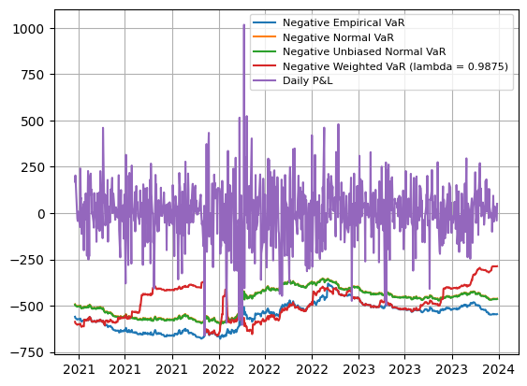
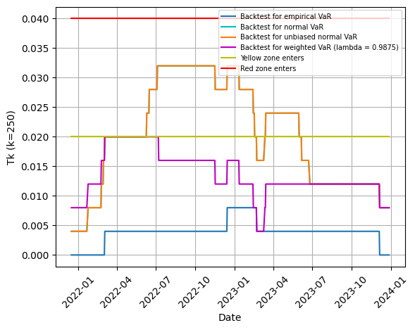
Backtesting for VaR’s lookback = 500 days
DAX

Slide 29
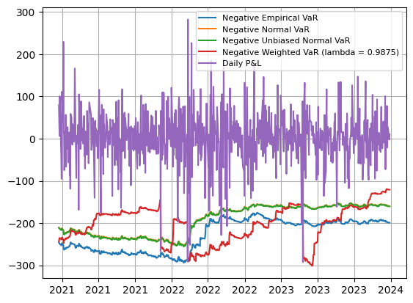
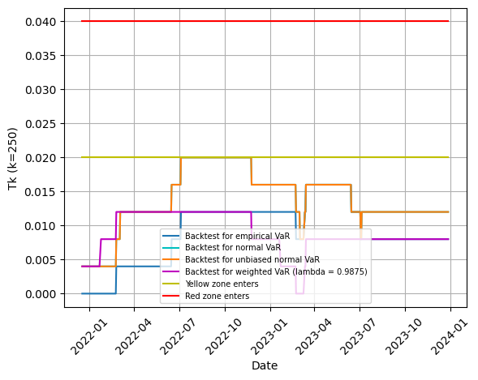
Backtesting for VaR’s lookback = 500 days
FTSE 100

Slide 30
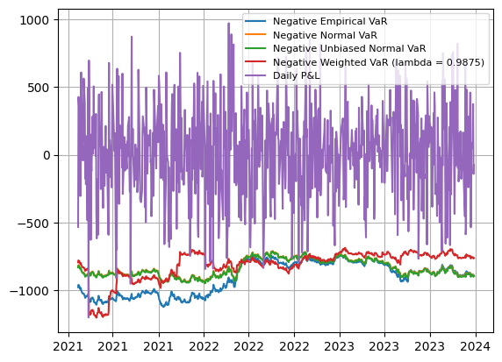
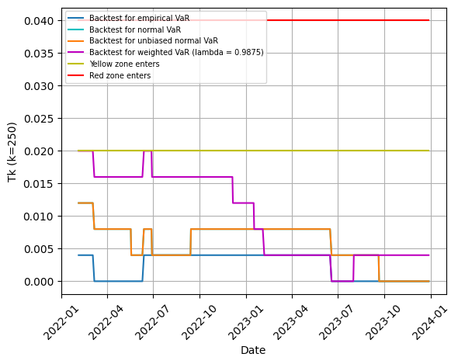
Backtesting for VaR’s lookback = 500 days
NIKKEI 225

Slide 31

Backtesting for VaR’s lookback = 500 days
 | S&P 500 | DAX | FTSE 100 | NIKKEI 225
Empirical | 10 | 2 | 5 | 2
Normal | 12 | 11 | 8 | 5
Unbiased normal | 12 | 11 | 8 | 5
Weighted | 8 | 8 | 5 | 7
Backtesting for all ($k=755)$ calculated VaRs with 500 days lookback period:
the green zone ends with 10 breaches
the yellow zone starts with 11 breaches
the red zone starts with 20 breaches

Slide 32

Conclusions
The best estimators for us are historical and weighted historical VaRs.
We see that the weighted one is slightly harder to implement and we must find appropriate decay factor. However we are more flexible in this case.
To conclude, we decided to choose weighted historical VaR as the best estimator. As stated by the regulator, we chose a 250-day lookback period.

Slide 33
Potential enhancements
We may add other risk factors (e.g.: GDP, inflation, FX rates, interest rates).
We may use filtered historical simulation. Using GARCH we can simulate volatility for historical return rates. Then divide these rates by its forecasted volatility. It should give us approximately I.I.D. values (returns).

Slide 34

Thank you!
Stanisław, Wojciech, Bartosz, Grzegorz, Norbert

