Slide 1
EDDY CURRENT BRAKING
Hywel Jones – T02

Slide 2
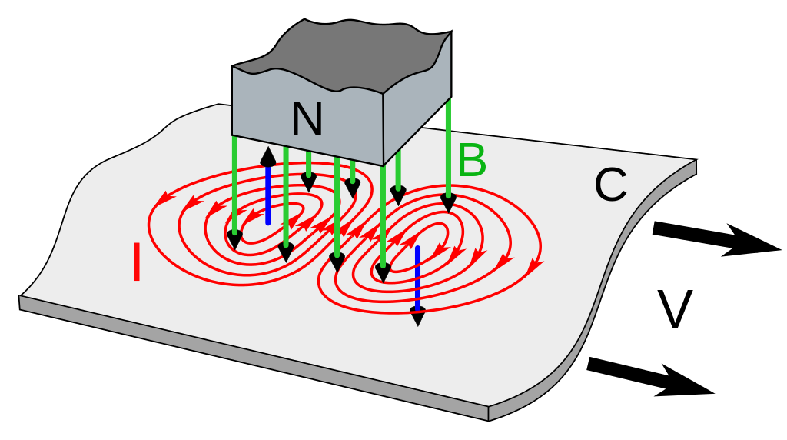
LINEAR EDDY CURRENT BRAKE
Source: Wikipedia

Slide 3
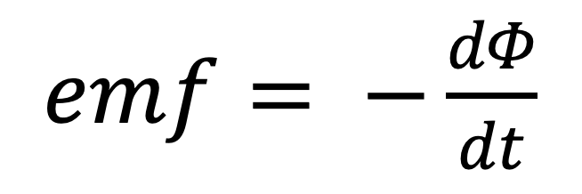
THE DRAG FORCE
$emf= −\frac{dΦ}{dt}$
where emf is the force, Φ is the magnetic flux and t is time
F ∝ v
where F is the force, v the velocity and B the magnetic field strength
F ∝ B

Slide 4
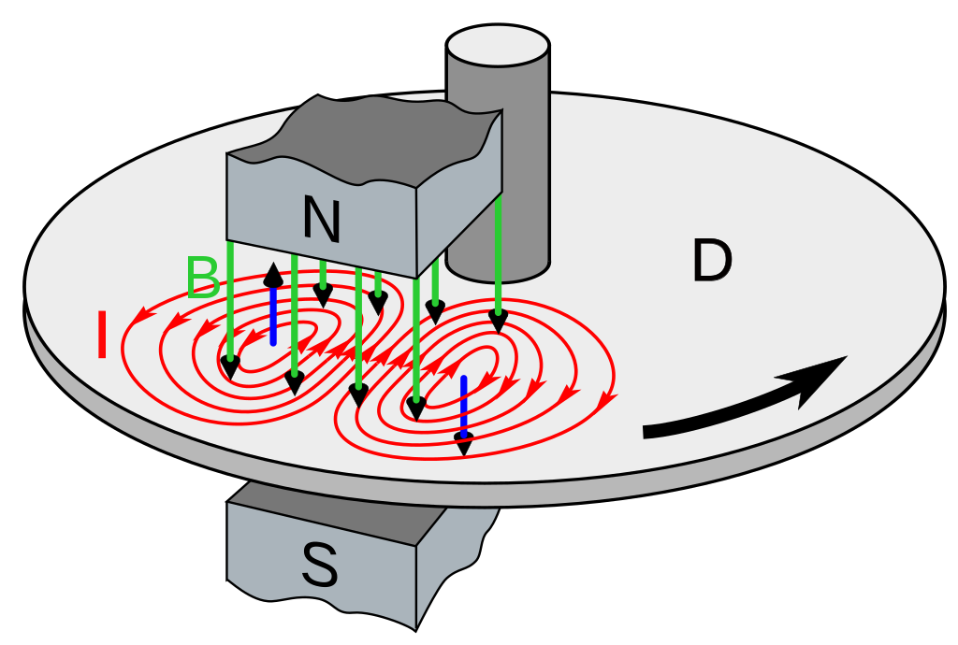
DISK EDDY CURRENT BRAKE
Source: Wikipedia

Slide 5
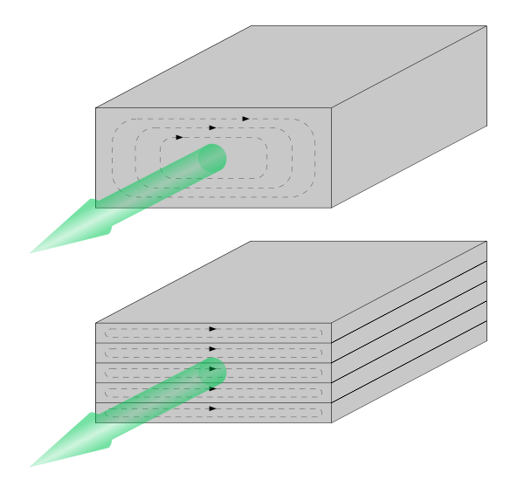
LAMINATIONS
Source: MagCraft

Slide 6
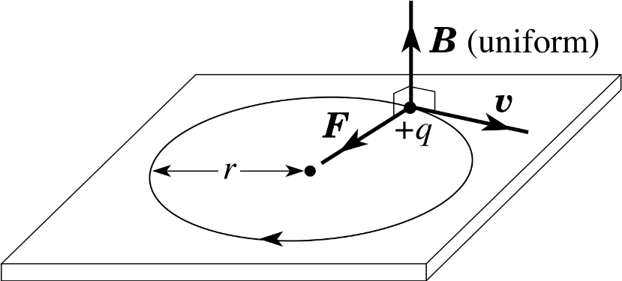
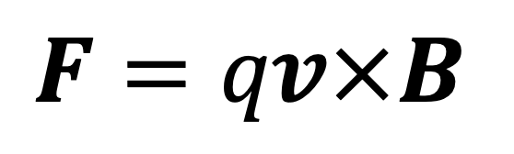
CREATING THE MODEL
$F=qv×B$
where F is the force, q is the charge, v is the velocity
and B is the magnetic field strength
Source: Whitesides Research Group, Harvard University
Source: Wikipedia

Slide 7
PROBLEMS
The surface is not infinite
The surface may not travel in a straight line

Slide 8
AIMS
Establish a working model
Analyse the given data

