Slide 1


T-02: Simulation
Primary: Ben Andrews

Slide 2
Presentation Structure
Theory
Developing the Model
Predictions, Tests, & what’s next

Slide 3





Theory
And Derivation

Slide 4
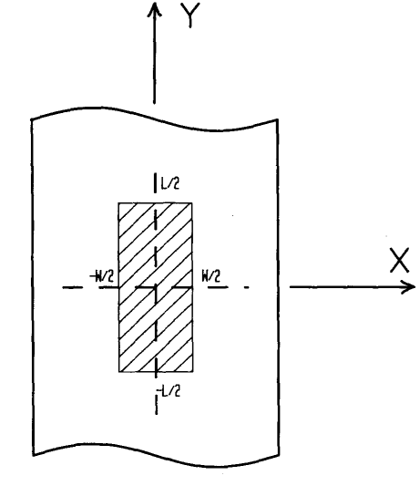



$B_{0}$k
We approximate the system as a small strip of metal travelling at a low velocity, with dimensions (w x l x $δ$).
If the poles of the magnets are close together, the field can be assumed to be uniform and negligible beyond the shaded area.
Low angular velocity -> Induced B-field is negligible.
Applying Ohm’s Law and the Lorentz Force Law:
$J=σ\left(E+v×B_{0}\right)$ (1)
If we assume that l >> w, then $J=\left(\frac{I}{δl}\right)$.
The induced electric field is given by:
$E=\left(\frac{V}{w}\right)i$
Where V is the voltage drop across the width w. This can be expressed similarly to the potential difference across the terminals of a battery of internal resistance r:
$V=ε−rI$ (2)
Where:
$ε=vB_{0}w$ (3)
$r=\frac{w}{σlδ}$ (4)
$ν$j
w
l

Slide 5



$B_{0}$k
If we define R as the resistance of the unshaded area, applying Ohm’s Law to (2) gives:
$I= ασB_{0}lδv$ (5)
w$ith,$
$α≡{(1+\frac{R}{r})}^{−1}$ (6)
R can be determined simply by experiment, or by a far more complex analytical method.
The drag force is therefore found to be:
$F=\int{J×Bdτ}$
$F=\left(ασlδwB_{0}^{2}v\right)j$ (7)
$ν$j
w
l

Slide 6

Next we assume that the strip is sufficiently far from the centre of rotation such that it’s velocity can be considered uniform.
Additionally, we assume that the outer disc edge is sufficiently far to neglect its influence on the induced current.
The torque experienced by the strip can be expressed:
$K\frac{dω}{dt}=Γ_{0}+Γ_{B}$ (8)
Where $Γ_{0}$ is the torque due to air resistance and $Γ_{B}$ is due to eddy-current braking. We can convert from linear to angular velocity easily by the relationship $ω=\frac{v}{L}.$ (8) is easily integrated to give:
$ω\left(t\right)=ω_{0}e^{−\frac{t}{τ}}$ (9)
Where,
$\frac{1}{τ}=\frac{1}{τ_{0}}+mB_{0}^{2}$ (10)
And,
$m=\frac{ασδlwL^{2}}{K}$ (11)
ω
v
y
l
x
x
L
w

Slide 7

Developing the Model

Slide 8
Aims of the Model
Provide accurate framework to link theory and physical measurements
Flexible
Fast
Easily understandable to new readers

Slide 9
The model
Built in Python 3.9
To ensure speed:
Minimise use of user-defined functions and nested for loops
Use Numpy and Python defined functions to take advantage of the speed of C.
Scipy for curve-fitting
To improve readability:
Separation of implementation from the simulation.
Keep to PEP8.

Slide 10

What was modelled?
How $τ^{−1}$ varies with several parameters
Magnetic field strength squared, conductivity, and thickness were varied.
Only magnetic field strength is considered due to time constraints.
Using the intercept to compare the measured value of $\frac{1}{τ_{0}}$
$\frac{1}{τ}=\frac{1}{τ_{0}}+mB_{0}^{2}$.
$τ$determined by measuring the gradient $\ln\left(ω\right)$ plot against time.
Due to missing measurements in the supplied data, values were used from [1].

Slide 11
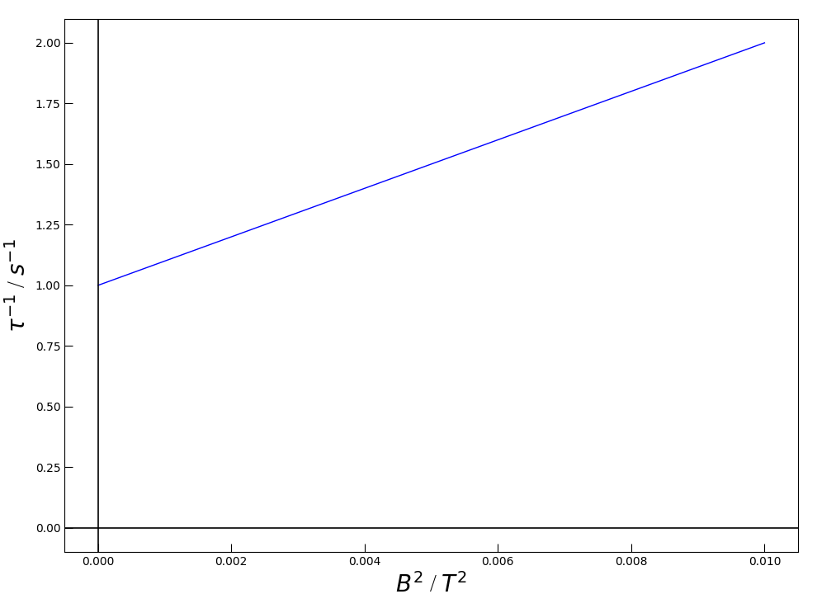

Predictions
The $τ^{−1}$is expected to be proportional to the square of the magnetic field strength.
As the magnetic field strength tends to 0, the drag force due to air resistance remains.

Slide 12
Current Problems
Lack of measurements of important constants.
Theory incorrectly models the electromagnet poles as rectangular.

Slide 13
What’s Next?
Continued research to improve model, see [2].
Considering which experiments to propose at the panel meeting.
Continue working with theoretician to fix problems in model.
Continue working with analyst to continue building out analysis pipeline.

Slide 14
References
[1] Wiederick, H. D., Gauthier, N., Campbell, D. A., Rochon, P., 1987. Magnetic braking: Simple theory and experiment. American Journal of Physics[Online], 55 (500). Available from https://www.researchgate.net/publication/252850785 [Accessed 14 February 2020]
[2] Heald, .M. A., 1988. Magnetic braking: Improved theory. American Journal of Physics[online], 56 (521). Available from https://scitation.aip.org/content/aapt/journal/ajp/56/6/10.1119/1.15570?ver=pdfcov [Accessed 16 February 2020]

