Slide 1
Quantum Machine Learning vs Classical
T.A.L.O.S.

Slide 2

Introduction
Quantum machine learning (QML) is an emerging field that combines the principles of quantum mechanics and machine learning. It involves using quantum computers to perform machine learning tasks, as well as using classical machine learning algorithms to analyze quantum data. The aim of QML is to exploit the inherent quantum properties, such as superposition and entanglement, to enhance the speed and efficiency of machine learning tasks.

Slide 3
Problem Statement & Motivation
Classical Machine Learning algorithms can get very complex and computationally expensive when learning higher level features. This results in very high training time as well. It is our understanding that Quantum Machine Learning algorithms can be used to reduce complexity by leveraging the Qubit states instead of the classical binary states. In this project we’ll be attempting to implement some classical machine learning problems with both the classical algorithms and the quantum algorithms.

Slide 4
Machine Learning
Classical Machine Learning
Quantum Machine learning
Vs
Classical computing based on bits that are either 0 or 1
Linear algebra, optimization
Uses classical data representation
Commonly used for tasks such as classification, regression, and clustering
Quantum computing based on qubits that can be in superpositions of 0 and 1
Quantum state manipulation, quantum gates
Can use quantum data representation
Currently limited to a few specific tasks such as, optimization, and pattern recognition

Slide 5
Related Works
An Introduction To Quantum Machine Learning
Challenges and opportunities in Quantum Machine Learning
Quantum Machine Learning: A Review and Case Studies

Slide 6
Possible Outcomes
01
02
Faster Computation
Optimization
03
04
Can work on more extensive datasets
More forms of data representation

Slide 7


Libraries Used

Slide 8
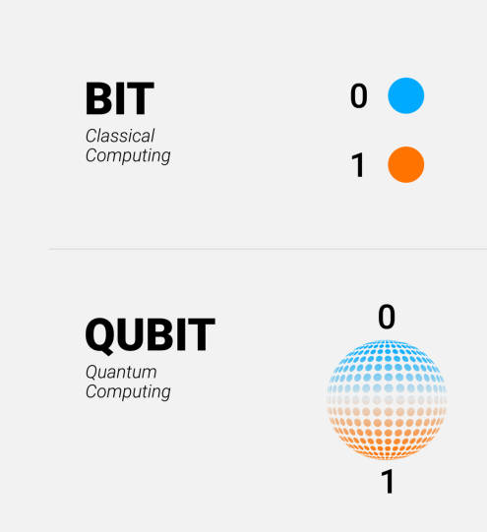
Feature Mapping
Feature mapping in quantum machine learning refers to the process of encoding classical data into a quantum state representation.
GOAL: extract relevant information from classical features and represent them in a quantum form that can be manipulated by quantum algorithms

Slide 9
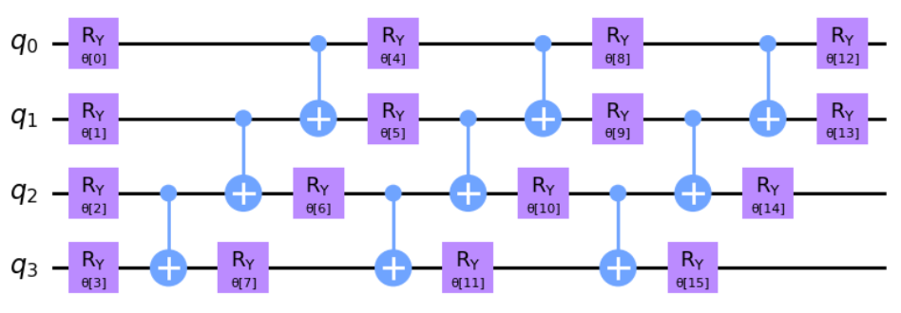
Ansatz Circuit
In quantum computing and quantum machine learning, an ansatz circuit refers to a parameterized quantum circuit used as a model for quantum algorithms or variational quantum algorithms.
key aspects and considerations related to ansatz circuits:
Parameterization
Gate Operations - Pauli gates (X, Y, Z) - Hadamard gate (H) - rotation gates (Rx, Ry, Rz)
Depth and Width: Number or layers and iterations
Optimization

Slide 10
Models used for Comparative Analysis
SVC & VQC
CNN & Hybrid QNN
Evaluation with PURE QCNN

Slide 11
Thank You

