Slide 1
Java-Based Test Automation Framework
Spring Boot · Selenium · REST-Assured · JDBC
Weeks 1–8 | Full Development Lifecycle

Slide 2
Objective
Design a scalable Java-based test automation framework
Integrate Selenium & REST-Assured for UI and API testing
Enable parallel test execution with multithreading
Provide real-time reporting and failure log collection
Expose RESTful APIs via Spring Boot for test management
Track and analyze test results with a built-in analytics module
Deploy a fully functional, end-to-end testable application

Slide 3
Introduction
What It Is
Enterprise-grade test automation platform
Built with Java, Spring Boot & Maven/Gradle
Centralized test execution and result storage
JDBC-backed persistence for test entities
RESTful API layer for external tool integration
Why It Matters
Reduces manual testing overhead significantly
Enables CI/CD pipeline integration
Supports parallel execution for faster feedback
Provides data-driven analytics on test trends
Modular design ensures easy maintainability

Slide 4

Requirements & References
Language & Build
Testing Tools
Java (JDK 17+)
Maven / Gradle
Spring Boot 3.x
Selenium WebDriver
REST-Assured
JUnit / TestNG
Database & ORM
Execution & CI
JDBC (Spring Data)
MySQL / PostgreSQL
Spring Repositories
Multithreading (Java)
Parallel Test Runs
REST API Triggers

Slide 5
System Architecture
API Layer Spring Boot RESTful Controllers
Service Layer Business Logic · Scheduling · Execution Engine
Integration Layer Selenium · REST-Assured · Test Runners
Data Layer JDBC Repositories · MySQL / PostgreSQL
Analytics & Reporting Result Tracker · Report Generator · Log Collector
▼ Data Flow ▼

Slide 6

Modules Overview
01
02
Test Integration Engine
Scheduling & Execution
Selenium & REST-Assured setup
JDBC-based data persistence
Test entity model definitions
Multithreaded parallel execution
Test suite scheduling logic
Spring Boot execution APIs
03
04
Reporting Hub
Result Analytics Tracker
Automated report generation
Failure log aggregation
Spring Boot reporting APIs
Trend analysis from stored data
Analytics REST endpoints
End-to-end validation support

Slide 7

Development Milestones
Week 1–2
Week 3–4
Week 5–6
Week 7–8
Setup & Training
Integration Engine
Scheduling & Reporting
Analytics & Deploy
JDK, DB, Spring Boot
setup
OOP, JDBC, Selenium training
Test entity model definition
Selenium/REST-
Assured classes
Spring Boot JDBC repos
RESTful API development
Multithreaded
execution logic
Report & log generation
Scheduling & report APIs
Result analysis
integration
Analytics REST endpoints
E2E testing & deployment

Slide 8
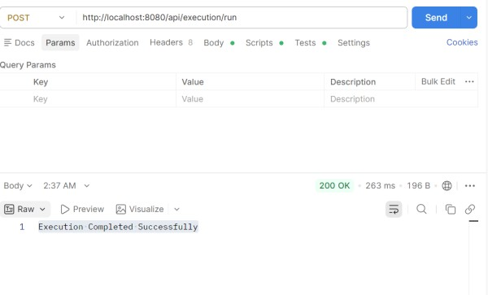
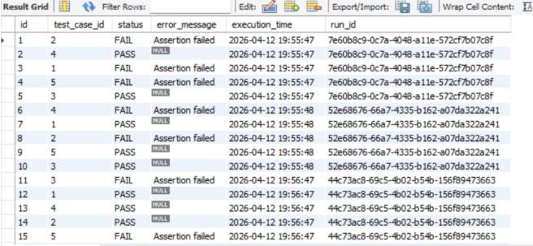
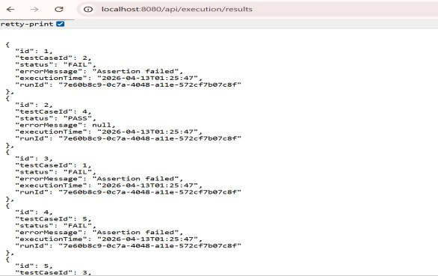
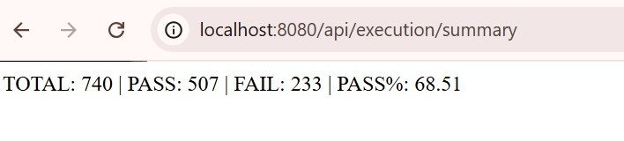
Screenshots / Outputs
SQL TABLE
Run API
Results
Summary

Slide 9
Key Technical Outcomes
Achievements
Fully modular 4-component architecture
RESTful APIs for all major operations
Real-time parallel test execution
Automated failure detection & logging
End-to-end test coverage validated
Skills Demonstrated
Java OOP & design patterns
Spring Boot & REST API development
Selenium & REST-Assured integration
JDBC data modeling & persistence
Multithreading & scheduling concepts

Slide 10
Conclusion
A robust, production-ready test automation framework built in Java
Spring Boot APIs enable seamless CI/CD pipeline integration
Parallel execution and scheduling reduce testing cycle times
Analytics module provides actionable insights on test quality
All 4 modules delivered across 8 weeks with full deployment
Demonstrates real-world enterprise Java development practices
Java · Spring Boot · Selenium · REST-Assured · JDBC · Analytics

Slide 11
THANK YOU
Any queries?
Java · Spring Boot · Selenium · REST-Assured · JDBC · Analytics

