Slide 1
What Factors Influence Video Game Success?
6DATA004W – Data Visualisation and Dashboarding
Tomasz Wasowski – W1684891
Notes:
Hello and welcome to this presentation where I share with you the results of my exploratory data analysis to determine what factors influence video game success.

Slide 2
‘Factors’ and ‘Success’
Success – Ratio of positive user reviews
Factors – Video game attributes:
Price
Average playtime
Genre
Etc.
Notes:
The first thing that needs to be established is our definition of ‘factors’ and ‘success’.
For the purpose of answering this research question, success will be defined from the perspective of the end user as the ratio of positive user reviews made about the game. The higher the ratio, the more successful the game.
Factors will be defined as attributes of a video game; these can range from anything between the price or genre of a video game, and the average playtime recorded amongst its player base.

Slide 3
Sourcing Data
Data originally sourced from Steam API:
75% market share of digital PC game distribution
34 000 video games available for sale
95 million monthly active users
Final data set acquired from Kaggle
Notes:
The data that was analysed in order to answer this question is publicly available and was originally sourced from the Steam API
Steam is a digital distribution service for PC video games, and is a very complete data source for a problem like this, as it holds 75% of the market share for digital PC game distribution, offers 34 000 video games for sale and has over 95 million monthly active users.
It is important to mention that the actual dataset utilised was acquired from Kaggle, a data scientist community site where data sets for projects like this one are commonly shared.

Slide 4
Video Game Release
Release Date
Price
Publishing Company
Age Restriction
Notes:
With the definitions set and the data sourced, the results of the analysis can be presented. The first key aspect identified to be influential over the success of a video game is the conditions under and specifications with which the game releases.
This includes factors such as the date the video game released on, the price for which the game sells for, the company which published the game and the age restriction that the game is categorised under.

Slide 5
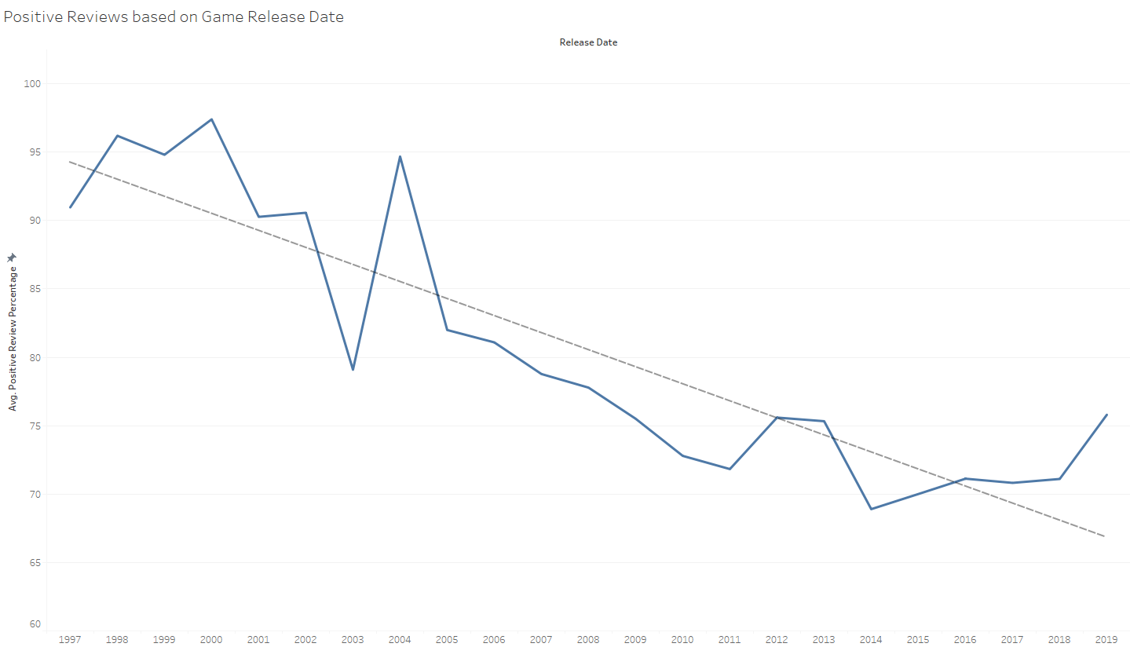
Release Date
Notes:
One of the most influential factors from that list was the release date, which signifies how old the video game is. We can see a clear negative correlation between the timeline of releases and the average positive review percentage.
This could be because users tend to rate familiar, nostalgic games higher, whereas newer, hyped games are judged under stricter scrutiny.

Slide 6
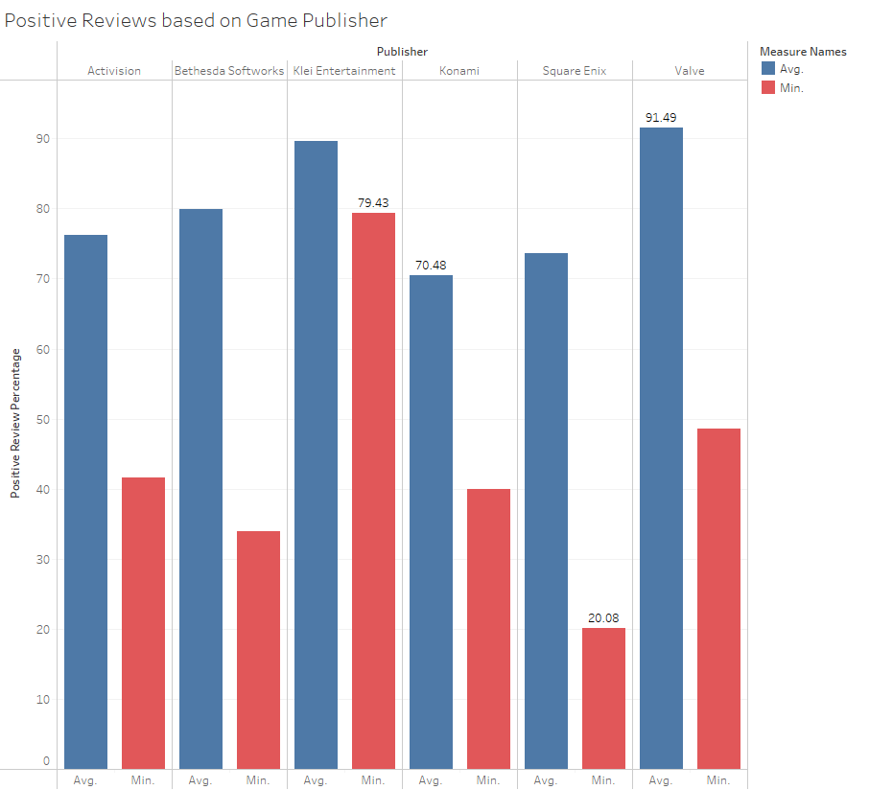
Publishing Company
Notes:
Another key factor was the company by which the game was published. As you can see, there is quite a variation between the average and minimum positive review percentages from company to company, signalling that some publishers might provide favourable conditions for the release of their game over others.

Slide 7
Video Game Popularity
Estimated number of ownership
Total number of user reviews made
Notes:
Another key aspect which influenced success was identified to be the popularity of the game after release. The factors that determine this are the number of people who own the game, or number of individual video game sales, and the total number of user reviews made for the game since release.

Slide 8
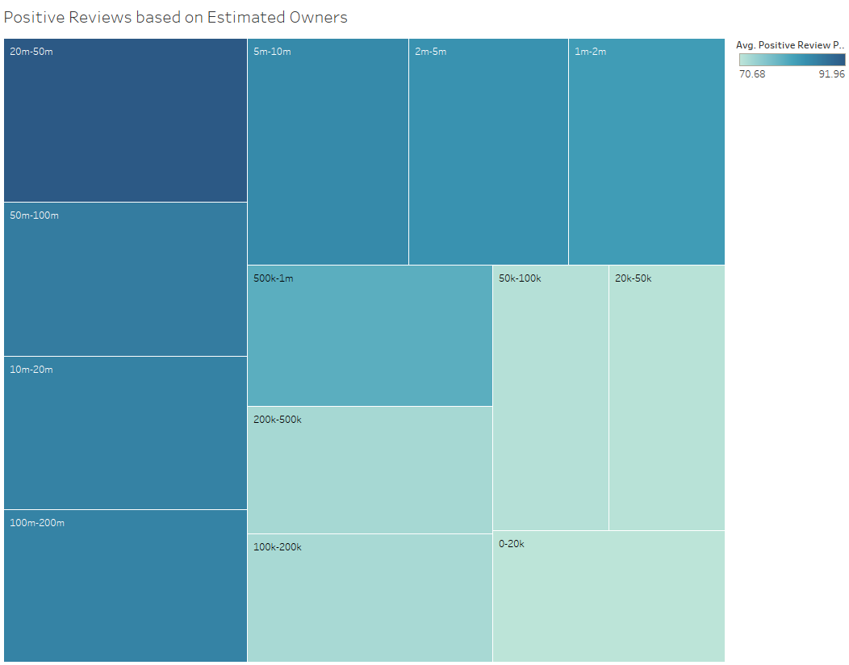
Estimated Owners
Notes:
As you can see, games that made fewer sales, that are not owned by a large percentage of the market’s player base, tend to have worse positive review ratios on average, when compared with games that have been bought by millions of players.
A reason for this could be that games are bought by many players when they are perceived to be of good value or quality, increasing the likelihood that a player will leave a positive review.

Slide 9
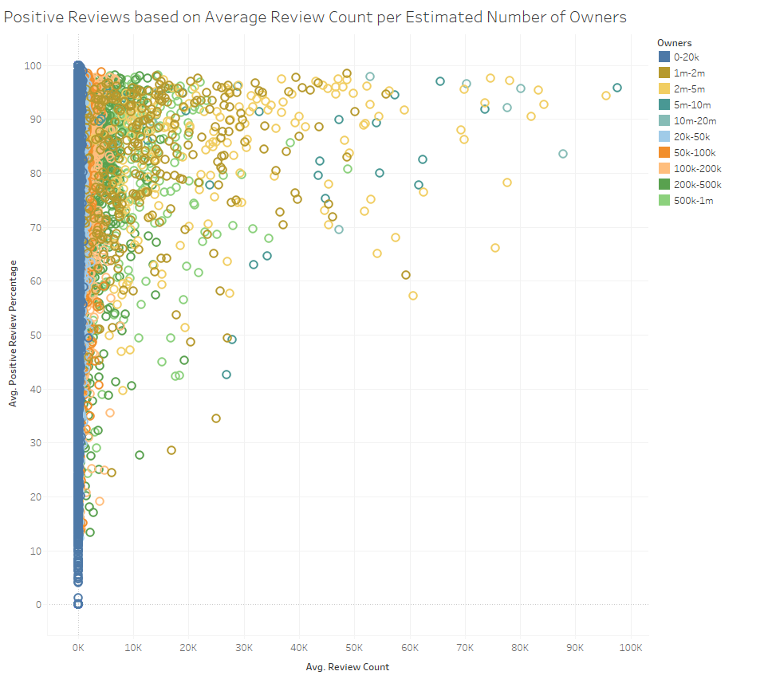
Review Count
Notes:
Another important factor is the total user reviews that have been made by players of the game in question. As you can see, the more popular the game, and the more total reviews it has, the better the reviews seem to be on average.
This could be because games popular enough to garner a large audience are likely providing desirable features, increasing the likelihood that a user leaves a positive review.

Slide 10
Conclusion
Release circumstances
Game popularity
Detailed analysis of all factors available in report
Notes:
To conclude, the analysis identified that the release circumstances, as well as game popularity are the most influential aspects when it comes to video game success, with the release date, the publishing company, the estimated number of owners and the total review count appearing to be the most impactful factors.
Thank you for watching this presentation. If you’re interested in the full list and detailed analysis of all factors considered, please know that they are available in the coursework report submitted.

