Slide 1

OOPD PROJECT
SMART HEALTHCARE SYSTEM
SUBMITTED TO:
Prof. SHACHI SHARMA
SUBMITTED BY:
SANKET DESAHPANDE [MT18248]
VIKRAM KUMAR [MT18250]
JYOTSANA MEHRA [MT18237]

Slide 2
Design
1. For database SQLite3 has been used.
2.The user class contain three users: admin, patient, doctor.
3.Admin
Register himself first after login he has certain functions.
Functions: add doctor, remove doctor, view patient and remove patient.
4. Doctor
Register himself giving his all details, to which department he belongs etc.
Functions: view patient, view history, view schedule, create report, refer patient.
5. Patient
Register himself , after login certain functions are:
Functions: search doctor and book appointment.

Slide 3
Issues and challenges
Issue regarding unit testing.
Problem in generating smart algorithm.

Slide 4
Methodology
SQLite3 has been used for database.
Admin can do its own registration. Admin can add and remove doctors, can view the history of patients.
Patient will first register after login he can select a doctor of a particular department.
Patient will take appointment and will fill a slot.
The slot will be booked.
Doctors will do their registration and can login. He will be having all the history of his patient.
Doctor can decide should a patient be transferred to OPD or not.
Junior doctor can refer a patient to senior specialist.

Slide 5
Contribution
Sanket- Sequential diagram and main code.
Jyotsana- UML diagram, basic structure of code.
Vikram Kumar- State diagram, some part of the code.

Slide 6

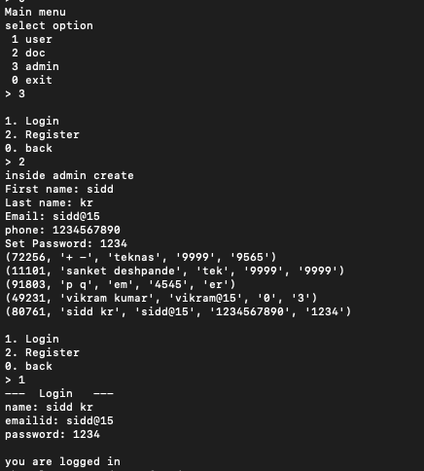
Screenshots

Slide 7
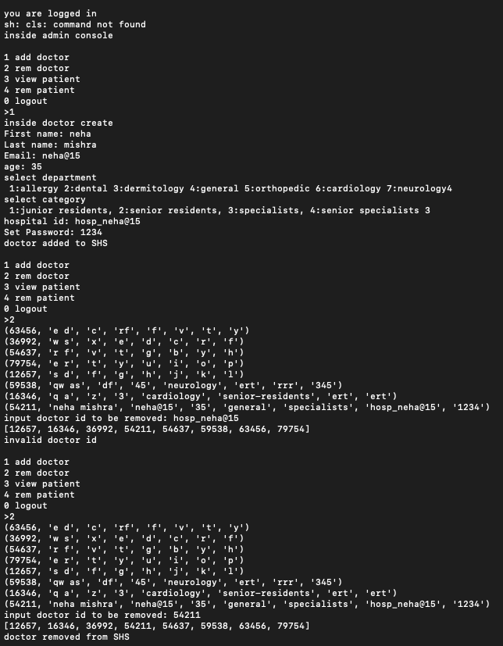
Screenshots

Slide 8
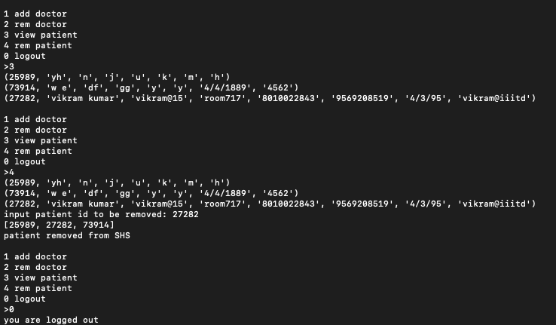
Screenshots

Slide 9
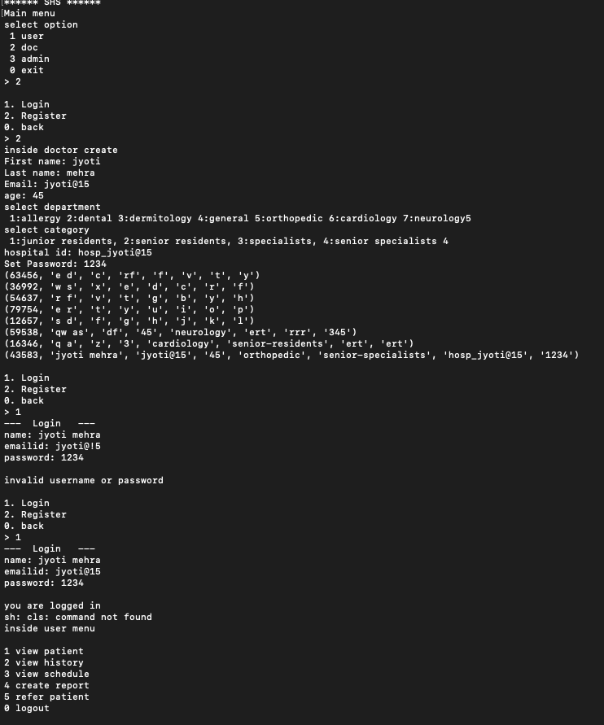
Screenshots

Slide 10
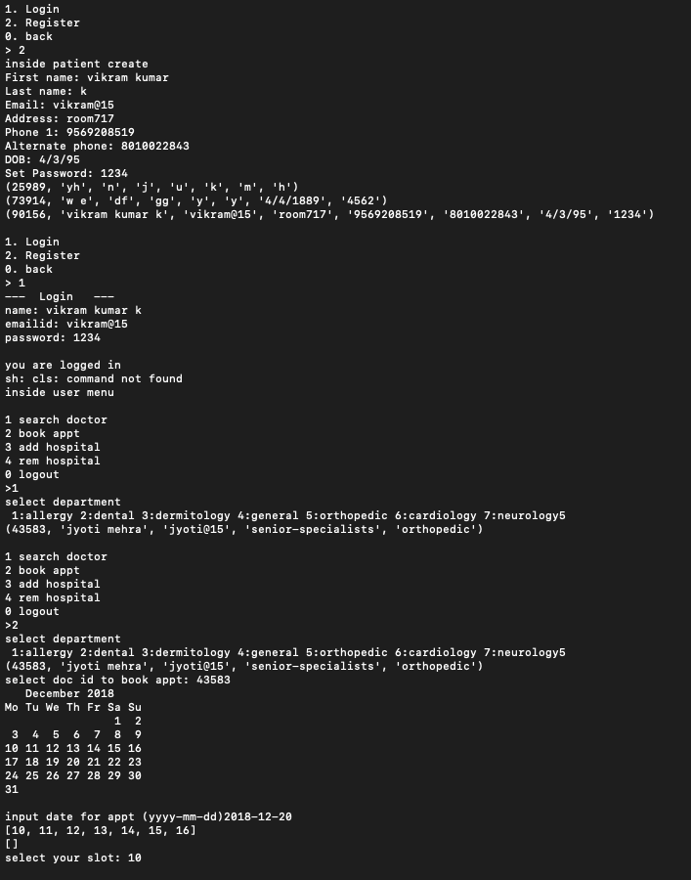
Screenshots

