Slide 1
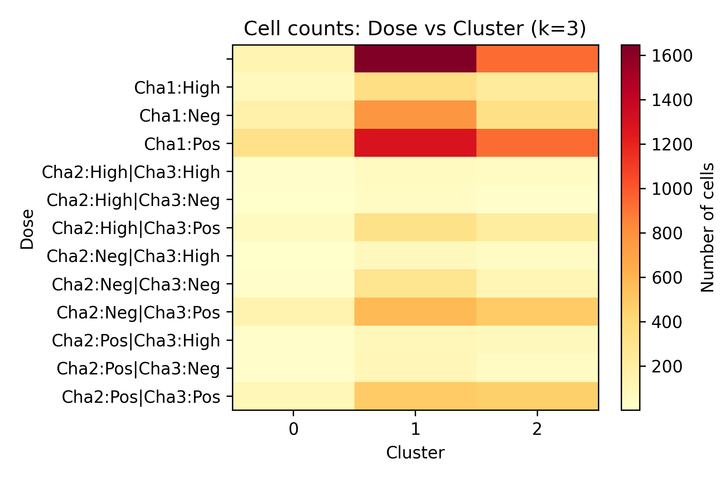
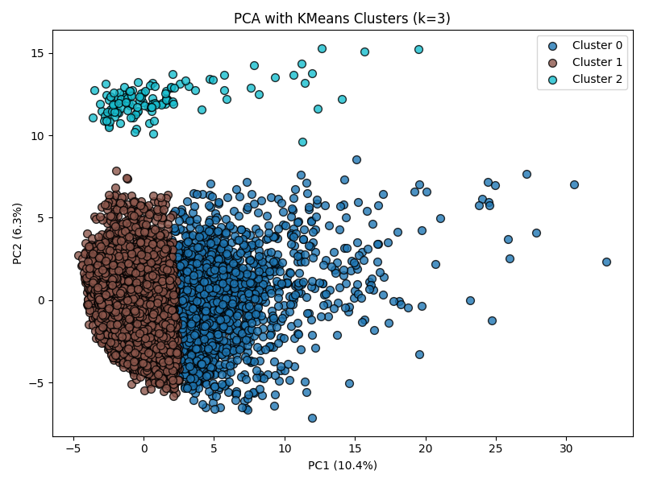
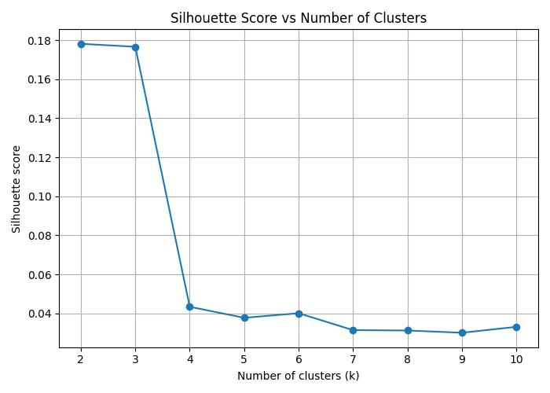
The Iby & Aladar Fleischman Faculty of Engineering Tel Aviv University
Cellomics 7: Development of an Advanced AI-Driven Framework: Integrating GenAI and Cellomics Analysis for Multivariate Time Series Investigation of Cancer Cell Motility and Metastasis
[Company / Lab Logo]
EXPANDING the BOUNDARIES of POSSIBILITY
Project Number: 3074
Students: Jeries Khoury, Waseem Bsharat
Advisor: Professor Ilan Tsarfaty
Introduction
Implementation
Results (cont.)
Cancer cell motility and metastasis are critical factors in tumour progression. Understanding the dynamic morphological behaviour of cancer cells under different drug treatments requires analysis of high-dimensional, multivariate time-series data generated by high-content screening (Cellomics) platforms. This project develops an end-to-end AI-driven framework that combines Generative AI foundation models with traditional Cellomics image analysis to investigate how drug treatments — Methotrexate (METR), Gabapentin (GABY), and their combination — alter cancer cell motility patterns over time. The pipeline processes ~238,000 single-cell trajectories across 4 treatment groups (NNIR control, METR+NNIR, GABY+NNIR, METR+GABY+NNIR), with 3 replicate wells each, tracked over multiple time points in a 12-well plate.
Data: 238,146 cell trajectories from a Cellomics high-content screening assay (12-well plate, 4 treatments × 3 replicates). Each cell is tracked over multiple time frames across 55 morphological features (area, speed, acceleration, displacement, shape descriptors, etc.). Feature Selection: Variance-based filtering and autocorrelation analysis reduce the feature space from 55 to 15 informative time-varying features. Mathematical Fitting: Five trajectory models (linear, exponential decay, damped sinusoidal, logistic, power-law) are fitted per cell per feature. The best model is selected by RMSE. GenAI Embedding: Pre-trained foundation models (Google TimesFM, Amazon Chronos, Salesforce Moirai) generate fixed-length vector representations of each cell's multivariate time series. Forecasting & Baseline: A many-model forecasting pipeline benchmarks 24 features against 4 baselines (LSTM, GRU, DLinear, Autoformer).
Forecasting: The many-model foundation model pipeline achieves substantially lower forecasting error across 24 cell features compared to standard deep-learning baselines: • vs. LSTM: 26.4% lower RMSE • vs. GRU: 28.3% lower RMSE • vs. DLinear: 12.7% lower RMSE • vs. Autoformer: 27.1% lower RMSE Two-Way ANOVA (Method × Cluster, k=3): • 37/49 features show significant Analysis effect (FDR < 0.05) • 43/49 features show significant Cluster effect • 40/49 features show significant Interaction effect This confirms that dynamic AI-based clustering captures biologically meaningful structure beyond static summary statistics.
Motivation
Traditional cell motility analysis relies on static, hand-crafted summary statistics (e.g. mean speed, total displacement) that collapse rich temporal dynamics into single numbers. Key limitations of existing approaches: • Loss of temporal information — when and how cells change behaviour is discarded • Single-feature analysis — fails to capture multivariate interactions between morphological features • No dose-response integration — cluster assignment is not linked to drug dose intensity Our framework addresses these gaps by: 1. Fitting mathematical models to each cell's full time-series trajectory 2. Using GenAI foundation models (TimesFM, Chronos, Moirai) to learn rich temporal embeddings 3. Performing unsupervised clustering in the embedding space 4. Linking clusters to dose-response categories (Neg / Pos / High) per drug channel 5. Statistical validation via Two-Way ANOVA comparing dynamic vs. static clustering approaches
Results
Clustering: Silhouette analysis identifies k=3 as the optimal cluster count. The three phenotypic clusters capture 88.3% of cells in cluster 1 (main population), 11.8% in cluster 0 (high-motility outliers), and 0.05% in cluster 2 (rare phenotype).
Fig 3. Cluster vs. Dose-Response heatmap (k=3). Left: cell counts. Right: row-normalised %.
Conclusions
1. GenAI foundation models (TimesFM, Chronos, Moirai) trained on general time-series data transfer effectively to biological single-cell trajectories, outperforming task-specific baselines by 13–28% RMSE. 2. Embedding-based unsupervised clustering reveals three distinct cell phenotypes that correlate with drug treatment and dose intensity. 3. Two-Way ANOVA confirms that dynamic (embedding-based) analysis captures significant interactions between clustering method and morphological features in 40/49 features tested. 4. The integrated Streamlit pipeline provides an accessible, reproducible framework for multivariate time-series analysis of cancer cell motility data.
Fig 1. PCA projection of embedding vectors coloured by K-Means cluster (k=3).
Pipeline Overview
Raw Cellomics Data → Feature Selection (15/55 features) ↓ Time-Series Normalisation → Mathematical Fitting (5 models) ↓ GenAI Embedding (TimesFM / Chronos / Moirai) ↓ PCA + K-Means Clustering (k=2–10, silhouette-optimised) ↓ Dose-Response Integration → Two-Way ANOVA → Conclusions
Bibliography
[1] Das, A. et al. "TimesFM: Time Series Foundation Model for Universal Forecasting." Google Research, ICML 2024. [2] Ansari, A. F. et al. "Chronos: Learning the Language of Time Series." Amazon Science, arXiv:2403.07815, 2024. [3] Woo, G. et al. "Unified Training of Universal Time Series Forecasting Transformers (Moirai)." Salesforce Research, ICML 2024. [4] Specht, E. A. et al. "High-Content Analysis and AI-based Cell Morphology Profiling." Nature Rev. Methods Primers, 2024. [5] Tsarfaty, I. et al. "Cell Motility and Metastasis: Cellomics Approaches." Methods in Molecular Biology, 2013.
Fig 2. Average silhouette score vs. number of clusters (k=2–10).

