Slide 1
MEDIA STREAMING WITH IBM CLOUD VIDEO STREAMING
Submitted by
T.Jayasurya
Department of Electronics and Communication Engineering
Anna University Regional Campus Coimbatore

Slide 2
Problem statement
Create a virtual cinema platform using IBM Cloud Video Streaming.Where users can upload and stream movies and videos on-demand.Define the virtual cinema platform, designing the user interface, integrating IBM Cloud Video Streaming services, enabling on-demand video playback, and ensuring a seamless and immersive cinematic experience.

Slide 3
Problem Definition
The Objective of this project is to create a Video streaming platform Which give user a virtual cinematic experience and enables to upload and stream high quality video from any remote devices. By the IBM Cloud video streaming the conent of video is data secured.Also the video access should be safe and secured by creating a login page for user e-mail & password.Comparing other media platforms this has an additional features of chatting in community groups and make coonections and acces links by using cloud.

Slide 4
IBM cloud video streaming platform
In an era characterized by the proliferation of digital content and the ubiquity of high-speed internet, the demand for seamless, high-quality media streaming experiences has never been greater.
The project aims to revolutionize the way we consume and deliver media content, offering a cutting-edge solution that addresses the evolving needs and preferences of modern audiences.
IBM Cloud Video Streaming is a platform that allows to host, manage, and deliver live and on-demand video content.
This project envisions a comprehensive and innovative media streaming platform that leverages the latest advancements in technology to provide a superior user experience.

Slide 5
Features Enabling Cloud streaming platform
1. Content Delivery:
High-quality video(4k & 8k) and audio streaming over the internet.
Adaptive streaming to adjust video quality based on the viewer's internet connection.
2. Content Storage and Management:
Secure storage and management of media assets, including videos and audio files.
Content categorization, metadata tagging, and search capabilities for easy content retrieval.
3. Streaming Formats:
Compatibility with different devices and platforms (web browsers, mobile apps, smart TVs, etc.).
4. Live Streaming:
Support for live streaming of events, webinars, conferences, and broadcasts.
Tools for setting up and managing live streams, including scheduling and encoding options.
5.Live Interaction:
Users will have the ability to interact with live content, such as sports events or interactive shows, through real-time chats, polls, and interactive features, enhancing the sense of community and engagement

Slide 6
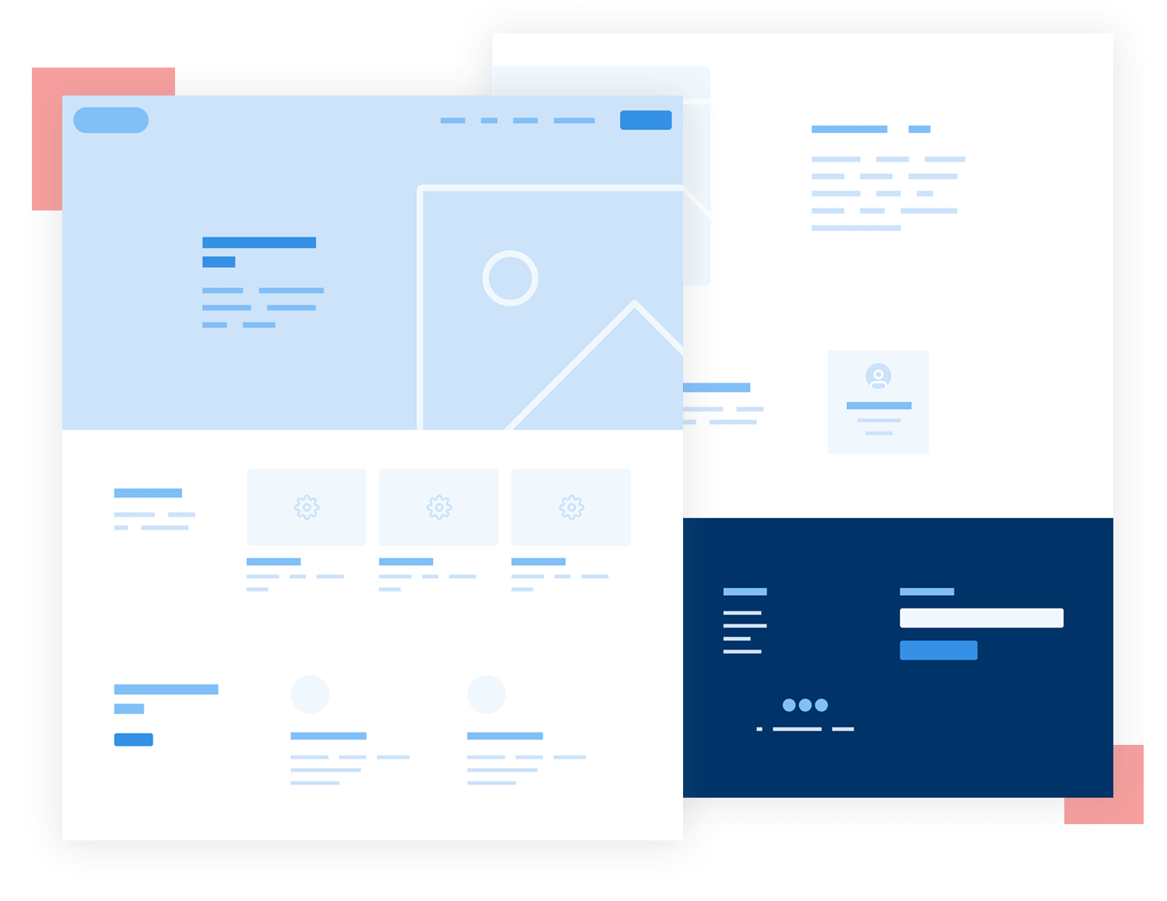
Platform Design
Creating User friendly and better user experience.
By Using HTML,CSS and sql (front end)a better UI(User Interface) will be created for user.
Python with flask is used to design webpage(backend)
Enabling a Seamless,Cinematic virtual and qualitive user experience

Slide 7
Conclusion
Video Upload:
Developing a prototype or minimum viable product (MVP) that allows users to upload videos.
Testing the video upload process with a small group of users and gather feedback to refine the feature.
Iterate on the prototype based on user feedback and technical feasibility.
Streaming Integration:
Testing the video streaming functionality across different devices and network conditions.
Collecting feedback on video quality, buffering issues, and user experience during playback.
Making necessary adjustments to ensure a seamless streaming experience.
User Experience:
Using feedback to make iterative improvements to the user interface, video upload process, and streaming quality.
Conducting usability testing to ensure that users can easily navigate the platform and enjoy a high-quality cinematic experience.

