Slide 1
MEDIA STREAMING WITH IBM CLOUD VIDEO STREAMING
Submitted by
T.JAYASURYA
Department of Electronics and Communication Engineering
Anna University Regional Campus Coimbatore

Slide 2
Project Objectives:
In this part we will continue building our project. Especially, building the platform by integrating video streaming services and enabling on-demand playback. Integrate IBM Cloud Video Streaming services to enable smooth and high-quality video playback.

Slide 3
Project Tasks:
How to stream and watch videos:
TASK: 1
Content Licensing and Acquisition: - Content licensing is the process of securing the rights to stream movies and TV shows on your platform, often through negotiations with studios and production companies. - Acquiring a diverse library of content is crucial for attracting and retaining subscribers. This may involve purchasing, licensing, or producing original content. - Ensuring that you have the legal rights to stream the content and adhering to copyright laws is essential to avoid legal issues.

Slide 4
2.User Experience and App Development:
- Developing user-friendly apps for various devices (smartphones, smart TVs, etc.) is essential for attracting and retaining users. - Personalization algorithms and recommendation systems help users discover content tailored to their preferences. - Implementing features like offline downloads, user profiles, and seamless cross-device synchronization enhances the overall user experience.

Slide 5
steps for Video storing in cloud
PRE-REQUIREMENTS:
An IBM Cloud account.
Docker and Kubernetes knowledge.
IBM Cloud CLI and Kubernetes CLI installed.
A media streaming application or service that you want to containerize.
Step 1: We have to set up the IBM Db2 DatabaseIBM . Db2 is a relational database service in IBM Cloud. You can create a Db2 instance and set up your database for storing metadata or any relevant data for your media streaming application. Log in to IBM Cloud account.Create a Db2 instance in the IBM Cloud Dashboard .Configure and manage the Db2 database schema and tables according to the application's requirements.

Slide 6
Step 2: Use IBM Cloud Object StorageIBM Cloud Object Storage is an ideal solution for storing media files and assets related to media streaming application.Create an Object Storage instance through the IBM Cloud Dashboard.Set up buckets and objects to store the media files.
Step 3: Develop a Media Streaming Application, ensuring that it can interact with both the Db2 database for metadata and the Object Storage for media files.
Step 4: Containerize the Application. Now, we need to containerize the media streaming application using Docker. This will allow us to create a container image that can be run in a Kubernetes cluster.

Slide 7
Create a Dockerfile that describes how to build your application's Docker image.
Log in to the IBM Cloud CLI:
Step 5: Deploy Your Containerized ApplicationDeploy your containerized application to a Kubernetes cluster on IBM Cloud. You can create a Kubernetes cluster using the IBM Cloud Kubernetes Service.Create Kubernetes deployment and service resources to run your container.Configure environment variables and secrets, including database connection details, Object Storage credentials, and application-specific settings.Deploy and expose your application within the Kubernetes cluster.

Slide 8
WEB APPLICATION FEATURES
Hight quality video playback
Watch later playlist
Download and sharing features
Searching option is provided for searching desired videos
Reviews for each video
Description (info) of video

Slide 9
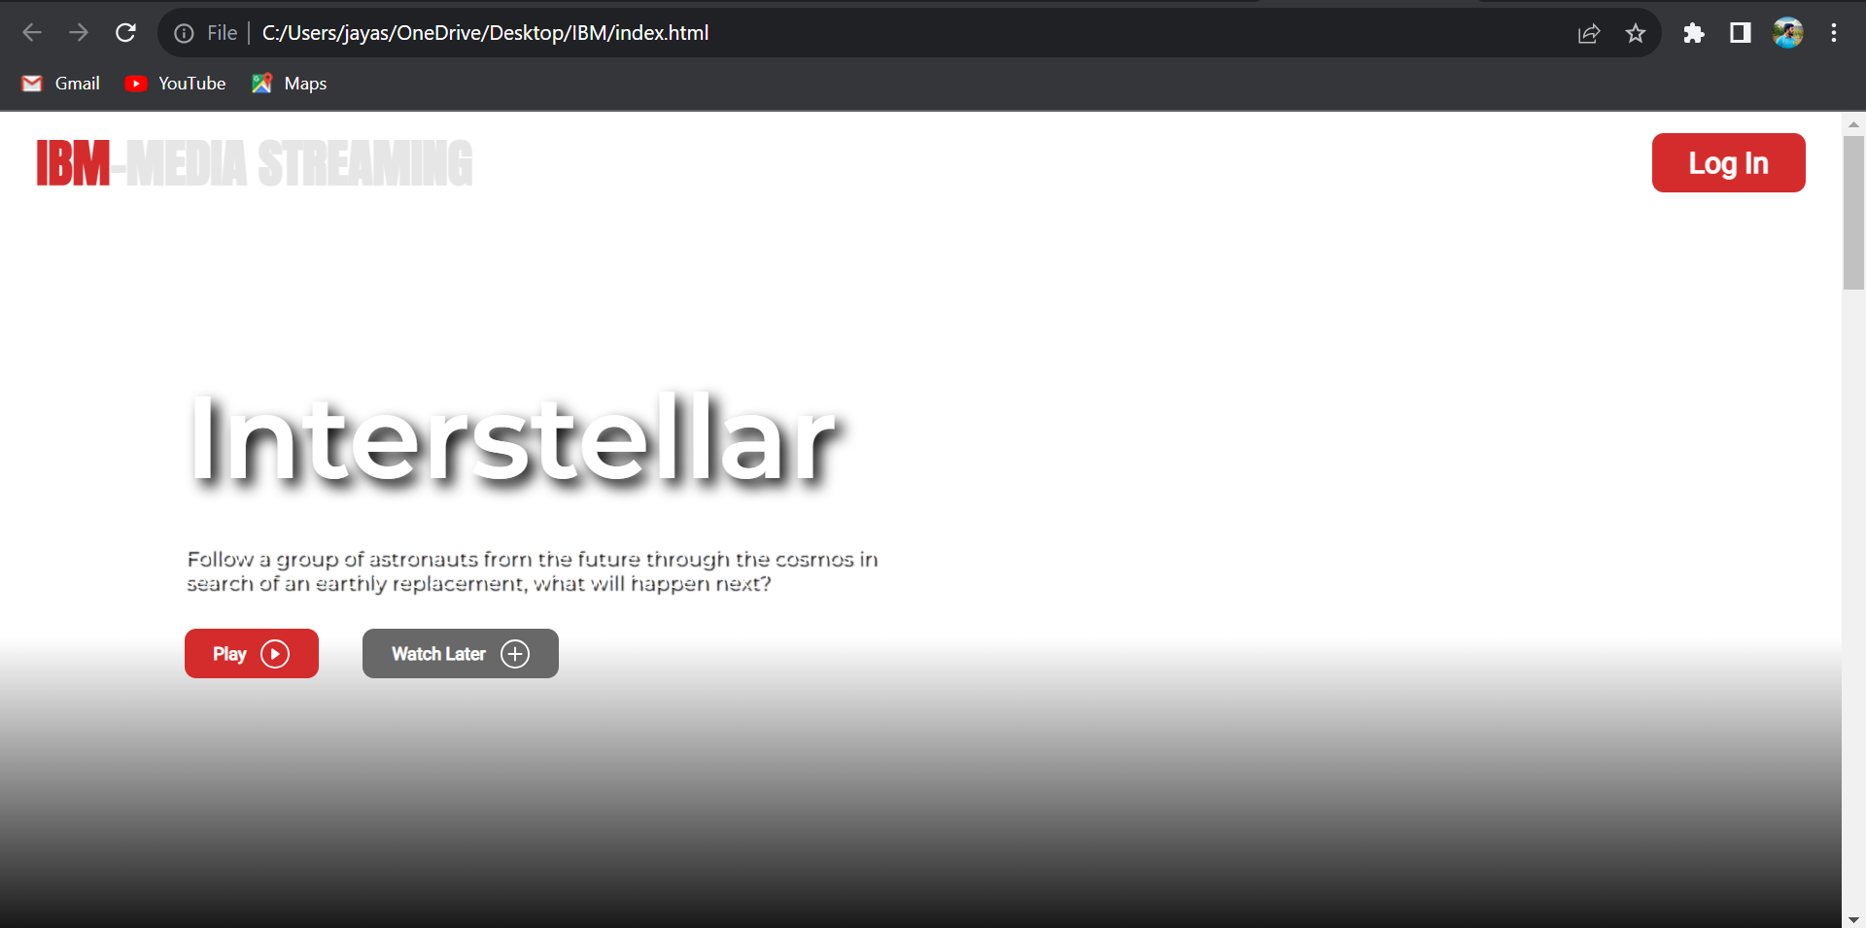

Slide 10
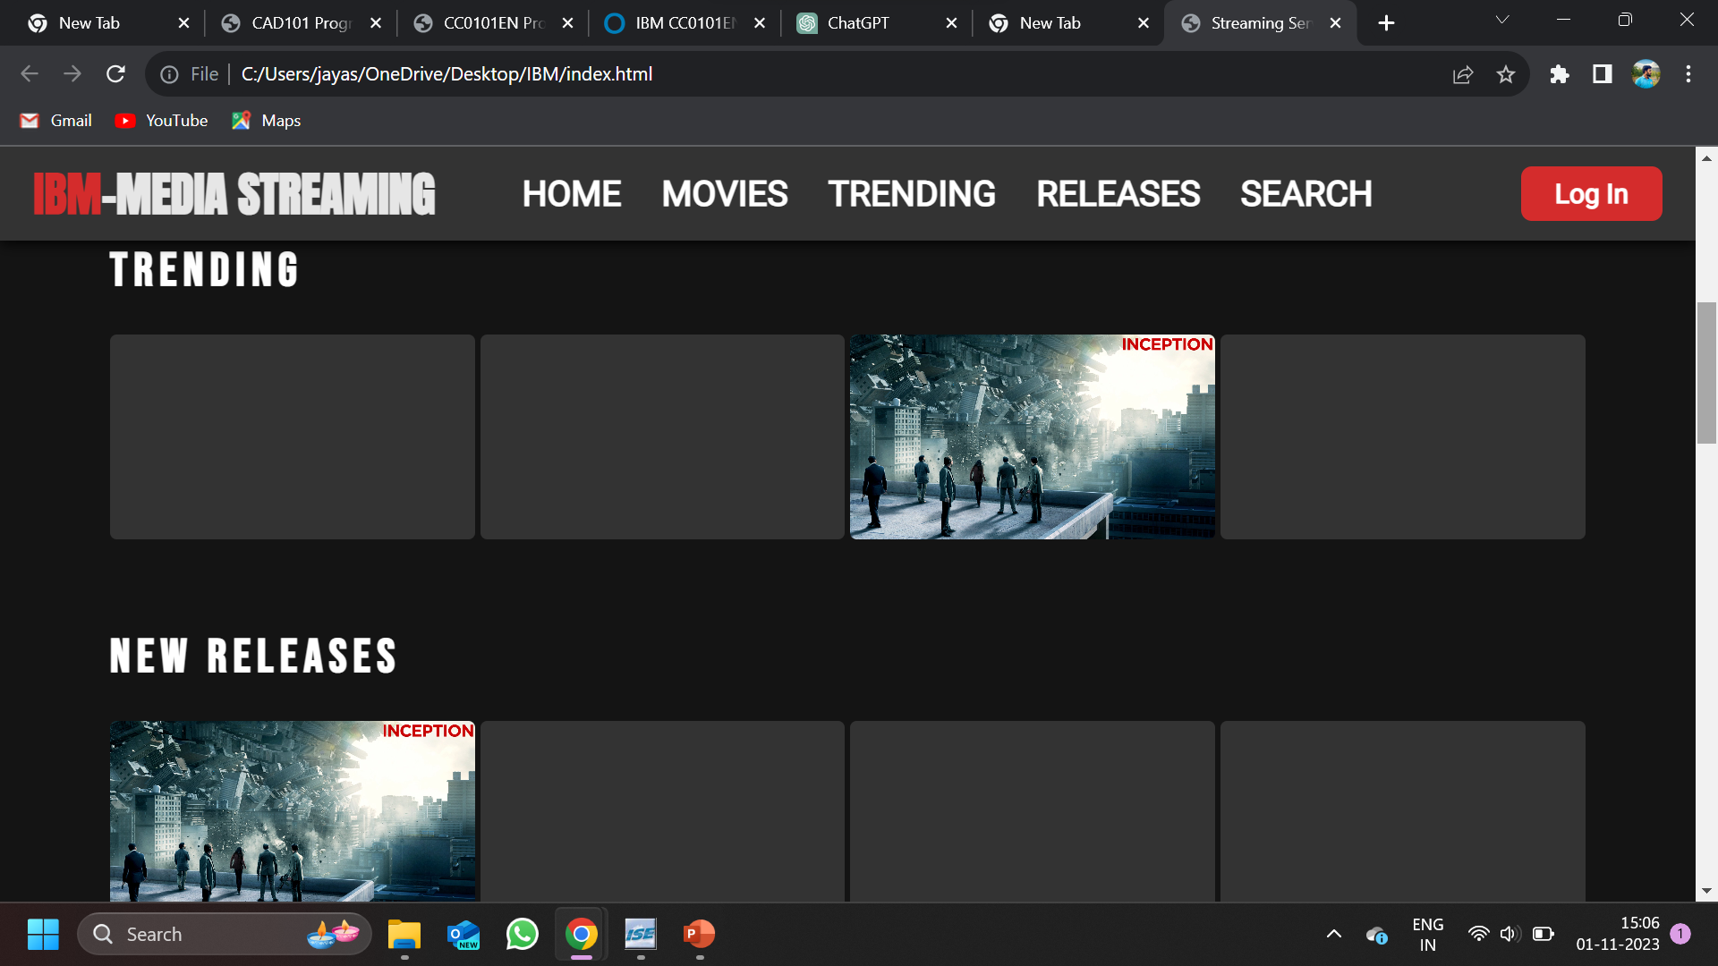

Slide 11
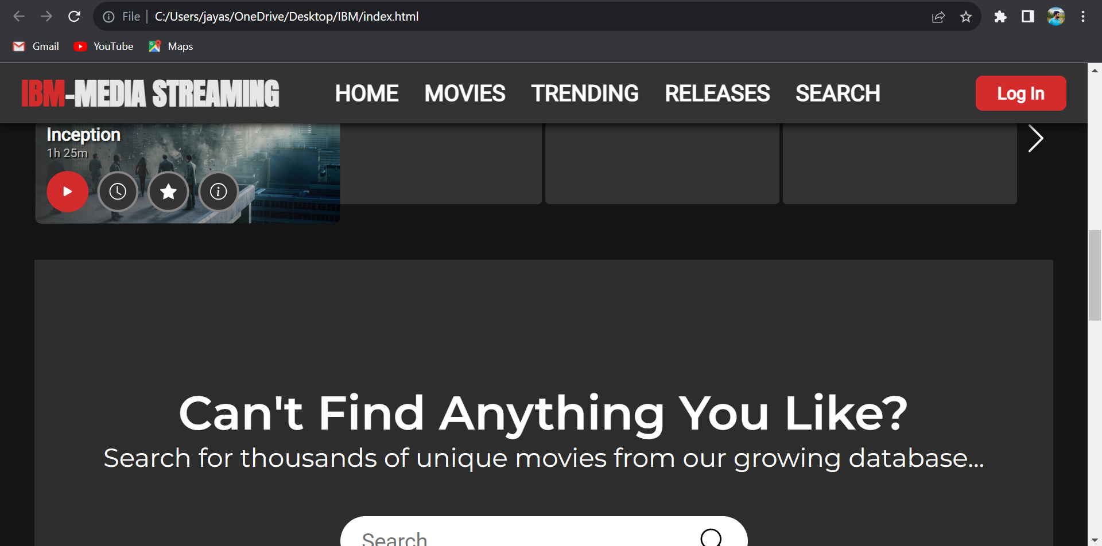

Slide 12
THANK YOU

