Slide 1


AUTONOMOUS RAIL TRACK INSPECTION ROBOT
PROJECT PHASE I
Guided by:
VINCY LEENA
Assistant Professor,
Department of Information Technology,
K. Ramakrishnan College of Engineering, (Autonomous),
Samayapuram, Trichy – 621 112.
Presented by:
GOUTHAMAN A (8115U23IT032)
JAYAPRAKASH T (8115U23IT041)
JOHN ADAN J R (8115U23IT046)

Slide 2
Overview
Objective
Introduction
Literature Survey
Existing System
Proposed System
System Architecture
Modules
Output
Conclusion
Future Enhancement
References

Slide 3
Objective
The primary objective of this project is to automate railway track inspection using a low-cost autonomous rail-mounted robot that replaces slow and error-prone manual patrolling.
The robot aims to detect rail-head cracks in real time using computer vision and grade them as minor, major or critical based on their length across the rail head.
It continuously measures the track gauge (1676 mm Broad Gauge) and reports any widening or tightening beyond the permitted tolerance.
It detects obstacles on the track using a front camera and ultrasonic sensors, slows down early and performs an emergency stop to avoid collision.
Every defect is geo-tagged with chainage, GPS and a photo, shown live on a control-room dashboard and exported as an inspection report.

Slide 4
Introduction
Indian Railways operates one of the largest rail networks in the world, and track defects such as rail cracks and gauge deviation are a major cause of derailments.
Track inspection in India is still largely manual – keymen walk or push a trolley along the line and check a few kilometres per shift by eye.
Small cracks are easily missed, records are paper-based, and obstructions on the line are found only when a train arrives.
This project introduces an autonomous inspection robot that runs on the rails like a mini train, uses cameras and sensors to find cracks, gauge faults and obstacles, and reports them live to the control room.

Slide 5
Literature Survey

Slide 6
S.NO | YEAR | TITLE | AUTHORS | ALGORITHM | FUTURE WORK
1. | 2015 | Railway fastener inspection by real-time machine vision | Ç. Aytekin, Y. Rezaeitabar, S. Dogru, I. Ulusoy | Image processing, pixel & histogram features | Real-time detection of missing fasteners from on-board cameras.
2. | 2016 | Deep convolutional neural networks for detection of rail surface defects | S. Faghih-Roohi, S. Hajizadeh, A. Núñez, R. Babuska, B. De Schutter | Deep CNN | Classified rail-surface defect images taken from track video.
3. | 2017 | Deep multitask learning for railway track inspection | X. Gibert, V. M. Patel, R. Chellappa | Multitask deep CNN | Joint detection of fastener and sleeper defects in track images.

Slide 7
S.NO | YEAR | TITLE | AUTHORS | ALGORITHM | FUTURE WORK
4. | 2017 | A hierarchical extractor-based visual rail surface inspection system | J. Gan, Q. Li, J. Wang, H. Yu | Coarse + fine extractor | Learned rail background to isolate surface defects with low false alarms.
5. | 2017 | A new rail inspection method based on deep learning using laser cameras | Y. Santur, M. Karakose, E. Akin | 3D laser camera + deep learning | Detected fracture, scouring and wear on the rail surface.
6. | 2020 | Object detection at level crossing using deep learning | M. A. B. Fayyaz, C. Johnson | Deep learning, CCTV + radar | Detected obstacles at level crossings using existing CCTV.

Slide 8
S.NO | YEAR | TITLE | AUTHORS | ALGORITHM | FUTURE WORK
7. | 2021 | Two deep learning networks for rail surface defect inspection of limited samples with line-level label | D. Zhang, K. Song, Q. Wang, Y. He, X. Wen, Y. Yan | Deep segmentation networks | Reduced the labelled data needed for defect detection.
8. | 2021 | A defect detection method for rail surface and fasteners based on deep convolutional neural network | D. Zheng, L. Li, S. Zheng et al. | YOLOv5, Mask R-CNN, ResNet | Located rails/fasteners, segmented surface defects on a high-speed line.
9. | 2021 | A review of vision-based on-board obstacle detection and distance estimation in railways | D. Ristić-Durrant, M. Franke, K. Michels | Survey: CV & AI methods | Identified need for on-board obstacle detection with distance estimation.

Slide 9
S.NO | YEAR | TITLE | AUTHORS | ALGORITHM | FUTURE WORK
10. | 2021 | Detection of safe passage for trains at rail level crossings using deep learning | T. Pamuła, W. Pamuła | Deep learning video analysis | Checked if the train's path is clear with 0.98 recall.

Slide 10
Existing System
Track inspection is mostly done by manual patrolling – keymen walk the section or use a push trolley and check the rails visually with a hand gauge.
Manual inspection covers only a few kilometres per shift and depends on the attention and experience of the inspector, so small cracks are often missed.
Ultrasonic flaw-detection trolleys and track recording cars are expensive, few in number and run only periodically.
Existing low-cost prototypes use simple IR / ultrasonic threshold sensors that give no crack size, no gauge value and no photo evidence.
Obstacles on the line are not detected in advance, and defect records are mostly paper-based without exact location.

Slide 11
Proposed System
The proposed system is an autonomous rail-mounted robot that drives along the track by itself with closed-loop motor control.
A down-looking camera with OpenCV detects rail-head cracks, rejects rust / grease stains and measures track gauge in every frame.
A front camera and ultrasonic sensors detect obstacles – the robot slows down at 15 m and makes an emergency stop at 2 m, then resumes when the track is clear.
Each defect is tagged with chainage (encoder), GPS, severity and photo; critical defects raise an alert and are paint-marked.
A live web dashboard shows cameras, sensor values, defect map and event log, with manual override and CSV / PDF report generation.

Slide 12
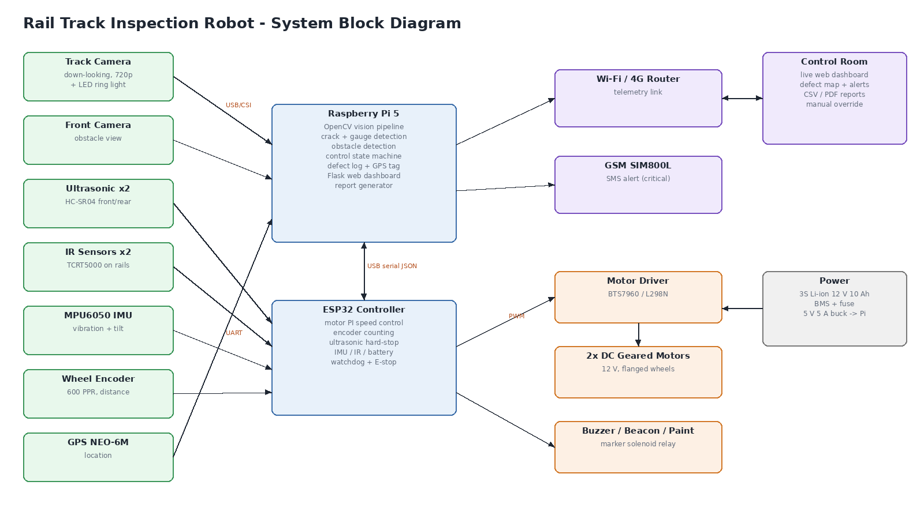
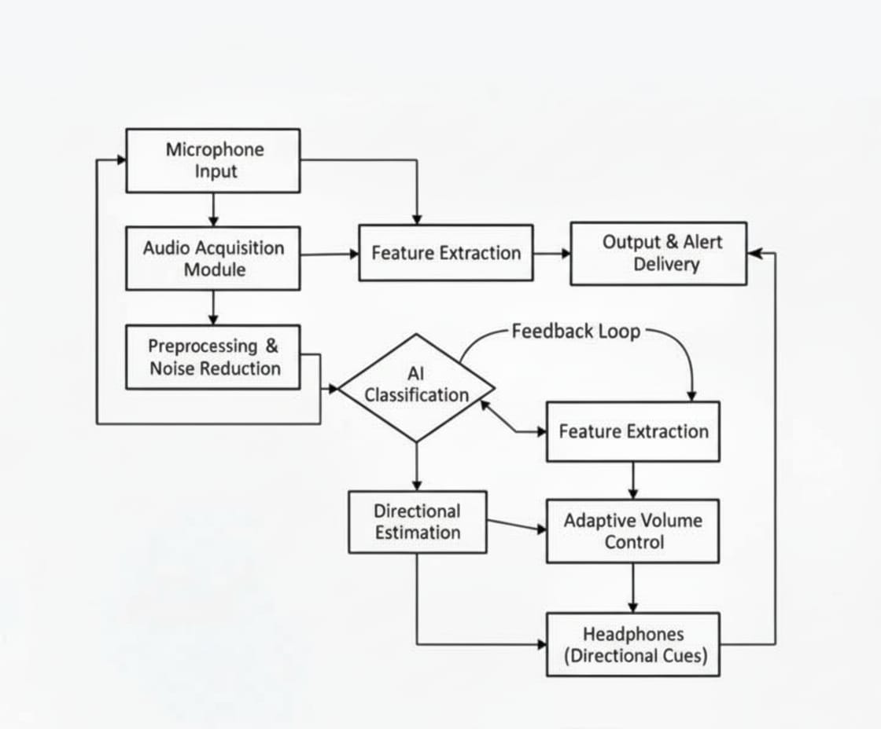
System Architecture

Slide 13
Modules
Track Vision Module
Obstacle Detection Module
Robot Control Module
Motor & Sensor Firmware Module
Defect Logging & Alert Module
Dashboard & Report Module

Slide 14
Module 1 – Track Vision Module
The Track Vision Module processes frames from the down-looking track camera mounted under the robot with an LED ring light.
It locates both rails in every frame using column-brightness profiles and computes the track gauge between the inner faces of the rails.
A morphological black-hat filter highlights thin dark lines across the rail head, and a shape test separates real cracks from round rust or grease stains.
Cracks are graded as MINOR, MAJOR or CRITICAL based on how far they run across the rail head.

Slide 15
Module 2 – Obstacle Detection Module
The Obstacle Detection Module uses the front camera to find objects such as boulders, logs, animals or workers inside the track corridor.
The distance to the object is estimated from where it touches the ground using the camera geometry, giving early warning up to about 25 m.
Ultrasonic sensors give an accurate distance at short range, and both readings are combined (sensor fusion) for a reliable stop decision.

Slide 16
Module 3 – Robot Control Module
The Robot Control Module runs a state machine: Idle, Inspecting, Slowing, Obstacle Stop, Manual and Completed.
It sets the robot speed – cruise during inspection, reduced when an obstacle is seen far away and zero when it is within 2 m.
After the obstacle is removed and the track stays clear for 2 seconds, the robot resumes automatically.
The operator can stop the robot or drive it manually, while the safety interlock stays active.

Slide 17
Module 4 – Motor & Sensor Firmware Module
The ESP32 controller drives the two DC geared motors through a BTS7960 driver using a PI speed controller with encoder feedback.
It reads the wheel encoder (distance), ultrasonic sensors, IR rail sensors, MPU6050 IMU (vibration and tilt) and battery voltage.
It performs a hardware emergency stop for obstacles, the E-stop button and a 1-second watchdog, so the robot stops even if the Raspberry Pi fails.
Data is exchanged with the Raspberry Pi as JSON over USB serial.

Slide 18
Module 5 – Defect Logging & Alert Module
The Defect Logging Module converts per-frame detections into unique defects – a crack must be seen in at least 2 frames and nearby detections are merged.
Each defect is tagged with chainage (km), GPS coordinates, rail side, severity and a photo close-up.
Critical cracks and obstructions trigger an alert to the control room and fire the paint marker on the track.

Slide 19
Module 6 – Dashboard & Report Module
A Flask web dashboard streams both cameras live and shows speed, chainage, gauge, obstacle range, vibration and battery.
It displays a track defect map, gauge profile, event log and a defect register with photos.
The operator can start, stop or manually drive the robot from any phone or laptop over Wi-Fi.
At the end of the run an inspection report is generated in CSV, JSON and PDF formats.

Slide 20
Output

Slide 21
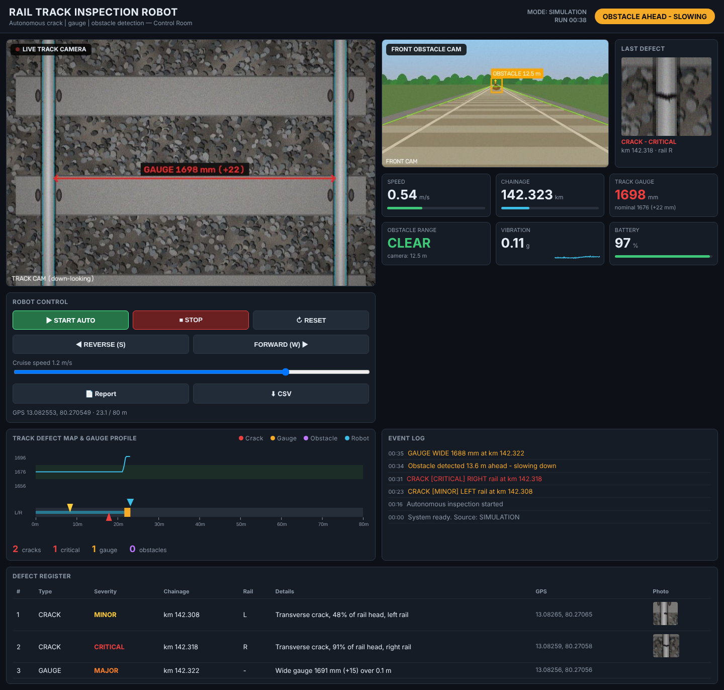
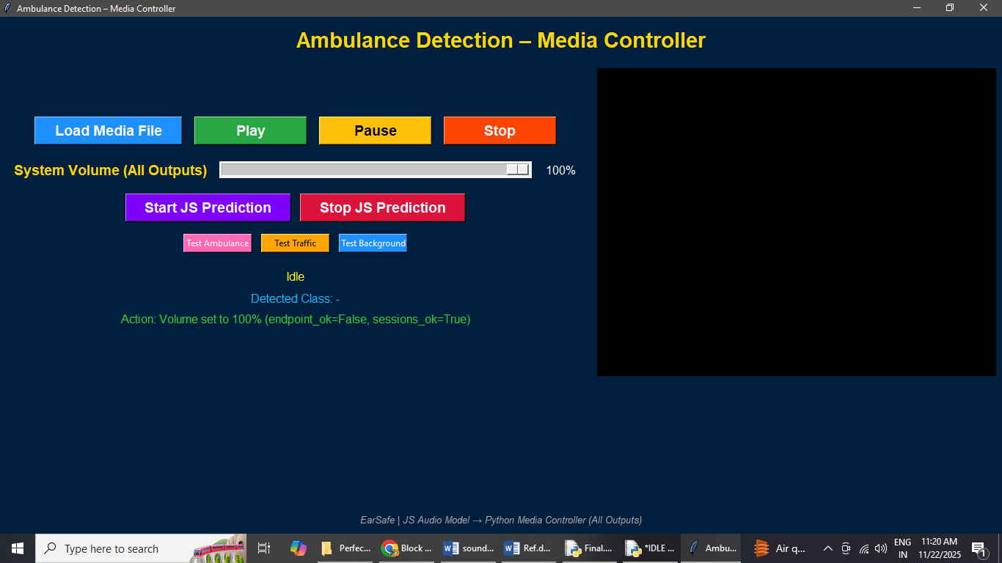
LIVE CONTROL-ROOM DASHBOARD

Slide 22
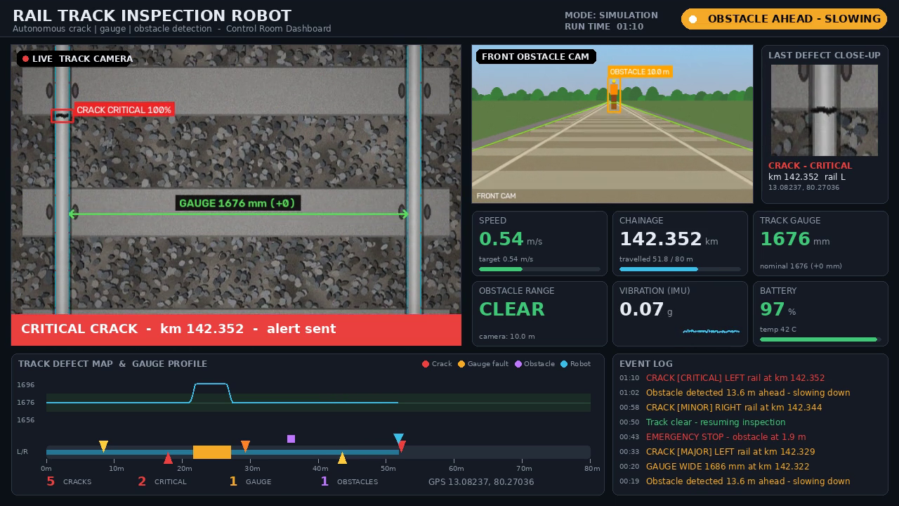
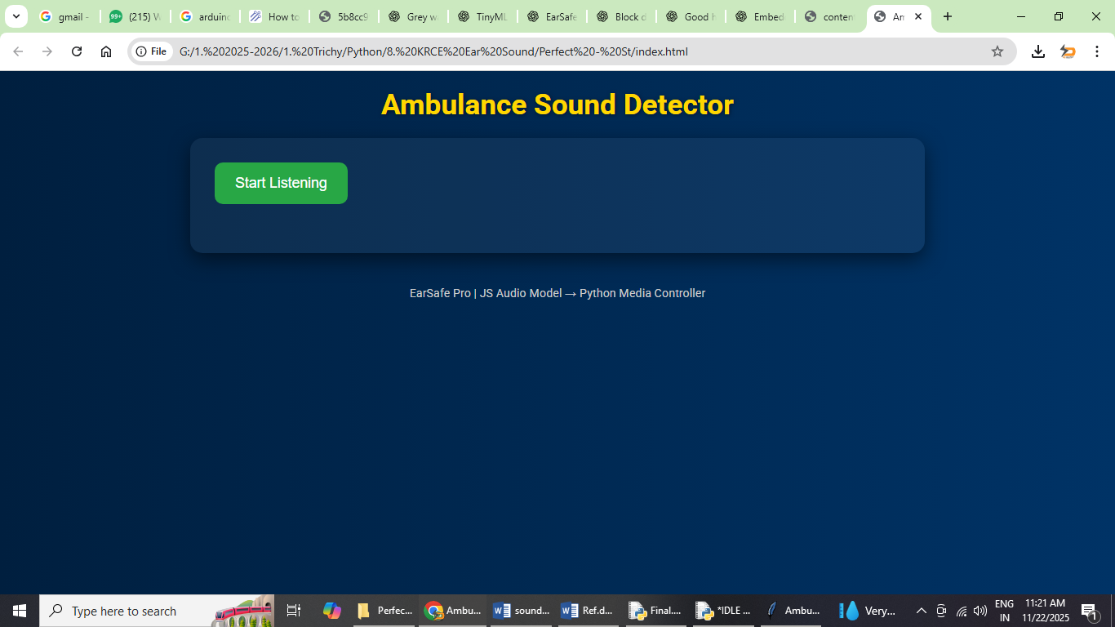
CRACK DETECTION OUTPUT

Slide 23
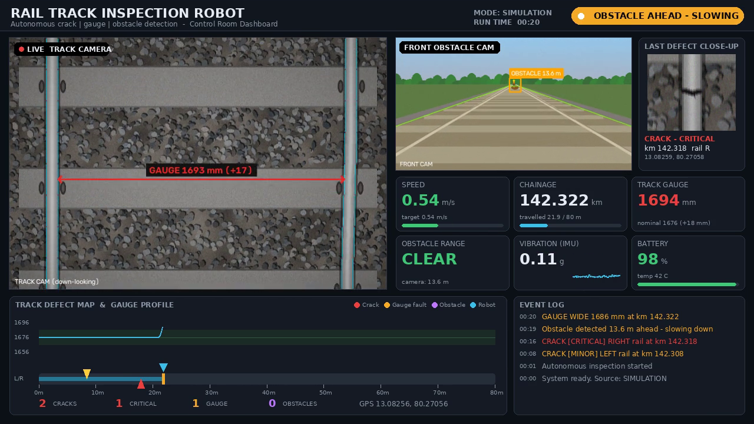
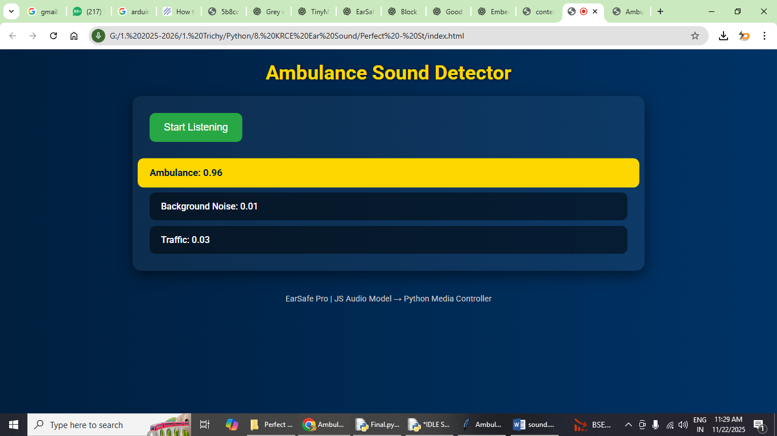
GAUGE MEASUREMENT OUTPUT

Slide 24
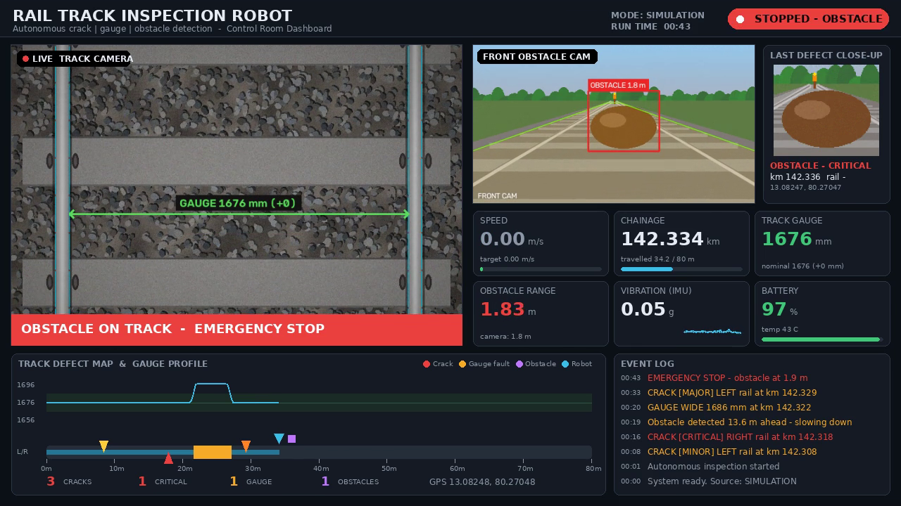
OBSTACLE DETECTION OUTPUT

Slide 25
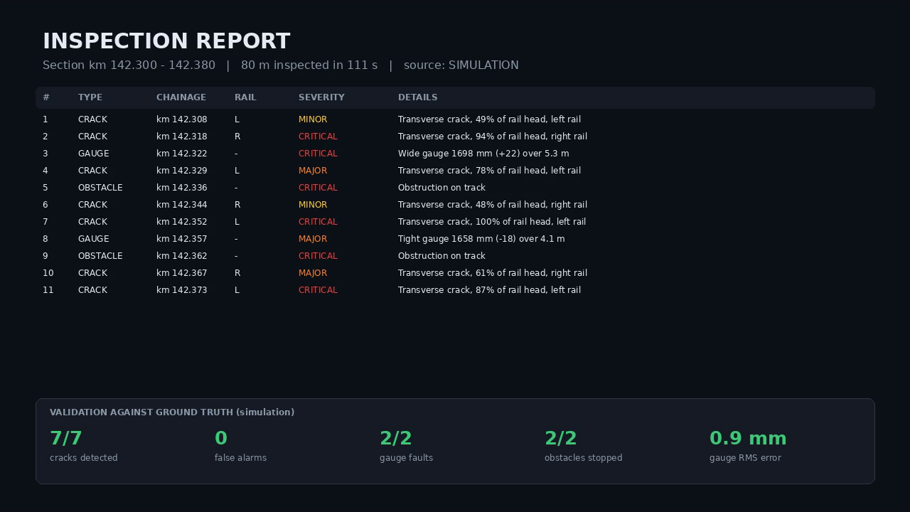
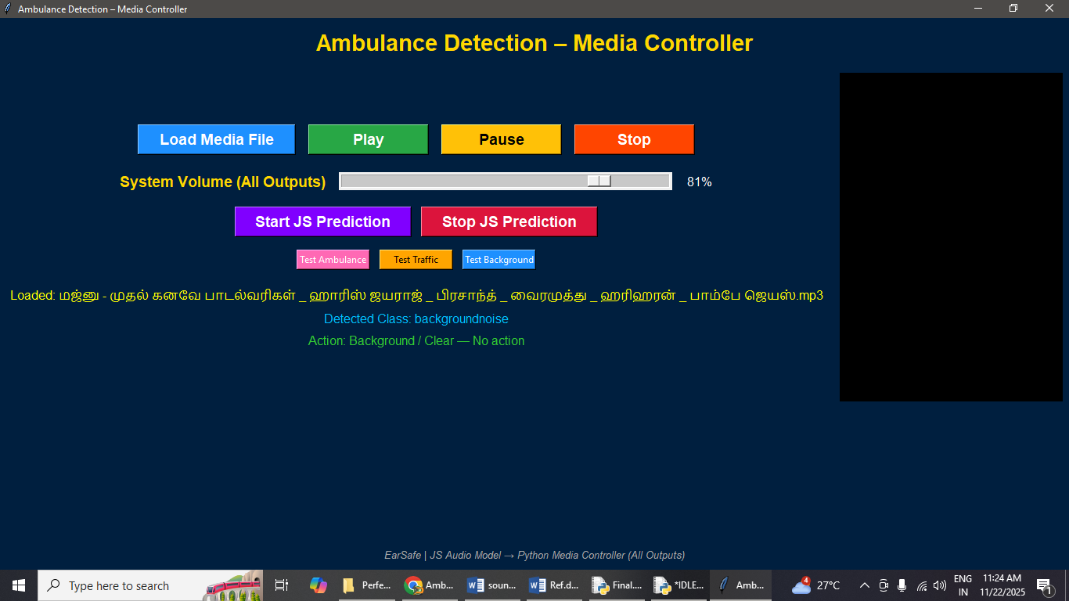
INSPECTION REPORT & VALIDATION

Slide 26
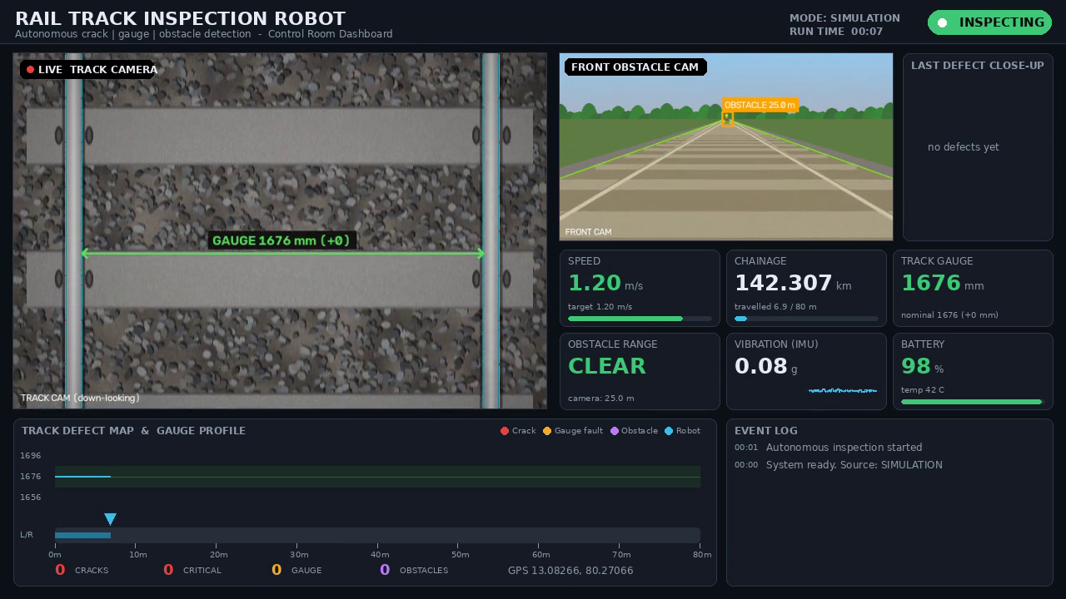
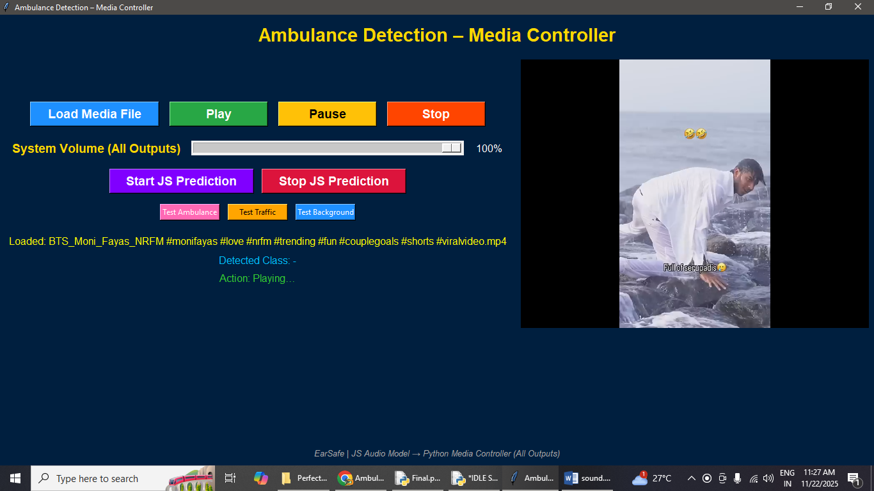
VIDEO

Slide 27
Conclusion
The project demonstrates that a low-cost autonomous robot can inspect railway track in real time and reduce dependence on manual patrolling.
In the validation run on an 80 m section, the system detected 7 out of 7 cracks with zero false alarms, found 2 out of 2 gauge faults with less than 1 mm measurement error, and stopped safely for 2 out of 2 obstacles.
Every defect is recorded with exact location and photo evidence and reported live to the control room.
The system makes track inspection faster, safer and more reliable at a fraction of the cost of track recording cars.

Slide 28
Future Enhancement
Integrating deep learning models (YOLOv8) trained on rail defect datasets can improve detection of cracks, missing clips, bolts and broken sleepers.
Adding ultrasonic or eddy-current probes will allow detection of internal rail flaws that are not visible on the surface.
A laser line profiler can measure rail wear and give a complete 3D track geometry profile.
Solar charging, a LoRa / 4G long-range link and integration with railway maintenance software will enable long unattended inspection runs.

Slide 29
References
[1] Ç. Aytekin, Y. Rezaeitabar, S. Dogru, and I. Ulusoy, “Railway fastener inspection by real-time machine vision,” IEEE Trans. Syst., Man, Cybern.: Syst., vol. 45, no. 7, pp. 1101–1107, 2015.
[2] S. Faghih-Roohi, S. Hajizadeh, A. Núñez, R. Babuska, and B. De Schutter, “Deep convolutional neural networks for detection of rail surface defects,” in Proc. IJCNN, Vancouver, Canada, 2016.
[3] X. Gibert, V. M. Patel, and R. Chellappa, “Deep multitask learning for railway track inspection,” IEEE Trans. Intell. Transp. Syst., vol. 18, no. 1, pp. 153–164, 2017.
[4] J. Gan, Q. Li, J. Wang, and H. Yu, “A hierarchical extractor-based visual rail surface inspection system,” IEEE Sensors J., vol. 17, no. 23, pp. 7935–7944, 2017.
[5] Y. Santur, M. Karakose, and E. Akin, “A new rail inspection method based on deep learning using laser cameras,” in Proc. Int. Artificial Intelligence and Data Processing Symp. (IDAP), 2017.

Slide 30
References
[6] M. A. B. Fayyaz and C. Johnson, “Object detection at level crossing using deep learning,” Micromachines, vol. 11, no. 12, p. 1055, 2020.
[7] D. Zhang, K. Song, Q. Wang, Y. He, X. Wen, and Y. Yan, “Two deep learning networks for rail surface defect inspection of limited samples with line-level label,” IEEE Trans. Ind. Informat., vol. 17, pp. 6731–6741, 2021.
[8] D. Zheng, L. Li, S. Zheng, X. Chai, S. Zhao, Q. Tong, J. Wang, and L. Guo, “A defect detection method for rail surface and fasteners based on deep convolutional neural network,” 2021, doi: 10.1155/2021/2565500.
[9] D. Ristić-Durrant, M. Franke, and K. Michels, “A review of vision-based on-board obstacle detection and distance estimation in railways,” Sensors, vol. 21, no. 10, p. 3452, 2021.
[10] T. Pamuła and W. Pamuła, “Detection of safe passage for trains at rail level crossings using deep learning,” Sensors, vol. 21, no. 18, p. 6281, 2021.

Slide 31
References
[11] Ministry of Railways, Government of India, Indian Railways Permanent Way Manual (IRPWM), 2020.
[12] R. C. Gonzalez and R. E. Woods, Digital Image Processing, 4th ed. New York, NY, USA: Pearson, 2018.
[13] OpenCV, “Morphological transformations,” OpenCV documentation. [Online]. Available: https://docs.opencv.org
[14] Espressif Systems, ESP32 Technical Reference Manual. [Online]. Available: https://www.espressif.com
[15] Raspberry Pi Ltd., Raspberry Pi 5 documentation. [Online]. Available: https://www.raspberrypi.com

Slide 32
THANK YOU……….

