Slide 1
FINAL YEAR PROJECT REVIEW
AUTONOMOUS RAIL TRACK
INSPECTION ROBOT
Crack detection | Gauge measurement | Obstacle detection | Live dashboard
Guided by :
Presented by :
Vincy Leena
Gouthaman A (8115U23IT032)
Jayaprakash T (8115U23IT041)
John Adan J R (8115U23IT046)

Slide 2
OVERVIEW
Abstract
Track defects such as rail cracks, gauge widening and obstructions are a major cause of derailments. In India, track inspection is still mostly manual: trackmen walk or push a trolley and check the rails by eye, which is slow and error-prone.
This project presents a low-cost autonomous rail-mounted robot. It drives along the track by itself; a down-looking camera with OpenCV detects rail-head cracks and measures track gauge, while a front camera and ultrasonic sensors detect obstacles and stop the robot safely. Every defect is tagged with chainage (km), GPS, severity and a photo, shown live on a web dashboard, and exported as a report.
On an 80 m validation run the system detected 7/7 cracks with 0 false alarms, 2/2 gauge faults (< 1 mm error) and stopped safely for 2/2 obstacles.

Slide 3
PROBLEM STATEMENT
Problem: manual track inspection
▸ Trackmen walk / push a trolley — only a few km per shift, depends on human attention
▸ Small rail cracks are easily missed — cracks grow under load and lead to rail fracture
▸ Gauge widening is hard to judge by eye — needs a gauge measuring tool at every spot
▸ Obstructions on the line — boulders, fallen trees, cattle are found only when a train arrives
▸ Paper records — no exact location or photo evidence for the maintenance gang
▸ Track-recording cars are costly — few of them, so inspection is infrequent

Slide 4
EXISTING SYSTEM
Existing system & its drawbacks
Existing methods
Drawbacks
▸ Manual patrolling — keyman walks the section daily
▸ Push trolley inspection — visual check, hand gauge
▸ Ultrasonic flaw-detection trolleys — operated manually
▸ Track recording cars — periodic, high cost
▸ Slow — few km per shift
▸ Human error and fatigue
▸ No exact location / photo record
▸ Obstacles not detected in advance
▸ Infrequent, expensive equipment

Slide 5
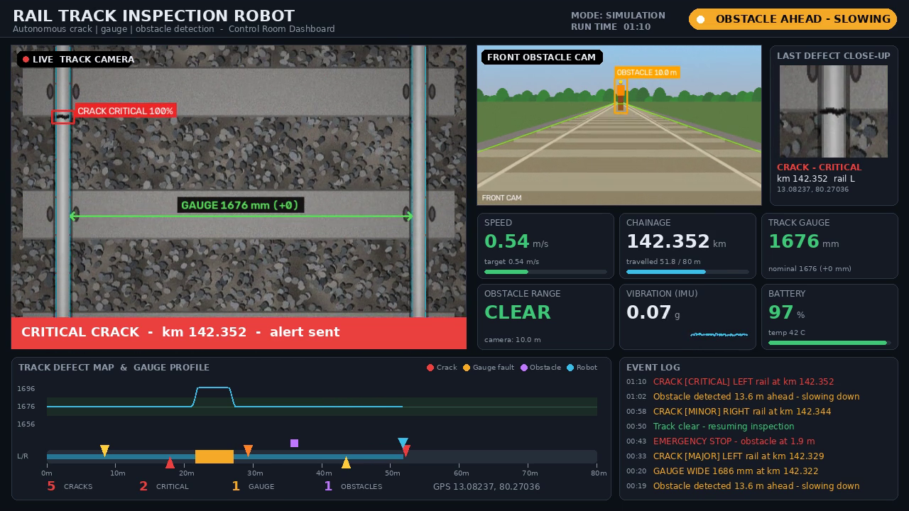
OUR IDEA
Proposed solution: an autonomous rail-mounted robot
▸ Runs on the rails by itself — flanged wheels, DC motors, PI speed control
▸ Down-looking camera — detects rail-head cracks and measures track gauge in every frame
▸ Front camera + ultrasonic — slows down for far obstacles, emergency-stops at 2 m
▸ Encoder + GPS — every defect tagged with chainage (km) and coordinates
▸ Live web dashboard — control room sees cameras, defect map, alerts; can override
▸ Automatic report — CSV / PDF with photo of every defect, paint mark on critical ones

Slide 6
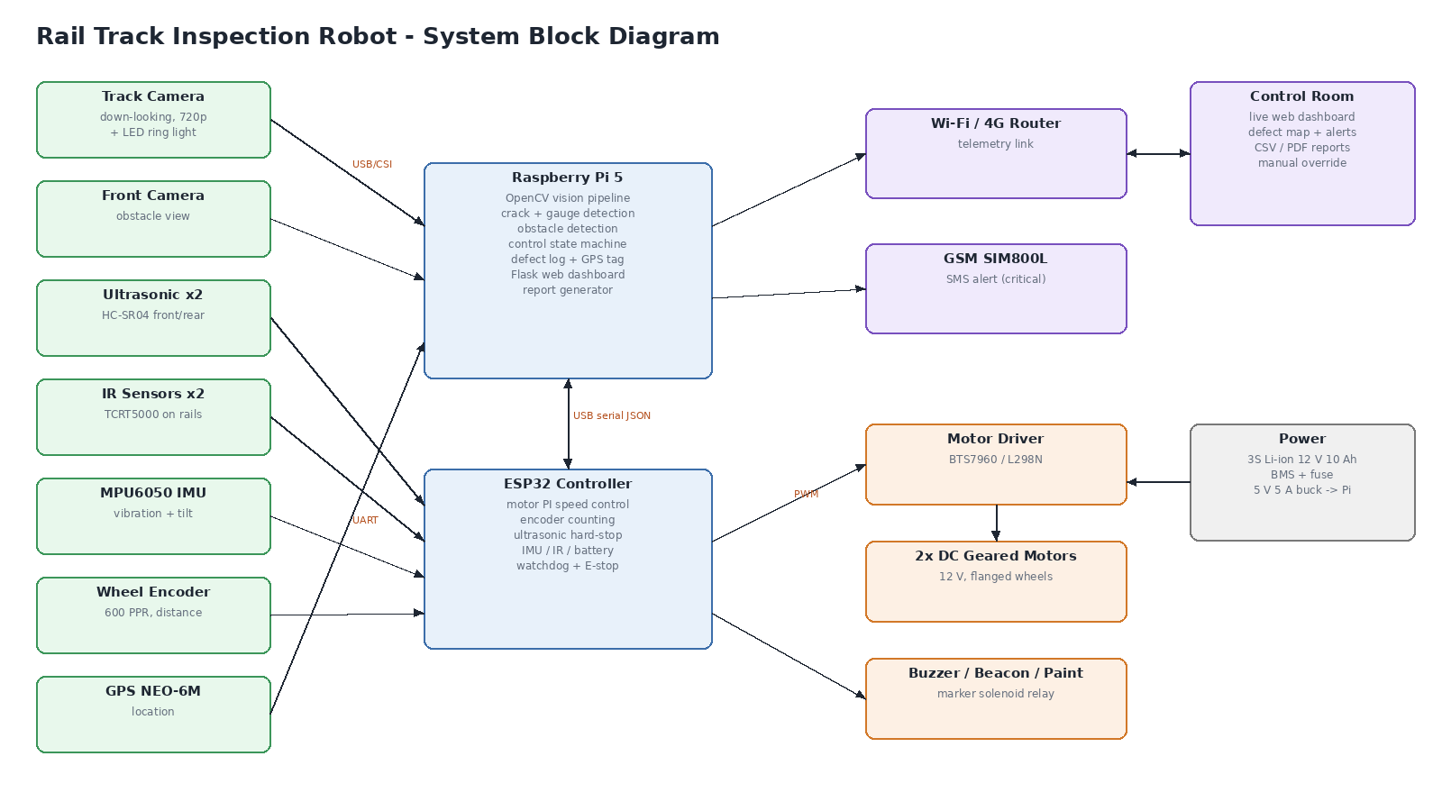
HARDWARE ARCHITECTURE
System block diagram

Slide 7
BILL OF MATERIALS
Hardware components (≈ ₹ 22-25k)
Component | Purpose | ₹ approx
Raspberry Pi 5 (4 GB) + SD | Vision, control, dashboard | 7,500
ESP32 DevKit | Motors, sensors, safety stop | 450
2x camera + LED ring light | Track cam + front cam | 3,900
HC-SR04 x2 / TF-Luna LiDAR | Obstacle range | 200 / 2,000
MPU6050, TCRT5000 x2, encoder | Vibration, rail presence, distance | 900
NEO-6M GPS, SIM800L GSM | Location, SMS alert | 900
2x 12 V geared motor + BTS7960 | Drive | 2,050
Chassis + flanged wheels | Mechanical | 3,000
3S Li-ion 10 Ah + BMS + buck | Power | 3,000
E-stop, buzzer, beacon, paint relay | Safety & marking | 700

Slide 8
MODULE DESCRIPTION
Project modules
▸ 1. Track vision module — rail localisation, gauge measurement, crack detection (OpenCV)
▸ 2. Obstacle detection module — front camera + ultrasonic sensor fusion
▸ 3. Robot control module — state machine: inspect / slow / stop / resume / manual
▸ 4. Motor & sensor firmware — ESP32: PI speed control, encoder, IMU, hard-stop, watchdog
▸ 5. Defect logging module — de-duplication, chainage + GPS tagging, photo capture, alerts
▸ 6. Dashboard & report module — Flask live web UI, defect map, CSV / PDF report

Slide 9
SOFTWARE
Software requirements
Item | Used
Programming languages | Python 3, C++ (Arduino), JavaScript, HTML/CSS
Computer vision | OpenCV, NumPy
Web framework | Flask (MJPEG streaming, REST API)
Firmware IDE | Arduino IDE with ESP32 core 3.x
Robot OS | Raspberry Pi OS (64-bit)
Communication | USB serial (JSON), Wi-Fi / 4G
Reports & demo | Pillow, FFmpeg, CSV / HTML-PDF

Slide 10
COMPUTER VISION (OpenCV)
Crack & gauge detection algorithm
▸ 1. Rail localisation — 8 image bands, column-brightness high-pass → bright 72 mm runs
▸ 2. Gauge — (centre R − centre L) × mm/px − head width, median of bands; ±10 mm alarm
▸ 3. Black-hat filter — closing(img) − img lights up thin dark lines across the rail
▸ 4. Shape test — length ≥ 35 % of head, aspect ≥ 1.8 → rejects round rust / grease stains
▸ 5. Severity — MINOR ≥ 35 %, MAJOR ≥ 55 %, CRITICAL ≥ 80 % of rail head
▸ 6. Tracking — seen in ≥ 2 frames, merged within 30 cm, located by encoder + pixel offset
▸ 7. Obstacles — colour anomaly in track corridor, distance d = f·h / (y − y_horizon)

Slide 11
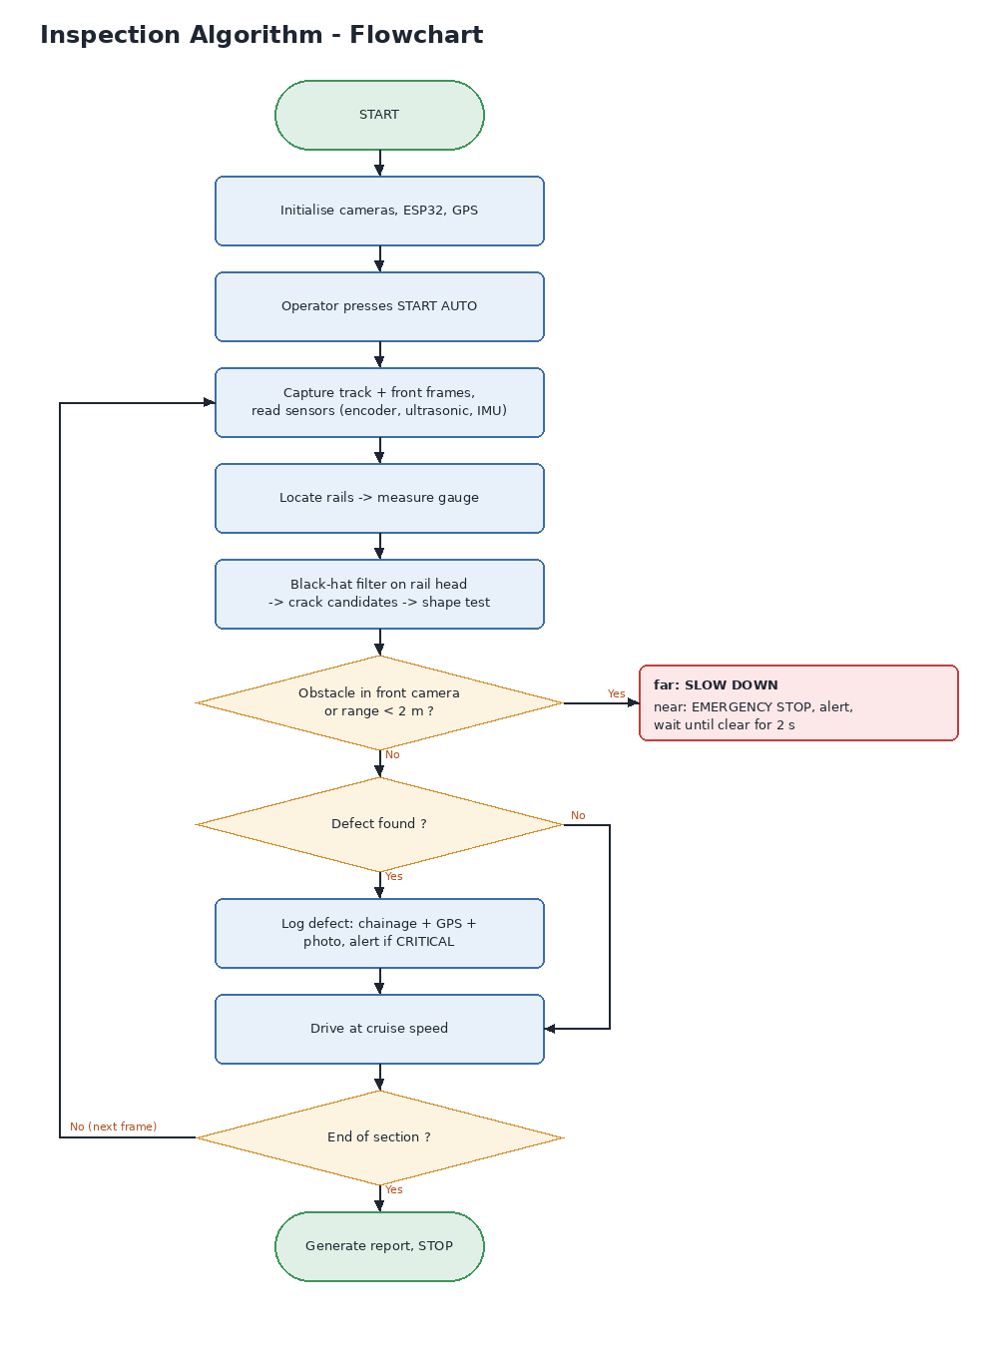
SOFTWARE LOGIC
Inspection flowchart
State machine:
IDLE
→ INSPECTING
⇄ SLOWING (obstacle < 15 m)
→ OBSTACLE_STOP (< 2 m)
→ clear 2 s → INSPECTING
→ COMPLETED
Manual override + E-stop
at any time

Slide 12
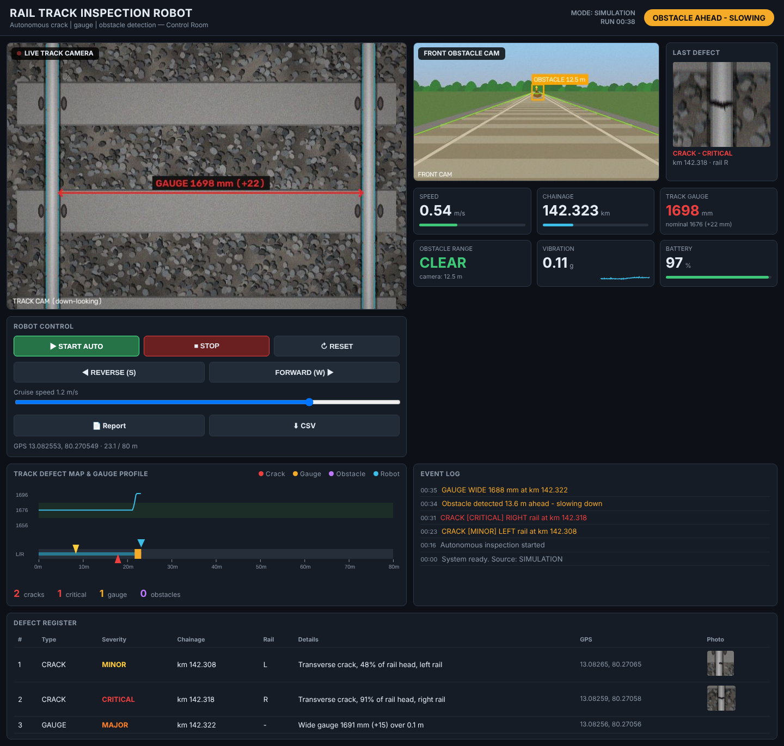
WEB APP (Flask)
Live control-room dashboard
Live track + front camera
Speed, chainage, gauge,
range, vibration, battery
Defect map + gauge profile
Event log + alerts
Defect register with photos
START / STOP / manual drive
CSV + PDF report
Opens on phone / laptop
over Wi-Fi

Slide 13
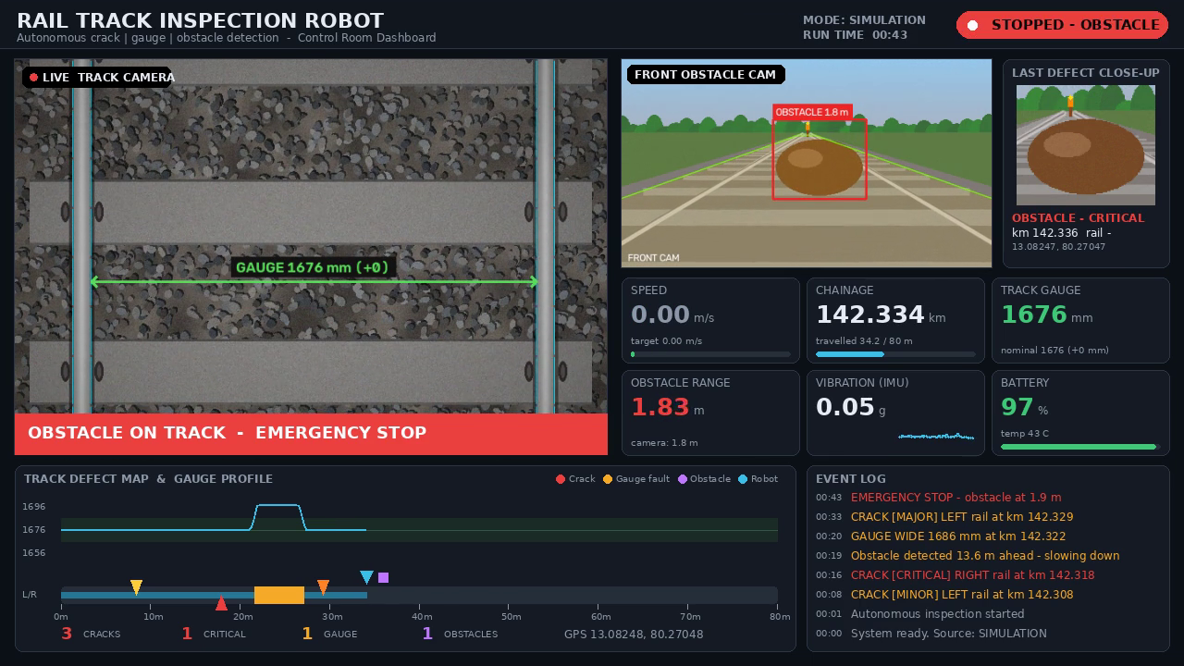
RESULTS
Demo: obstacle emergency stop

Slide 14
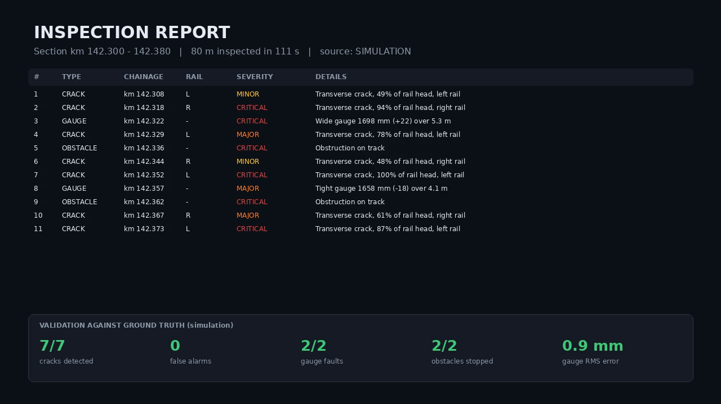
RESULTS
Validation results (80 m test section)
7 / 7
0
2 / 2
< 1 mm
2 / 2
cracks detected
false alarms (stains rejected)
gauge faults
gauge RMS error
obstacles stopped

Slide 15
DISCUSSION
Advantages, limitations & future scope
Advantages
Limitations
Future scope
▸ Low cost
▸ Never tired, every metre recorded
▸ Exact location + photo
▸ Real-time alerts
▸ Fail-safe stop (ESP32 watchdog)
▸ Surface cracks only (camera)
▸ Needs a maintenance block
▸ Rain / shadows → needs lighting
▸ YOLOv8 deep-learning detection
▸ Ultrasonic probe for internal flaws
▸ Laser rail-wear profile
▸ Missing clip / bolt detection
▸ Solar charging, LoRa link

Slide 16
CONCLUSION
Conclusion
The project shows that a low-cost autonomous robot can inspect railway track in real time: it detects rail-head cracks with severity grading, measures track gauge to within 1 mm, and stops safely for obstacles.
Every defect is recorded with exact chainage, GPS and photo evidence, and reported live to the control room. This makes track inspection faster, safer and more reliable than manual patrolling, at a fraction of the cost of track-recording cars.

Slide 17
REFERENCES
References
[1] Indian Railways Permanent Way Manual (IRPWM), Ministry of Railways, Government of India.
[2] J. Gan, Q. Li, J. Wang, H. Yu, "A Hierarchical Extractor-Based Visual Rail Surface Inspection System," IEEE Sensors Journal, vol. 17, no. 23, 2017.
[3] R. C. Gonzalez, R. E. Woods, Digital Image Processing, Pearson (morphological processing).
[4] OpenCV documentation - Morphological Transformations, https://docs.opencv.org
[5] Ultralytics YOLOv8 documentation, https://docs.ultralytics.com
[6] Espressif Systems, ESP32 Technical Reference Manual.
[7] Raspberry Pi Foundation, Raspberry Pi 5 documentation.

Slide 18
Thank you
Autonomous Rail Track Inspection Robot — Questions?
Guided by :
Presented by :
Vincy Leena
Gouthaman A (8115U23IT032)
Jayaprakash T (8115U23IT041)
John Adan J R (8115U23IT046)

