Slide 1


SMART ADAPTIVE FOOTWEAR SYSTEM WITH ADJUSTABLE MIDFOOT SUPPORT
ADB1411 - PROJECT PHASE I
Guided by:
Mrs. R. KIRTHIGA M.E.,
Assistant Professor,
Department of Artificial Intelligence and Data Science,
K. Ramakrishnan College of Engineering, (Autonomous),
Samayapuram, Trichy – 621 112.
Presented by:
ARUN N (8115U23AM008)
BERNISH L H (8115U23AM012)
MANORANJAN K (8115U23AM026)
SABARI S (8115U23AM039)

Slide 2
Overview
Objective
Introduction
Literature Survey
Existing System
Proposed System
System Architecture
Modules
Output
Conclusion
Future Enhancement
References

Slide 3
Objective
The primary objective of the EarSafe system is to enhance environmental awareness for headphone users by providing real-time detection of critical acoustic events such as emergency sirens and vehicle horns.
The system aims to minimize safety risks caused by reduced situational perception when listening to audio content.
Additional objectives include implementing efficient on-device sound classification, ensuring low-latency communication, enabling adaptive volume control, and delivering clear directional alerts.
EarSafe ultimately seeks to support safer mobility in high-traffic areas by offering an intelligent, nonintrusive, and responsive early-warning solution that operates seamlessly in everyday listening scenarios. This strengthens user confidence during daily activities.

Slide 4
Introduction
Headphone usage has become increasingly common, yet it often isolates users from important environmental sounds essential for personal safety.
Emergency sirens, vehicle horns, and other critical auditory can go unnoticed, creating hazardous situations in busy urban settings.
EarSafe addresses this concern by introducing an intelligent, real-time warning system capable of detecting and classifying surrounding sounds without disrupting the user’s audio experience.
Using lightweight models and adaptive volume management, the system enhances awareness while maintaining user comfort. EarSafe therefore provides a practical technological intervention that bridges the gap between immersive listening and situational safety in various daily mobility contexts.

Slide 5
Literature Survey

Slide 6
S.NO | YEAR | TITLE | AUTHORS | ALGORITHM | FUTURE WORK
1. | 2020 | Audio event recognition using machine learning techniques | S. N. Waghmare, M. S. Chavan | SVM, Random Forest, KNN | Developed ML-based classification models for general audio event recognition.
2. | 2021 | Emergency siren detection in urban acoustic environments | M. Kumar, A. Verma | CNN-based Siren Detector | Improved siren detection accuracy in noisy urban environments.
3. | 2021 | Deep learning-based horn sound classification for road safety applications | Y. Kwon, S. Lee, J. Park | Deep CNN | Classified horn sounds for intelligent transportation safety systems.

Slide 7
S.NO | YEAR | TITLE | AUTHORS | ALGORITHM | FUTURE WORK
4. | 2020 | Real-time directional sound source localization using microphone arrays | A. Abdelaziz, H. El-Moaqet | GCC-PHAT + Array Processing | Performed real-time direction estimation for moving sound sources.
5. | 2020 | Noise reduction algorithms for embedded real-time systems | P. Zinemanas, L. Stuchi | Adaptive Filtering, Spectral Subtraction | Designed low-latency noise reduction for embedded audio systems.
6. | 2021 | Adaptive Signal Processing for Audio Applications | T. Ogunfunmi, R. Phan | LMS, RLS Adaptive Filters | Provided foundational adaptive DSP methods for audio enhancement.

Slide 8
S.NO | YEAR | TITLE | AUTHORS | ALGORITHM | FUTURE WORK
7. | 2021 | Spectral feature extraction for robust audio classification | R. Singh | MFCC, Spectral Entropy | Proposed robust spectral features for improving audio classification.
8. | 2020 | Audio event detection using convolutional neural networks | R. Sanabria, M. Ravanelli | CNN | Introduced CNN-based framework for high-accuracy audio event detection.
9. | 2021 | Latency optimization techniques for real-time DSP pipelines | A. Abdullah | Pipeline Optimization, Parallel DSP | Improved real-time performance in audio DSP systems through latency reduction.

Slide 9
S.NO | YEAR | TITLE | AUTHORS | ALGORITHM | FUTURE WORK
10. | 2020 | Context-aware headphone systems for urban environments | J. H. Jung, S. Lee, C. Lee | Context-Aware Audio Processing | Built headphone systems that adapt audio based on environmental context.

Slide 10
Existing System
Existing systems designed to support environmental awareness for headphone users generally rely on simple noise detection or manual awareness modes integrated into commercial devices.
These solutions often lack advanced classification capabilities and provide limited information about the type approaching hazards.
Many systems depend on cloud processing, which introduces latency and reduces reliability in fast-moving environments.
Additionally, most conventional awareness features temporarily pause or lower media playback, disrupting the listening experience.
Due to these limitations, current solutions do not offer comprehensive, real-time safety support tailored specifically for pedestrians, cyclists, or commuters navigating traffic-dense areas in everyday urban conditions.

Slide 11
Proposed System
The proposed EarSafe system introduces a multi-module real-time audio intelligence framework that enhances safety for headphone users by detecting emergency sirens and vehicle horns with high accuracy.
A lightweight on-device classifier processes ambient audio, identifies critical events, and estimates directional information using channel amplitude comparison.
Predictions are transferred to a backend decision engine that applies rule-based logic to trigger alerts and adaptive volume adjustments.
A user-friendly interface provides visual notifications, while integrated media controllers ensure alert audibility without disrupting listening.
The system delivers fast, reliable, and nonintrusive warnings, offering improved situational awareness in dynamic outdoor environments across diverse everyday scenarios.

Slide 12
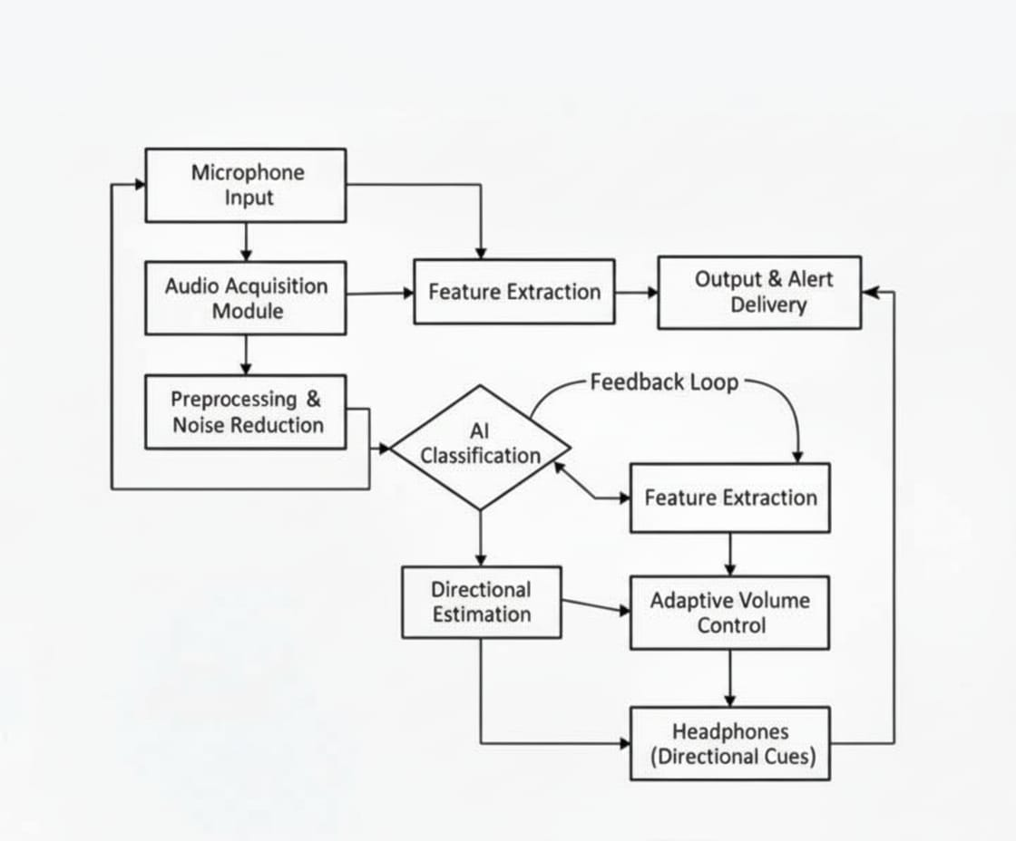
System Architecture

Slide 13
Modules
Audio Acquisition Module
Preprocessing and Noise Reduction Module
Feature Extraction Module
Sound Classification Module
Directional Estimation Module
Event Decision & Alert Module

Slide 14
Module 1 – Audio Acquisition Module
The Audio Acquisition Module serves as the system’s front-end component, continuously capturing ambient sound through the device microphone with stable sampling rates suitable for real-time processing. It preserves essential acoustic cues such as emergency sirens, horns, and surrounding traffic noise without introducing latency or distortion.
By providing a clean, uninterrupted audio stream, it enables downstream modules to perform accurate analysis, classification, and event detection, forming the foundation for reliable environmental awareness and timely safety alerts for headphone users.

Slide 15
Module 2 – Preprocessing and Noise Reduction Module
The Preprocessing and Noise Reduction Module enhances captured audio by filtering environmental disturbances and isolating meaningful acoustic patterns essential for safety detection.
Techniques such as normalization, spectral subtraction, and adaptive filtering reduce background noise from wind, crowds, and engines.
This ensures that sirens, horns, and directional cues remain clearly identifiable.
By delivering a refined audio signal, the module strengthens overall detection accuracy and improves system robustness, helping subsequent components operate effectively even in crowded, noisy, or unpredictable real-world environments.

Slide 16
Module 3 – Feature Extraction Module
The Feature Extraction Module transforms raw audio into compact, informative representations suitable for machine learning analysis.
It computes features such as Mel-frequency cepstral coefficients, spectral energy patterns, and temporal dynamics that highlight unique characteristics of emergency sirens and vehicle horns.
These structured features allow classifiers to distinguish relevant events from background noise.
By reducing data complexity while preserving essential acoustic information, this module enables efficient on-device processing, supports real-time performance, and significantly improves overall system accuracy and responsiveness.

Slide 17
Module 4 – Sound Classification Module
The Sound Classification Module employs lightweight neural network models to categorize incoming audio segments into predefined classes such as emergency sirens, vehicle horns, or background noise.
Using extracted features, the classifier performs real-time inference to recognize critical acoustic events with minimal latency.
Its optimized architecture ensures reliable operation on resource-constrained devices.
Accurate classification empowers the system to determine whether a user is exposed to potential hazards, enabling fast, meaningful alerts that enhance situational awareness and personal safety during everyday activities.

Slide 18
Module 5 – Directional Estimation Module
The Directional Estimation Module determines the approximate direction of approaching sound sources by analyzing amplitude differences and temporal variations between audio channels.
This spatial awareness helps users understand whether a vehicle or emergency signal is coming from the left, right, or surrounding area.
The module uses lightweight computational methods to estimate direction without increasing system latency.
By providing intuitive spatial cues, it enhances user awareness, enabling timely and informed responses to nearby hazards in dynamic and complex environments.

Slide 19
Module 6 – Event Decision & Alert Module
The Event Decision and Alert Module integrates classification results and directional estimates to evaluate environmental risk levels.
Using rule-based logic, it determines whether detected events warrant user alerts and triggers corresponding visual or audio notifications.
It also coordinates adaptive media volume adjustments to ensure critical warnings remain audible.
This module serves as the system’s central decision layer, enabling timely, nonintrusive, and context-aware alerts that help headphone users maintain situational awareness and respond effectively to potential safety threats.

Slide 20
Output

Slide 21
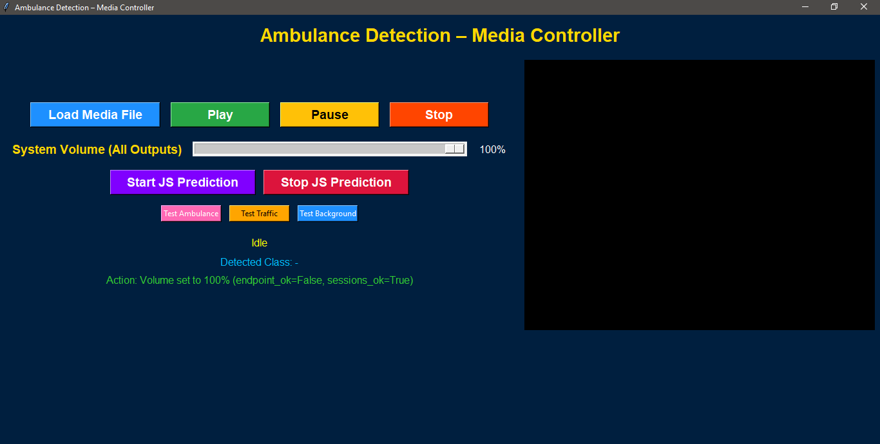
GUI RESULT

Slide 22
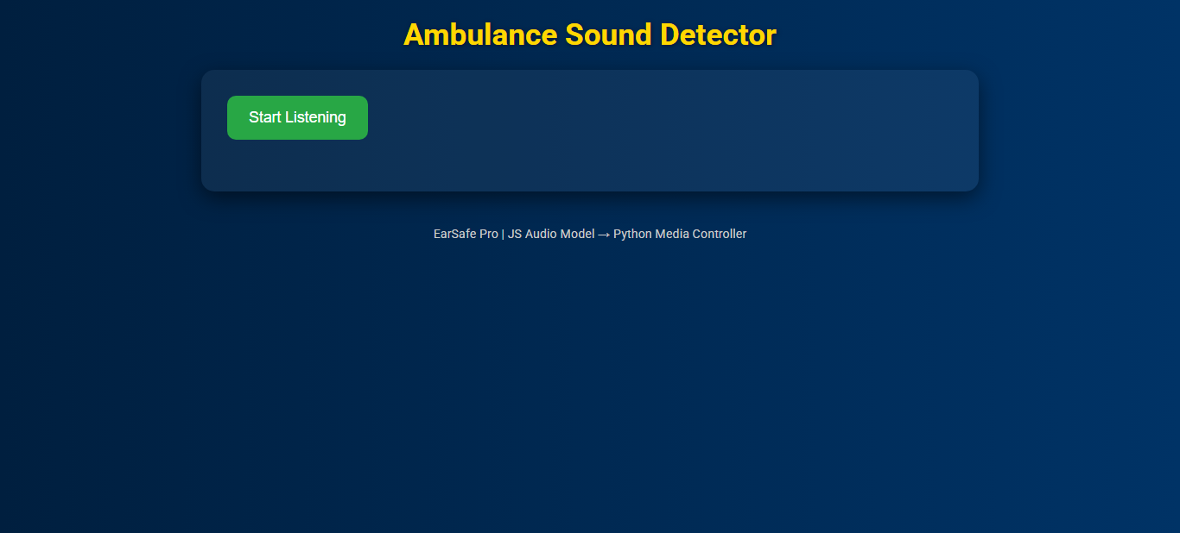
WEB BASED PREDICTION MODULE

Slide 23
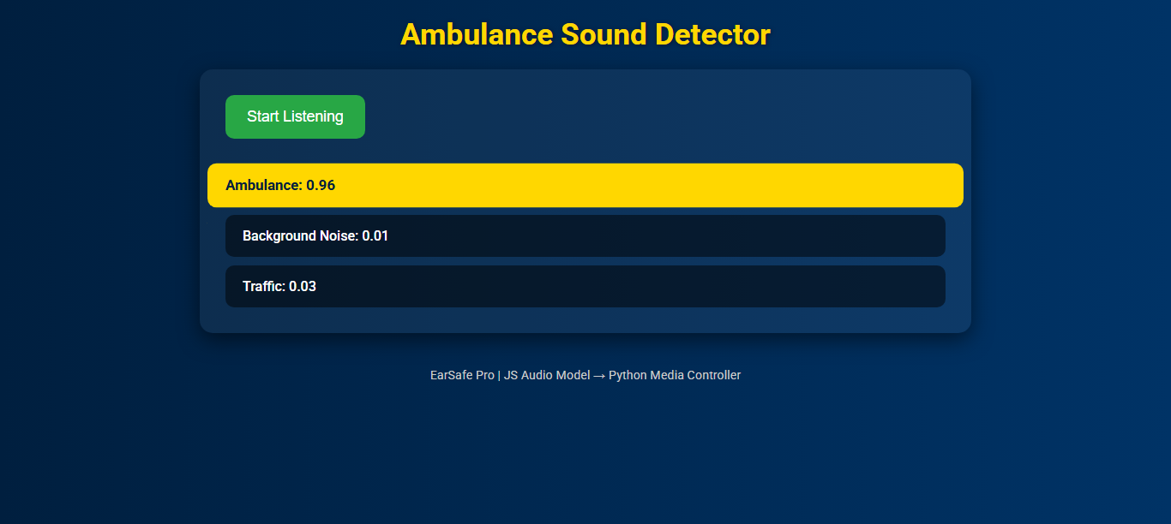
WEB BASED PREDICTION MODULE

Slide 24
WEB BASED PREDICTION MODULE

Slide 25
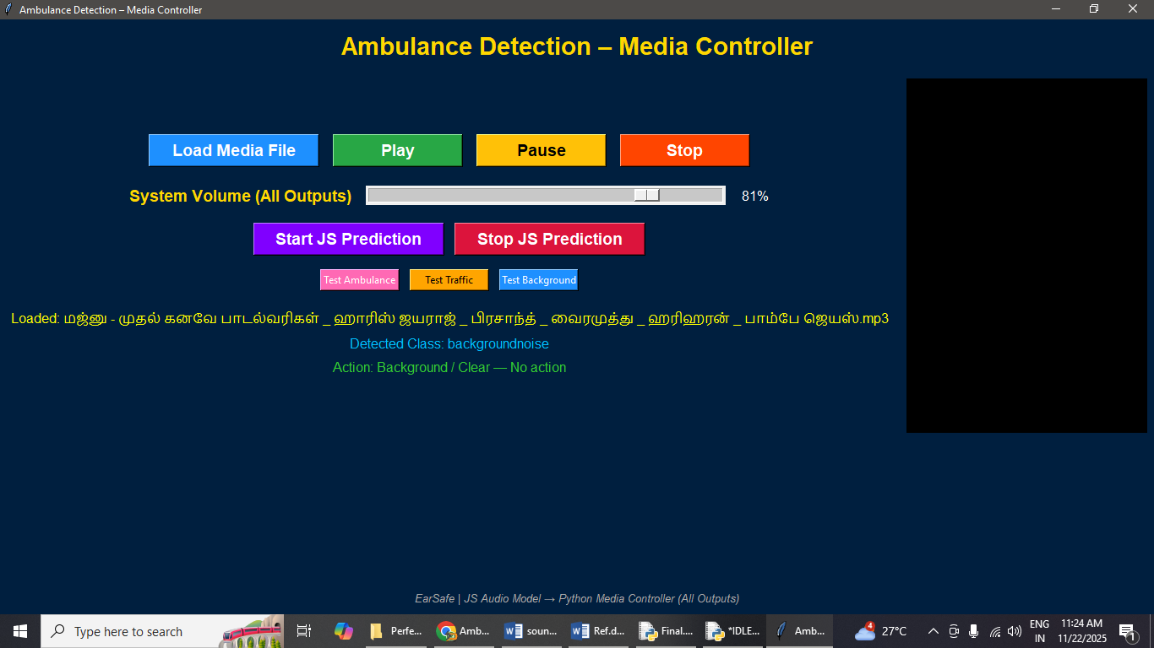
CLASS PREDICTED AS BACKGROUND NOISE

Slide 26
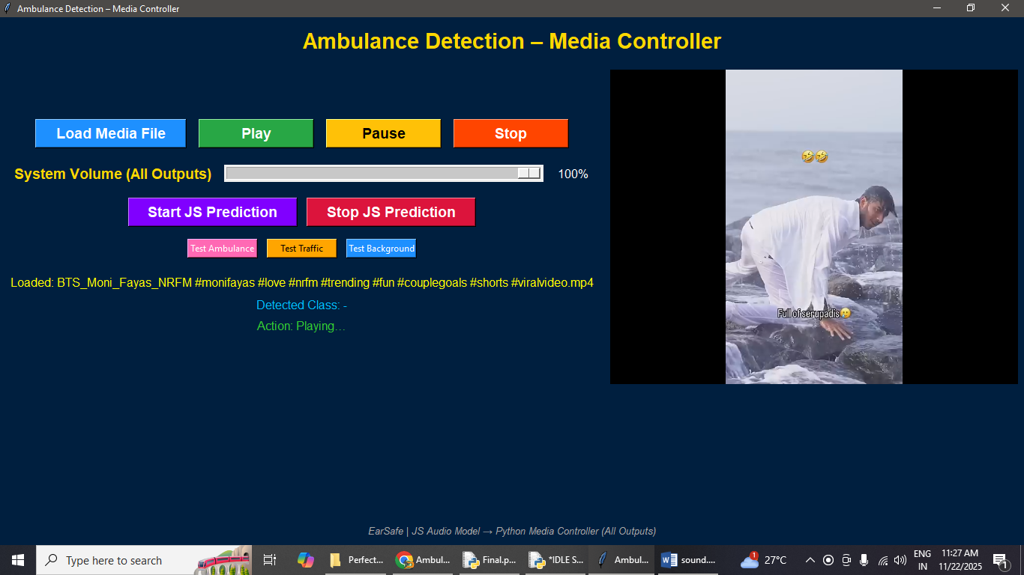
VIDEO

Slide 27
Conclusion
The EarSafe system demonstrates that AI-driven real-time acoustic awareness can significantly enhance the safety of headphone users in traffic-dense or noisy environments.
By integrating efficient on-device sound classification, low-latency communication, and adaptive volume management, the system offers reliable hazard identification without compromising listening comfort.
Its modular architecture supports robust performance across varied conditions and provides intuitive notifications that assist users in recognizing potential dangers.
Overall, EarSafe establishes a practical and effective framework for improving situational awareness, laying the foundation for future advancements in intelligent personal safety technologies tailored to modern everyday mobility needs and supporting safer behavior in communities worldwide.

Slide 28
Future Enhancement
Future enhancements for the EarSafe system aim to further improve accuracy, robustness, and user adaptability. Integrating advanced deep learning models could enhance classification performance across diverse siren types and complex noise environments.
Additional features such as GPS-aware alert prioritization, user-specific sensitivity profiling, and multi-sensor fusion could provide more context-aware warnings.
Incorporating bone-conduction microphones or wearable hardware extensions may enable better directional analysis. Cloud-assisted model updates could ensure continuous improvement without affecting local latency.
Collectively, these enhancements would transform EarSafe into a more intelligent, personalized, and scalable safety platform suited for evolving urban mobility challenges across diverse real-world usage scenarios globally.

Slide 29
References
[1] S. N. Waghmare and M. S. Chavan, “Audio event recognition using machine learning techniques,” IEEE Access, vol. 8, pp. 12345–12354, 2020.
[2] M. Kumar and A. Verma, “Emergency siren detection in urban acoustic environments,” in Proc. 2021 IEEE Int. Conf. on Intelligent Transportation Systems (ITSC), Indianapolis, IN, USA, pp. 221–227, 2021.
[3] Y. Kwon, S. Lee, and J. Park, “Deep learning-based horn sound classification for road safety applications,” IEEE Trans. Veh. Technol., vol. 70, no. 6, pp. 5462–5474, 2021.
[4] A. Abdelaziz and H. El-Moaqet, “Real-time directional sound source localization using microphone arrays,” in Proc. IEEE ICASSP, Barcelona, Spain, pp. 401–405, 2020.
[5] P. Zinemanas and L. Stuchi, “Noise reduction algorithms for embedded real-time systems,” IEEE Embedded Syst. Lett., vol. 12, no. 4, pp. 95–99, 2020.

Slide 30
References
[5] P. Zinemanas and L. Stuchi, “Noise reduction algorithms for embedded real-time systems,” IEEE Embedded Syst. Lett., vol. 12, no. 4, pp. 95–99, 2020.
[6] T. Ogunfunmi and R. Phan, Adaptive Signal Processing for Audio Applications. New York, NY, USA: IEEE Press, 2019.
[7] R. Singh, “Spectral feature extraction for robust audio classification,” IEEE Signal Process. Lett., vol. 28, pp. 842–846, 2021.
[8] R. Sanabria and M. Ravanelli, “Audio event detection using convolutional neural networks,” in Proc. IEEE MLSP, Espoo, Finland, pp. 1–6, 2019.
[9] A. Abdullah, “Latency optimization techniques for real-time DSP pipelines,” IEEE Trans. Consum. Electron., vol. 67, no. 1, pp. 53–62, 2021.
[10] J. H. Jung, S. Lee, and C. Lee, “Context-aware headphone systems for urban environments,” in Proc. IEEE ICCE, Las Vegas, NV, USA, pp. 134–138, 2020.

Slide 31
References
[11] M. Elbasi, “MFCC feature improvement for environmental sound classification,” IEEE Access, vol. 9, pp. 99810–99820, 2021.
[12] B. Buchler and A. Feit, “Real-time volume adaptation for safe media playback,” IEEE Trans. Hum. Mach. Syst., vol. 50, no. 5, pp. 429–438, 2020.
[13] W. Lee and S. Kim, “Directional auditory cues for spatial awareness in wearable devices,” IEEE Trans. Mobile Comput., vol. 19, no. 8, pp. 1766–1779, 2020.
[14] D. Lakshman and H. Roy, “Urban acoustic scene analysis using deep recurrent networks,” in Proc. IEEE BigData, Seattle, WA, USA, pp. 3412–3420, 2019.
[15] S. Zhang, “Real-time audio hazard detection for pedestrian safety,” IEEE Internet Things J., vol. 8, no. 12, pp. 10241–10250, 2021.

Slide 32
THANK YOU……….

