Slide 1

The Technology Value Stream
Tevyah Hanley
DevOps – Sue Sampson
1/17/25

Slide 2
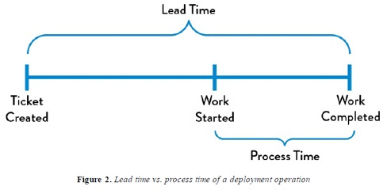
What is the Technology Value Stream?
The technology value stream is the process of delivering software, where it starts with a request from your users and is finished once that request is carried out. It makes communication and your end goal very clear, and its main goal is to help improve speed and quality for a great end result.

Slide 3
Lead time vs. Processing Time
Lead Time
The amount of time from the users request to the delivery of the product
Includes all of the time included, meaning any days off or breaks will be included in that time.
Processing Time
The amount of time that it takes to build the product
More focused on the time involved to create, build, and the active time to make the product involved.

Slide 4
Why month long deployments are common
Whenever you are tackling on a project, especially when your user is involved and has a specific vision, it takes time and effort to make a great end result. Brainstorming, the development process, and any obstacles that will inevitably show up at some point will add more to the overall lead time.
With additional lead time adding to stress on the team, it could sometimes lead to some long deployments. With every code change, there might be hesitancy to push it to the main project. Overall, tiptoe-ing around pushing your deployments will make your customer wait even longer than expected.

Slide 5
Why deployment in minutes is ideal
Deployments in minutes are small changes that get pushed immediately, instead of having huge changes all at once. That way, if something breaks or has bugs, you know exactly where it comes from and what to do from it. It provides for quick reaction and updates, and overall gets the process finished way quicker. Speeding up the lead time.

Slide 6
The Plus sides of having shorter lead times
Customers are happier due to faster delivery times
Confidence in pushing changes, leading to less stress
More testing throughout each change
Reduced overall risk
Less chances of bugs wiping out entire systems

Slide 7
To wrap up
Lead time is the overall time of the project, while processing time is the time spend working on the project.
Month long deployments are common without an effective plan.
Deployment in minutes have several upsides, including faster lead time.
Having less stress on the team, happier customers, and less bugs getting through are just some of the benefits of having deployments in minutes.

Slide 8
Thank you!
Tevyah Hanley
DevOps – Sue Sampson
1/17/25

