Slide 1

Barriers to Implementing a Just Culture
2/23/26 – Tevyah Hanley – Sue Sampson (CSD-380)

Slide 2
What is a Just Culture?
A culture that encourages open reporting of failures, incidents, and near misses.
Focuses on system design rather than individual blame.
Makes sure that it knows what errors need to have accountability for your team

Slide 3
Why implement a Just Culture?
Has your team be more accountable in the long run.
Improves your teams overall safety, morale, and learning for your whole company.
Reduces repeat errors by focusing on root causes rather than punishment.
Makes it where your projects issues are more likely to get pointed out instead of hidden.

Slide 4
Major Barriers in DevOps Without a Just Culture
Blame culture: Where your team is going to blame either the project, or each other to take the heat off of them
Improper leadership: Your leadership might be the issue, but they can blame their team and take the pressure off of them.
Time Pressure: Instead of dealing with the issues, your team might overlook them and try to not point them out as long as possible.

Slide 5
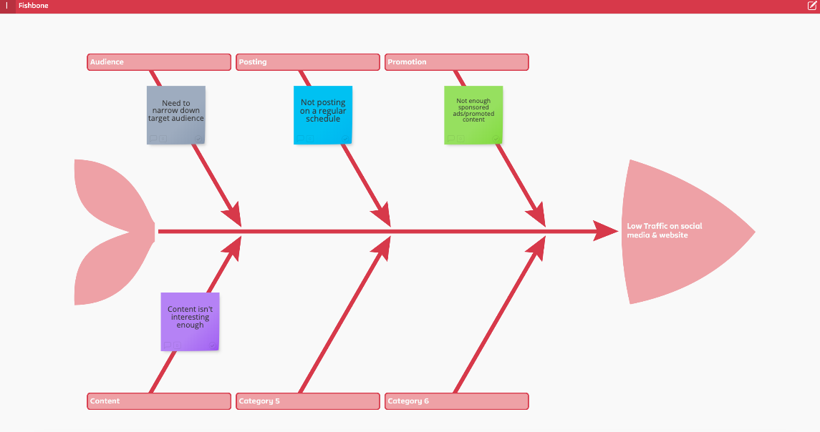
Root causes of poor Just Culture
This diagram illustrates the root causes that prevent a Just Culture from developing. While this image is for content creation, the point is still there. Without the proper system in place, you are branching off other issues from the root cause.

Slide 6
How to overcome these barriers
Separate performance reviews from incident mistakes
Clear accountability framework
Publicly share lessons learned
Take accountability as a team

Slide 7
To Sum Up
Just Culture is super important for your DevOps team
The biggest barriers are when it’s a problem organizationally
Leadership determines your teams overall success.
A true Just Culture improves reliability, innovation, and trust.

Slide 8
Thank you!

